Slide 1
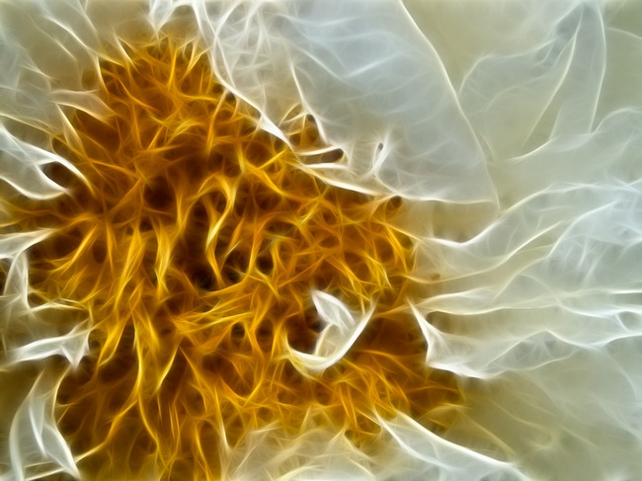
Science NCEA L1
1.1 Reaction Rates Investigation

Slide 2
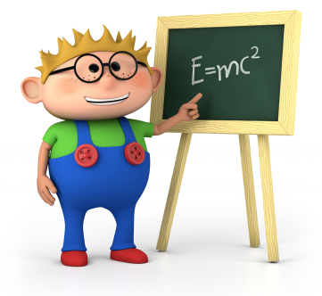
The typical way that scientists work is called the Scientific method.
Scientific experiments are written up in a standard way under the following headings:
Aim : what you are trying to find out or prove by doing the experiment
Equipment : the things that you need to do the experiment
Method : A simple, clear statement of what you will do – and can be repeated by another person
Results : data, tables and graphs collected from experiment
Conclusion : what your results tell you
– linked back to the aim
Discussion : Science ideas to explain
your results – possible improvements
to the experiments

Slide 3
A 'fair test' is one in which you only change one thing (variable).
Variables are all the things that could change during an investigation.
In a bouncing ball investigation many things could change from one experiment to the next.
A different ball.
A different drop height.
You should only change one thing in your experiments. This called the independent variable.
As a result of your experiment your results should show something changing. (How high the ball bounces might change).
This is called a dependent variable.
The factors you keep the same in your experiments (fair test) are called control variables
Year 9 Science 2012
3

Slide 4
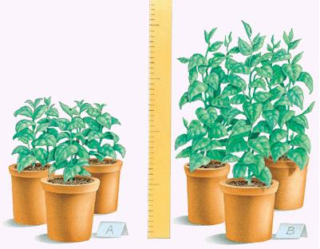
Focus Question / Purpose
Your purpose or focus question must include both variables.
For example: If I change (independent variable) how will it affect (dependant variable)
Such as: If I change the temperature of the water (independent) how will it affect how much sugar I can dissolve into the water (dependant)
Independent variable – amount of light a plant receives
Dependant variable - height that plant grows
Focus Question: How does the amount of light a plant receives affect the height it grows to

Slide 5
Task 1: Develop a procedure
You are to develop a step-by-step procedure to determine how altering one variable (the independent variable) affects the variable you measure (dependant variable).
You must also include variable that you are going to keep the same. (controlled variables)
A range given for the independent variable – the one you will change – must be stated in the method including how you will alter it and what units it will have, such as ml for volume or gms for mass.
Be accurate: select the correct equipment and list it within the method. Decide how you will measure the dependant variable and keep it consistent every time.
Be reliable: include at least 3 trials into your investigation and average the results. Use at least a range of 4 different values of independent variables. Spread the range evenly.

Slide 6
Task 2: Collect, record and process results
Carry out your procedure to collect data and record the results in a table, or other systematic way. Remember to record any changes to your procedure and the reasons for the changes e.g., to increase accuracy or reliability.
Your data table must be labelled and include units. It must provide areas to record at least 3 repeats of trials and an area which shows the data averaged. It must include at least a range of 4 independent variables.
Process your results in ways that will help you reach a conclusion that is linked to the purpose of the investigation. This will usually involve some calculations (e.g., averages) and/or graphing to establish a relevant pattern.
Your graph must be labelled, with units, and give information about both the independent and dependant variables.

Slide 7
Task 3: Interpret information and present a report
Present a report on your investigation. This will include:
Your step-by-step procedure, including any changes made during your investigation
The recorded and processed data, with relevant units.
A conclusion based on the processed data that links to the purpose of the investigation
A discussion that includes
>justification of the choices you made to increase accuracy during the
investigation
>justification of your conclusion in terms of the processed data and the purpose
of the investigation
>relating the findings of the investigation to known Science concepts
>using appropriate chemistry vocabulary, symbols and conventions throughout
your report.

Slide 8
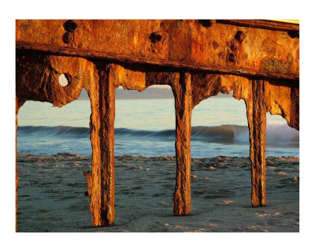
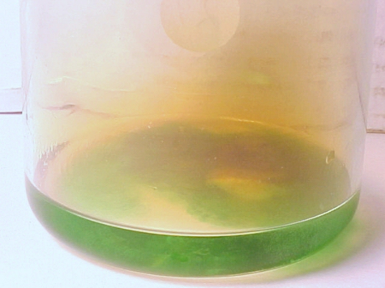
Reaction rate is the speed at which a chemical reaction occurs
This is measured by how quickly the reactants change into products.
Reactions can vary in their reaction rate
Copper and Nitric Acid
Iron oxidising

Slide 9
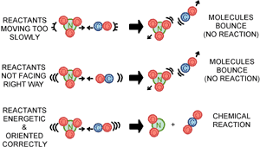
Reaction rate is the speed at which a chemical reaction occurs
The Collision Theory states that for a reaction to occur:
Particles must collide with enough energy (called activation energy) and with the correct orientation

Slide 10
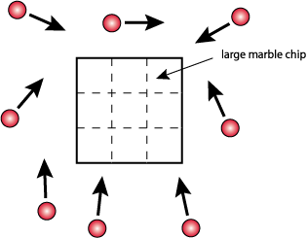
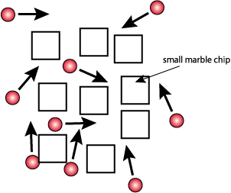
Reaction rate can be increased by increasing surface area
Low surface area
High surface area
Surface area can be increased by grinding and crushing large lumps into a finer powder.
SJ
Gaze

Slide 11
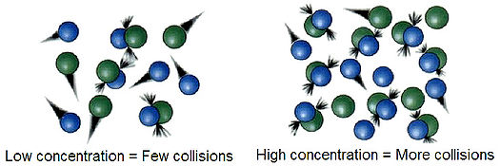
Reaction rate can be increased by increasing the concentration
If there is more of a substance in a system, there is a greater chance that molecules will collide and speed up the rate of the reaction. If there is less of something, there will be fewer collisions and the reaction will probably happen at a slower speed.
SJ
Gaze

Slide 12
Reaction rate can be increased by increasing temperature
Low temperature
High temperature
When you raise the temperature of a system, the molecules bounce around a lot more (because they have more energy). When they bounce around more, they are more likely to collide. That fact means they are also more likely to combine. When you lower the temperature, the molecules are slower and collide less. That temperature drop lowers the rate of the reaction.

Slide 13
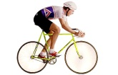
Reaction rate can be increased by using a catalyst.
Catalyst
Activation energy
Activation energy
reactants
reactants
Energy level
Energy level
products
products
Reaction proceeding
Reaction proceeding
Reaction rate can be slowed down by decreasing these factors

Slide 14
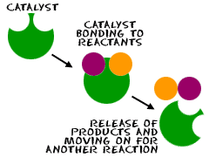
Reaction rate can be increased by using a catalyst.
A catalyst is a substance that speeds up a reaction without being used up itself. Some reactions have catalysts that can speed them up, but for many reactions there is no catalyst that works.
How does a catalyst work?
1) A catalyst provides a surface on which the reaction can take place. This increases the number of collisions between the particles of the substances that are reacting.
2) A catalyst lowers the activation energy (the minimum amount of energy needed for a reaction to take place). This means that the particles can react with less energy than they needed before the catalyst was added. If we lower the amount of energy needed for particles to react, then more particles can react).

Slide 15
Factors affecting Reaction Rate
Increase the frequency of collisions
By increasing surface area: smaller pieces of reactant expose more reactant particles to collisions. Stirring will also in crease the reaction rate
By increasing the concentrations: more reactant particles exist in a given volume so more collisions occur
Increase the energy of collisions
>by increasing temperature: particles move faster so have more kinetic energy. More collisions will be effective.
Note: increasing temp also increases frequency of collisions
Make it easier for reaction to occur
>by using a catalyst: allows reaction to occur along a different pathway that requires less activation energy
Reaction rate can also be slowed down by decreasing these

