Slide 1
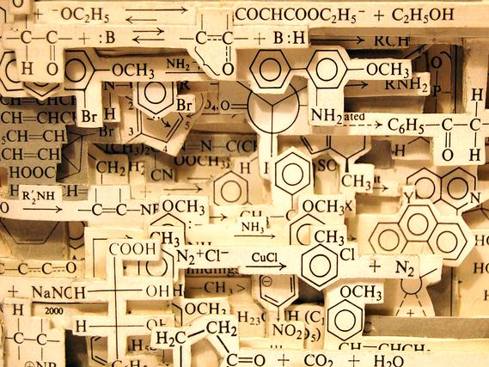
Chemistry NCEA L2
2.5 Organic Chemistry

Slide 2
Achievement Standard
This achievement standard involves demonstrating understanding of the properties of selected organic compounds.
Selected organic compounds are limited to: alkanes, alkenes, alkynes, haloalkanes, primary amines, alcohols, and carboxylic acids.
Properties are limited to:
• structural and geometric (cis–trans) isomerism.
• classification of alcohols and haloalkanes as primary, secondary or tertiary.
• solubility, melting and boiling points.
• chemical reactions.
Chemical reactions are limited to:
• addition reactions of alkenes with H₂/Pt, Cl₂, Br₂, H₂O/H⁺ (conc. H₂SO₄/H₂O) and hydrogen halides (including identification of major and minor products on addition to asymmetric alkenes), polymerisation
• substitution reactions of:
- alkanes with halogens (limited to monosubstitution)
- alcohols with hydrogen halides
- haloalkanes with ammonia
• oxidation of:
- primary alcohols to form carboxylic acids with MnO₄⁻/H⁺ or Cr₂O₇²⁻/H⁺
- alkenes with MnO₄–/H⁺
• elimination of:
- water from alcohols
- hydrogen halides from haloalkanes
• acid–base reactions of carboxylic acids and amines.

Slide 3
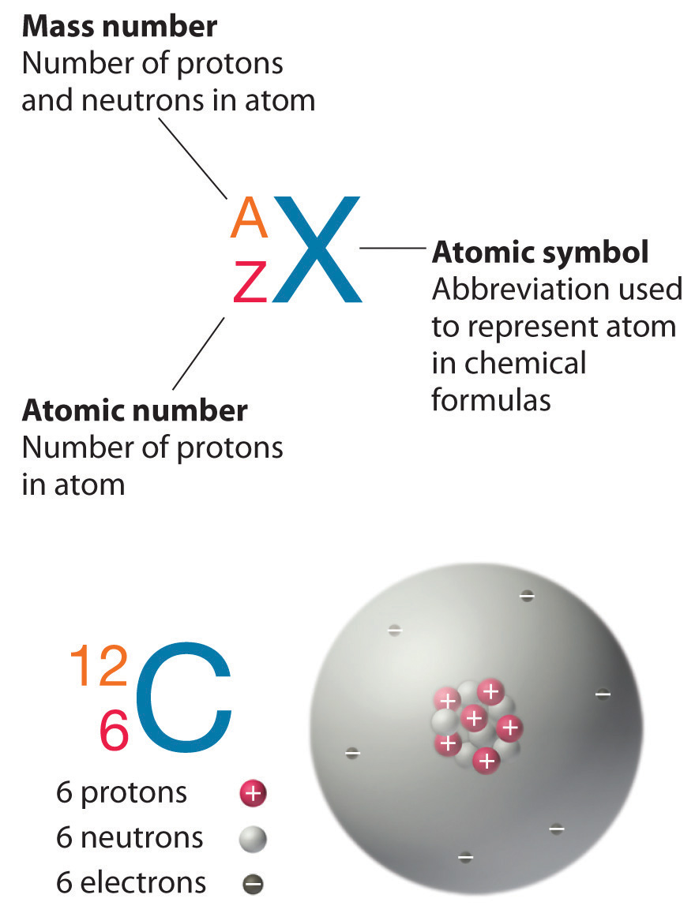
Organic Chemistry
We define organic chemistry as the chemistry of compounds that contain both carbon and hydrogen.
Carbon has four valence electrons. The electronegativity of carbon is too small for carbon to gain electrons from most elements to form C⁴⁻ ions, and too large for carbon to lose electrons to form C⁴⁺ ions. Carbon therefore forms covalent bonds with a large number of other elements, including the hydrogen, nitrogen, oxygen, phosphorus, and sulfur.

Slide 4
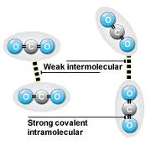
Covalent bonding between atoms
Covalent bonding occurs where valence electrons around atoms are shared between neighbouring atoms. This type of bonding is found between the C and H atoms in hydrocarbons and the C, H and O atoms in alcohol and is called intramolecular bonding. This bonding is very strong. The bonding between molecules is called intermolecular bonding and this is much weaker. When hydrocarbons are heated and they change state into liquids and gases it is this bonding that is broken not the covalent bonding.
Note the distinction:
Intra-molecular Forces: the strong bonding forces within a molecule. i.e. the covalent bonds holding the molecule together.
Inter-molecular Forces: the weak bonding forces between molecules due to the attractions between partial charges.

Slide 5
Covalent bonding between atoms
Lewis diagram of CH₄ (methane)
H
Hydrogen electron
x
Bonded pair
H
C
H
x
x
x
H
Carbon electron
Lewis diagrams can be used to show how atoms are arranged in a molecule and which valence electrons are used in bonding. A bonding pair of electrons can also be shown as a line:
H
H C H
H

Slide 6
Organic Chemistry Formula
Molecular Formula – type and number of each atom.
i.e. Propane C3H8
Structural Formula – placement of each atom.
Condensed Structural Formula
CH3-CH2-CH3
Structural isomers are molecules with
the same molecular formula but different
structural formula.
How many ways can you draw C₆H_{14 ?}

Slide 7
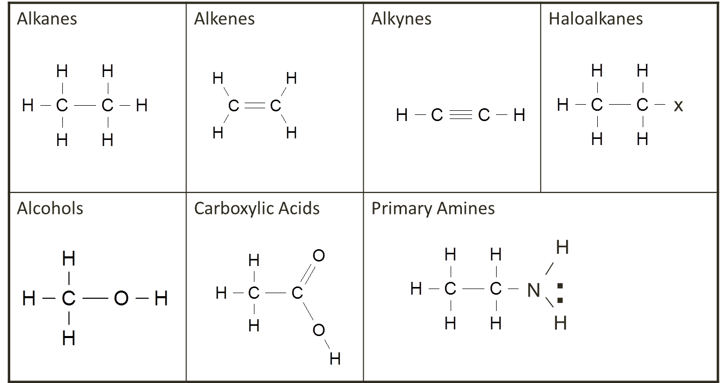
Functional groups
Organic compounds are divided into main functional groups. This is determined by the type and arrangement of atoms – this determines chemical properties. The families of organic compounds which have the same general formula and functional group are called homologous series. The compounds which make up a homologous series will have same chemical properties. The selected functional groups covered at this level include alkanes, alkenes, alkynes, haloalkanes, primary amines, alcohols, and carboxylic acids.

Slide 8
Reaction types
Substitution reactions are characterized by replacement of an atom or group (Y) by another atom or group (Z). Aside from these groups, the number of bonds does not change.
Addition reactions increase the number of bonds to the Carbon chain by bonding additional atoms, usually at the expense of one or more double bonds.
Elimination reactions decrease the number of single bonds by removing atoms and new double bonds are often formed.
Acid Base Reactions involve the transfer of a proton from the acid to the base which produces a salt and water
Oxidation reactions involve a lost of electrons from the organic molecule or a gain of oxygen. An oxidant such as dichromate or permanganate is used.
Polymerisation reactions join monomers together to form a polymer.
Addition polymerisation breaks double bonds of alkenes and joins monomers
Condensation polymerisation removes a molecule of water (H from one monomer and OH from another) and joins the two ends of the monomers together
Combustion reactions require oxygen and the products are H₂O and CO₂ (CO or C in limited O₂)

Slide 9
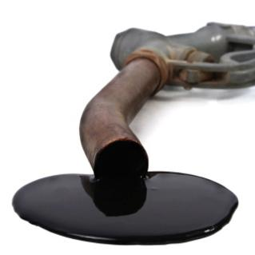
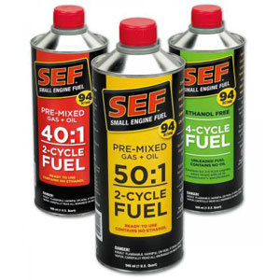
Alkanes
Compounds that contain only carbon and hydrogen are known as hydrocarbons. Those that contain as many hydrogen atoms as possible are said to be saturated. The saturated hydrocarbons are also known as alkanes.

Slide 10
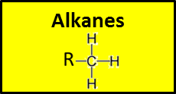
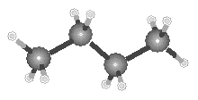
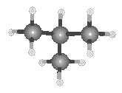
Alkanes
Straight-chain hydrocarbons, in which the carbon atoms form a chain that runs from one end of the molecule to the other .i.e. butane
Alkanes also form branched structures. The smallest hydrocarbon in which a branch can occur has four carbon atoms. This compound has the same formula as butane (C₄H₁₀), but a different structure. Compounds with the same formula and different structure are called structural isomers.
generic formula C_{n}H_{2n+2}

Slide 11
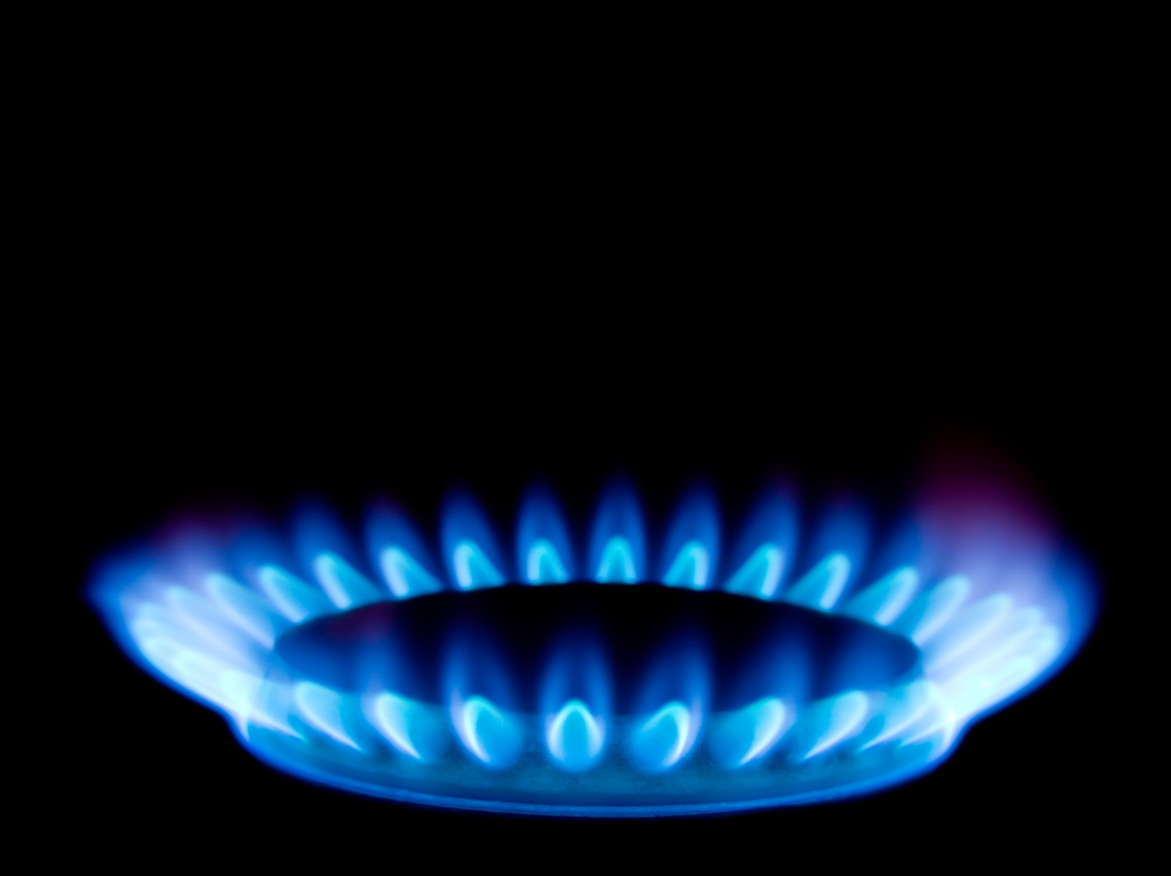
Sources of Alkanes
Alkanes are found in petroleum (either crude oil or natural gas). They are formed by the anaerobic decomposition of marine plant and animal organisms. The main components in new Zealand natural gas are methane (one carbon alkanes) and carbon dioxide.
Crude oil is imported into New Zealand from other countries and contains a mixture of different hydrocarbons with different length carbon chains. The different chain length hydrocarbons are separated by a process called fractional distillation as they have different boiling points.

Slide 12
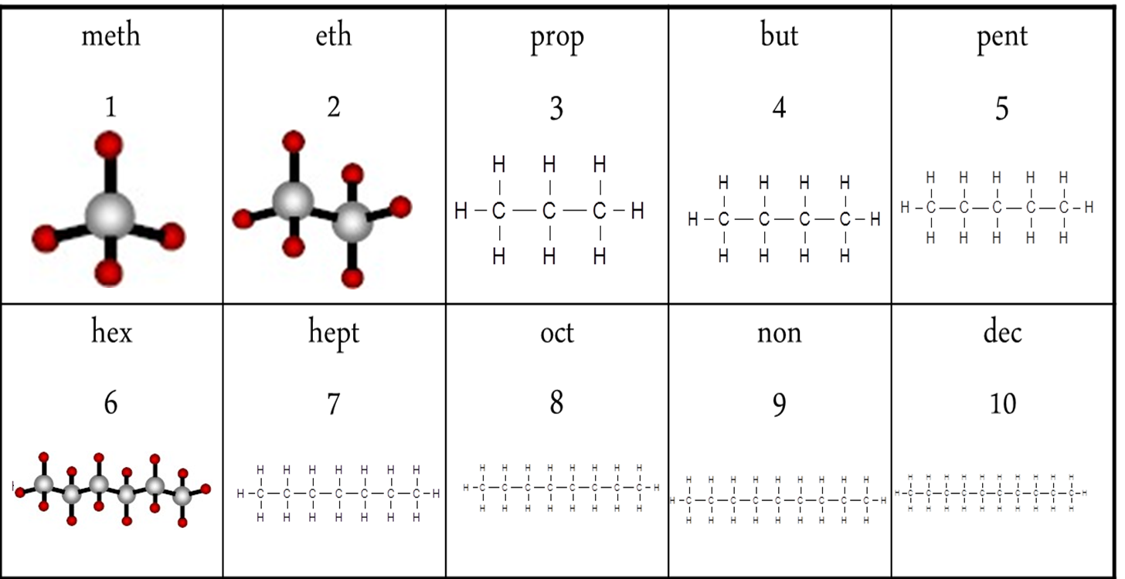
Prefixes
Prefixes are used to indicate number of carbon atoms in the longest carbon chain

Slide 13
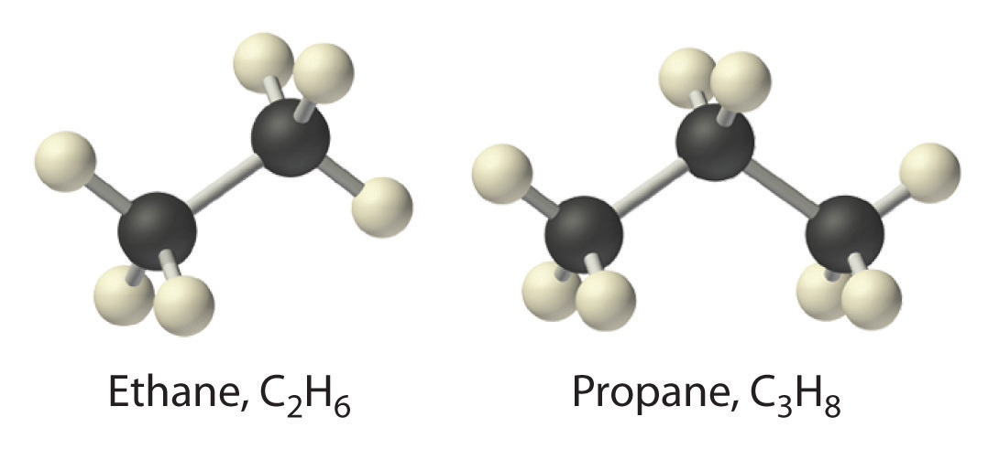
Naming straight chain alkanes
Write the name of the alkane as –
Identify the longest C chain
Write the name
  Prefix of long chain
  -ane

Slide 14
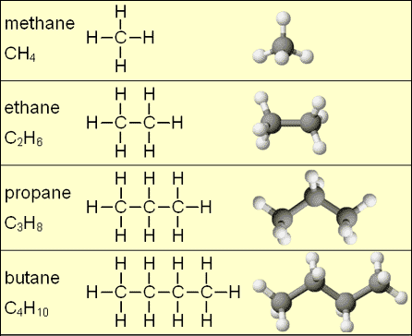

Slide 15
Naming Branched chain Alkanes
Write name as –
Identify the longest C chain
Identify any branches
Number the C atoms in longest chain so branches are on the lowest numbers
Write the name
  Location of branch
  Name of branch
  Prefix of long chain
  -ane
methyl | ethyl | propyl
1 | 2 | 3
-CH₃ | -CH₂CH₃ | -CH₂CH₂CH₃

Slide 16
IUPAC rules for Naming Branches
IUPAC Rules for Alkane Nomenclature
1. Find and name the longest continuous carbon chain.
2. Identify and name groups attached to this chain.
3. Number the chain consecutively, starting at the end nearest a substituent group.
4. Designate the location of each substituent group by an appropriate number and name.
5. Assemble the name, listing groups in alphabetical order.
The prefixes di, tri, tetra etc., used to designate several groups of the same kind, are not considered when alphabetising.
methyl | ethyl | propyl
1 | 2 | 3
-CH₃ | -CH₂CH₃ | -CH₂CH₂CH₃

Slide 17
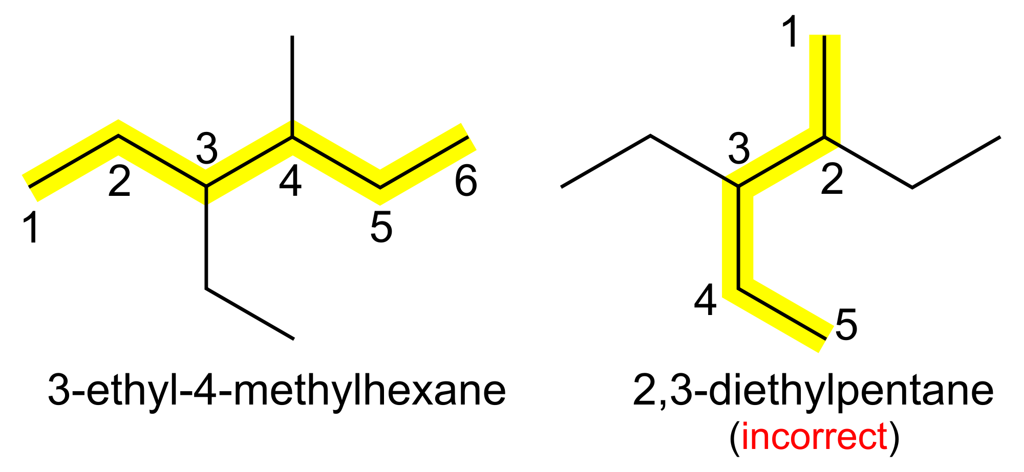
Naming Branched chain Alkanes
Always make sure the longest possible chain of carbons – and therefore the shortest possible branches – is used.

Slide 18
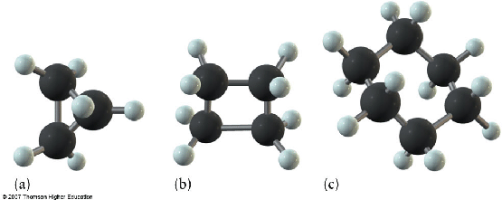
Naming cyclic Alkanes
Alkanes can also form cyclic molecules. These are named by placing cyclo- in front of the longest chain. At this level knowledge of branched chain cyclic alkanes is not required
cyclopropane
cyclobutane
cyclohexane

Slide 19
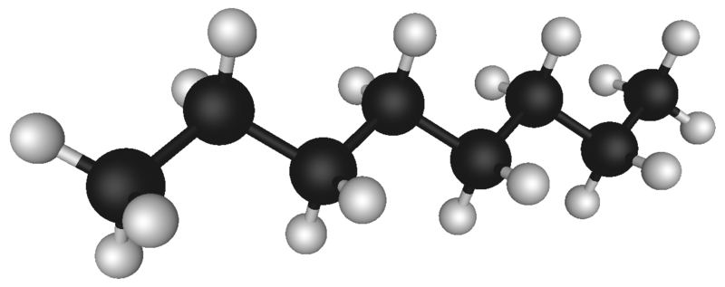
Chemical and physical properties of alkanes
Non reactivity of alkanes (in relation to acids, alkalis, metals, water, because they are non-polar molecules).
Low melting and boiling points – intermolecular forces are weak van der Waal forces.
Odour – hydrocarbons are volatile because they have weak intermolecular forces and they have characteristic smells.
Do not conduct heat or electricity.
As the C chain gets longer the hydrocarbons change from gas to liquid to solid.
Combustion of alkanes. Alkanes are very good fuels. You must know the equations for complete and incomplete combustion. You must know that the products of combustion for both complete and incomplete combustion.
Alkanes are non-polar so they are
not soluble in water

Slide 20
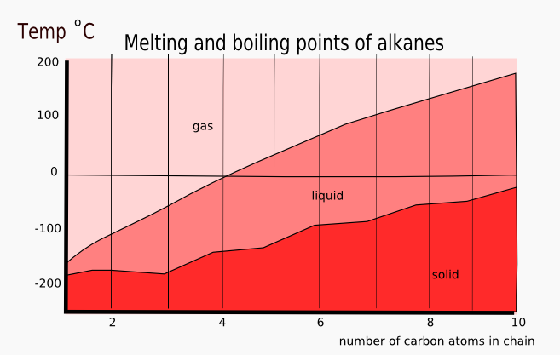
Melting and boiling points of alkanes
Alkanes are non-polar molecules and are bonded together by weak intermolecular forces. As the number of carbons increase so does the Molar Mass of the molecule. The larger the molar mass the more total valence electrons are available. These valance electrons can randomly cluster on one side or the other creating an instantaneous polar end – thereby creating a bond to another molecules instantaneous polar end
The greater the number of carbons the stronger the bond between molecules therefore the higher the melting and boiling point.

Slide 21
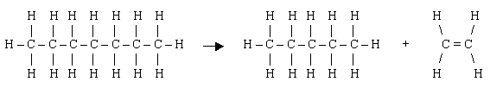
Cracking of alkanes to get Alkenes
In petroleum there are many more long chain molecules than can be used (at the present time anyhow) and not enough short chain ones for petrol. So the long chain molecules are split up into shorter molecules. This is called cracking.
Temp, pressure, catalyst
C₁₀H₂₂ ----------------------→ C₈H₁₈ + C₂H₄
Long hydrocarbon chain alkane + alkene

Slide 22
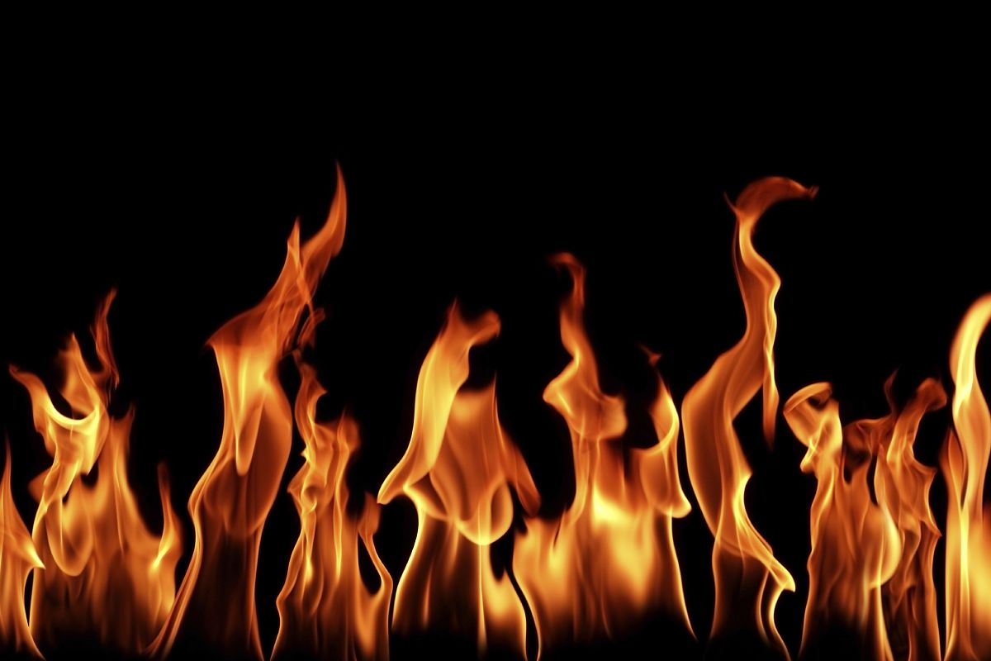
Combustion of Alkanes
Combustion of hydrocarbons involves the breaking of bonds between the atoms, (as opposed to melting) either with plentiful oxygen – complete combustion, or limited oxygen – incomplete combustion. The products formed are water plus CO₂ (or CO/C with limited oxygen).

Slide 23
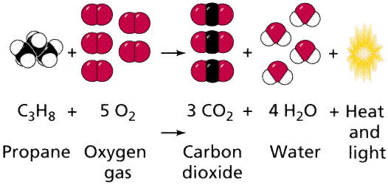
Combustion of Alkanes
Complete combustion
Alkane + Oxygen → Carbon Dioxide + water
Incomplete combustion
Alkane + limited oxygen → Carbon Monoxide or Soot + Water

Slide 24
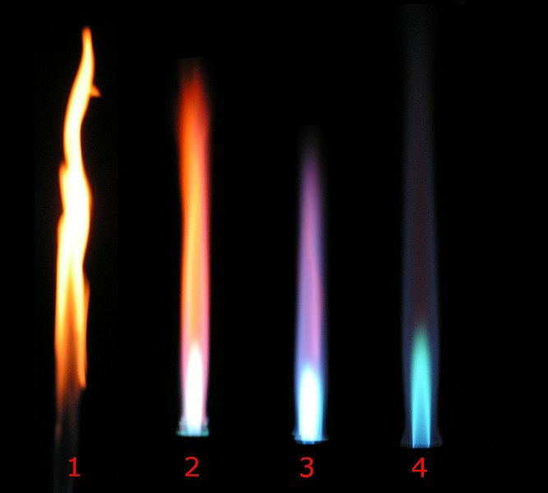
Combustion
Complete combustion: needs plentiful O₂ / good ventilation. Flame burns clear / blue. The products are CO₂ and H₂O
Energy efficient - maximum amount of energy in hydrocarbon released
Incomplete combustion: occurs in limited O₂ / poor ventilation. Flame burns dirty yellow/orange. The products CO and C (soot) and H₂O.
Reduced energy efficiency – less than the maximum amount of energy in hydrocarbon is released
As C chain length increases you get more incomplete combustion occurring as bigger molecules need more O₂ from complete combustion
complete
incomplete

Slide 25
Combustion equations
Combustion Equations
Step 1. Write down the molecular formula of the alkane plus O₂ on the left hand side
Step 2. Write down CO₂ plus H₂O on the right hand side
Step 3. Add the number of carbon atoms in the Alkane and balance the number of CO₂ (same as number of Cs)
Step 4. Add number of Hydrogen atoms in the Alkane and balance the number of H₂O (will be half number of Os)
Step 5. add the total number of Os on the RHS and balance the LHS of O₂ (if there is an uneven number then you can use ½ Os)
Incomplete combustion
For limited oxygen replace CO₂ with CO and use same steps
For very limited oxygen replace CO₂ with C and use same steps
25

Slide 26
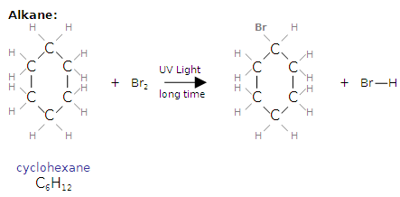
Alkane Reactions - Substitution
Alkanes are saturated molecules, that is that every carbon atom has the maximum amount of atoms bonded to it. If any other atoms are to be added to an alkane one atom must be removed first.
This reaction is known as a substitution reaction. For this reaction to proceed enough energy must be available to overcome the activation energy required to break the strong C-H bond. The available site can then be occupied by the provided atom. This energy may be provided by heat or UV light

Slide 27
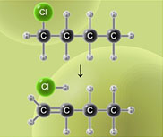
Elimination Reactions
Elimination reactions decrease the number of single bonds by removing atoms and new double bonds are often formed.
The Halogen atom is removed and a double bond forms between the two carbon atoms.

Slide 28
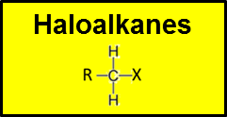
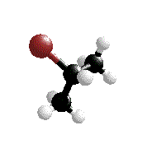
Haloalkanes (alkyl halides)
Named as a chloroalkane or bromoalkane etc, with the position of the halogen given by the appropriate number of the carbon that it is attached to in the chain.
The haloalkanes can be classified as
Primary RCH₂X - the C atom to which X is attached is only attached to one other C atom
Secondary R₂CHX - the C atom to which X is attached, is attached to two other C atoms
Tertiary R₃CX - the C atom to which X is attached,
is attached to three other C atoms.

Slide 29
Haloalkanes
Haloalkanes are single bonded hydrocarbons with one or more hydrogen atoms are substituted (replaced) by a group 17 halogen atom.
Haloalkanes can be formed when alkanes undergo a substitution reaction or alkenes undergo an addition reaction
For example, methane undergoes a series of substitution reactions with chlorine gas (Cl₂) in the presence of ultraviolet light.
+
+

Slide 30
Naming Haloalkanes
Haloalkanes are classified according to the position of the halogen atom bonded in the molecule.
This leads to the existence of
>primary (1°) – bonded to a C that is bonded to only 1 other C
>secondary (2°) – bonded to a C that is bonded to 2 other C
>tertiary (3°) – bonded to a C that is bonded to 3 other C
1-chlorobutane
(1°haloalkane)
2-chlorobutane
(2°haloalkane)
2-chloro-2-methylpropane
(3°haloalkane)

Slide 31
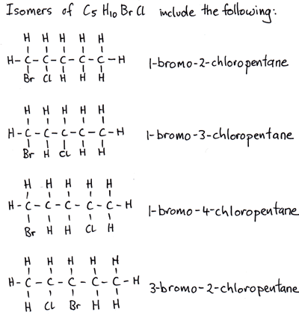
Naming Haloalkanes
Atom | Name used in haloalkane
Bromine Chlorine Fluorine iodine | Bromo Chloro Fluoro iodo

Slide 32
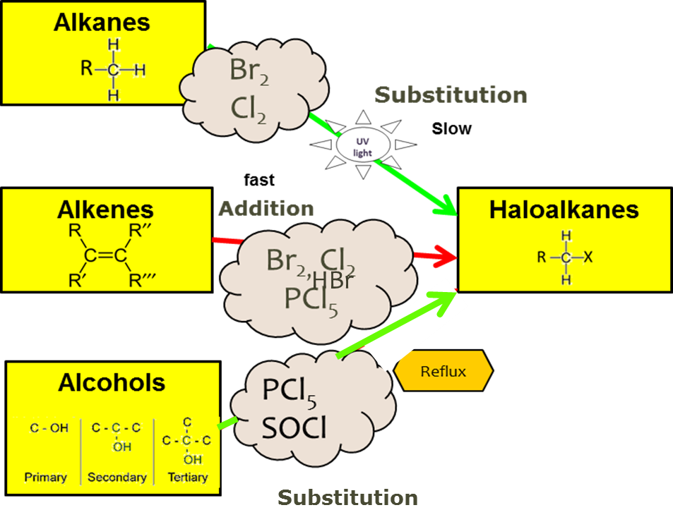
Haloalkane preparation
Haloalkanes are relatively nonpolar overall (despite the polarity of the C-X bond) and are insoluble in water. A monohaloalkane eg. 2-bromopropane can be formed by
a) substitution of propane using Br₂. (forming two products, the bromoalkane and HBr)
b) addition of HBr to propene (forming only one product)
c) substitution of the OH on an alcohol using eg. PCl₃, PCl₅,SOCl₂ or conc HCl/ZnCl₂

Slide 33
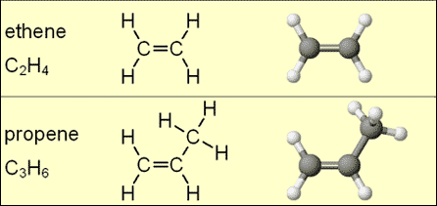
Alkenes
Alkenes are known as unsaturated hydrocarbons. The carbons do not contain as many hydrogen atoms as possible because two or more carbons are joined by a double bond. Each carbon atom involved in the bond shares two of its valance electrons therefore four electrons (in two pairs) are involved in the covalent bond.

Slide 34
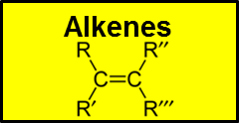
Alkenes
Functional Group – One double carbon-carbon bond C=C
A functional group is the part of the molecule responsible for
reactions typical of the homologous series.
Alkene Nomenclature
Alkenes are named in a similar way to alkanes, but the longest continuous carbon chain is numbered to give the carbon atoms in the double bond the lowest possible numbers.
The position of the double bond is given by the smaller number of the two carbon atoms involved.
After numbering the longest chain C1-C2=C3-C4, the compound is named 2-butene or but-2-ene, but not 3-butene nor but-3-ene.
generic formula C_{n}H_{2n}

Slide 35

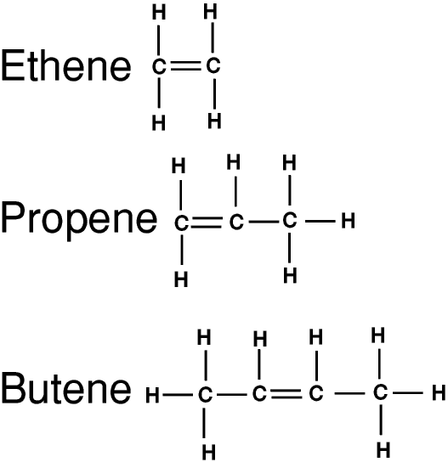
Naming Straight Chain alkenes
Write name as
1. Prefix of long chain
2. Location of C=C
3. –ene
Number carbons so double bond has the lowest number.

Slide 36
Naming Branched Alkenes
Functional Group – One double carbon-carbon bond C=C
A functional group is the part of the molecule responsible for reactions typical of the homologous series.
Number carbons so double bond has the lowest number.
The Alkene shown below is found to be 4-methylhex-2-ene by numbering the chain C1-C2=C3-C4-C5-C6.
Write name as
1.Location of branch
2. Name of branch
3.Prefix of long chain
4. Location of C=C
5.-ene

Slide 37
Alkenes – Geometric Isomers
Cis – Trans Isomerism (geometric isomers)
Forms of an alkene which occur because carbon-carbon double bonds do not rotate. Also each carbon on the double bond must have two different groups attached.
Cis isomers have the same groups on the same side of the molecule. Trans isomers have the same groups on opposite sides of the double bond.
Geometric isomers have different physical properties, but usually the same chemical properties.
Trans but-2-ene
Cis but-2-ene

Slide 38
Alkenes – Geometric Isomers
SUMMARY
Cis if chain on same side of C=C (shaped like a C)
Trans if on different sides (a transverse line)

Slide 39
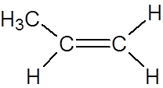
Addition reactions
Alkenes are unsaturated molecules, that is that not every carbon atom has the maximum amount of atoms bonded to it because it has one or more double bonds. If another atom is added to an alkene the double bond can be broken down to a single bond and the available site can be occupied by another atom.
This reaction is known as an addition reaction. This reaction has a lower activation energy requirement than substitution, that is it requires less energy to break a double bond than break a C-H bond, therefore it can proceed easier than a substitution reaction.
Break this bond
Two places to bond atoms to

Slide 40

Addition reactions
Alkenes undergo addition reactions - this means they can undergo addition of a halogen atom (chlorine, bromine, iodine) across the double bond to form a haloalkane.
The common test for an unsaturated hydrocarbon (alkene) to distinguish it from a saturated hydrocarbon (alkane) is therefore the rapid decolourisation of an orange solution of bromine. This occurs both in the presence or absence of sunlight compared with the slower decolourisation (only with uv light) of the alkanes.
CH₃CH=CH₂ + Br₂ →
1,2-dibromopropane

Slide 41
Addition to unsymmetrical Alkenes
Asymmetric molecules such as HCl and H₂O can also be added to alkenes resulting in the formation of two possible products.
+ HBr →
1-bromopropane
or
+ HBr →
2-bromopropane
Markovnikov’s rule -sometimes called the “rich get richer” rule
The major product is the one in which the H atom of HBr attaches to the C atom with the most H atoms already
Minor
Major

Slide 42
Alkene Reactions - Addition
Hydrogenation
Alkene + H₂ Alkane (platinum is the catalyst)
Hydration
Alkene + H₂O Alcohol (sulphuric acid is the catalyst)
Reaction with HCl
Alkene + HCl Haloalkane
Halogenation (Bromine/Chlorine)
Alkene + Halogen Haloalkane
Oxidation (addition of acidified potassium permanganate or similar)
Alkene + H⁺/MnO₄- Alcohol
Pt @ 25°C
H₂SO₄

Slide 43
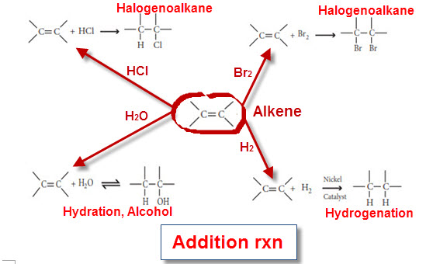
Alkene Reactions - Addition

Slide 44
Tests to distinguish between Alkanes and Alkenes
We can use these to identify whether the molecule is an alkene or alkane
Alkane – single bonds, saturated hydrocarbon | Alkenes – at least one double bond, unsaturated hydrocarbon
Subsitution – one (or more) hydrogen replaced by another atom | Addition reaction – double bond breaks and atoms added
Halogenation (Bromine) Orange colour fades slowly in UV light | Halogenation (Bromine) Orange colour disappears immediately changes to haloalkane
Acidified Potassium Permanganate Doesn’t react – solution remains purple | Acidified Potassium Permanganate Purple to colourless – oxidation changes to alcohol

Slide 45

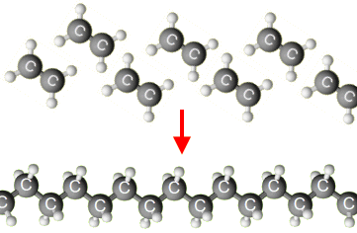
Addition polymers
Addition polymers are formed when alkene monomers undergo addition to form a polymer eg. polythene from ethene, P.V.C. from vinyl chloride (chloroethene), polypropene from propene.
n(CH₃CH=CH₂) →

Slide 46
Addition polymerisation
Monomers - smallest repeating unit with a double bond
Polymers – long chains of monomers joined together
Polymerisation – breaking of the double bond of each monomer and joining together with single bonds
MONOMERS
POLYMER
polymerisation

Slide 47
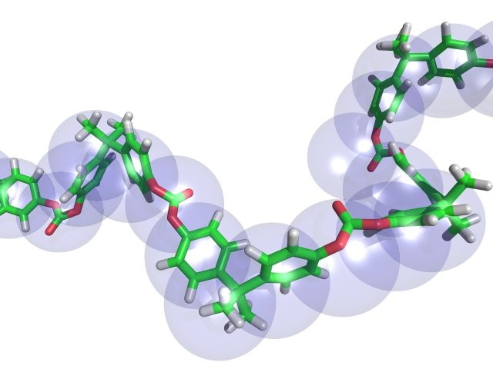
Uses and importance of polymers from ethene and propene
The alkenes are used to make polymers (which we also refer
to generally as plastics).
The chemical properties of these polymers such as low
chemical reactivity with air, water and many chemicals
make them ideal as containers for liquids and chemicals
as they will not corrode or
decompose. Polymers
are also ideal as
clothing that
can be washed
repeatedly.

Slide 48
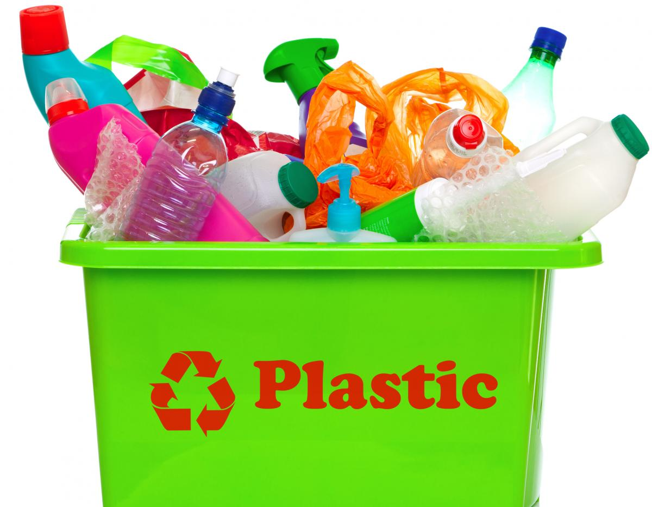
Uses and importance of Polymers from ethene and propene
The physical properties of polymers such as their density (low) and strength make them ideal for strong yet light containers and clothing. Their ability to be melted and shaped makes production of moulded shapes efficient and cheap, as well as making polymers easy to recycle and reuse.
As polymers are insoluble in water they will not dissolve when exposed to water. Polymers are thermal and electrical insulators they have many uses in electrical applications, appliances and insulating wires.

Slide 49
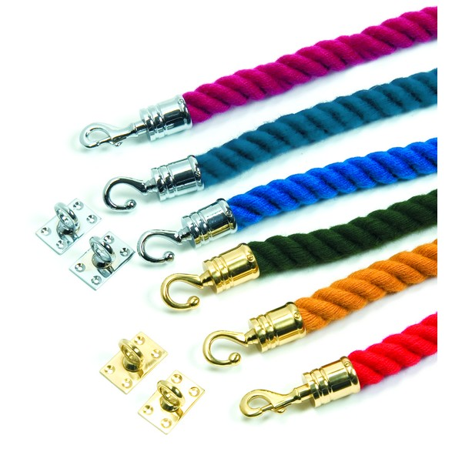
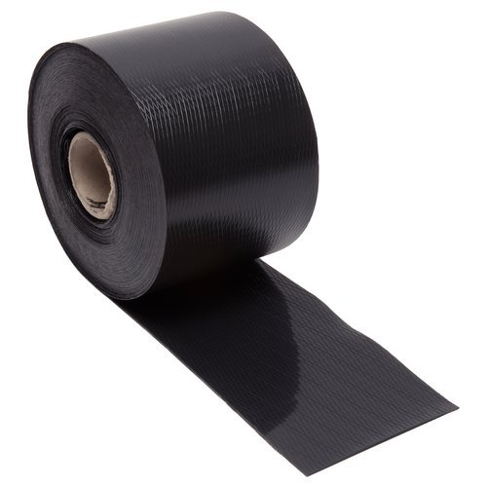
Uses and importance of Polymers from ethene and propene
Examples:
Polythene, made from ethene, is very cheap and strong, and is easily molded. It is used to make, for example, plastic bags, bottles, and buckets.
Polypropene, made from propene, has strong fibers and a high elasticity. It is used, for example, in the manufacture of crates, ropes, and carpets

Slide 50
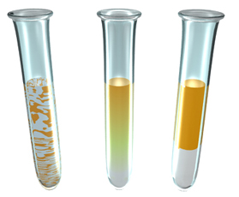
Summary of solubility in Water –Alkanes and Alkenes
Alkanes and Alkenes: Not soluble in water. These molecules are non-polar (there is no negative or positive ends to the molecule) compared with water which is polar (having a negative area near the oxygen atom and positive area near the hydrogen atoms) so they are not attracted to each other. Alkanes and alkenes are immiscible (two or more liquids that will not mix together to form a single homogeneous substance) and form a distinct layer from the water. Smaller C chained alkanes and alkenes are less dense than water and float on top.
If either an Alkane or Alkene is mixed into water eventually the two liquids will form separate immiscible layers

Slide 51
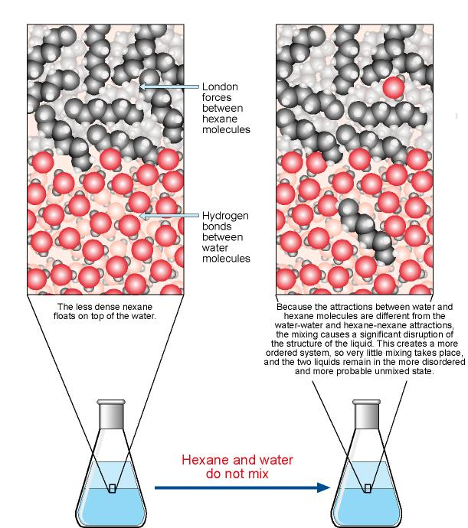
Summary of solubility in Water –Alkanes and Alkenes
Weak intermolecular bonds between alkane molecules
Hydrogen bonds between water molecules
The less dense alkane floats on top of the water
Because attractions between water and alkane molecules are different from the water – water and alkane – alkane attractions the two types of molecules stay separate
Alkanes and water do not mix.

Slide 52
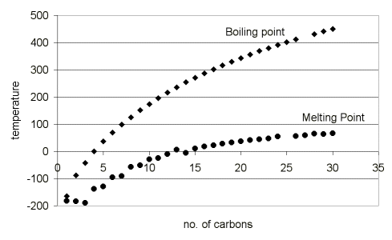
Summary of Boiling points

Slide 53
Triple c=c bonds
generic formula CnH2n - 2
Alkynes
Functional Group – One Triple carbon-carbon bond C=C
A functional group is the part of the molecule responsible for reactions typical of the homologous series.
The Alkyne shown below is found to be 4-methylhex-1-yne by numbering the chain C1-C2-C3-C4-C5-C6.
Write name as
1.Location of branch
2. Name of branch
3.Prefix of long chain
4. Location of C=C
5.-yne
Addition reactions of Alkynes are similar to Alkene
First break triple bond to double bond- adding atoms and forming Alkene
Next break double bond – adding atoms and forming Alkane

Slide 54
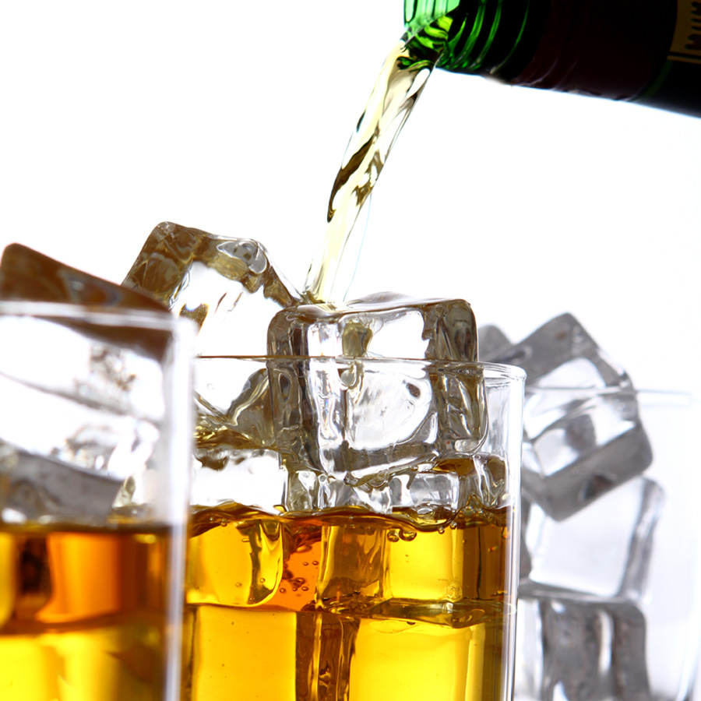
Alcohol
Alcohols are not considered hydrocarbons as they have one or more oxygen atoms attached in addition to the hydrogen and carbon atoms. Alcohols are organic substances however and share many of the same chemical and physical properties of the alkanes and alkenes. Alcohols are used as solvents and fuels and ethanol (a two carbon alcohol) is used as a drink.

Slide 55
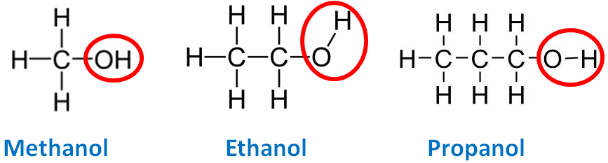
Naming Straight chain Alcohol
Functional group is the hydroxyl group –OH (not a hydroxide)
Naming alcohols
Prefix of long chain
an-
Location of OH
- ol

Slide 56
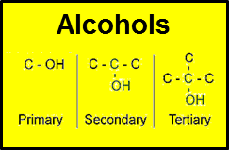
Naming Branched Alcohol
Functional group is the hydroxyl group –OH (not a hydroxide)
Naming alcohols
Location of branch
Name of branch
Prefix of long chain
an-
Location of OH (if multiple di, tri, tetra)
-ol
Butan-1-ol
Alcohols are classified according to the position of the hydroxyl group bonded in the molecule.
This leads to the existence of
>primary (1°) – bonded to a C that is bonded to only 1 other C
>secondary (2°) – bonded to a C that is bonded to 2 other C
>tertiary (3°) – bonded to a C that is bonded to 3 other C

Slide 57
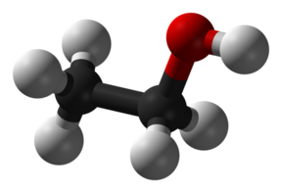
Alcohol properties
Small alcohol molecules are polar and the presence of the OH group means they are able to undergo intermolecular hydrogen bonding. The large difference in electronegativity (ability to “grab” electrons from another atom due to their pull from the combined positive protons in their nucleus) between the O and H atoms means the O-H bond is very polar and the slightly positive charge on this H atom is attracted to the non-bonding electron pairs of the oxygen on another molecule.
Physical properties: This means small alcohol molecules are highly soluble in water. However as the length of the non-polar hydrocarbon chain increases this solubility in water decreases.
Chemical properties: Aqueous solutions are neutral. The presence of the OH group in this molecule is NOT the same as the OH- in sodium hydroxide, NaOH (an ionic compound).

Slide 58
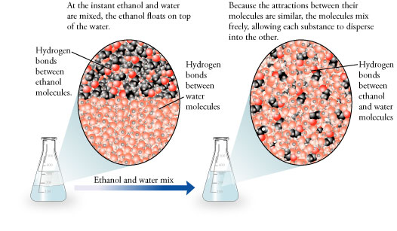
Summary of solubility in Water - Alcohol
Alcohols: Soluble in water. These molecules are polar (due to the –OH end) and water, also being polar, will bond with the alcohol. The alcohol molecules will therefore disperse and mix within the water molecules.
At the instant ethanol and water are mixed the ethanol floats on top of the water
Because the attractions between their molecules are similar, the molecules mix freely, allowing each substance to disperse into the other
Hydrogen bonds between ethanol molecules.
Hydrogen bonds between water molecules.
Hydrogen bonds between ethanol and water molecules.
Ethanol and water mix.

Slide 59
Summary of Boiling points
Alkanes: The smaller the alkane molecule the lower the boiling point and the more volatile (easier to combust) the alkane. As the molar mass (Mass number of all the atoms combined) increases, the boiling points also increase as the strength of the intermolecular (between molecules) attractions increases.
The alkanes methane to butane (C1 – C4) are all gases at room temperature
Alkanes with between 5C and 15C atoms are all liquids
Alkanes with over 15 C atoms are soft solids
Alkenes: The boiling point trend is similar to alkanes where the larger the number of C atoms in the chain the higher the boiling point. The equivalent length C chain alkene has a slightly higher point than that of the alkanes.
Alcohols: The boiling point trend is similar to both alkanes and alkenes where the larger the number of C atoms in the chain the higher the boiling point.
The boiling point is higher than both alkanes and alkenes as the intermolecular bonding is stronger due to being a polar molecule– which creates a positive and negative end and hold the individual alcohol molecules together stronger and thus needs more energy to break them (heat energy)
Even small chain alcohols are liquid at room temperature

Slide 60
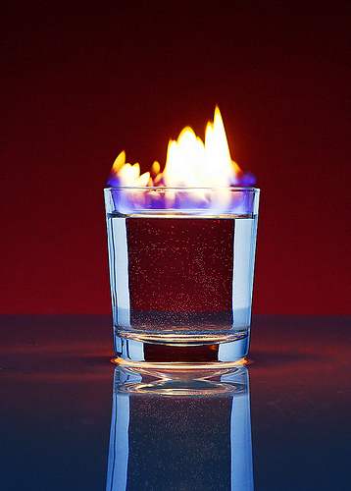
Combustion of Alcohol
Combustion
Complete Alcohol + 11/2 Oxygen CO2 + 2H2O
Incomplete Alcohol + 1 Oxygen CO + 2H2O
The longer the chain of carbons in the alcohol the less vigorously the combustion reaction. Methanol and ethanol (drinking alcohol) combust more readily.
Chefs will flambé a dish, setting alight the alcohol – this will reduce the alcohol content in the food or drink.

Slide 61
Combustion summary
Complete combustion – plentiful supply of Oxygen (CO2 + H2O)
Alkane C3H8 + 5O2 3CO2 + 4H2O
Alkene C3H6 + 41/2 O2 3CO2 + 3H2O
Alcohol C2H6O + 3 O2 2CO2 + 3H2O
Incomplete combustion – limited supply (CO + H2O)
Alkane C3H8 + 31/2O2 3CO + 4H2O
Incomplete combustion – very limited supply (C + H2O)
Alkane C3H8 + 2O2 3C + 4H2O
>Balance Carbon and Hydrogen on RHS
>Add oxygen to make CO2/CO/C and H2O on RHS
>Balance Oxygen by adding number of O2 to LHS

Slide 62
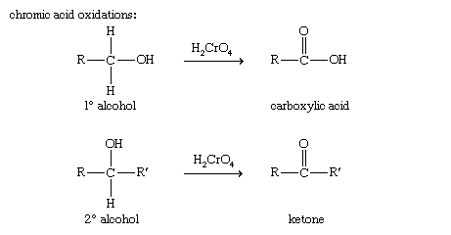
Alcohol Reactions - Oxidation
Oxidation – using acidified potassium permanganate or acidified dichromate
Alcohol + oxidant warmed carboxylic acid + H2O
+ KMnO4
Lose 2 Hydrogen (as water) and add a double bonded Oxygen to end carbon

Slide 63

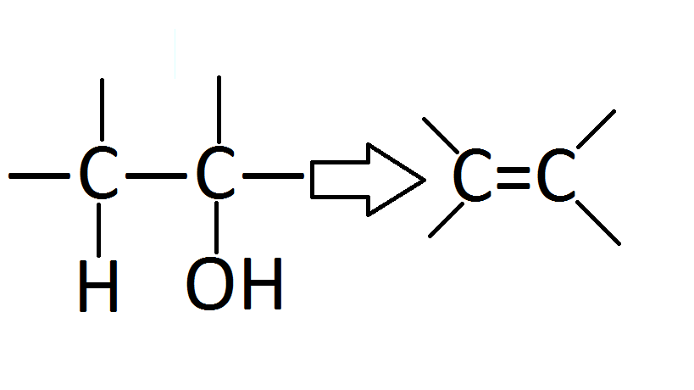
Alcohol reactions - Elimination
elimination (or dehydration) - forming an alkene and water
conc H₂SO₄/heat
→ CH₃CH=CH₂ + H₂O
propan-2-ol propene

Slide 64
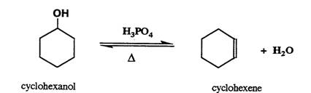
Alcohol Reactions - Elimination
Elimination – using conc. Sulfuric acid (catalyst)
Alcohol + H₂SO₄ heated Alkene
+H₂SO₄
+H₂O

Slide 65
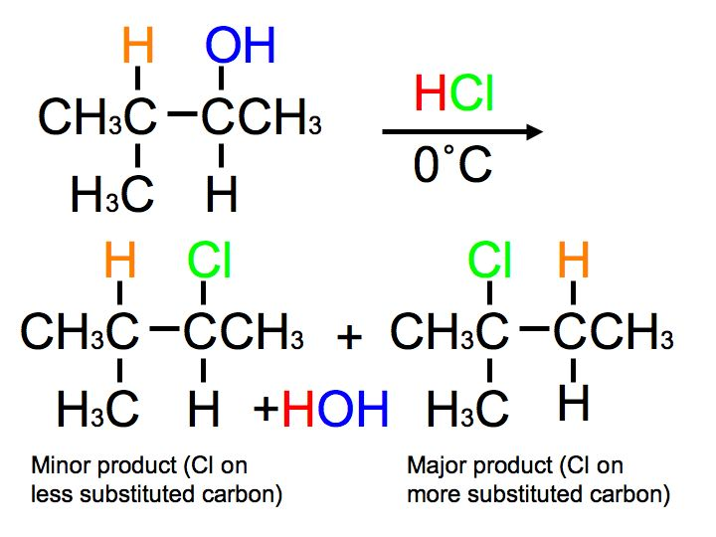
Alcohol reactions - Substitution
Substitution - of the OH⁻ by a Cl⁻ to form a chloroalkane.
This substitution removes the hydroxl group (plus one hydrogen to form water) and replaces the two bonding sites on the carbons with a H and Cl (from HCl).The haloalkane formed is nonpolar and insoluble in the aqueous solution so forms a cloudy emulsion that separates out as two layers. Two possible products can be formed – as per Markovnikovs rule

Slide 66

Reflux
The rate of substitution of primary alcohols is increased by heating the reaction mixture under reflux. Reflux is a system of heating the solution with a condenser attached to the reaction vessel so that any organic substance which evaporates will be condensed and returned to the container. This way the reaction can be heated for a period of time without the organic substance (reactant, product or solvent) evaporating away.

Slide 67
Alcohol Reactions - summary
1.Combustion – same as alkenes and alkanes
Complete Alcohol + 11/2 Oxygen CO₂ + 2H₂O
Incomplete Alcohol + 1Oxygen CO + 2H₂O
2. Oxidation – using acidified pottasium permanganate or acidified dichromate
Alcohol + oxidant warmed carboxylic acid + H₂O
+ KMnO₄
Lose 2 Hydrogen (as water) and add a double bonded Oxygen to end carbon
3. Elimination – using conc. Sulfuric acid (catalyst)
Alcohol + H₂SO₄ heated Alkene + H₂O
+H₂SO₄

Slide 68

Carboxylic Acids
All the simple, straight-chain carboxylic acids up to ten carbons are liquids at room temperature. The liquids have sharp pungent odours and all have high boiling points.
Smaller molecules, less than 10 carbons, are completely miscible in water due to the formation of hydrogen bonds with the water.
The highly polar carboxylic acids dimerise in the liquid phase and in non-aqueous solvents (CCl₄) and form two hydrogen bonds between each pair.
This extra degree of hydrogen bonding causes carboxylic acids to have higher boiling points compared to their corresponding alcohols.

Slide 69
Carboxylic Acids
Functional group is the carboxyl group –COOH
Naming carboxylic acids
Longest –C chain with -COOH
Identify branches
No. 1 C is the C in -COOH
Location of branches
Name branch
Prefix
-anoic acid
propanoic acid
>polar molecules as short chains ~ non-polar molecules as long chains
>boiling points and melting points increase with chain length
>turn blue litmus red (weakly acidic)
>conduct electricity
>react with metal to form salt and H₂
>react with metal oxides to form salt and H₂O
>react with metal carbonates to form salt and H₂O and CO₂

Slide 70

Carboxylic Acid properties
All the simple, straight-chain carboxylic acids up to ten carbons are liquids at room temperature. The liquids have sharp pungent odours and all have high boiling points.
Smaller molecules, less than 10 carbons, are completely miscible in water due to the formation of hydrogen bonds with the water.
The highly polar carboxylic acids dimerise in the liquid phase and in non-aqueous solvents (CCl₄) and form two hydrogen bonds between each pair.
This extra degree of hydrogen bonding causes carboxylic acids to have higher boiling points compared to their corresponding alcohols.

Slide 71

Carboxylic Acid Reactions
Carboxylic Acids are Weak Acids
proton donors in water
React with magnesium to give hydrogen gas (a useful test)
CH₃COOH + Mg ➔ Mg(CH₃COO)₂ + H_{2(g)}
React with calcium carbonate to give CO_{2(g)} (a useful test)
CH₃COOH + CaCO₃ ➔ Ca(CH₃COO)₂ + CO_{2(g)} + H₂O
H₂O
H₃O⁺

Slide 72

Carboxylic Acid Reactions
Neutralise bases:
RCOOH + NaOH ➔ RCOONa + H₂O
Ex: Write equations for the following, using structural formulae, and naming products.
methanoic acid + ammonia
propanoic acid + aminoethane
ethanoic acid + ammonia
methanoic acid + aminobutane

Slide 73

Amines
Functional group is the amino group –NH₃
Amines are named as substituents eg aminomethane, CH₃NH₂. These may be classed as primary, secondary or tertiary, but unlike the haloalkanes the classification depends on the number of C atoms attached to the N atom. Primary RNH₂, secondary R₂NH, tertiary R₃N.
Amines have an unpleasant “fishy” smell. The smaller amines, up to C5, are soluble in water but larger amino alkanes are insoluble, as the size of the non-polar hydrocarbon chain cancels out the effect of the polar amino functional group

Slide 74
Naming Primary Amines
Write name as –
Identify the longest C chain -Identify any branches
Number the C atoms in longest chain so number Carbon 1 attached to amino group (NH₂)
Write the name
  Location of branch
  Name of branch
  Amino-
  Prefix of long chain
  -ane

Slide 75

Bonding and physical properties
Intermolecular bonding results from hydrogen bonding between the NH groups and ID-ID attractions from the hydrocarbon portions.
States
- Aminomethane and aminoethane are gases.
-Aminopropane and aminobutane are volatile liquids with fishy smells.
-Heavier aminoalkanes are solids.
Solubility in water
Lower molecular mass aminoalkanes are soluble in water due to hydrogen bonding. Solubility in water decreases as hydrocarbon portion increases.

Slide 76
Amine reactions
Behave like ammonia due to a lone pair of e-
proton acceptors (due to lone pair of e-) (i.e. bases)
e.g. reaction with water
NH₃ + H₂O → NH₄⁺ + OH⁻
ammonia + water ammonium hydroxide
CH₃NH₂ + H₂O → CH₃NH₃⁺ + OH⁻
aminomethane methylammonium hydroxide
e.g. reaction with acid to form salts
NH₃ + HCl → NH₄⁺ + Cl⁻
CH₃NH₂ + HCl → CH₃NH₃⁺ + Cl⁻
aminomethane hydrochloric methylammonium chloride
acid
This reaction can occur in solution, or in the air as vapours given off solutions of both chemicals meet and combine to form a smoke. This smoke is made of the salt in solid form.

Slide 77


