Slide 1
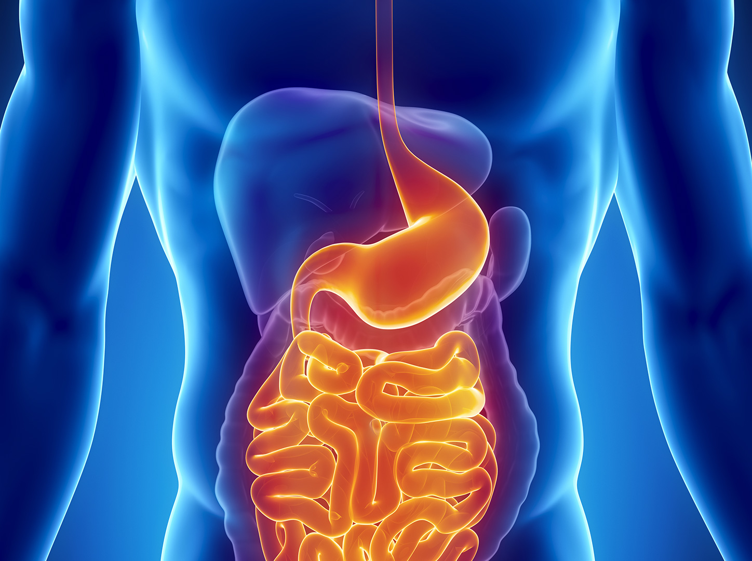
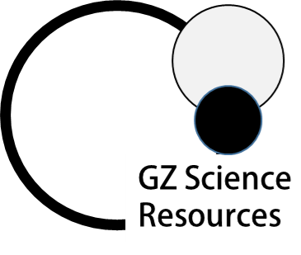
Food and Digestion
Junior Science

Slide 2
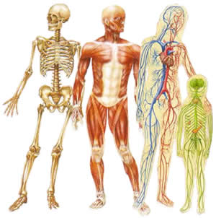
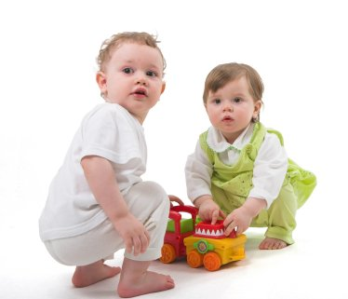
The structure and functions of the human (as an animal) systems:
skeletal, digestive, circulatory, respiratory.
6a
All vertebrates share the same basic body plan, with tissues and organs functioning in a similar manner. We focus on the human body, studying structure (anatomy) and function (physiology).

Slide 3
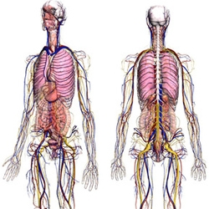
6b
The body is made up of different organ systems
Different tissues functioning together for a common purpose are called organs (eg, stomach, kidney, lung, heart).
Organ systems are composed of individual organs working together to accomplish a coordinated activity. For example, the heart, veins and arteries all play a role in circulation.

Slide 4
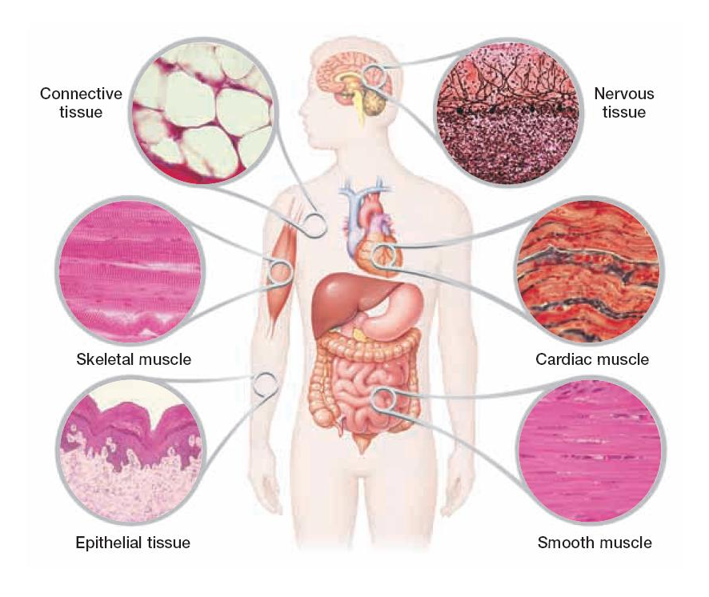
6b
The body is made up of different organ systems
Animals are made of complex systems of cells, which must be able to perform all of life’s processes and work in a coordinated fashion to maintain homeostasis (a stable internal environment).
During a human’s early development, groups of cells specialize into three fundamental embryonic layers. These embryonic layers differentiate into a number of specialized cells and tissues. Tissues are groups of cells similar in structure and function .

Slide 5
6b
The body is made up of different organ systems
Body
Organ
Systems
Organs
The order of organisation in a body starts with organ systems (e.g digestive)that are made up of organs (e.g. stomach, liver) . Each organ is made up of one or more type of tissue (e.g. muscle) which in turn is made up of specialist cells. Each cell is comprised of smaller parts called organelles.
Tissues
organelles
Cells

Slide 6
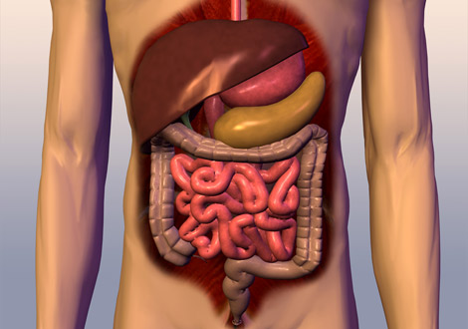
7a
The digestive system
The digestive system converts foods to simple substances that can be absorbed and used by the cells of the body. It is composed of the mouth, pharynx, oesophagus, stomach, small intestine and large intestine and is aided by several accessory organs (liver, gall bladder, and pancreas).

Slide 7
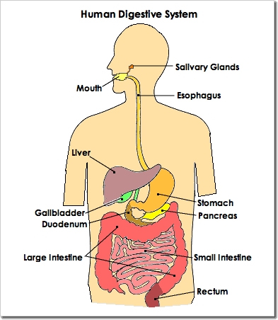
Digestion breaks large molecules of food into small ones, which can then pass through the wall of the gut into the blood.
7a
Ingestion
How we take in food using our mouths
Digestion
Breaking food into smaller pieces
Absorption
Taking food into the blood
Egestion
Removal of food from the anus
anus
7

Slide 8
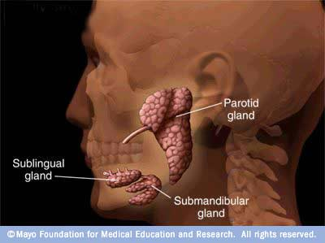
7a
Ingestion is how we take in food using our mouths.
Canine and incisors teeth rip, tear and bite pieces of the food.
Suitable sized pieces of food enter the mouth.
Pre-molars and molars grind the food into smaller pieces.
Saliva is mixed with the food from the saliva glands.
Enzymes in the saliva start breaking down (digesting) the food.
Lumps of chewed food are swallowed down the esophagus.
Food moves into the stomach

Slide 9
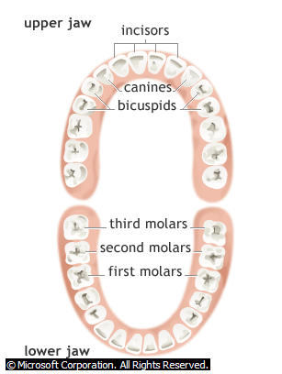
7a
How the different types of human teeth are used when eating.
There are 32 teeth in a full set of adult teeth.
The incisors at the front of the mouth are used to bite pieces of food.
The bicuspids (also called premolars) and the molars at the back of the mouth are used to chew food.
The canines are bigger and used to tear food.

Slide 10
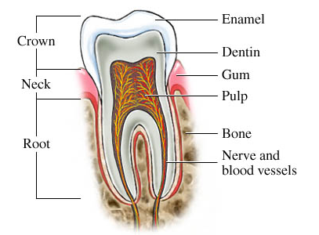
7b
The internal structure of a human tooth.
The tooth has a hard covering of enamel which protects it and gives it strength to bite and chew food. When tooth decay occurs the enamel is eaten away by bacteria and tooth pain occurs because acid and infection reach the dentine and tooth nerves. The tooth is embedded into the jaw bone by the roots which secure it.

Slide 11
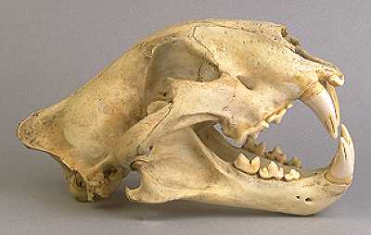
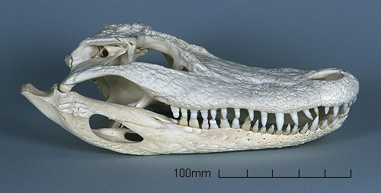
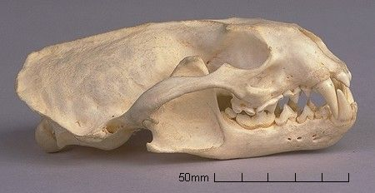
How the different types of Animal (carnivores) teeth are used when eating.
7c
Tiger carnivorous cat
Alligator carnivorous reptile
Otter carnivorous fish eater
Sharp pointed canines

Slide 12
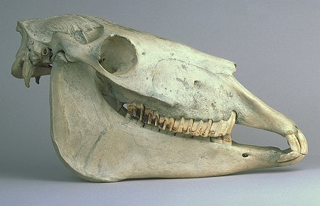
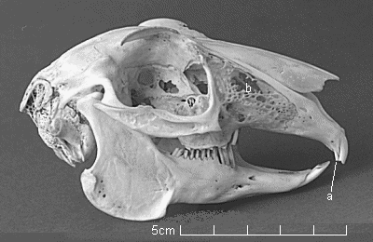
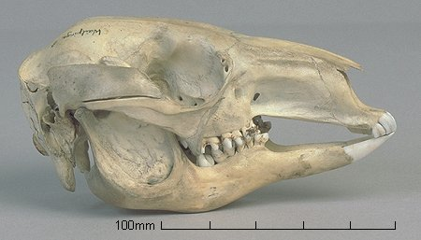
How the different types of Animal (Herbivores) teeth are used when eating.
7c
Horse grazing herbivore
Rabbit grazing rodent
Grey kangaroo Australian grazing marsupial
Chisel-like incisors
No canines
Grinding molars

Slide 13
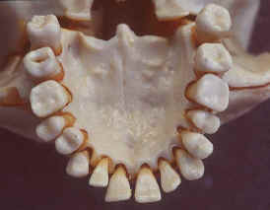
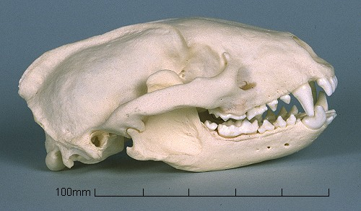
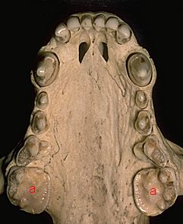
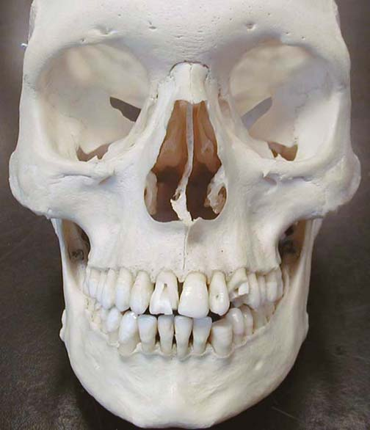
How the different types of Animal (omnivores) teeth are used when eating.
7c
Badger eats more animals than plants.
Human eats more plants than animals
Flattened molars to grind plants
Canines much smaller

Slide 14
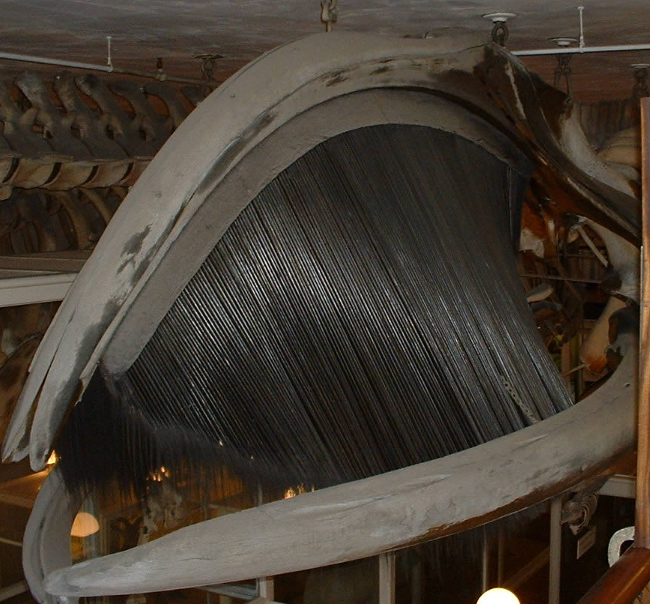
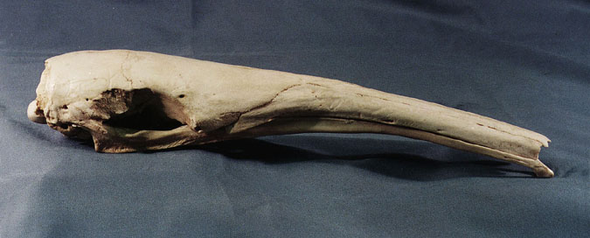
How the different types of Animal teeth (specialist) are used when eating.
7c
Baleen whales The specialized filter-feeding mechanism of baleen whales enables them to feed low on the food chain by primarily eating zooplankton and schooling fishes.
Giant Anteater sucks up ants with long tongue and has no need for teeth at all.

Slide 15
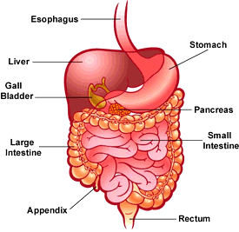
7d
The gut is a coiled tube and is the site of digestion and absorption.
The second stage in food processing is digestion
Definition Digestion Breaking food into smaller pieces
Once food is ingested it moves down into the oesophagus and then into the stomach
Definition Oesophagus The tube that food travels from the mouth to the stomach through
Definition Stomach Organ from the digestive system that digests food

Slide 16
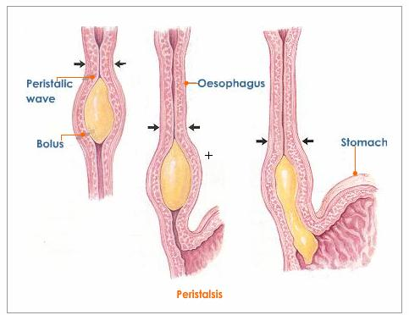
The main structure of the digestive system and its associated organs -oesophagus.
7d
The oesophagus is like a stretchy pipe that's about 25 centimeters long.
It moves food from the back of your throat to your stomach. When you swallow a small ball of mushed-up food or liquids, a special flap called the epiglottis closes over the opening of your windpipe to make sure the food enters the oesophagus and not the windpipe.
Once food has entered the oesophagus muscles in the walls move in a wavy way to slowly squeeze the food through the oesophagus (peristalsis) and into the stomach.

Slide 17
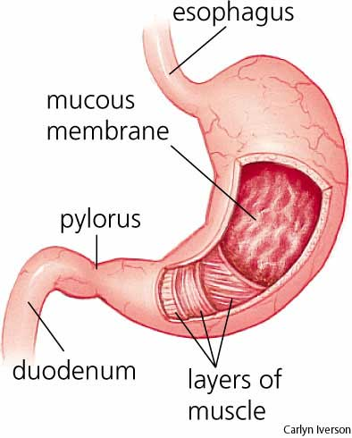
The main structure of the digestive system and its associated organs – stomach.
7d
Your stomach is attached to the end of the oesophagus.
It has three important functions:
>to store the food you've eaten
>to break down the food into a liquid mixture
>to slowly empty that liquid mixture into the small intestine
The stomach mixes, churns and mashes together all the small pieces of food into smaller and smaller pieces – called digestion.
It does this with help from the strong muscles in the walls of the stomach and gastric juices that also come from the stomach's walls.
In addition to breaking down food, gastric juices also help kill bacteria that might be in the eaten food.

Slide 18
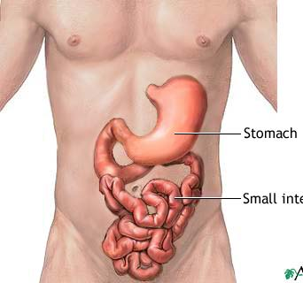
The main structure of the digestive system and its associated organs - small and large intestine.
7d
The small intestine is a long tube around 3.5 to 5 centimeters around, which connects from beneath your stomach and is about 7 meters long.
The small intestine breaks down the food mixture even more so your body can absorb all the vitamins, minerals, proteins, carbohydrates, and fats.
Food may spend as long as 4 hours in the small intestine and will become a very thin, watery mixture which can pass from the intestine into the blood.
Small
intestine

Slide 19
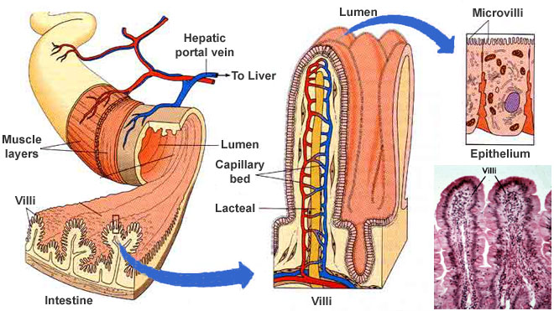
The small intestine is the site of absorption of the products of digestion.
7d
The walls of the small intestine are covered in protruding villi which increase the surface area and provide close contact for capillaries to absorb small food particles through the wall.

Slide 20
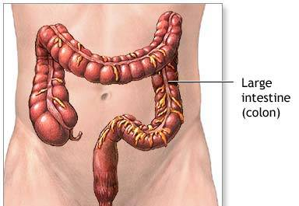
The main structure of the digestive system and its associated organs - small and large intestine.
7d
The large intestine is about 7 to 10 centimeters, which is wider than the small intestine from which it joins on. It would measure about 1.5 meters long spread out.
Most of the nutrients have already been removed from the food mixture before it enters but there is waste and water left over.
Before it leaves the large intestine, it passes through the part called the colon where the body is able to absorb the water and some minerals into the blood.

Slide 21
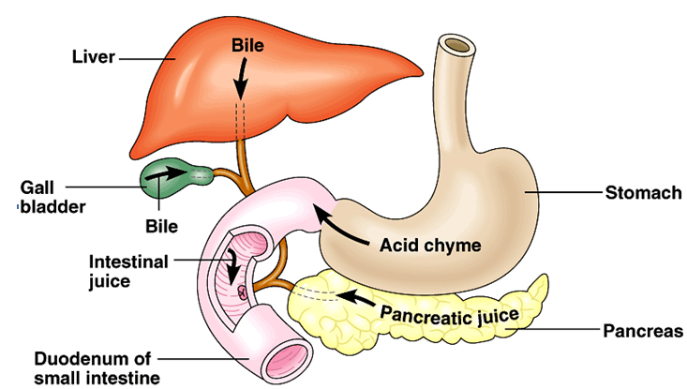
The main structure of the digestive system and its associated organs – Pancreas, gall bladder and liver.
7d
These organs send different juices to the first part of the small intestine. These juices help to digest food and allow the body to absorb nutrients.
The pancreas makes enzymes that help the body digest fats and protein.
Enzymes from the liver called bile helps to absorb fats into the bloodstream.
The gallbladder serves as a warehouse for bile, storing it until the body needs it.

Slide 22
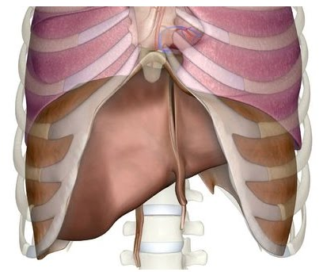
The main structure of the digestive system and its associated organs – pancreas, gall bladder and liver.
7d
The nutrient-rich blood comes directly to the liver from the small intestine for processing. The liver filters out harmful substances or wastes, turning some of the waste into more bile. The liver sorts how many nutrients will be distributed to the body, and how many will stay behind in storage. The liver stores certain vitamins and a type of sugar your body uses for energy.

Slide 23
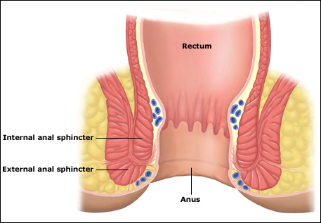
The main structure of the digestive system and its associated organs – rectum and anus.
7d
The final stage of food processing is egestion, where the waste food that hasn’t been absorbed is moved through the rectum and out of the body through the Anus.
Definition Egestion
Removal of wastes from the anus
Definition
Anus
part of the digestive system through which wastes exit the body

Slide 24
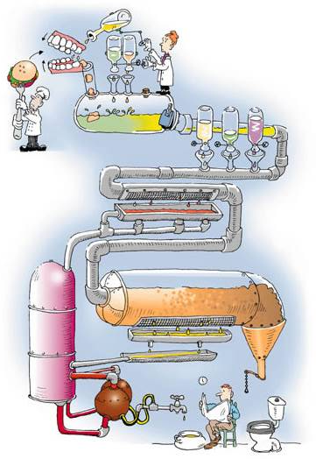
7e
The journey of food through the body
In summary the food enters the mouth (ingestion) and is broken into smaller pieces by the teeth and saliva then the stomach and various enzymes and acid (digestion). The small intestine is where most of the food passes into the blood stream (absorption) and further down in the large intestine the water is reclaimed. The waste products from the digestive system are then passed out of the body (egestion)

Slide 25
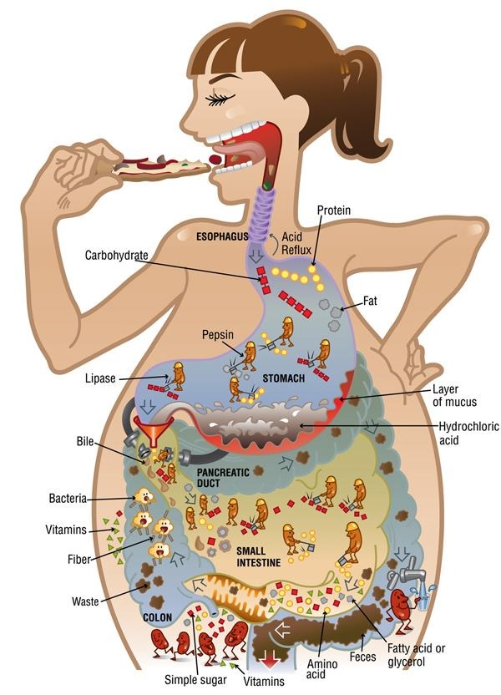
7e
The journey of food through the body
Various parts of the food are digested and absorbed in different parts of the digestive system.
The body produces different enzymes and substances, such as acid, which break down all the components of the food.
We also have numerous “helpful” bacteria which also help digest the food.

Slide 26
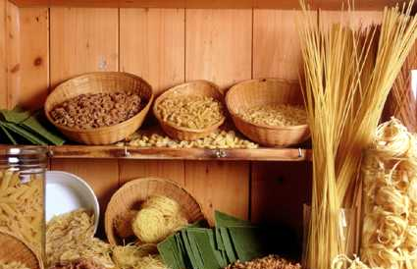
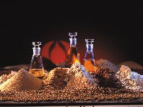
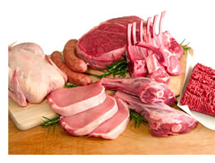
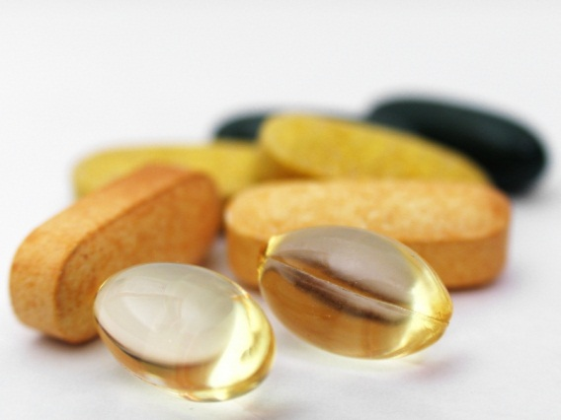
7f
The food we eat is divided into four main groups
There are four main food groups
Carbohydrates >supply instant energy >include sugar and starches >are supplied by fruit (sugars) or by cereals (starches)
Lipids >act as energy stores >include fats and oils >are energy rich >are made of fatty acids
Proteins >are used for growth and repair >are found in meat and eggs >are made of amino acid chains
Minerals and Vitamins >body needs them in small amounts >found in many foods >non-organic substances
extension

Slide 27
7g
We use tests to determine which type of food is present.
Lipids – present in fats and oils
Protein – present in meat and eggs
Some of the food rubbed into filter paper. Remove food and allow to dry
Sodium hydroxide solution
Add benedicts solution
Broken up food particles
Mixture turns purple if protein present
A ‘grease spot’ is left where the food was rubbed in if lipid was present
extension

Slide 28
7g
We use tests to determine which type of food is present.
Starch –present in cereals
Glucose – type of sugar
Add Benedict’s solution
Heat mixture gently
Place a few drops of iodine on the food
Mixture turns orange if glucose present
Food will turn black if starch is present
Broken up food particles in water
extension

