Slide 1
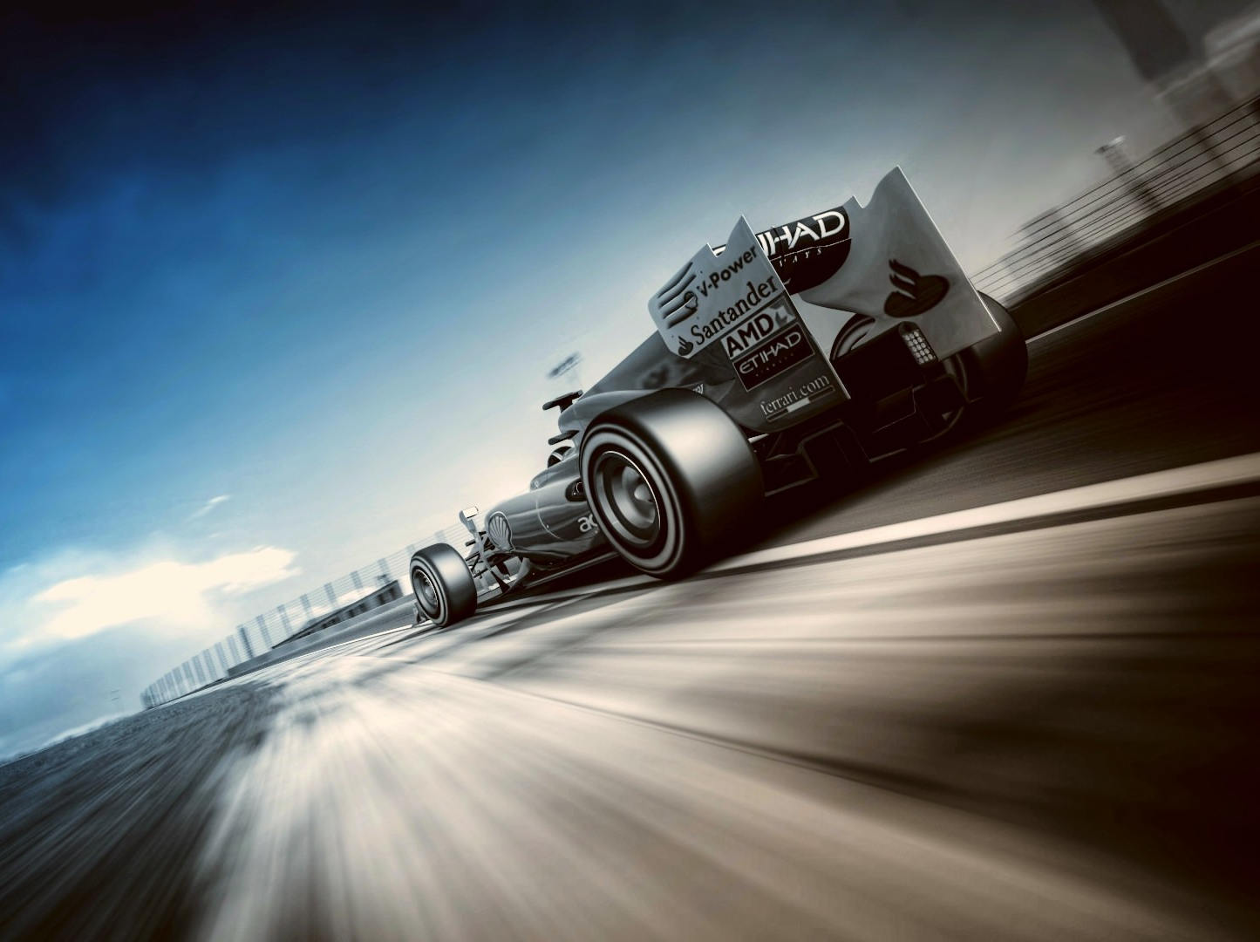
Force and Motion
Junior Science

Slide 2
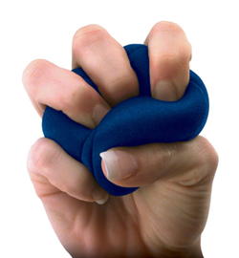
1a
Force can cause an object to change its velocity or shape.
Forces push, pull, tug, heave, squeeze, stretch, twist or press.
Forces change:
The shape of an object
The movement of an object
The speed of an object
The direction of an object
Not all forces can be seen but the effects can be measured.
Forces can be classified as contact or non-contact

Slide 3
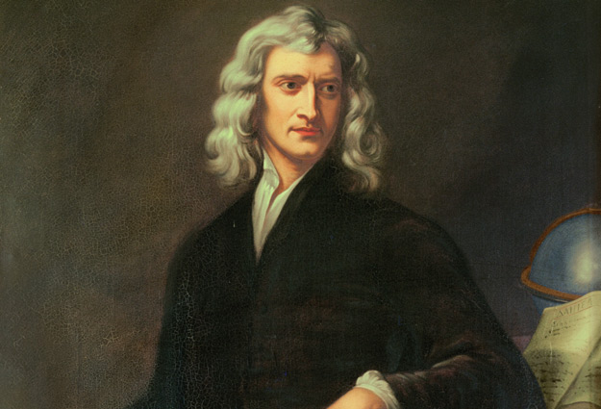
1a
Extra for experts
Force is measured in Newtons
Isaac Newton was born in 1642 in England. He created laws of motion and gravity.
Isaac Newton used three laws to explain the way objects move and how force acts upon them. They are often called Newton’s Laws.
The units of force are named after this scientist and are called Newtons. (N)

Slide 4
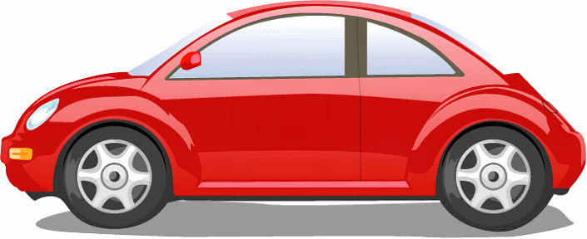
1a
Extra for experts
Newton’s Laws
First Law
If the forces acting on an object are balanced, then the object will remain stationary or carry on at the same speed in the same direction.
Force one
Stationary
Balanced forces
Force two
Constant speed
thrust force
NOTE: More on this in later lessons
Friction force

Slide 5
1a
Extra for experts
Newton’s Laws
Second Law
If unbalanced forces act on an object, then the object will accelerate in the direction that the net force acts.
Un-Balanced forces
Force one
Force two
NOTE: More on this in later lessons
Direction of acceleration

Slide 6
1a
Extra for experts
Newton’s Laws
Third Law
When a force acts on an object, an equal and opposite reaction force occurs. This is called action-reaction.
Action force
Reaction force

Slide 7
1a
Units of Force, Motion and Energy in Science
Quantity | What is it measured in? | Symbol | Equipment used
Force (including weight) | Newton's | N | Spring balance
Mass | kilograms | kg | scales
Velocity / speed | metres per second | ms⁻¹ | Ticker timer
Acceleration (including gravitational acceleration ) | metres per second per second | ms⁻² | Ticker timer
Energy (including Work) | Joules | J

Slide 8
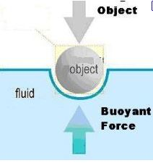
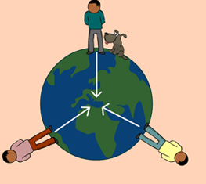
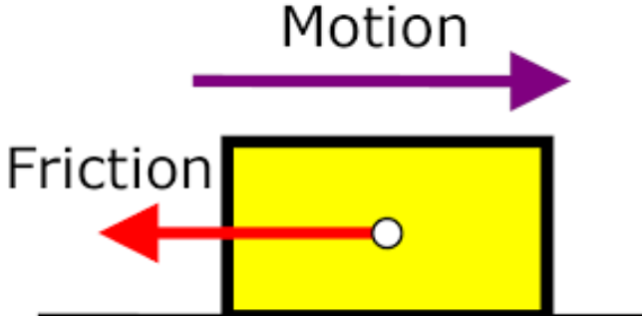
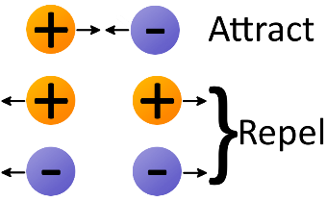
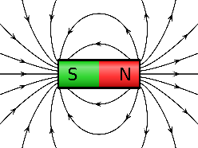
2a
Forces
Contact Forces
Buoyancy and surface tension
Thrust Force
Non-contact Forces
Gravitational Forces
Friction
Electrostatic Forces
Magnetic Forces
Contact and non-contact forces
Pushes, pulls, friction and tension are contact forces. Whatever exerts the force actually touches the object it acts upon.
Non-contact forces such as electrostatic forces, magnetic forces and gravitational forces act without contact between the object.

Slide 9
2a
Comparing contact and non-contact forces
Similarities: 1. Both contact and non contact forces can be represented by direction and size (vectors)
Both involve attraction between the objects
Differences:
Contact Forces | Non contact Forces
Force arises due to the contact between two different objects | Force arises due to the attraction between two objects there is no contact between the objects
This force takes immediate effect after the applied force | There is a time lag between the applied force and the effect of this force
There is no field associated with a contact force. | There is always a field associated with a non-contact force

Slide 10
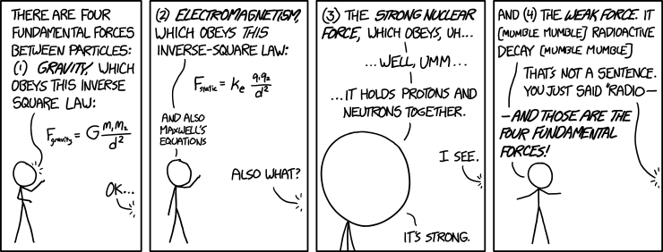
2a
Four Fundamental Forces
Extra for experts
Non-Contact Forces can often be classified into four Fundamental forces. These act over a distance between particles of matter.
The particles need not be in contact.
Force is affected by the distance between particles
Electromagnetic forces – only forces that both attract and repel.
Strong nuclear forces -holds neutrons and protons together
weak nuclear forces – attractive force between particles in nucleus
Gravitational forces – attractive force between any two objects

Slide 11
Gravity is a force which acts between bodies even though they are not in contact
2a
GRAVITATIONAL FORCE
Objects create a gravitational field around them. Gravity gives objects of mass in the field a weight force.
>the bigger the object; the stronger the field
>the further away from the object, the less gravitational pull
Any other object within the field is pulled to the center of the mass:
>accelerating
>feeling weight
Strong pull
Weakest pull
acceleration
Not so strong pull

Slide 12
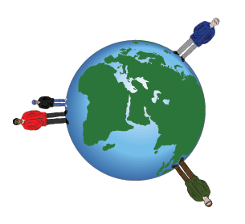
2a
The Earth is the source of a gravitational field
GRAVITATIONAL FORCE
Isaac Newton was also famous for his work on gravity. His law of universal gravitation states that objects with mass attract each other with a force that varies directly as the product of their masses and decreases as the distance between them increases.
This gravitation force causes objects to accelerate towards the centre of the Earth (remember F = m x a). Once they reach solid ground the support force prevents them falling any further. Because we also have mass the Earth feels a gravitational attraction and accelerates towards us but our mass is so tiny compared to the Earth and the effect is not noticed.
Extra for experts

Slide 13
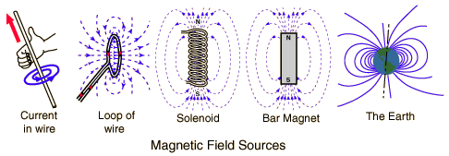
3a
Magnetic forces can act on magnetic objects
MAGNETIC FORCE
Magnetic force is the force that exists between two magnets, caused by the interaction of their magnetic fields. This force causes the magnets to attract or repel one another. Magnets can be made out of materials such as iron, cobalt, or nickel.
Magnetic fields affect neighbouring objects along things called magnetic field lines. Magnetic poles are the points where the magnetic field lines begin and end. Field lines come together at the poles. We call those poles north and south because that's where they're located on Earth. All magnetic objects have field lines and poles.
Magnetic fields are can also be produced by moving charges (current). And moving charges are affected by magnets. This is called an electromagnetic force.

Slide 14
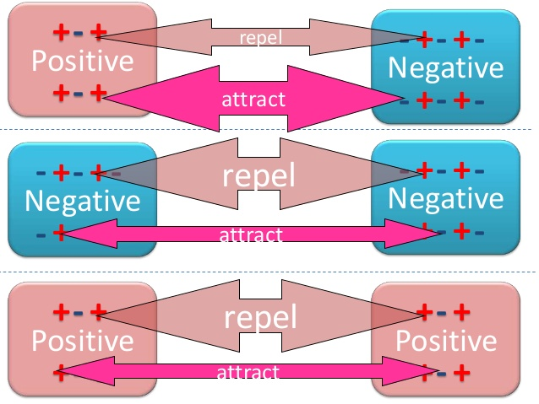
3a
Electrostatic forces can act on non-moving charged particles
ELECTROSTATIC FORCE
Although moving charges create electromagnetic force, non-moving charges create electrostatic force (static means non-moving). Commonly we see this as static electricity in situations such as lightning. It is also the force that bonds ions together to form molecules and some molecules together to form substances.
Electrostatic forces cause like charges (+ and + or – and -) to repel and unlike charges (+ and -) to attract.

Slide 15
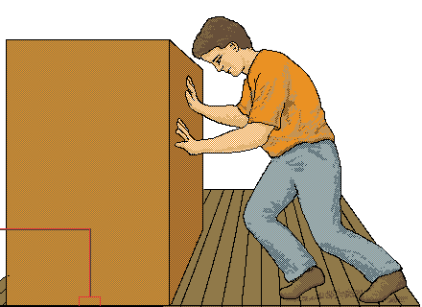
3a
Friction often provides opposing force acting on moving bodies
FRICTION
Friction is a force that opposes motion. If an object has no motion then there is no friction.
When friction occurs, and one surface moves against another. kinetic energy from movement is changed into heat energy.
Smooth surfaces create less friction than rough surfaces. Friction that occurs between air or water and a solid body is called resistance.
Close-up

Slide 16
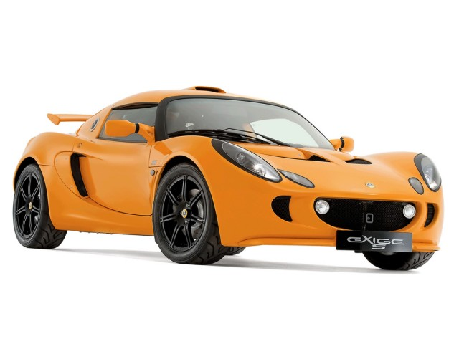
3a
Sometimes friction is useful, at other times it is unhelpful.
FRICTION
situation | Increased by
walking | Having grip on the soles of your shoes
cycling | Wider tyres with tread
driving | Good tread on tyres. Brake pads
situation | decreased by
Friction in bearings | Oil around bearings
Drag on car | Aerodynamic design to reduce drag
Drag on snowboard | Smooth lacquered surface
Situations where Friction is useful
Situations where Friction is unhelpful

Slide 17
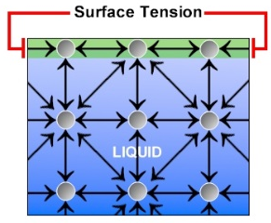
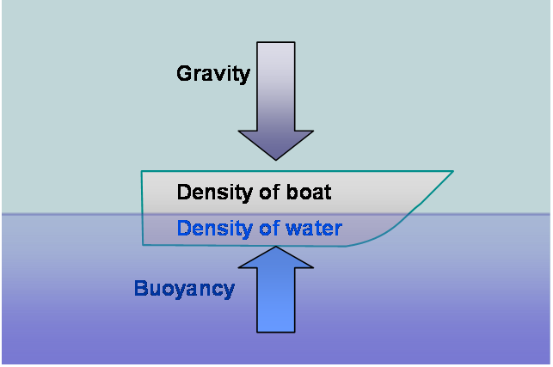
3a
Surface tension and buoyancy act as support forces
SURFACE TENSION and BUOYANCY
The attractive (cohesive) forces or ‘stickiness’ between molecules of liquids creates surface tension. Attractive forces of a molecule to its remaining neighbours are stronger on the surface of the liquid. As a result, a force (F) develops that opposes the weight force of an object on the surface.
Buoyancy is an upward support force caused by a fluid that opposes the weight (gravitational force) of an object in the fluid, usually water. Once the object remains at a set depth then the support force and weight force are balanced.

Slide 18
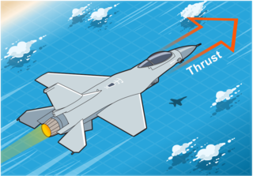
3a
Thrust force
THRUST FORCE
Thrust (or applied force) requires some parts of an object (whether gas, liquid or solid) being pushed forcefully from itself (rocket fuel from a rocket, for example). Once the rocket has left, the "thrust" is no longer present. It also requires reaction (actual touching) of the thrust medium against the object. Acceleration is the state of an object, due to a force applied. It is dependent on the force, and on the mass of an object, but is not a force itself.
Friction force opposes an object that is experiencing thrust force.

Slide 19
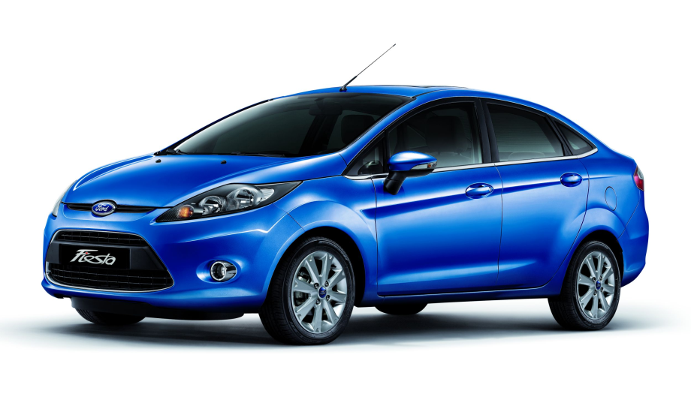
4a
The effects of balanced and unbalanced forces
Note: when an object is stationary there are only 2 forces acting upon the object; support and weight force. There is no thrust or friction force
If all four forces acting on an object are equal they are said to be balanced.
Support force (reaction force)
Thrust (resultant force)
Friction force
Weight force (gravity)

Slide 20
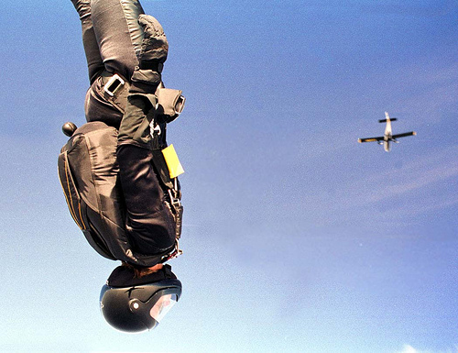
In the absence of an unbalanced force an object will either remain at rest or travel with a constant velocity
4a
Extra for experts
When sky divers reach terminal velocity they are traveling at a constant speed. The forces of gravity accelerating the skydiver towards earth are matched exactly by the force of friction from the air particles pushing against the skydiver. If the person wears a more aerodynamic suit or points their body downwards so there is less surface area to act against the air which reduces friction then the terminal velocity will be faster.

Slide 21
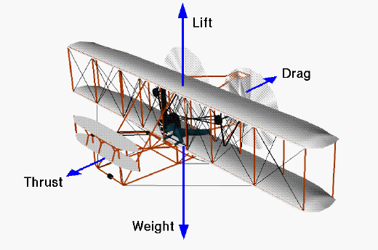
4b
Unbalanced forces change motion
Balanced forces cause no change in speed or direction (acceleration or deceleration) since they exert equal, but opposite, push/pull effects on an object. Unbalanced forces can change the speed and/or direction of an object (acceleration or deceleration)
Note: in air the support force is replaced by lift and in water the support force is replaced by buoyancy
Direction of flight

Slide 22
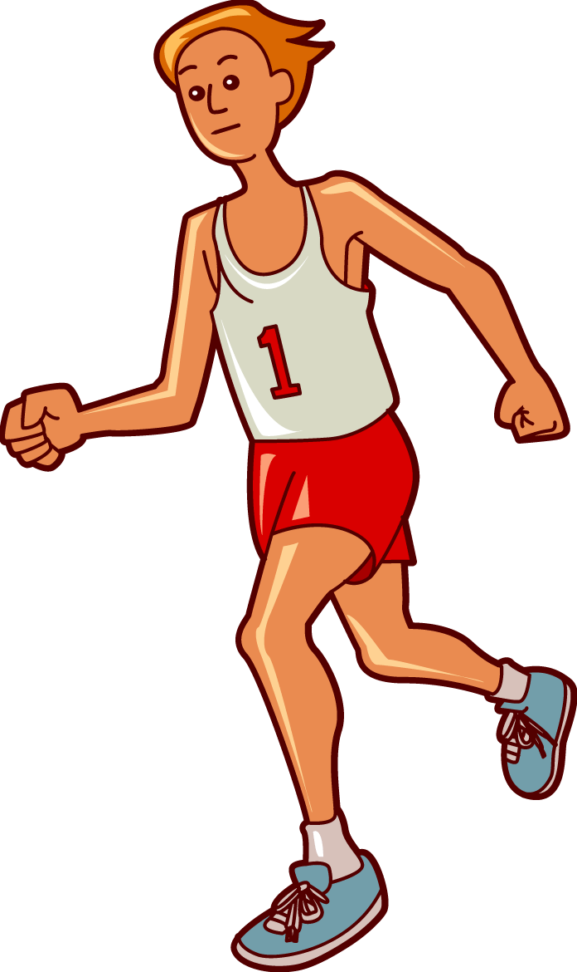
5a
Rules of Force Diagrams
We use force diagrams to show the direction and magnitude (size) of a force.
Force is known as a vector quantity.
Force diagrams have rules:
>The arrows showing a force must start (preferably) from the centre of an object, but at least touching it.
>Pairs of forces, such as support and weight, must be directly opposite each other
>Arrows must be pointing out.
>The length of an arrow indicates magnitude of a force. More force=longer arrow
>Pairs of balanced forces have equal length arrows.
>Pairs of unbalanced forces have different length arrows
Runner at constant speed
Support force
Thrust force
Friction force
Weight force

Slide 23
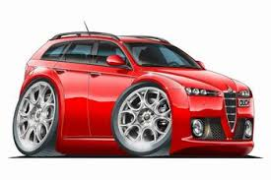
5a
Unbalanced Force Diagrams
Falling cat
Accelerating car
Support force
Support force
Friction force
Thrust force
Weight force
Weight force

Slide 24
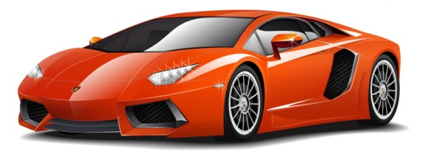
6a
Calculating Net force
An object experiencing unbalanced force will accelerate in the direction of the largest force. The net force can be calculated by subtracting the smaller force from the larger force.
Force two = 120N
Force one = 30N
Net force = 120N – 30N = 90N pushing the object from right to left
Note: if there are two or more forces acting in the same direction then they are added
Net force

Slide 25
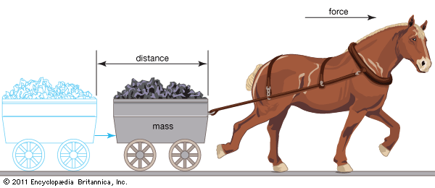
7a
Work
When a force is applied to an object of mass and moves it over a distance then work has been done.
Work is measured in joules.
To do 1 joule of work you need 1 joule of energy.
Work = force x distance
W= f x d
W=fd
W = work done (J)
f = force (N)
d = distance (m)

Slide 26
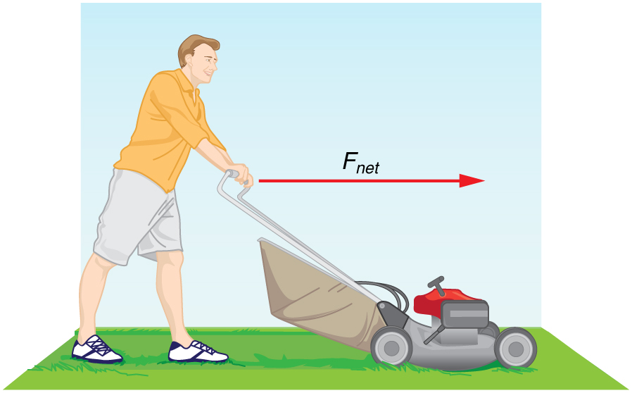
7b
Work Calculations
James is mowing the lawns at home. James pushes the lawn mower with a force of 230N over a distance of 20m. How much Work has he done?
W=Fd
W=230N x 20m
W= 460J
W=Fd
W = work done (J)
F = force (N)
d = distance (m)

Slide 27
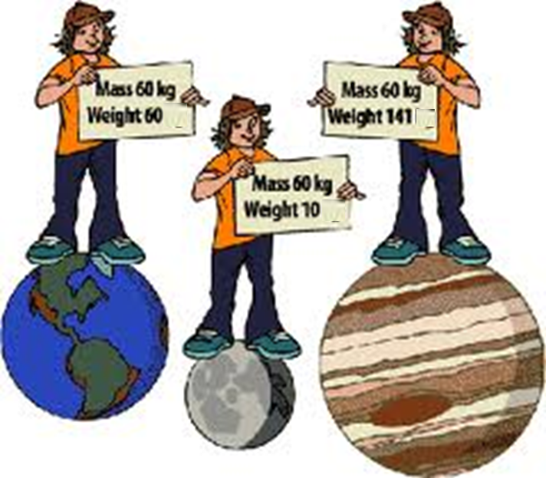
9a/b
Mass and weight
All objects have Mass. Mass refers to the amount of atoms in an object.
The formula symbol for mass is m.
Mass is measured in grams (g) or kilograms (kg). 1kg = 1000g
The mass of the object remains the same regardless of its location.
The weight of an object depends on its location and the gravity pulling down on it.
The weight of an object can change depending on where it is located. Astronauts weigh less on the moon because the force of gravity is less, but their mass is the same in both locations.

Slide 28
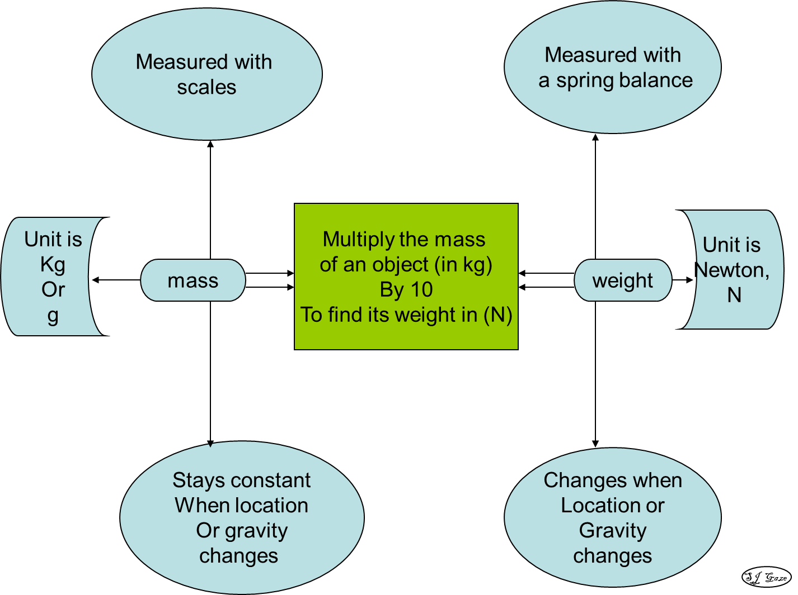
9a/b
Mass and weight

Slide 29
10a
Extra for experts
The Earth is the source of a gravitational field
The mass of the Earth creates an acceleration of 10 ms⁻² for objects falling towards it. Regardless of the size of the object, they all fall with the same acceleration - only the shape, which causes changes in air resistance, causes some objects to experience more opposing force and accelerate slower.
To calculate our weight, which is a force on an object in a gravitational field, we multiply our mass by the gravitational acceleration of Earth (10 ms-²)
Force = mass x acceleration
Weight = mass x gravity
F=mg
g = gravitational acceleration (10ms⁻²)
F= force (N)
m = mass (kg)

Slide 30
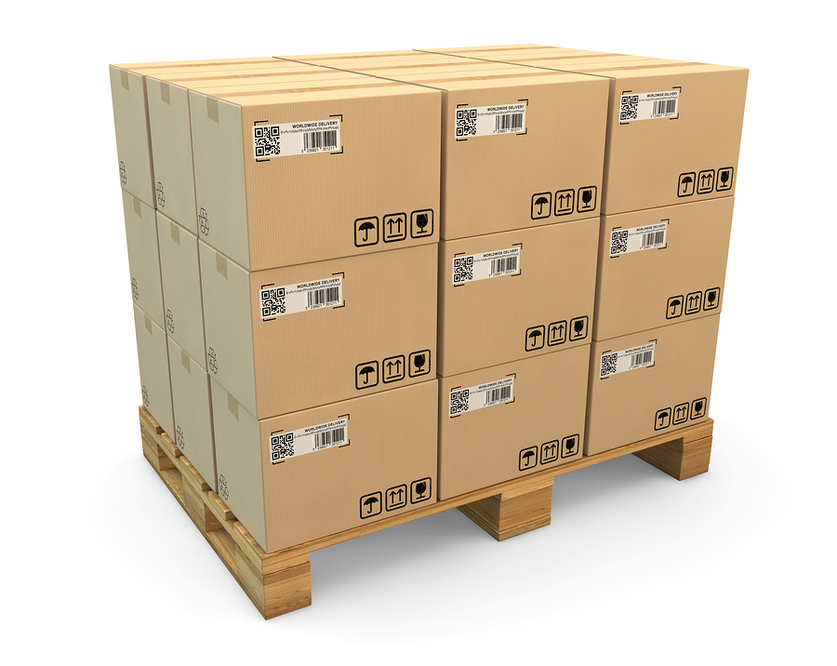
10b
Mass and Weight - Calculations
Q1: A box in a warehouse has a mass of 2 500 kg. assuming g=10ms⁻²
Explain the difference between weight and mass.
(b) Calculate the weight of the box.
Weight is the downward force due to gravity that an object experiences, while mass is a measure of the amount of matter that an object has.
F_{weight/gravity} = mg
= 2 500 × 10 = 25 000 N

Slide 31
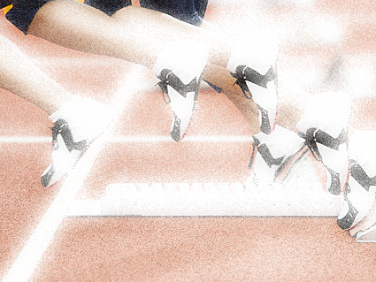
12a
The different types of motion
Objects that move from one point of space to another over time are said to have motion. Examples include a tortoise slowly moving across the ground or a bullet moving fast after it has been fired from a gun. Objects that remain at the same point of space over a period of time are called stationary. Examples include a person sitting still on a chair or a parked car.

Slide 32
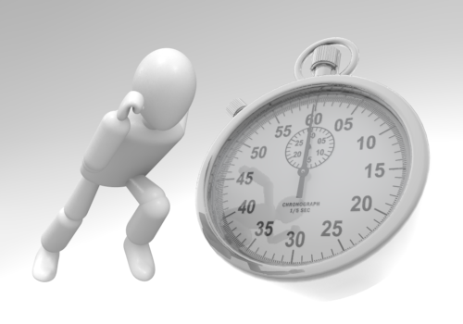
1b
12a
Measuring Motion in Science
Quantity | Unit | Symbol | Equipment used
Distance | Kilometre | km | odometer
 | Metre | m | Metre ruler
 | millimetre | mm | Hand ruler
Time | Hour | hr | clock
 | minute | min | watch
 | second | s | Stop watch

Slide 33
12a
Converting measurements
Prefix Scale
Kilo = 1000
Centi = 1/100th
Milli = 1/1000th
So 1 kilometre = 1000 metres
1 metre contains 100 centimetres
1 metre contains 1000 millimetres
Quantities are often measured in different scales depending upon what is most appropriate for the original size. In Science (and Mathematics) we use common prefixes to indicate the scale used.
We sometimes want to convert scales from one to another to compare data or to place the measurements into equations.
To convert from metres to kilometres divide by 1000
To convert from kilometres to metres multiply by 1000
Time is measured in “imperial units” 1 hour has 60 minutes and 1 minute has 60 seconds therefore 1 hour has 3600 seconds
NOTE: m/s to km/h multipy by 3.6
km/h to m/s divide by 3.6

Slide 34
Errors may occur in measurements may be reduced by taking the average of a number of readings
1b
Extra for experts
When collecting and measuring data in investigations, such as that for calculating speed, errors can occur. This may be due to the measuring instrument and the way it is used. Data can also be recorded incorrectly.
Repeating the investigation a number of times and averaging out the measurements can help reduce random errors. This value is called the mean.
Distance walked in 1 minute
The mean is the most common measure of average.
To calculate the mean add the numbers together and divide the total by the amount of numbers:
Mean = sum of numbers ÷ amount of numbers
Trial 1
Trial 2
Trial 3
Distance (m)
113 121 119
Mean = (113 + 121 + 119 ) ÷ 3
= 117.7 m

Slide 35
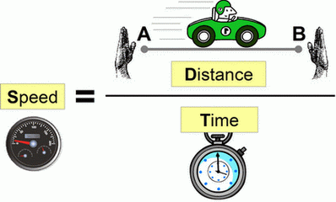
12a
Speed is a measure of motion
Speed is a measure of the distance travelled over the time taken. The more distance covered by an object during a given time, the faster the speed it is moving.
Constant speed occurs when the object travels the same amount of distance at each even time period. When we travel on an object moving at a constant speed we do not feel movement for example travelling in an airplane .
Only when we observe other objects
moving at a different speed to us do
we notice that we are moving.
v=d/t
v = velocity (ms⁻¹)
d = distance (m)
t = time (s)
NOTE: in this unit we also use the symbol V to stand for speed

Slide 36
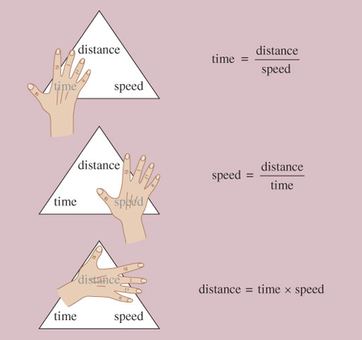
12b
The relationships between distance, time and speed
Triangles can be used to calculate speed, distance or time.
Cover the part of the triangle you wish to calculate and multiply or divide the remaining two values.
The unit for speed depends upon the units for time and distance but the most common unit in the lab is metres per second (ms⁻¹)

Slide 37
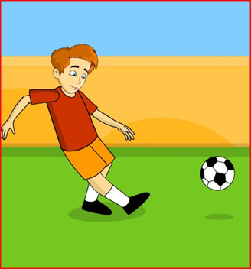
12b
Speed calculations
A football is kicked and during the first 2s it travels 36m. What speed is it going during this time?
v=d/t
v=36m/2s
v=18ms⁻¹
v=d/t
v = velocity (ms⁻¹)
d = distance (m)
t = time (s)

Slide 38
12b
Extra for experts
Speed and Velocity
Velocity measures the speed of an object and the direction it travels. Two objects can have the same speed but different velocities if they are not travelling the same direction. An object can have a constant speed but its velocity can change if it does not travel in a straight line.
This car has a change in velocity because it is traveling around a corner even though it has constant speed.

Slide 39
14a
Acceleration is a change in velocity
Objects that have a change in velocity are said to have acceleration.
An increase in velocity or a decrease in velocity (deceleration) are both types of acceleration.
A change in direction while travelling a constant speed is also acceleration. We notice when we are travelling on an object that is accelerating by experiencing a change in gravity or G-force.

Slide 40
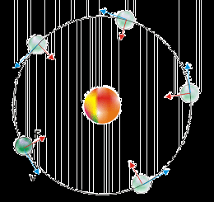
14a
Extra for experts
The Earth accelerates around the Sun
The Earth travels at a constant average speed around the Sun (the speed varies slightly due to the elliptical path) and yet it is accelerating. This is because the direction that the Earth is travelling is constantly changing as it moves around the sun. The gravity force from the sun acts on the Earth and causes a change in velocity or acceleration. The Earth’s speed is fast enough so that it does not spiral into the Sun but not so fast that it continues in a curved line away from the Sun.
Satellites including the Moon also accelerate around the Earth. If the Speed of a satellites falls beyond a set limit then it will fall to the Earth.

Slide 41
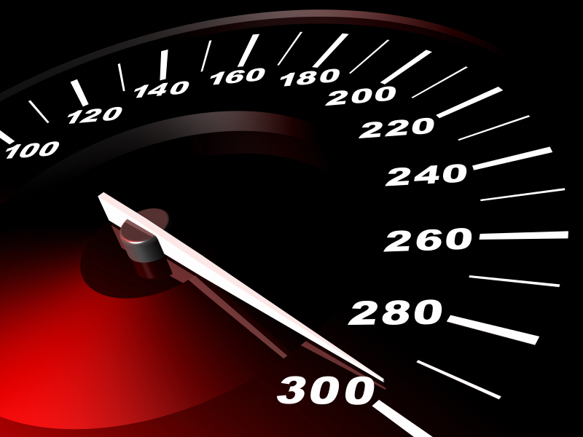
14b
acceleration
acceleration = change of velocity
change in time taken
The units for Acceleration depend on what velocity and time are measured in.
If time is measured in seconds (s) and velocity is measured in metres per second (ms⁻¹) then the units for acceleration will be metres per second per second (ms⁻²)
a_{ave}=∆v/∆t
a = acceleration (ms⁻²)
v = velocity (ms⁻¹)
t = time (s)

Slide 42
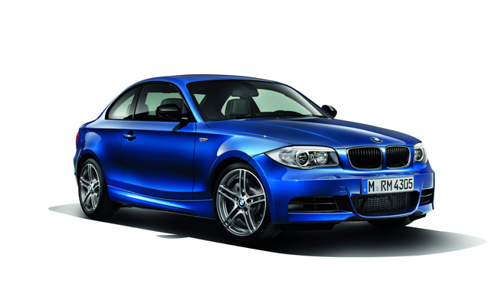
14b
Acceleration Calculations
The BMW 135i is a formidable sports car, accelerating from 0kmhr⁻¹ to 97kmhr⁻¹ in 4.6 seconds. What is the acceleration of this car in ms⁻²?
97kmhr⁻¹ /3.6 = 26.9ms⁻¹
a_{ave}=∆v/∆t
a_{ave}=26.9ms⁻¹/4.6s
a_{ave}=∆v/∆t
a_{ave}=5.9ms⁻²
REMEMBER: m/s to km/h multipy by 3.6
km/h to m/s divide by 3.6
a_{ave}=∆v/∆t
a = acceleration (ms⁻²)
v = velocity (ms⁻¹)
t = time (s)

Slide 43
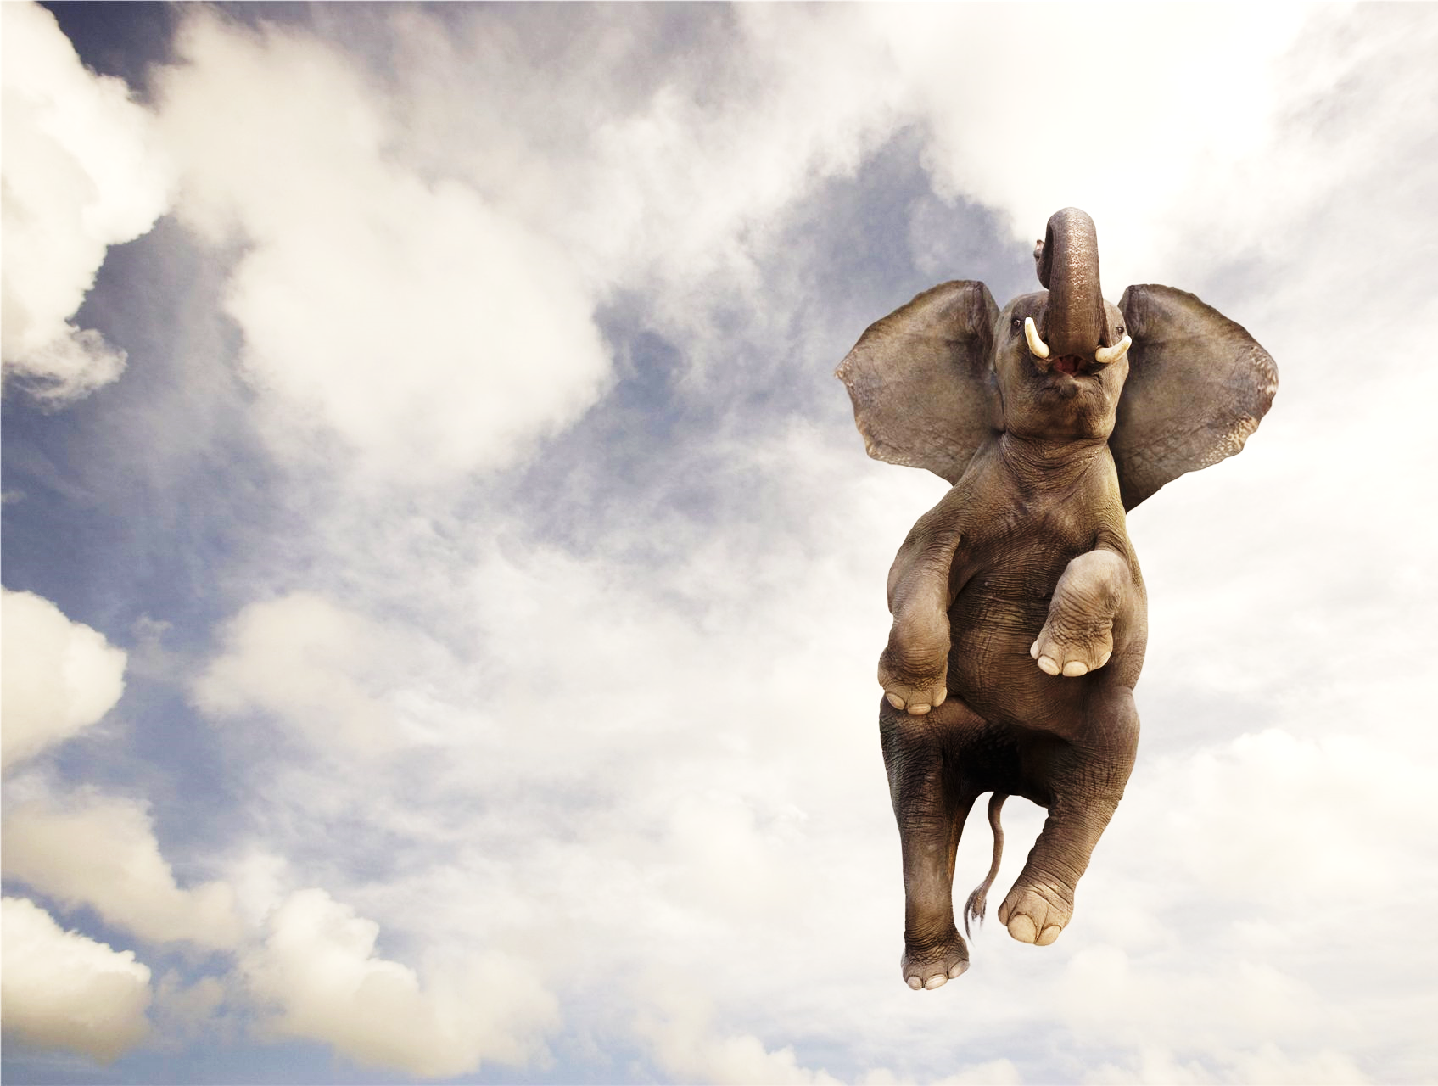
16a
Force, mass and acceleration
The Force experienced by an object can be calculated by multiplying the mass of the object by its acceleration.
Force = Mass x Acceleration
If more force is applied to an object then it will accelerate faster
F=ma
a = acceleration (ms⁻²)
F = force (N)
m = mass (kg)

Slide 44
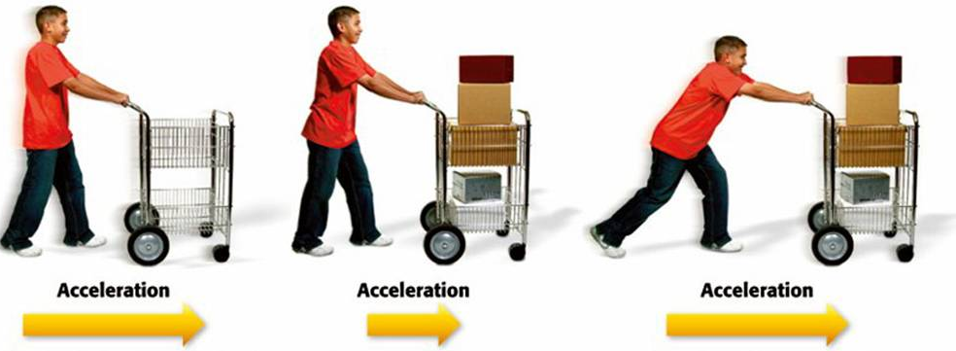
Acceleration of a body depends both on its mass and on the size of the unbalanced force acting on it
16a
Force = Mass x Acceleration
If the same amount of force is applied to two similar objects that have different mass then then smaller object will accelerate faster.

Slide 45
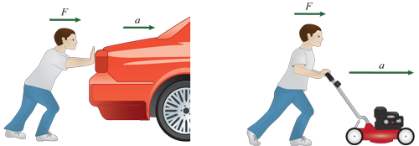
16a
F = ma calculations
Ben is able to push both the car and the lawn mower so they accelerate at 0.5ms⁻². The mass of the car is 950kg and the mass of the lawn mower is 10kg. What is the force required to accelerate the car compared to the lawn mower?
Car lawn mower
F=ma F=ma
F=950kg x 0.5ms⁻² F=10kg x 0.5ms⁻²
F= 475N F= 5N
F=ma
a = acceleration (ms⁻²)
F = force (N)
m = mass (kg)

Slide 46
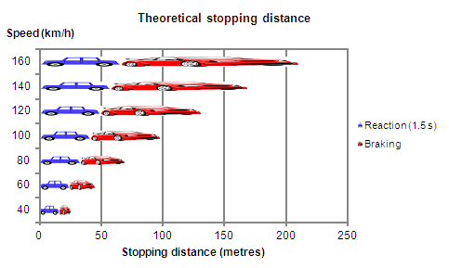
Extra for experts
Factors effecting stopping distance
The Stopping distance of a vehicle is the total distance travelled from the time the driver registers they have to stop to the actual stopping point. The reaction time (1.5seconds) is the average time a driver takes to apply the brakes. The main factor affecting the stopping distance is the speed the vehicle is travelling at before the brakes are applied.

Slide 47
Extra for experts
Factors effecting stopping distance
Other factors that increase stopping distance include a wet road, low tread on a tyre and worn brakes. These factors decrease friction and therefore the kinetic energy of the car (making it move) is transformed into heat energy at a slower rate.

Slide 48
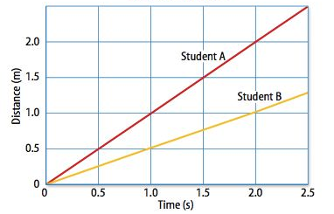
18a
Motion can be represented graphically - Distance vs Time
Distance verses Time graph
Distance (y axis) and time (x axis) data can be plotted on a graph to show patterns and compare speeds.
The steeper line on the left shows student A has a faster speed than student B.
A straight diagonal line indicates constant speed. A straight horizontal line indicates the object is stationary .

Slide 49
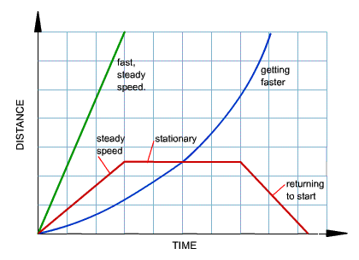
18a
Motion can be represented graphically – Distance vs Time
Distance verses Time graph
A distance time graph can also show acceleration with a curved line (blue) because at each time interval the distance travelled becomes larger and larger.
Changes in speed are also shown with a combination of diagonal and horizontal lines (red).

Slide 50
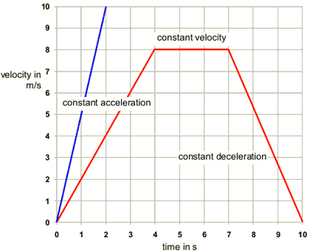
18c
Motion can be represented graphically – Velocity vs Time
Velocity verses Time graph
A velocity time graph can show acceleration with a diagonal line.
Constant velocity is shown with a straight horizontal line.
Values can be taken from the graphs and used to calculate acceleration.
The blue line shows a velocity of 10ms⁻¹ travelled in 2 seconds.
The acceleration would therefore be:
a = ∆v/ t
= 10/2
a = 5ms⁻²

Slide 51
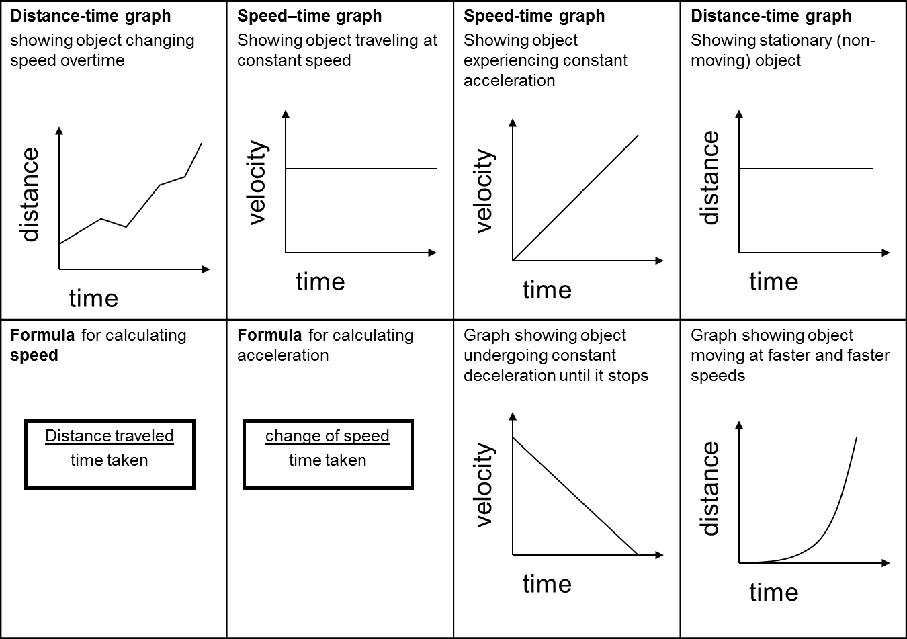
18c
Graphs may be used to display motion/time relationships

Slide 52
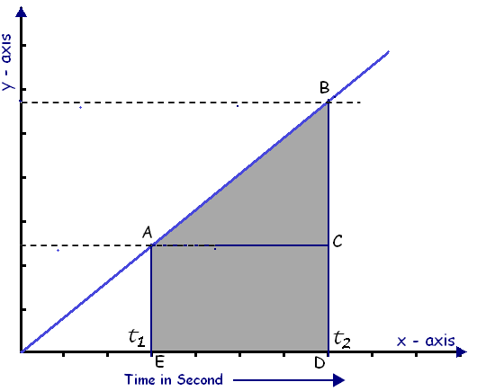
18d
Velocity (speed) can be calculated from a Distance-time graph
Distance verses Time graph
A distance - time graph can be used to calculate speed (velocity). The co-ordinates of a straight line in the graph are taken (for example from A to B) by projecting back to the x and y axis.
To calculate the value for time find the difference between t1 and t2 by subtracting the smallest value from the largest value. This will be your time.
Repeat to find distance on the y axis. This will be your distance.
Place both values into your formula to calculate speed (velocity)
v = d/ t
Distance (metres)
Time (seconds)

Slide 53
18d
Distance / time graph – Describing motion
Q1: The cyclists journey was plotted on the distance / time graph below. Describe the motion of the cyclist in each of sections A,B,C and D
Section A: Increasing speed / accelerating
Section B: Constant speed
Section C: Decreasing speed, decelerating
Section D: Stopped / stationary
Q2: Calculate the cyclists speed during section B.
v = d / t
= 10 / 5
= 2 ms⁻¹
Q3: what is the total distance covered from 5 to 15seconds?
19m – 5m
= 14m in distance covered
Don’t forget units

Slide 54
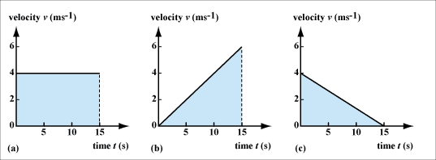
18d
Acceleration can be calculated from a speed-time graph
Use the start and finish points of the time and the velocity to work out the total change.
If the time starts from 0 use that as your start point.
a_{ave}=∆v/∆t
a = acceleration (ms⁻²)
v = velocity (ms⁻¹)
t = time (s)
Remember: that ∆ means change in.
The line must be straight in order to calculate acceleration

Slide 55
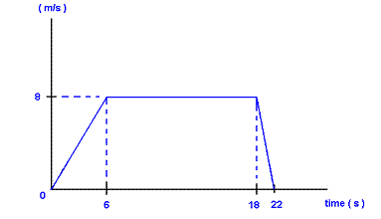
Distances travelled can be calculated from the area under a velocity-time graph
Extra for experts
The total distance can be calculated from a velocity time graph by calculating the area under the graph.
Work out the area of each triangle (1/2 height x width) and add to the area of the rectangle (height x width)
For example:
d = (½ 8 x 6) + (1/2 8 x 4) + (8 x 12)
d = 24 + 16 + 96
d = 136seconds
Velocity verses Time graph
velocity

