Slide 1
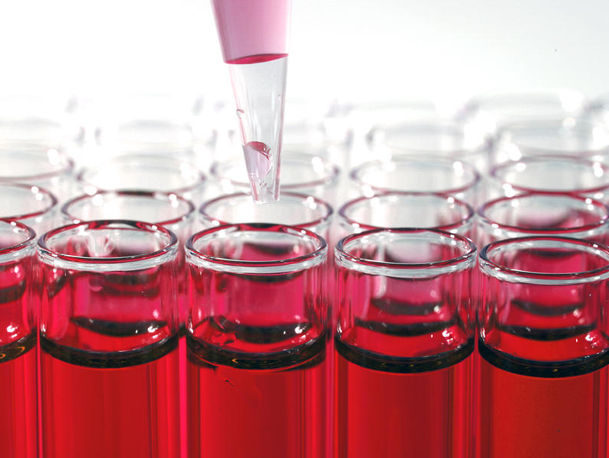
2018
Version
Introduction to Science
Junior Science

Slide 2
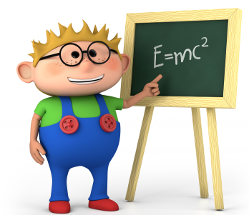
What is Science?
Science is both a collection of knowledge and the process for building that knowledge.
Science asks questions about the natural world and looks for natural explanations.
Science works only with testable ideas
and uses observations to make
conclusions.
Theories are developed based on the evidence scientists collect.
Moral judgments, decisions about how to use science discoveries, and conclusions about the supernatural are outside the area of science

Slide 3
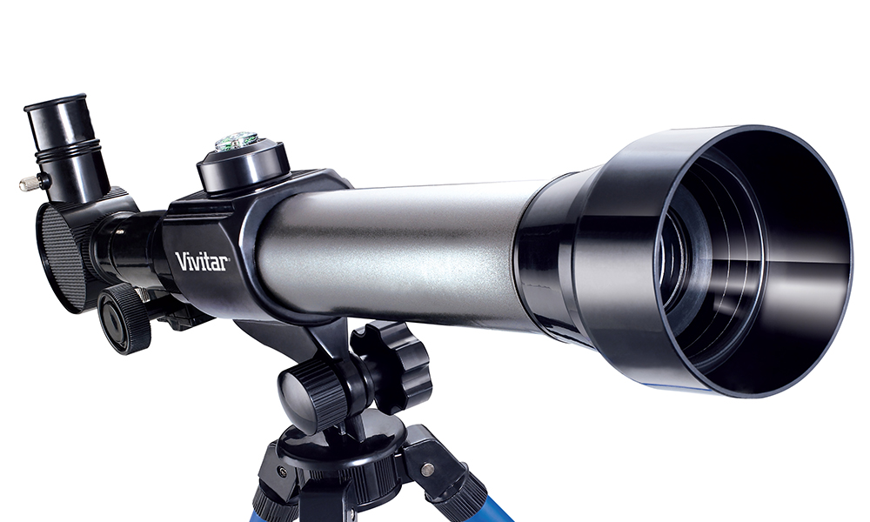
Observation in Science
To observe means to record or make note of something we have experienced. We also think of observations as watching something, but in Science, observations may be made with any of our senses (by seeing, feeling, hearing, tasting, or smelling) or even using tools to make observations that are then changed into something our senses detect.
Observation tools include thermometers, microscopes, telescopes, radars, computer sensors and spaces probes. Sometimes these tools are able to observe and collect data that humans cannot directly sense. By using these tools scientists can often make many more observations and much more precisely than our senses are able to.

Slide 4
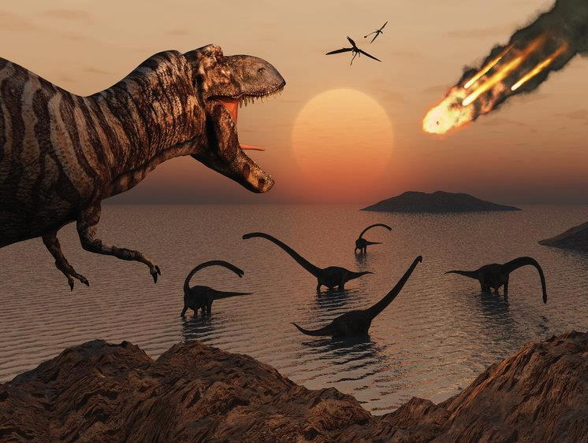
Observation or Inference?
Inferences are an explanation for an observation.
Inferences are based on prior knowledge and experiences.
As new observations are made an inference can often be changed or modified.
Observations are known by actually seeing, hearing or any other method of observing.
Inferences are guesses that best fit the set of observations made.
Scientists use inference to state that that a large meteorite most likely contributed to Dinosaur extinction due to the observations of a large crater and sudden lack of dinosaur fossils after 65million years ago.

Slide 5
I have a Theory
Many people understand the word theory means a guess about what something
is or how it works but in Science the word means something else.
A Scientific theory is the best explanation available currently for how the world works. A theory has been thoroughly tested and is supported by large amounts of evidence.
Create or modify the theory
Use the theory to make a prediction
Theory
Observation
Prediction
Perform the investigation
investigation
Design an investigation to test the prediction
Scientific theories must also be flexible and be modified or changed so it is able to explain any tested observations that do not fit the original version.

Slide 6
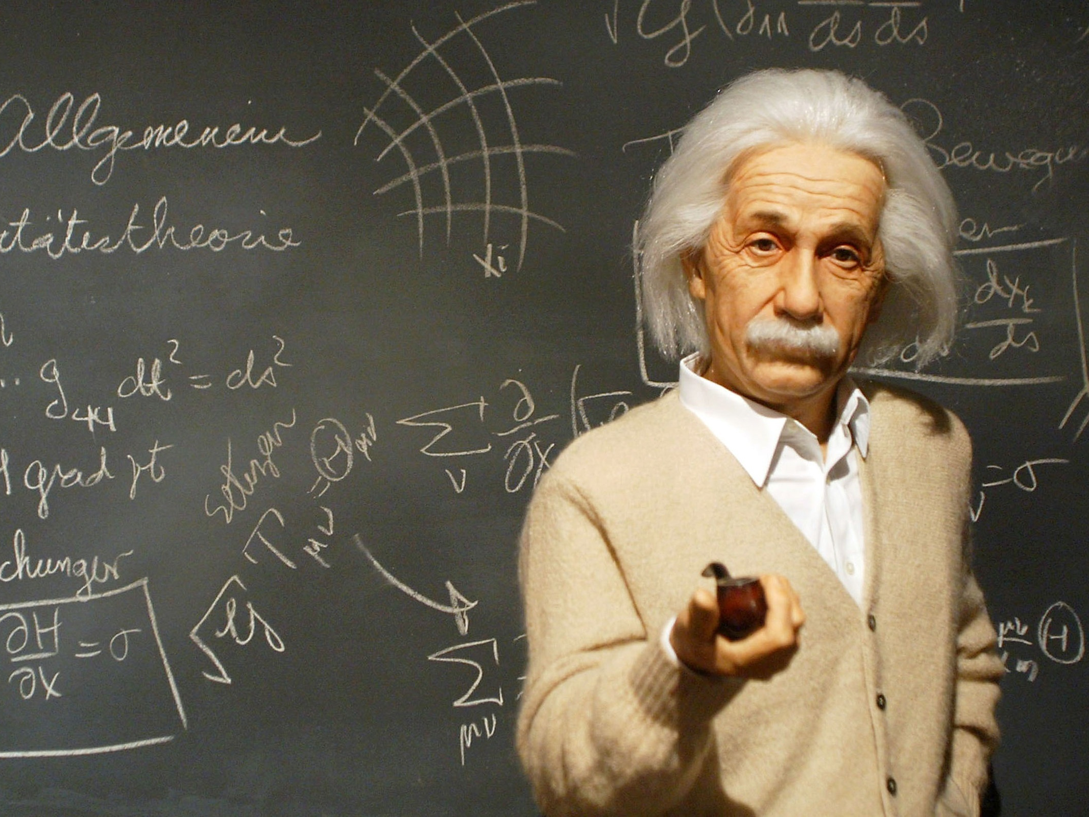
Standing on the shoulders of Giants
Science ideas are often the result of many scientists contributing observations and evidence which build on previous knowledge.
Before Scientists begin testing their predictions they need to research what has already been found out in the past so they know what to look for.
Scientists such as Isaac Newton, Albert Einstein and Sir Ernest Rutherford all built on knowledge from others that came before them.

Slide 7
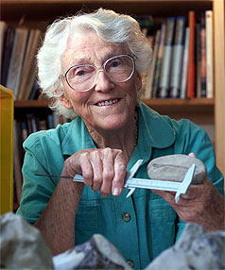
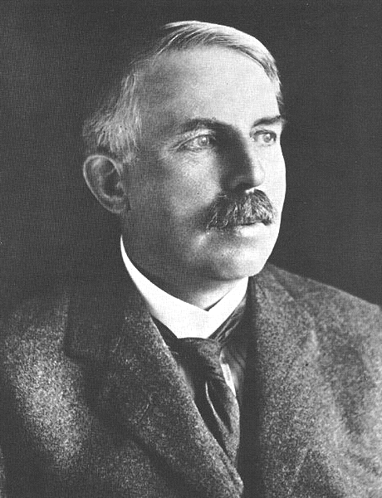
Who wants to be a Scientist?
The New Zealander Joan Wiffen was well known as a tireless hunter of New Zealand Dinosaur bones – disproving the long established idea that no dinosaurs made it across to NZ before it broke away from Gondwana or if they did then New Zealand’s active geological past destroyed any evidence of dinosaur fossils. Although she was not formally trained as a scientist, she self taught herself the correct ways of working scientifically.
The New Zealand Scientist Sir Ernest Rutherford completed his secondary schooling and three university degrees here at home then went on to continue his Scientific education at other universities overseas including Cambridge University, England. He was most famously known for inferring the structure of the atom from his testing and tireless observations. Sir Rutherford collaborated with many other scientists and freely shared his evidence with others.

Slide 8
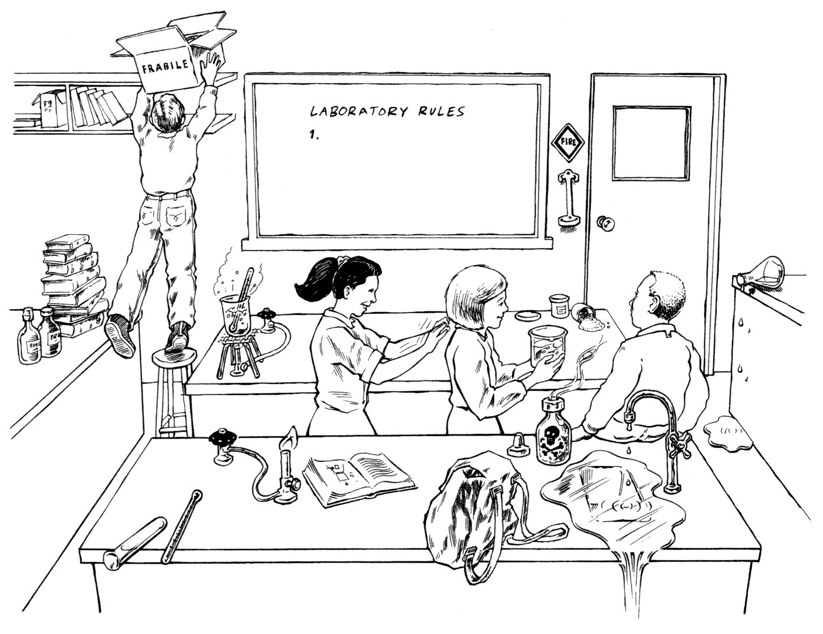
Spot the Dangers in the lab

Slide 9
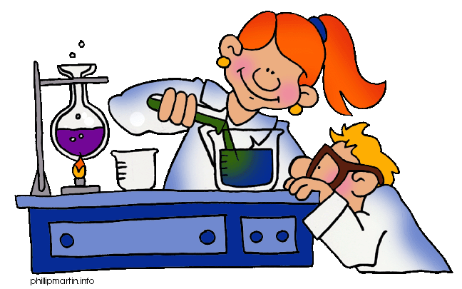
Laboratory Rules
A School Science Laboratory can be a fun place that allows you to investigate and observe Science taking place. It can also be a dangerous place if rules are not followed. To protect yourself and the classroom from harm we need to follow School Lab Rules carefully each time we are in the class or taking part in a practical.
Don’t smell or taste chemicals.
Place bags under your desks.
Wear safety equipment if asked.
Tie long hair back during practicals.
No running in class.
Tell the teacher if you break equipment.
Clean up your work area after practicals.
No eating in the class.
………………….
………………...

Slide 10
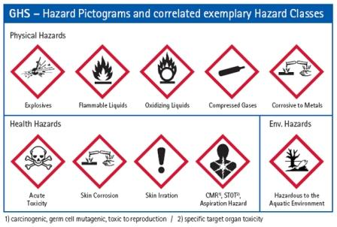
Laboratory safety symbols
Easy to recognise safety Hazchem symbols are often used in Labs and on labels of chemicals when special care is required. A chemical may be poisonous or be explosive or burn when it touches skin. Safety symbols and Lab rules are designed to warn and protect you from dangerous situations.

Slide 11
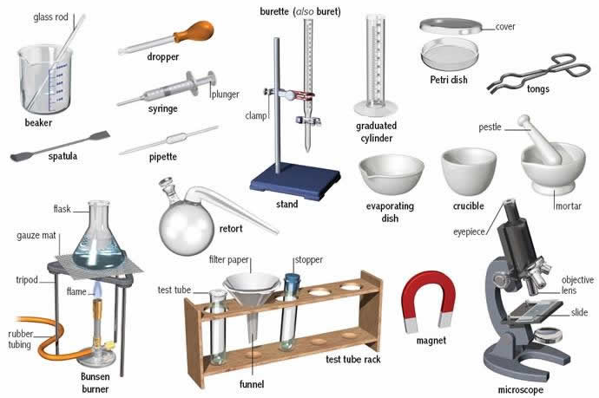
Common Laboratory equipment
Science labs contain equipment that are used to carry out investigations and experiments. This equipment may be quite different from what we have in our homes but it is often designed for specific uses.
The names and uses of the equipment will need to be learnt along with how to use it.

Slide 12
Drawing equipment in Science
In the science lab we use special equipment. Often we have to draw the equipment. We use diagrams to show the equipment, which saves us time drawing. The scientific diagrams are recognised world wide.

Slide 13
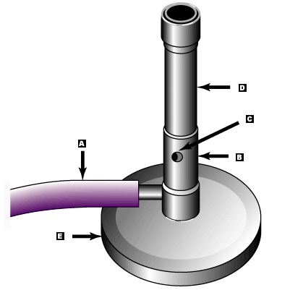
Draw and label the Bunsen Burner
Part of the Bunsen Burner | Function
A. Gas hose | To allow gas to enter the burner
B. Collar | To control the amount of air entering the burner
c. Air Hole | To allow air to enter the burner
D. Barrel | To raise the flame to a suitable height for heating and burning
E. Base | To support the burner and make it more stable

Slide 14
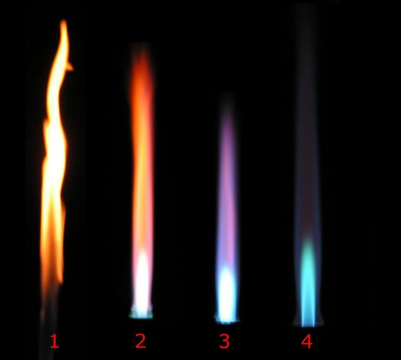
The Bunsen Burner Flame
When using the Bunsen Burner to heat boiling tubes etc place it at the hottest place at the top of the bright blue flame.
The Bunsen Burner burns gas with oxygen in the air to make a hot flame used in the laboratory. When the air hole is closed (1) the flame is large and orange. This flame only partly allows oxygen to burn with the gas so is cooler and creates soot. As the air hole is opened more (2-4) the flame becomes bluer and hotter. The best flame to use is (4) with the air hole mostly open.

Slide 15
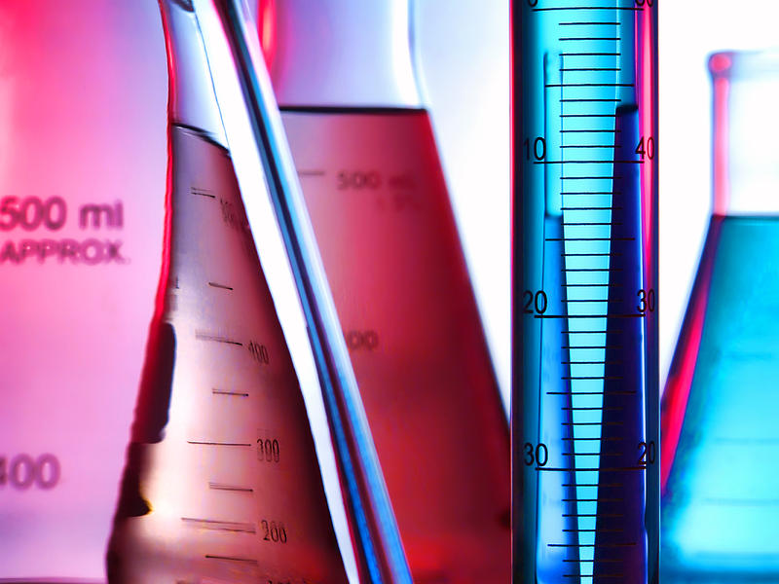
Measurements in Science
The process of science involves observation, investigation and testing. Scientific observations can be made directly with our own senses or may be made indirectly through the use of equipment to collect data. Being able to take accurate measurements is important.
The units and type of equipment used depends on whether you are measuring length, volume, temperature or mass.

Slide 16
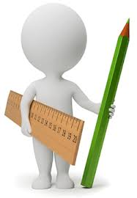
Measuring in Science
Quantity | Unit | Symbol | Equipment used
Volume | litre | L | flask
 | millilitre | mL | measuring cylinder
Temperature | Celsius | °C | thermometer
Mass | kilograms | Kg | Scales
 | grams | g | Scales
Length | Metres | m | Metre ruler
 | millimetres | mm | Hand ruler
Note: Weight is the result of force (gravity) acting on mass and is measured in Newton’s using a spring balance. Weight and Mass are often confused.

Slide 17
Converting measurements
Quantities are often measured in different scales depending upon what is most appropriate for the original size. In Science (and Mathematics) we use common prefixes to indicate the scale used.
We sometimes want to convert scales from one to another to compare data or to place the measurements into equations.
Prefix Scale
Kilo = 1000
Centi = 1/100th
Milli = 1/1000th
So 1 kilometre = 1000 metres
1 metre contains 100 centimetres
1 metre contains 1000 millimetres
To convert from grams to kilograms divide by 1000
(or metres to kilometres and millilitres to litres)
To convert from kilograms to grams multiply by 1000
(or kilometres to metres and litres to millilitres)

Slide 18
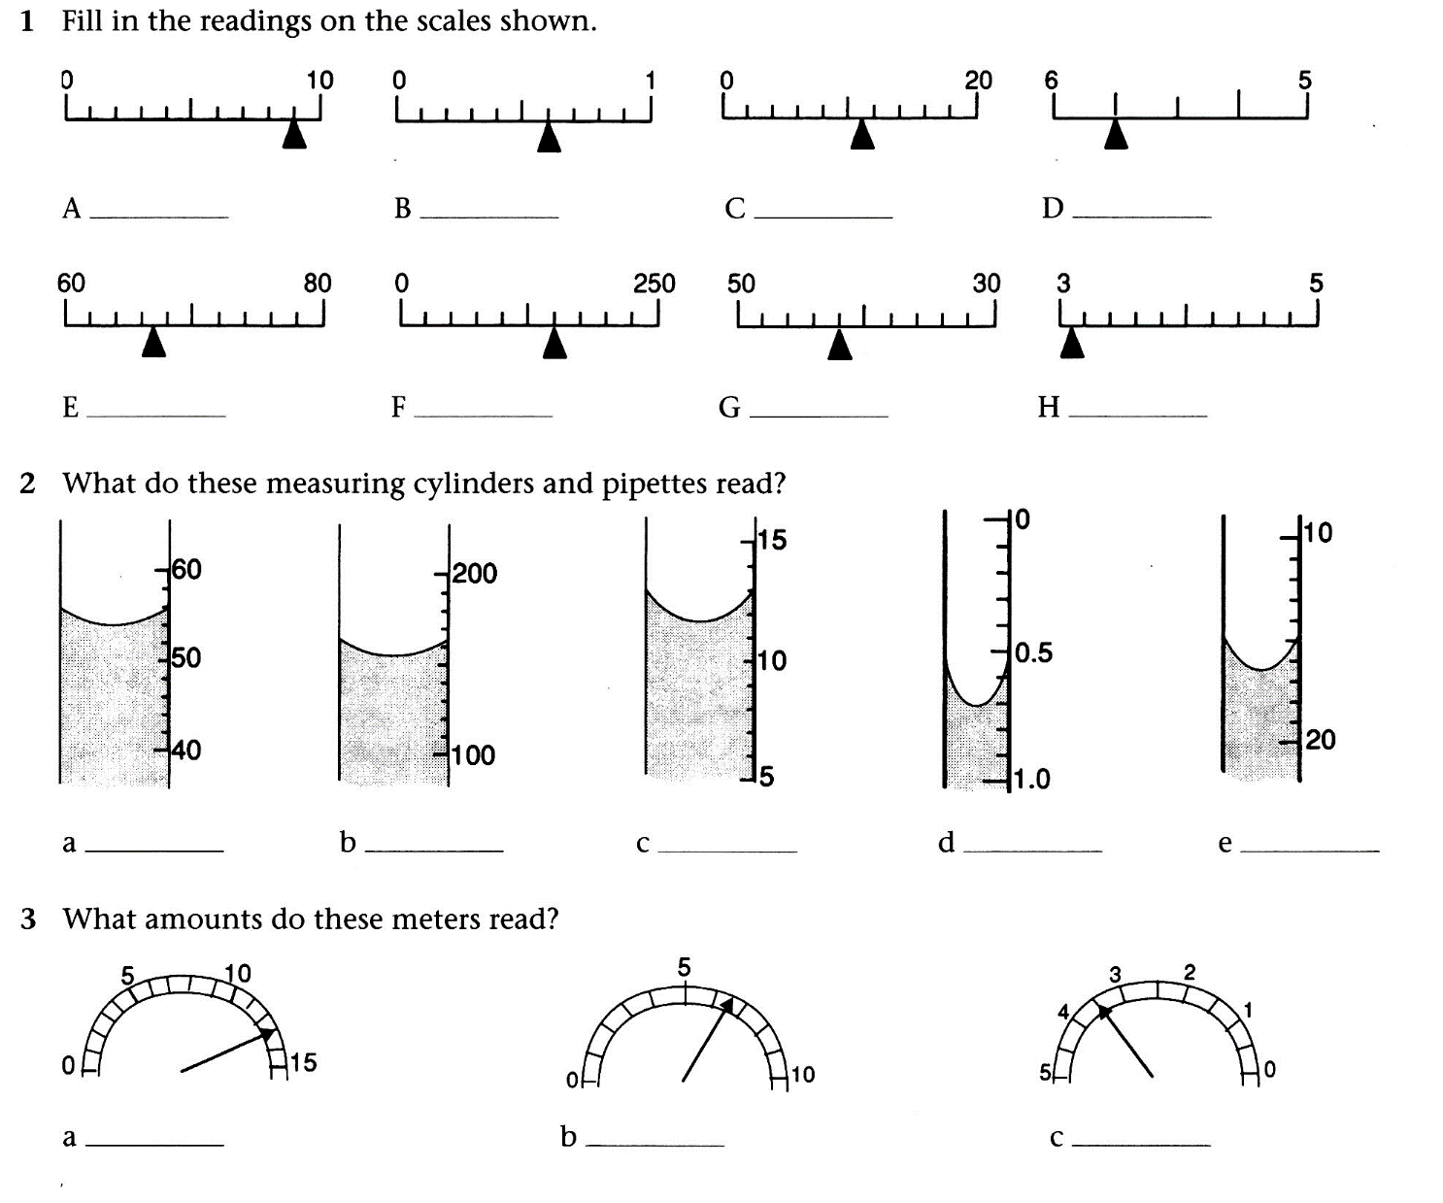
Measurements in Science
As well as recording the number what must we also record?
Where do we look from when reading measuring cylinders and pipettes?
Why is the surface of the liquid not flat?

Slide 19
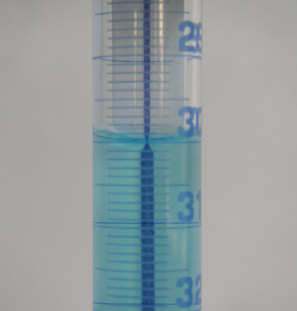
Measuring volume
Water is a liquid that “sticks together”. In a narrow tube or measuring cylinder the water surface tends to curve up the sides. This is called a meniscus curve. A measurement reading is to be taken from the bottom of the meniscus curve because only a very small volume of liquid is actually around the side.

Slide 20
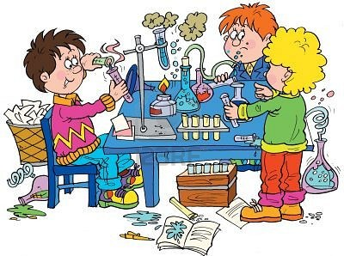
An investigation is used to collect data for evidence
Scientists ask questions to help work out what is occurring in the natural world around them. They then create testable ideas which they think may answer the question.
Scientists test their ideas by predicting what they would expect to observe if their idea were true (called a hypothesis) and then seeing if that prediction is correct.
Scientists look for patterns in their observations and data.
Analysis of data usually involves putting data into a more easily accessible format (graphs, tables, or by using statistical calculations).
The process of creating a question, developing a hypothesis and carrying out a test to collect data which is then analysed to see if their hypothesis is proved or disproved is called a scientific investigation.

Slide 21
A 'fair test' is one in which you only change one thing (variable).
Variables are all the things that could change during an investigation.
In a bouncing ball investigation, where the height a ball bounces to is measured after it is dropped at different heights, many things could affect the results from one experiment to the next such as using a different ball, a different drop height or a different surface which the ball is dropped on.
You should only change one thing at a time in your investigation. This called the independent variable.(The height the ball is dropped at)
During your investigation you should be able to measure something changing which is called the dependent variable. (How high the ball bounces after being dropped)
The factors you keep the same in your experiments (fair test) are called control variables

Slide 22
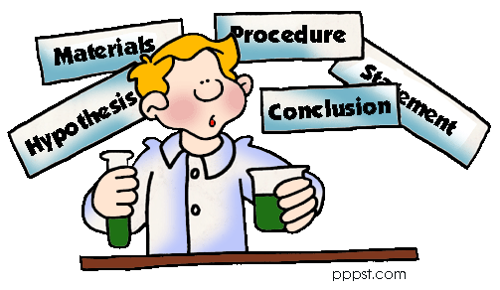
The typical way that scientists work is called the Scientific method.
Scientific investigations are typically written up in a standard way under the following headings:
Aim (focus question): what you are trying to find out or prove by doing the investigation
Hypothesis: what you think will occur when an investigation is carried out
Equipment (or materials): the things that you need to do the investigation
Method : A simple, clear statement of what you will do – and can be repeated by another person
Results : data, tables and graphs collected from investigation
Conclusion : what your results tell you – linked back to the aim and hypothesis
Discussion : Science ideas to explain your results, possible improvements to the investigation, how you managed to control the other variables.

Slide 23
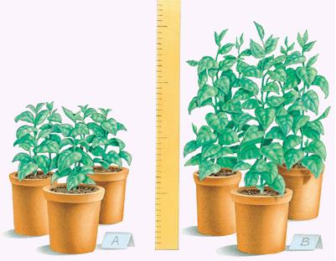
Focus Question / Aim
Your Aim or focus question must include both variables.
For example: If I change (independent variable) how will it affect (dependant variable)
Such as: If I change the temperature of the water (independent) how will it affect how much sugar I can dissolve into the water (dependant)
Independent variable – amount of light a plant receives
Dependant variable - height that plant grows
Focus Question: How does the amount of light a plant receives affect the height it grows to

Slide 24
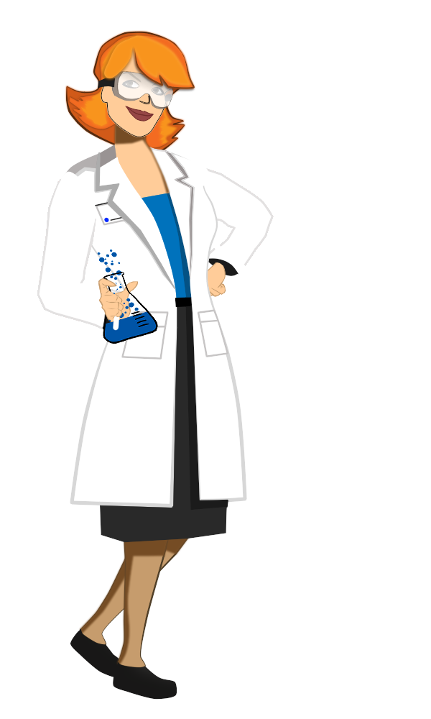
Writing the Method
A method must be written so that an investigation is repeatable by another person.
In order for results from an investigation to be reliable an investigation must be able to be repeated exactly the same way following the method. The results gained from each repeat must show the same pattern each time for the conclusion to be valid (or if not an explanation or fault in following the method given)

Slide 25
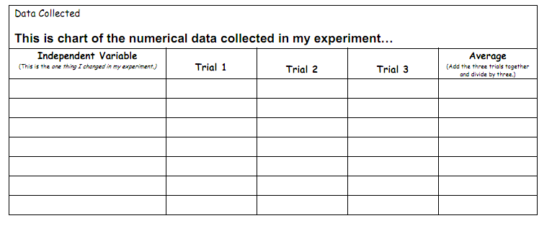
Collecting Data
Data that is collected from an investigation can be analysed (in order to explain and interpret it) easier if placed into a clearly labelled and laid out data table. The left column is the data of the variable (factor) that you are changing. The right hand side columns are for the data of the variables you are measuring.
The table must have:
A heading linked to the aim
Labelled quantities, units and symbols
Values (often numerical) of data
collected
Data tables can also contain processed data such as results from multiple trials that have been averaged to give a more reliable value.

Slide 26
Processing Data - Averaging
When collecting and measuring data in investigations, such as that for calculating speed, errors can occur. This may be due to the measuring instrument and the way it is used. Data can also be recorded incorrectly.
Repeating the investigation a number of times and averaging out the measurements can help reduce random errors and increase reliability. This value is called the mean.
Distance walked in 1 minute
The mean is the most common measure of average.
To calculate the mean add the numbers together and divide the total by the amount of numbers:
Mean = sum of numbers ÷ amount of numbers
Trial 1
Trial 2
Trial 3
Distance (m)
113 121 119
Mean = (113 + 121 + 119 ) ÷ 3
= 117.7 m

Slide 27
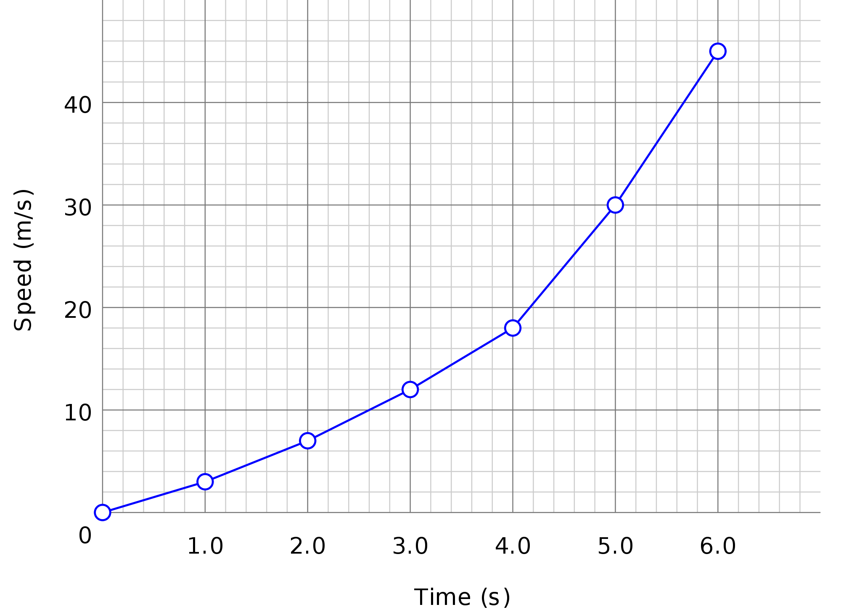
Drawing a line Graph
Graphs are used to show patterns in data more easily than a data table. Often processed (averaged) data is used.
A well drawn line graph must have the following features:
A suitable heading
Evenly spaced numbered axes
Labels with units
Correctly plotted line.
Use the acronym SALT when plotting graphs:
Scales Axes Labelling Title
Speed of a toy car over 6 seconds

Slide 28
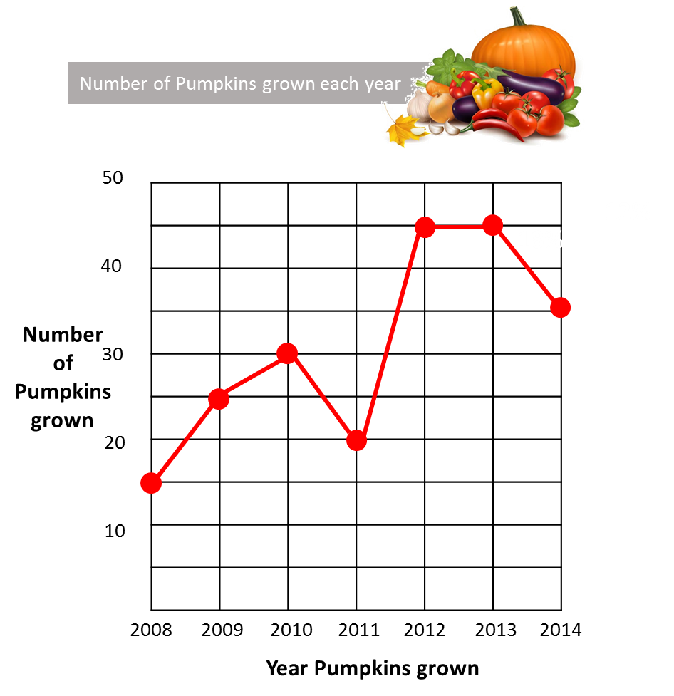
Looking for patterns in results - Graphs
Line Graph
A line graph is used to show changes in a variable. It could graph discrete variables - such as the number of pumpkins each year: 1 or 2 etc but not 2.5. It can also graph continuous variables – such as the weight of pumpkins grown: any value between a minimum and maximum.
More than one set of data can be graphed to make comparisons.

Slide 29
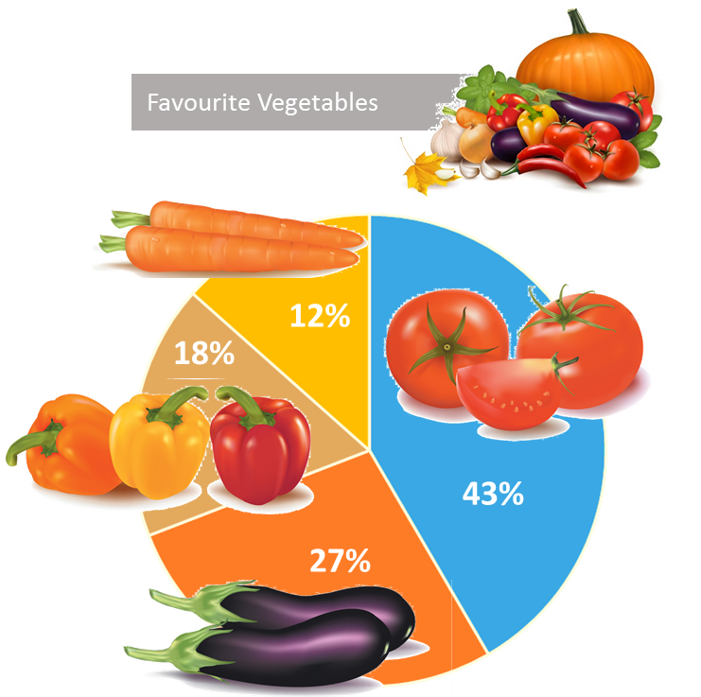
Looking for patterns in results - Graphs
Pie Graph or Chart
A circle that shows parts of a whole. Each segment represents a percentage adding up to 100%.
The pie chart is a good visual tool when you want to show proportions of variables in comparison to each other.

Slide 30
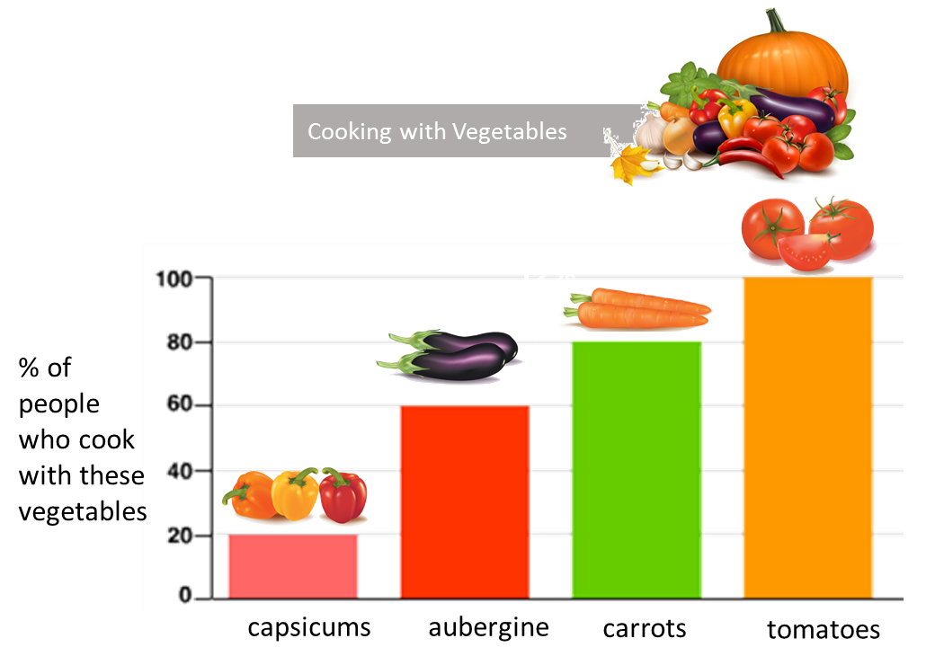
Looking for patterns in results - Graphs
Bar Graph
A bar graph is used to show changes in a discrete variable. The columns do not touch each other. The discrete variables mean they can be in one group (or have one value) or another but not be anywhere in between – as in half tomato and half carrot.

Slide 31
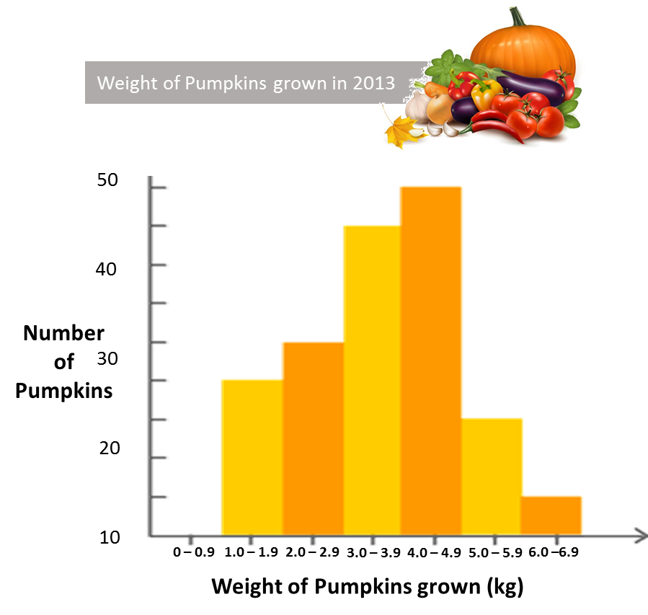
Looking for patterns in results - Graphs
Histogram
Has columns that touch each other, shows comparisons between continuous data.
The weight of the pumpkin can be any value between zero and possible maximum.
The histogram shows the frequency of data. The most frequent weight of pumpkins is between 4.0 and 4.9 kg

Slide 32
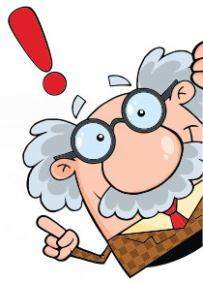
Writing a conclusion
A conclusion looks for patterns in collected data from an investigation and used to answer the original Aim (or to agree or disagree with the hypothesis)
Both the variable that is changed (independent) and the variable that is measured (dependant) must be included in the conclusion statement.
The data is used as evidence in the conclusion.

Slide 33
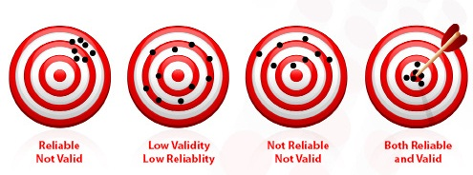
Reliability and Validity
Reliability means that that any results produced in a scientific investigation must be more than a one-off finding and be repeatable.
Other scientists must be able to perform exactly the same investigation using the same method and generate the same results.
Validity is the extent to which a investigation measures what it is supposed to measure. In a valid investigation the results gained will be as close to reality as possible if only one variable is changed and all other variables are kept the same.

