Slide 1
Chemistry Year 9
Atoms and the Periodic Table
Science ideas I need to know | Start of Unit |  |  | End of Unit
 | I know this | I know some of this | I need to learn this | I know this | I know some of this | I need to learn this
Know that all matter is made up of tiny particles called atoms
Know that atoms can join together to form molecules
Know Atoms are made up of protons, electrons and neutrons
Know that atoms have equal number of protons and electrons
Know that matter made of only one type of particle (atom) is an element
Know that each different type of element has a different number of protons inside its atom
Know the name and symbol for the first 20 elements
Know there is a correct way of writing element symbols.
Know that elements are arranged on the periodic table according to their atomic number.
Know that the more protons an atom has the further down the table it is.
Know that Groups of elements on the periodic table have common physical and chemical properties
Know that groups are numbered vertical columns and periods are horizontal rows
Know that metals are placed on the left hand side and non-metals are placed on the right hand side of the periodic table
Know that the physical properties of substances include: density, ductility, malleability, lustre
Know that the groups of metals and non-metals have different physical properties

Slide 2
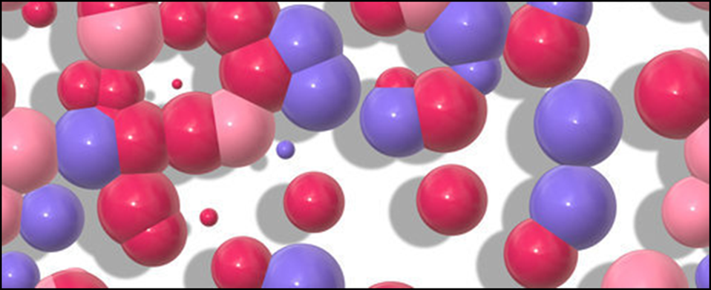
Chemistry Year 9
Particle Reactions
Science ideas I need to know | Start of Unit |  |  | End of Unit
 | I know this | I know some of this | I need to learn this | I know this | I know some of this | I need to learn this
Know that matter exists in different states – solid, liquid and gases
Know that matter can change from one state to another
Know that Particles are arranged and move differently in solids, liquids and gases
Know that the particles of different states have different kinetic energy levels
Know that Solutions form when a solute is dissolved in a solvent
Know that Diffusion occurs because particles mix with and move through another substance
Know the theory of Brownian motion
Know that elements are pure substances that combine to make mixtures & compounds
Know that Mixtures can be easily separated physically using methods such as: decanting, evaporating, filtering, crystallising, magnetism, distillation and chromatography.
Know that there is a link between the physical properties of substances and their uses
Know that some metals are more suitable for certain uses than others because of their physical properties
Know that Reactants (elements or compounds) join together to form new products during chemical reactions
Know that Compounds (reactants) cannot be separated using physical separation techniques

