Slide 1
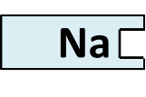
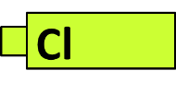
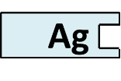
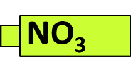
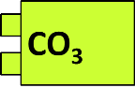
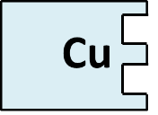
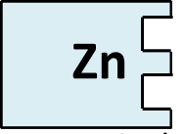
Combination
General equation Metal + Oxygen → Metal Oxide
Word equation Magnesium + Oxygen → Magnesium Oxide
Formula equation 2 Mg + O₂ → 2MgO
Mg
₊
O
₊
Mg
O
2. Precipitation
General equation Cation(1)Anion(1) + Cation(2)Anion(2)→ Cation(1) Anion(2) + Cation(2)Anion(1)
Word equation Sodium Chloride + Silver Nitrate → Sodium Nitrate + Silver Chloride (precipitate)
Formula equation NaCl + AgNO₃ → NaNO₃ + AgCl_{(ppt)}
₊
₊
3. Thermal Decomposition
General equation Metal Carbonate → Metal Oxide + Carbon Dioxide
Word equation Magnesium Carbonate → Magnesium Oxide + Carbon Dioxide
Formula equation MgCO₃ → MgO + CO₂
₊
CO₂
4. Displacement
General equation Metal (1) + Metal(2) salt → Metal (2) + Metal(1) salt
Word equation Zinc + Copper Nitrate → Copper + Zinc Nitrate
Formula equation Zn + Cu(NO₃)₂ → Cu + Zn(NO₃)₂
₊
₊
Zn
Cu

