Slide 1
NCEA Physics 1.1
Linear Relationship Investigation

Slide 2
What is a NCEA Achievement Standard?
When a student achieves a standard, they gain a number of credits. Students must achieve a certain number of credits to gain an NCEA certificate (80 for Level 1)
The standard you will be assessed on is called Physics 1.1 Carry out a practical physics investigation that leads to a linear mathematical relationship, with direction
It will be internally (in Class) assessed as part of a Investigation and will count towards 4 credits for your Level 1 NCEA

Slide 3
What are the main steps required in this Internal Assessment?
AS90935 Carry out a practical physics investigation that leads
to a linear mathematical relationship, with direction
The method
The teacher may provide a suitable aim and an outline of a method. Students are able to gather data in small groups, but it is expected that each student is involved in making measurements. The investigation write up is done individually by each student.
Evidence that an appropriate method has been developed may be presented by either a suitably described method or from evidence that appropriate data has been gathered.
Evidence that the appropriate variables have been changed and measured may be presented in the method or the results table. Students are not required to specifically define which variable is the independent and which one is the dependent but need to clearly identify which variable is changed and which variable is measured.

Slide 4
Gathering data and drawing a graph
Appropriate units need to be stated for each variable. Evidence for this may come from anywhere in the report.
A reasonable number of values is considered to be at least four measurements of different values. A zero value is not normally considered to be one of these measurements. A suitable range is as needed to determine
a linear relationship.
A graph based on the data is considered to be plotted
points with a single best fit straight line, ruled to
represent the trend. It is not appropriate to simply rule
lines to connect each plotted point, or force the best fit
line to go through the origin if that point does not
represent the trend of the plotted points.

Slide 5
Aiming for Merit and Excellence
Interpretation of evidence for Merit
Describing variables that would not affect the results does not contribute evidence.
The linear graph must be a reasonable representation of the plotted points. The equation of the relationship should be stated in terms of the variables being investigated, rather than using y and x, unless these have been defined. y is the variable being measured and x is the variable being changed.
Dependant variable = gradient x independent variable
Interpretation of evidence for Excellence
When describing accuracy improving techniques, the student needs to explain how each technique made measurements more reliable.
Any reasons given, for the limits to either end of the value chosen for the independent variable, or descriptions of how any difficulties were overcome, need to be related to the reliability of measurements rather than limitations of the equipment. For example, stating that the maximum length of the string was chosen to be 1 meter because that’s all that was supplied is not sufficient.

Slide 6
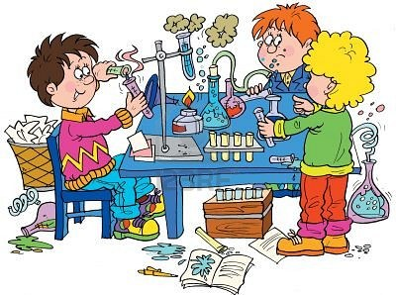
An investigation is used to collect data for evidence
Scientists ask questions to help work out what is occurring in the natural world around them. They then create testable ideas which they think may answer the question.
Scientists test their ideas by predicting what they would expect to observe if their idea were true (called a hypothesis) and then seeing if that prediction is correct.
Scientists look for patterns in their observations and data.
Analysis of data usually involves putting data into a more easily accessible format (graphs, tables, or by using statistical calculations).
The process of creating a question, developing a hypothesis and carrying out a test to collect data which is then analysed to see if their hypothesis is proved or disproved is called a scientific investigation.

Slide 7
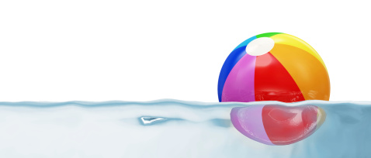
A 'fair test' is one in which you only change one thing (variable).
Variables are all the things that could change during an investigation.
In a bouncing ball investigation, where the height a ball bounces to is measured after it is dropped at different heights, many things could affect the results from one experiment to the next such as using a different ball, a different drop height or a different surface which the ball is dropped on.
You should only change one thing at a time in your investigation. This called the independent variable.(The height the ball is dropped at)
During your investigation you should be able to measure something changing which is called the dependent variable. (How high the ball bounces after being dropped)
The factors you keep the same in your experiments (fair test) are called control variables

Slide 8
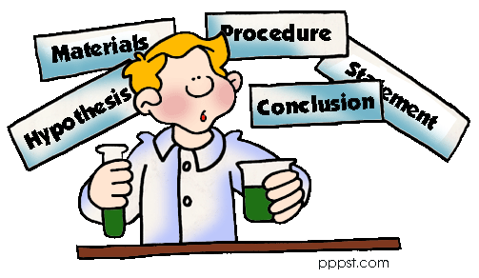
The typical way that scientists work is called the Scientific method.
Scientific investigations are typically written up in a standard way under the following headings:
Aim (focus question): what you are trying to find out or prove by doing the investigation
Hypothesis: what you think will occur when an investigation is carried out
Equipment (or materials): the things that you need to do the investigation
Method : A simple, clear statement of what you will do – and can be repeated by another person
Results : data, tables and graphs collected from investigation
Conclusion : what your results tell you – linked back to the aim and hypothesis
Discussion : Science ideas to explain your results, possible improvements to the investigation, how you managed to control the other variables.

Slide 9
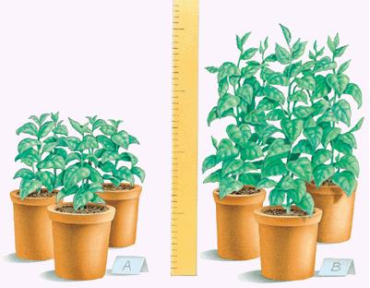
Focus Question / Aim
Your Aim or focus question must include both variables.
For example: If I change (independent variable) how will it affect (dependant variable)
Such as: If I change the temperature of the water (independent) how will it affect how much sugar I can dissolve into the water (dependant)
EXAMPLE
Independent variable – amount of light a plant receives
Dependant variable - height that plant grows
Focus Question: How does the amount of light a plant receives affect the height it grows to

Slide 10
Writing the Method
A method must be written so that an investigation is repeatable by another person.
In order for results from an investigation to be reliable an investigation must be able to be repeated exactly the same way following the method. The results gained from each repeat must show the same pattern each time for the conclusion to be valid (or if not an explanation or fault in following the method given).
Your method must be repeatable by another person and include:
>independent (variable changed) and dependent (variable measured) variables that are clearly stated with units given.
>All variables listed that must be controlled (kept the same) AND how they are controlled
>Techniques used to increase accuracy (closer to actual value) and reliability (consistently the same when repeated)

Slide 11
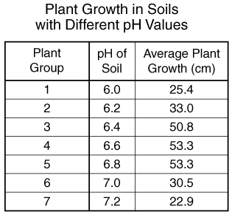
Collecting Data
Data that is collected from an investigation can be analysed easier if placed into a clearly labelled and laid out data table.
The table must have:
A heading linked to the aim/hypothesis
Labelled quantities, units and symbols
Values (often numerical) of data collected
Data tables can also contain processed data such as results from multiple trials that have been averaged to give a more reliable value.

Slide 12
Errors may occur in measurements may be reduced by taking the average of a number of readings
When collecting and measuring data in investigations, such as that for calculating speed, errors can occur. This may be due to the measuring instrument and the way it is used. Data can also be recorded incorrectly.
Repeating the investigation a number of times and averaging out the measurements can help reduce random errors. This value is called the mean.
Distance walked in 1 minute
The mean is the most common measure of average.
To calculate the mean add the numbers together and divide the total by the amount of numbers:
Mean = sum of numbers ÷ amount of numbers
Trial 1
Trial 2
Trial 3
Distance (m)
113 121 119
Mean = (113 + 121 + 119 ) ÷ 3
= 117.7 m

Slide 13
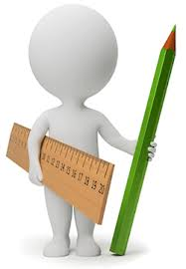
Measuring in Science
Quantity | Unit | Symbol | Equipment used
Volume | litre | L | Flask
 | Millilitre | mL | Measuring cylinder
Temperature | Celsius | °C | thermometer
Mass | kilograms | Kg | Scales
 | grams | g | Scales
Length | Metres | m | Metre ruler
 | millimetres | mm | Hand ruler
Note: Weight is the result of force (gravity) acting on mass and is measured in Newton’s using a spring balance. Weight and Mass are often confused.

Slide 14
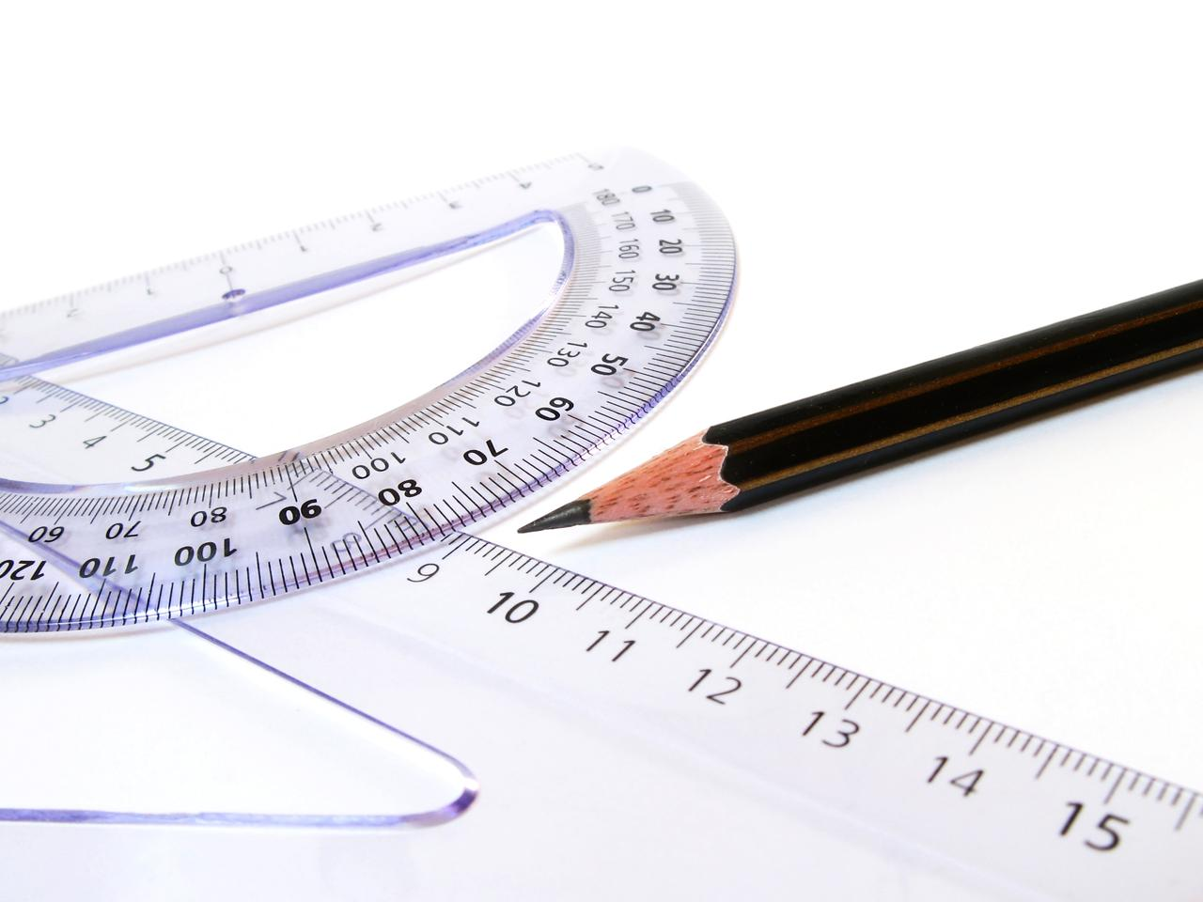
Converting measurements
To convert from grams to kilograms divide by 1000
(or metres to kilometres and millilitres to litres)
To convert from kilograms to grams multiply by 1000
(or kilometres to metres and litres to millilitres)
Quantities are often measured in different scales depending upon what is most appropriate for the original size. In Science (and Mathematics) we use common prefixes to indicate the scale used.
We sometimes want to convert scales from one to another to compare data or to place the measurements into equations.
Prefix Scale
Kilo = 1000
Centi = 1/100th
Milli = 1/1000th
So 1 kilometre = 1000 metres
1 metre contains 100 centimetres
1 metre contains 1000 millimetres

Slide 15
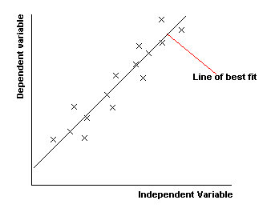
Drawing a line Graph
When a line graph is used to analyse data from a fair test the dependent variable (variable measured) must be placed on the y axis and the independent variable (variable changed) must be on the x axis.
A line of best fit is used to generate a straight line – this shows the trend and allows a gradient to be calculated.
Do not join the points
A line of best fit gives the smallest distance from all plotted points to the line

Slide 16
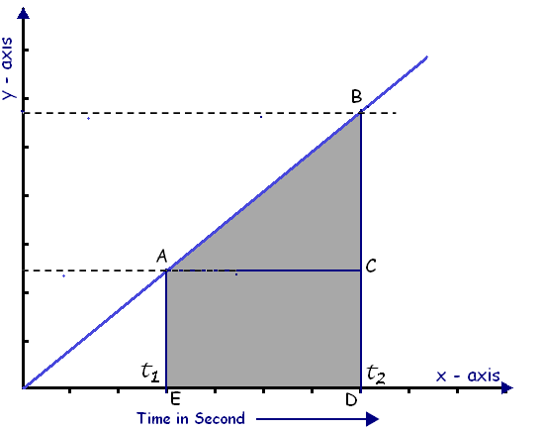
Calculating Gradient
A line graph can be used to
calculate gradient. The co-ordinates
of a straight line in the graph are taken (for example from A to B) by projecting back to the x and y axis.
To calculate the value for x find the difference between t1 and t2 by subtracting the smallest value from the largest value. This will be your ∆x.
Repeat on the y axis. This will be your ∆y.
Gradient = rise = ∆y
run ∆x
The relationship of the variables is stated as a mathematical equation
Y = gradient x X + intercept
for example:
Height ball bounces(cm) = gradient x height ball dropped(cm)
Independent variable verses Dependent variable graph
∆y
Height ball bounces (cm) - dependant
∆x
Height ball dropped (cm) - independent

Slide 17
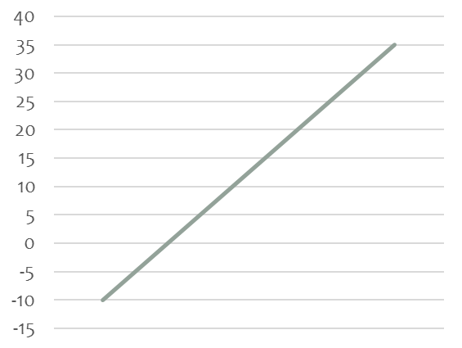
Intercept in a line graph
The relationship of the variables
is stated as a mathematical equation
Y = gradient x X + intercept
If the line intercepts the y axis at 0,0 (where the x and y axis cross) then the intercept will be 0
If the line crosses the y axis at any other point than the intercept will have a value
A positive value if above the x axis
A negative value if below the x axis
Independent variable verses Dependent variable graph
y axis
x axis
The intercept for this graph would be -5 (unit)
Y is the dependent variable that you are measuring
X is the independent variable that you are changing
Gradient = rise / run = ∆y /∆x

Slide 18
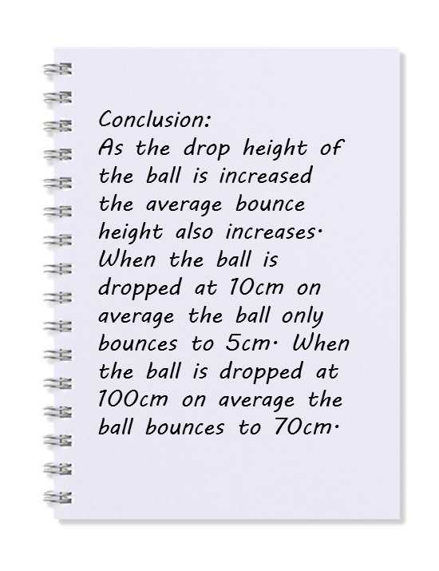
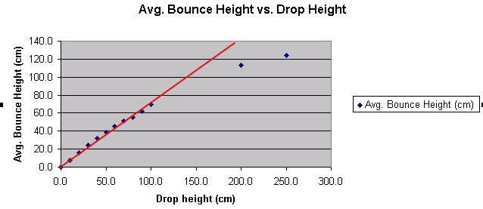
Writing a conclusion
A conclusion looks for patterns in collected data from an investigation.
Both the variable that is changed (independent) and the variable that is measured (dependant) must be included in the conclusion statement.
The data is used as evidence in the conclusion.
The conclusion can also be used to answer the original aim
EXAMPLE

Slide 19
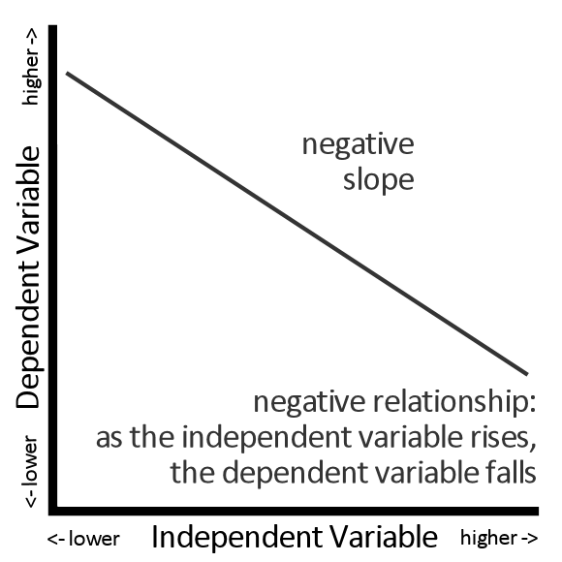
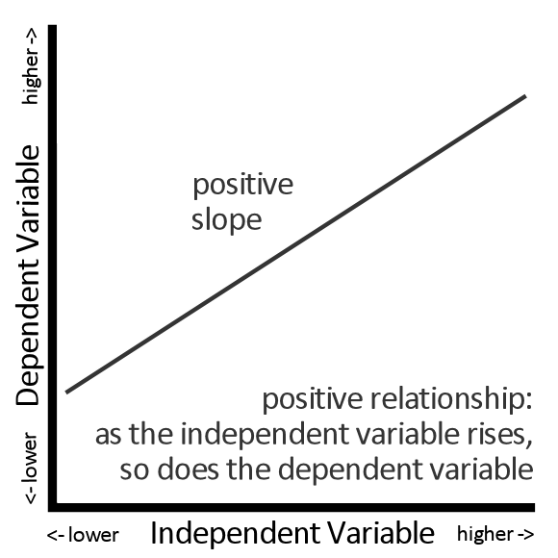
Writing a conclusion based on the gradient
A gradient of a line will be positive when the rise of the variable changed causes the rise of the variable measured.
A gradient of a line will be negative when the rise of the variable changed caused the fall of the variable measured.
You must include either statement (positive or negative) in your conclusion based on your results

Slide 20
Discussion
This part of an investigation covers what you did to increase reliability with repeats, and discussion how you kept all other variables controlled. Accuracy is discussed along with the techniques used to ensure accuracy such as reducing parallax errors and anything else to make sure your data was collected without error, such as correcting for zero error.
Areas of the investigation that could have been improved (and were modified to improve them) are discussed as well as known unavoidable errors are made.
Unexpected random results and outliers in the data can be explained, and the method used to discard them from averages.
Science ideas that could explain the results and conclusion are discussed here. Any relevant equations (including the mathematical relationship equation from the graph) can be included and further explained.
Any differences between your results and expected results based on known Science ideas can be discussed.
The discussion is an in-depth report on your investigation.

Slide 21
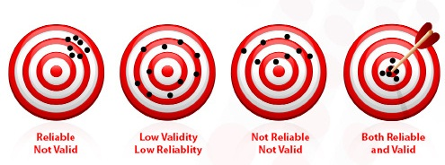
Reliability and Accuracy in the Discussion
Reliability means that that any results produced in a scientific investigation must be more than a one-off finding and be repeatable.
Other scientists must be able to perform exactly the same investigation using the same method and generate the same results.
Accuracy is the extent to which a investigation measures what it is supposed to measure. In a valid investigation the results gained will be as close to reality as possible if only one variable is changed and all other variables are kept the same.
Reliable
Not Accurate
Low Reliability
Low Accuracy
Not Reliable
Not Accurate
Both Reliable
And Accurate

Slide 22
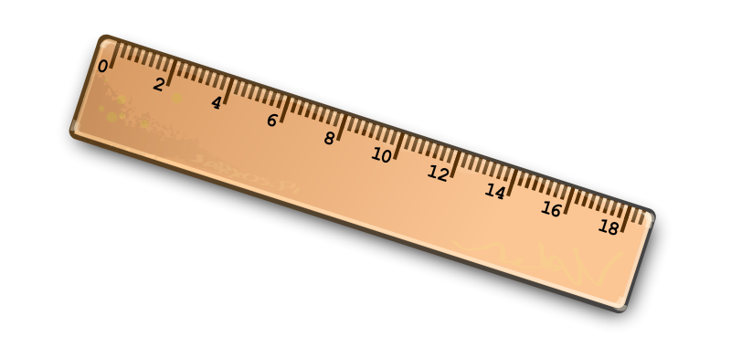
Errors in the Investigation
Whenever we measure something the measurement is never exact, it is an estimate of the value of a physical quantity.
Errors (not mistakes) can be caused by limitations to the accuracy of measurement.
There are two kinds of error:
Systematic
Caused by faulty equipment or experimental design, often affect all results to the same extent.
e.g. Friction causes an object not to accelerate as quickly as expected or a ruler may be incorrectly used.
constant attention to detail is needed to avoid systematic errors
Random
These result from the limits of the accuracy of all measuring devices. They can be reduced but can never be eliminated.
e.g. Reaction time, sensitivity of measuring apparatus or observer error/parallax error.

Slide 23
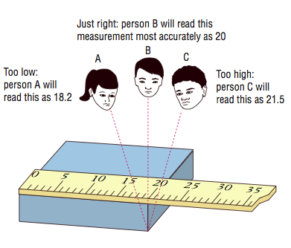
Accuracy and Parallax
The direct line of sight when making a reading from a ruler needs to be used to avoid parallax error. Measurements made by viewing the position of a ruler (or meter) relative to something to be measured are subject to parallax error if the ruler is some distance away from the object of measurement and not viewed from directly on.
To avoid parallax error read the ruler straight on and level, as well as holding the ruler as close to the object as possible.

Slide 24
Accuracy and Zero error
Many rulers do not start at zero. When you are measuring with a ruler you need to account for this error, called zero error. You will need to measure the gap from the end of the ruler to the start of measuring (the zero line) and deduct that amount away from each measurement.
This normally occurs when you are measuring a height from the floor upwards.
Zero error

