Slide 1
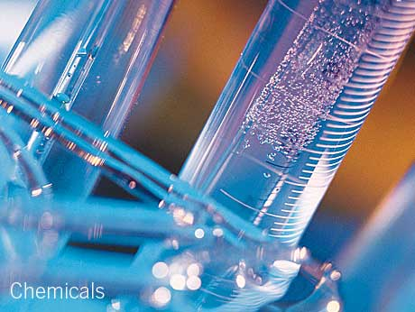
Chemistry NCEA L3
3.1 Quantitative Investigation

Slide 2
What is this NCEA Achievement Standard?
When a student achieves a standard, they gain a number of credits. Students must achieve a certain number of credits to gain an NCEA certificate (80 for Level 3)
The standard you will be assessed on is called Chemistry 3.1 Carry out an investigation in chemistry involving quantitative analysis
It will be internally (in Class) assessed as part of a Investigation and will count towards 4 credits for your Level 3 NCEA in Chemistry

Slide 3
What are the main steps required in this Internal Assessment?
AS91387 Carry out an investigation in chemistry involving quantitative analysis
The method
The teacher will provide a suitable context for an Investigation. Students are able to gather data in small groups, but it is expected that each student is involved in making measurements. The investigation write up is done individually by each student.
A logbook needs to be kept throughout the investigation. The logbook contains
details of the development of the purpose, procedure, raw data, and calculations.
Evidence that an appropriate method has been developed must be presented by a suitably described method and from evidence that appropriate data has been gathered.
Evidence that the appropriate variables have been changed and measured may be presented in the method or the results table. Students are required to specifically define which variable is the independent and which one is the dependent and clearly identify which variable is changed and which variable is measured.

Slide 4
Gathering data and drawing a graph
Appropriate units need to be stated for each variable. Evidence for this may come from anywhere in the report.
A reasonable number of values is considered to be at least four measurements of different values. A zero value is not normally considered to be one of these measurements. A suitable range is as needed to determine
a relationship.
A graph based on the data is considered to be plotted
points with a single best fit straight line, ruled to
represent the trend. It is not appropriate to simply rule
lines to connect each plotted point, or force the best fit
line to go through the origin if that point does not
represent the trend of the plotted points.
3 significant figures are used consistently throughout the report

Slide 5
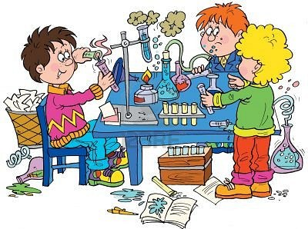
Presenting a report
Presenting a report of your investigation must contain:
1. a statement of the purpose of the investigation
2. a description of the procedure that includes preparation of samples and the
analytical technique used. This must include a description of how significant variables are controlled, preparation of samples, and any modifications made to the method during the course of the investigation
3. Results
>a summary of the collected and processed data
>a conclusion based on the processed data.
4. Discussion - an evaluation of the whole investigation that considers:
>an evaluation of the reliability of data by considering the procedure used and sources of error
>reasons for any modifications made to the original method
>the accuracy and reliability of the data collected
>comments on the significance and validity of the conclusion
>links between the conclusion(s) and chemical principles and/or real life applications
5. a bibliography that acknowledges and identifies sources of information.

Slide 6
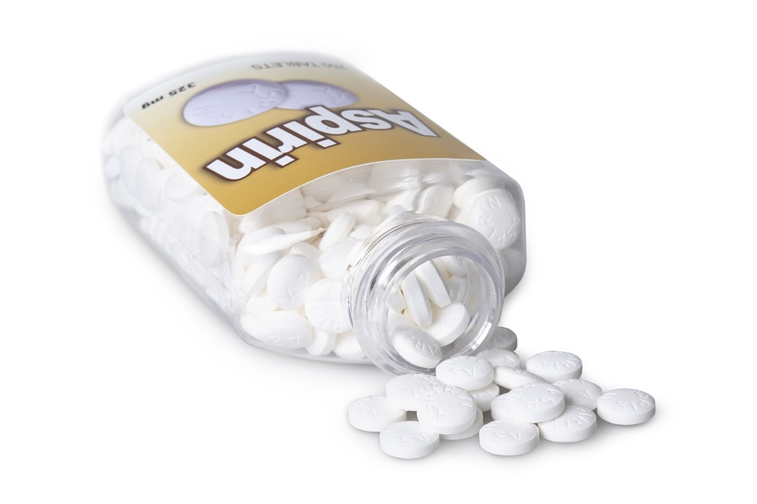
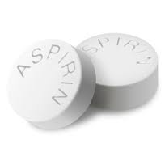
Context of your report
How stable is your aspirin?
This activity requires you to investigate the stability of aspirin (acetyl salicylic acid) in different conditions (such as different pH, temperature, and moisture levels).
Aspirin (acetylsalicylic acid) is an analgesic (pain reliever) and an antipyretic (for reducing fever). Analgesics dull pain but don’t impair sensitivity. Aspirin is also used long term, in low doses, to help prevent heart attacks, blood clots and strokes. It is produced by reacting salicylic acid and acetic anhydride in the presence of an acid catalyst. Aspirin is only slightly soluble in water and acidic
solutions which are present in the stomach.
However, it is more soluble in alkaline (basic) solutions,
so it dissolves easily in the intestines.

Slide 7
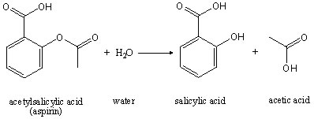
Context of your report
Aspirin is hydrolysed to form salicylic acid. Hydrolysis is a reaction that causes the dissociation of water and results in a hydroxide replacing an organic functional group. In this case when aspirin (an ester) hydrolyses it forms salicylic acid and acetic acid. Aspirin has 3 groups an ester, a carboxylic acid and a benzene ring.
The amount of salicylic acid can be determined by colorimetric analysis. You are to conduct an investigation into the stability of acid under different circumstances.
In a group define the purpose of your investigation, conduct background research, and identify how you will ensure safety (for example, safety considerations and how you will reduce any possible risks). The purpose should include exploring possible trend or pattern in the quantity of acetyl salicylic.

Slide 8
Aiming for Merit and Excellence
Interpretation of evidence for Merit
Carry out an in-depth investigation in chemistry involves:
• collection of quality data which includes standardising the standard solution(s)
and control of significant variables
• accurate processing of the data to reach a valid conclusion
• providing evidence of the mathematical steps used to process the experimental
data
• presenting a report that contains:
− a description of the procedure in sufficient detail for the investigation to be
duplicated
− a conclusion that links the processed data to the purpose of the investigation
− an explanation of how the procedure used contributed to the collection of
quality data.

Slide 9
Aiming for Merit and Excellence
Interpretation of evidence for Excellence
Carry out a comprehensive investigation in chemistry involves:
• accurate processing of the data using appropriate significant figures and units
• presenting a report that shows evidence of:
− justifying the steps used in the procedure in relation to the reaction(s)
occurring and to the nature of the samples being analysed
− a comprehensive evaluation of the investigation that includes a selection from:
− evaluation of the reliability of the data by considering the procedure used
and possible sources of error
− justification of how the processed data supports the conclusion(s)
− linking the conclusion(s) to chemical principles and/or real life applications.

Slide 10
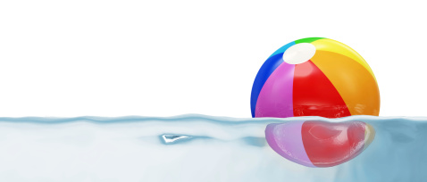
A 'fair test' is one in which you only change one thing (variable).
Variables are all the things that could change during an investigation.
In a bouncing ball investigation, where the height a ball bounces to is measured after it is dropped at different heights, many things could affect the results from one experiment to the next such as using a different ball, a different drop height or a different surface which the ball is dropped on.
You should only change one thing at a time in your investigation. This called the independent variable.(The height the ball is dropped at)
During your investigation you should be able to measure something changing which is called the dependent variable. (How high the ball bounces after being dropped)
The factors you keep the same in your experiments (fair test) are called control variables

Slide 11
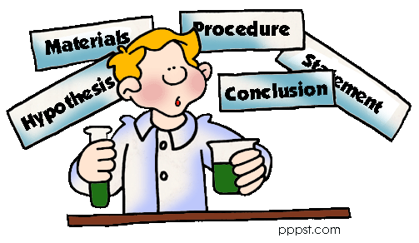
The typical way that scientists work is called the Scientific method.
Scientific investigations are typically written up in a standard way under the following headings:
Aim (focus question): what you are trying to find out or prove by doing the investigation
Hypothesis: what you think will occur when an investigation is carried out
Equipment (or materials): the things that you need to do the investigation
Method : A simple, clear statement of what you will do – and can be repeated by another person
Results : data, tables and graphs collected from investigation
Conclusion : what your results tell you – linked back to the aim and hypothesis
Discussion : Science ideas to explain your results, possible improvements to the investigation, how you managed to control the other variables.

Slide 12
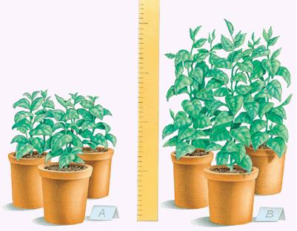
statement of the purpose of the investigation
Your statement of the purpose of the investigation must include both variables.
For example: If I change (independent variable) how will it affect (dependant variable)
Such as: If I change the temperature of the water (independent) how will it affect how much sugar I can dissolve into the water (dependant)
EXAMPLE
Independent variable – amount of light a plant receives
Dependant variable - height that plant grows
statement of the purpose of the investigation: How does the amount of light a plant receives affect the height it grows to

Slide 13
Writing the Method
A method must be written so that an investigation is repeatable by another person.
In order for results from an investigation to be reliable an investigation must be able to be repeated exactly the same way following the method. The results gained from each repeat must show the same pattern each time for the conclusion to be valid (or if not an explanation or fault in following the method given).
Your method must be repeatable by another person and include:
>independent (variable changed) and dependent (variable measured) variables that are clearly stated with units given.
>All variables listed that must be controlled (kept the same) AND how they are controlled
>Techniques used to increase accuracy (closer to actual value) and reliability (consistently the same when repeated)

Slide 14
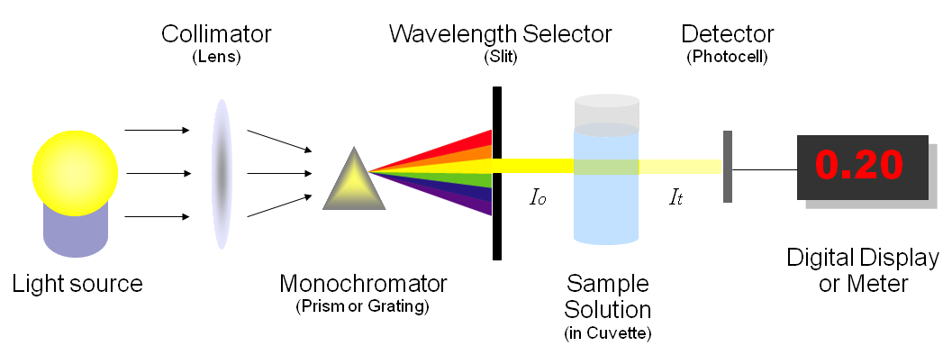
Test the colorimetric absorbance of an aspirin sample
Instructions are provided for an analytical technique that may be used in a school laboratory
This investigation is based on an analytical technique of colorimetry.
To enable a conclusion to be reached for colorimetry the range of the standard curve must be appropriate.
Salicylic acid reacts with acidified iron (III) nitrate to produce a violet complex, tetraaquosalicylatroiron (III).
You will prepare a set of standard solutions of the violet complex, tetraaquosalicylatroiron (III). The absorbance of the standard solutions can be determined using a colorimeter. A standard curve can then be created and used to determine the amount of salicylic acid in the aspirin tablets.

Slide 15
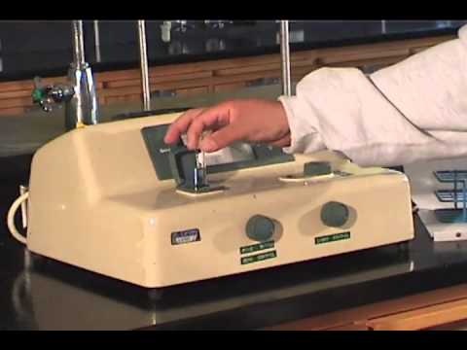
Analytical technique - Colorimetry
To prepare salicylic acid standard solutions and standard curve:
1. Measure out 0.200g of salicylic acid. Record the precise mass you got so you can work out the concentration of salicylic acid using, n=m/M and c=nv.
2. Transfer the salicylic acid to a 250ml beaker, add 10mL of 95% ethanol and swirl the beaker to dissolve the solid.
3. Add 150mL of distilled to the beaker and mix the solution.
4. Transfer the solution from the beaker to a 250mL volumetric flask and make up to the mark with distilled water, making sure that you have transferred all the salicylic acid to the flask and mix.
5. Calculate the concentration of your stock solution. (see log book for calculations).

Slide 16
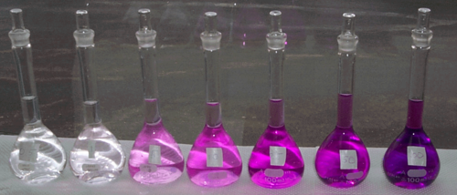
Analytical technique - Colorimetry
6. To prepare 100mL of violet complex solution, transfer 10mL of the stock salicylic acid solution to a 100mL volumetric flask.
7. Then add 90mL (to make up to the mark) of 0.025molL⁻¹ Fe (NO₃)₃. (This is made by dissolving 10.1g of Fe (NO₃)₃ into 1.00L of water.) The Fe (N0₃)₃ is used because when it reacts with the salicylic acid solution it creates a purple complex ion which we then put in the colorimeter and find out the absorbency. We can later use the absorbency readings to find out the concentration of salicylic acid.

Slide 17
Analytical technique - Colorimetry
8. Then use this table to prepare the set of standard solution.
9. This is done by transferring the right amount of solution into a test tube and then adding the correct about of water.
10. Then put some of each solution into a cuvette (these come with the colorimeter). Calibrate the colorimeter using some distilled water. Then put each solution into the colorimeter and record the readings for the solution. Repeat this process 2 more times to make it a fair test. This increases the accuracy of the experiment. The averages of these results have to be calculated as this will give us a more reliable result.
11. Calculate the concentration of your standard solutions using the equation. New concentration= Old concentration x (old volume/new volume).
Example: Standard solution 2= (5.80x10⁻³)x (0.00750÷0.0100)= 4.35x10⁻³
Standard Solution number | Volume of complex solution (ml) | Water (ml)
1 | 10.0 | 0.00
2 | 7.50 | 2.50
3 | 5.00 | 5.00
4 | 2.50 | 7.50

Slide 18
Analytical technique - Colorimetry
12. Then use these results to graph absorbency against concentration of salicylic acid. This is done as a conversion chart so when we measure the absorbency of aspirin in different pH’s in our investigation we can work out the concentration of the salicylic acid.

Slide 19
Testing for Salicylic acid
Determine the concentration of salicylic acid in samples
1. Place one aspirin tablet, 0.45g, in 100mL of water and ‘treat’ (expose to different pH levels, temperatures, etc). Leave for ___________min/hr. Make sure the aspirin tablet is not coated.
2. Add 10 mL of 95% ethanol to each beaker of aspirin sample. Swirl the mixture to dissolve the solid.
3. Add 50 mL of distilled water to each beaker. Mix the solutions.
4. Quantitatively transfer the solutions from the beakers to 250 mL volumetric flasks. Make up to the mark using distilled water. Mix thoroughly.
5. Transfer 5 mL of each of the aspirin solutions from the 250 mL volumetric flasks to clean, dry 100 mL volumetric flasks. Add 0.025 M Fe (NO₃)₃ solution to each flask to make precisely 100 mL. Mix the solutions thoroughly.
6. Measure and record the absorbance of the treated aspirin samples using a colorimeter. This must be done within five minutes.
7. Repeat Steps 5 and 6 twice with new aliquots of the treated aspirin samples.
Use your standard curve to determine the concentration of salicylic acid in the samples.

Slide 20
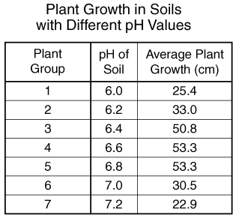
Collecting Data
Data that is collected from an investigation can be analysed easier if placed into a clearly labelled and laid out data table.
The table must have:
A heading linked to the aim/hypothesis
Labelled quantities, units and symbols
Values (often numerical) of data collected
Data tables can also contain processed data such as results from multiple trials that have been averaged to give a more reliable value.

Slide 21
Errors may occur in measurements may be reduced by taking the average of a number of readings
When collecting and measuring data in investigations, such as that for calculating speed, errors can occur. This may be due to the measuring instrument and the way it is used. Data can also be recorded incorrectly.
Repeating the investigation a number of times and averaging out the measurements can help reduce random errors. This value is called the mean.
Distance walked in 1 minute
The mean is the most common measure of average.
To calculate the mean add the numbers together and divide the total by the amount of numbers:
Mean = sum of numbers ÷ amount of numbers
Trial 1
Trial 2
Trial 3
Distance (m)
113 121 119
Mean = (113 + 121 + 119 ) ÷ 3
= 117.7 m

Slide 22
Measuring in Science
Quantity | Unit | Symbol | Equipment used
Volume | litre | L | Flask
 | Millilitre | mL | Measuring cylinder
Temperature | Celsius | °C | thermometer
Mass | kilograms | Kg | Scales
 | grams | g | Scales
Length | Metres | m | Metre ruler
 | millimetres | mm | Hand ruler
Note: Weight is the result of force (gravity) acting on mass and is measured in Newton’s using a spring balance. Weight and Mass are often confused.

Slide 23
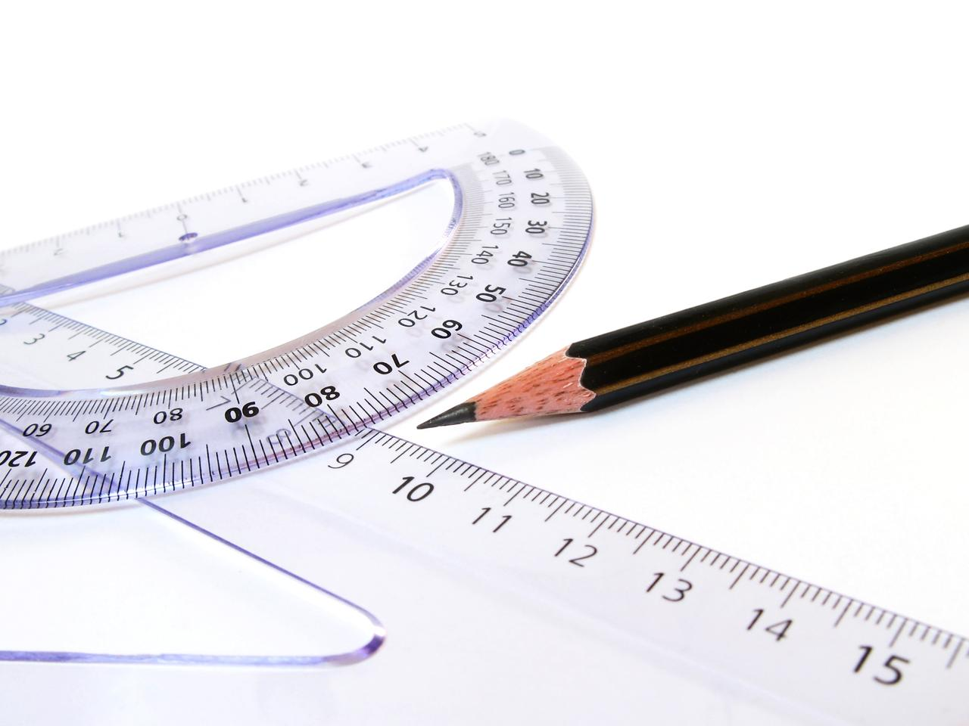
Converting measurements
To convert from grams to kilograms divide by 1000
(or metres to kilometres and millilitres to litres)
To convert from kilograms to grams multiply by 1000
(or kilometres to metres and litres to millilitres)
Quantities are often measured in different scales depending upon what is most appropriate for the original size. In Science (and Mathematics) we use common prefixes to indicate the scale used.
We sometimes want to convert scales from one to another to compare data or to place the measurements into equations.
Prefix Scale
Kilo = 1000
Centi = 1/100th
Milli = 1/1000th
So 1 kilometre = 1000 metres
1 metre contains 100 centimetres
1 metre contains 1000 millimetres

Slide 24
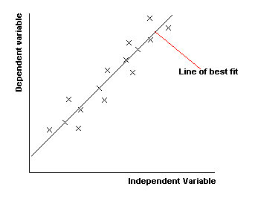
Drawing a line Graph
When a line graph is used to analyse data from a fair test the dependent variable (variable measured) must be placed on the y axis and the independent variable (variable changed) must be on the x axis.
A line of best fit is used to generate a straight line – this shows the trend and allows a gradient to be calculated.
Do not join the points

Slide 25
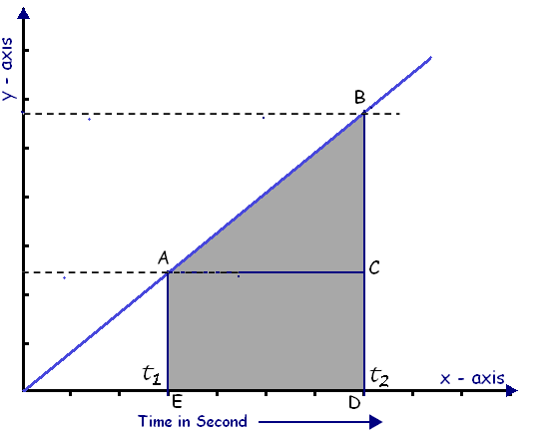
Calculating Gradient
A line graph can be used to
calculate gradient. The co-ordinates
of a straight line in the graph are taken (for example from A to B) by projecting back to the x and y axis.
To calculate the value for x find the difference between t1 and t2 by subtracting the smallest value from the largest value. This will be your ∆x.
Repeat on the y axis. This will be your ∆y.
Gradient = rise = ∆y
run ∆x
The relationship of the variables is stated as a mathematical equation
Y = gradient x X
for example:
Height ball bounces(cm) = gradient x height ball dropped(cm)
Independent variable verses Dependent variable graph
Height ball bounces (cm) - dependant
Height ball dropped (cm) - independent

Slide 26
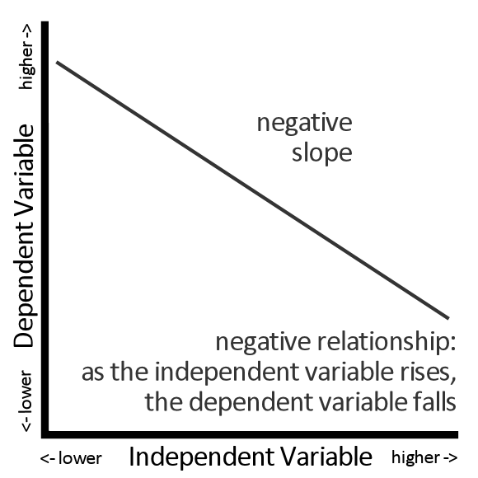
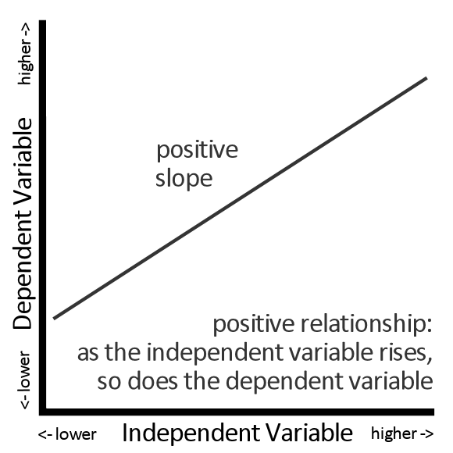
Writing a conclusion based on the gradient
A gradient of a line will be positive when the rise of the variable changed causes the rise of the variable measured.
A gradient of a line will be negative when the rise of the variable changed caused the fall of the variable measured.
You must include either statement (positive or negative) in your conclusion based on your results

Slide 27
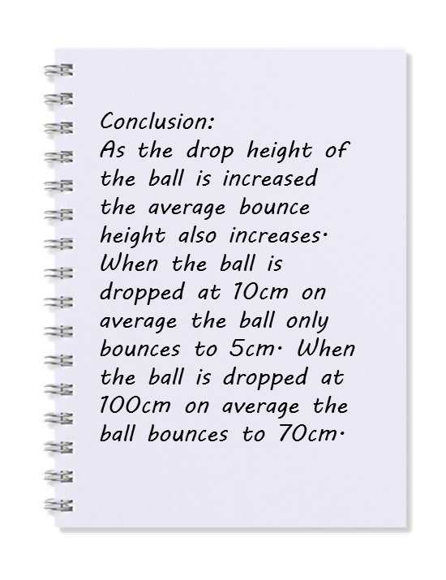
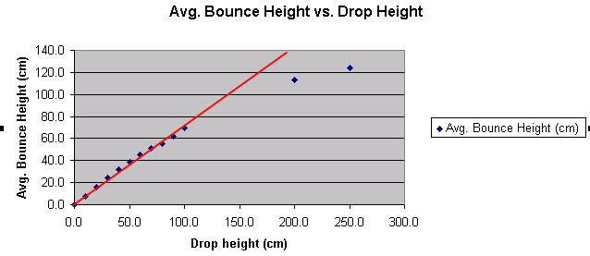
Writing a conclusion
A conclusion looks for patterns in collected data from an investigation.
Both the variable that is changed (independent) and the variable that is measured (dependant) must be included in the conclusion statement.
The data is used as evidence in the conclusion.
The conclusion can also be used to answer the original aim
EXAMPLE

Slide 28
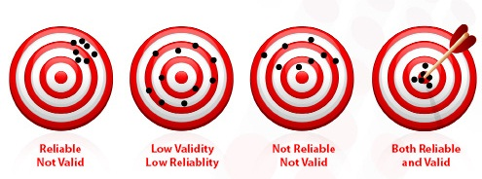
Reliability and Accuracy in the Discussion
Reliability means that that any results produced in a scientific investigation must be more than a one-off finding and be repeatable.
Other scientists must be able to perform exactly the same investigation using the same method and generate the same results.
Accuracy is the extent to which a investigation measures what it is supposed to measure. In a valid investigation the results gained will be as close to reality as possible if only one variable is changed and all other variables are kept the same.
Reliable
Not Accurate
Low Reliability
Low Accuracy
Not Reliable
Not Accurate
Both Reliable
And Accurate

Slide 29
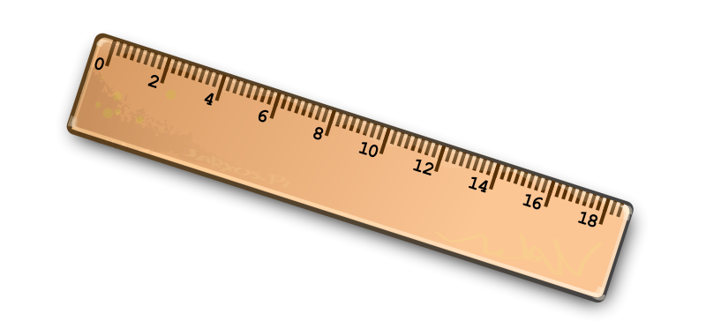
Errors in the Investigation
Whenever we measure something the measurement is never exact, it is an estimate of the value of a physical quantity.
Errors (not mistakes) can be caused by limitations to the accuracy of measurement.
There are two kinds of error:
Systematic
Caused by faulty equipment or experimental design, often affect all results to the same extent.
e.g. Friction causes an object not to accelerate as quickly as expected or a ruler may be incorrectly used.
constant attention to detail is needed to avoid systematic errors
Random
These result from the limits of the accuracy of all measuring devices. They can be reduced but can never be eliminated.
e.g. Reaction time, sensitivity of measuring apparatus or observer error/parallax error.

Slide 30
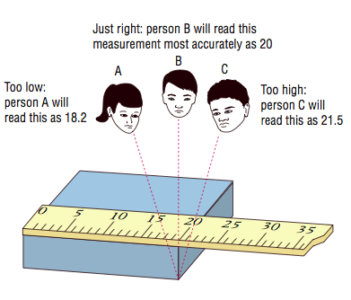
Accuracy and Parallax
The direct line of sight when making a reading from a ruler or measuring container needs to be used to avoid parallax error. Measurements made by viewing the position of a ruler (or measuring container) relative to something to be measured are subject to parallax error if the ruler is some distance away from the object of measurement and not viewed from directly on.
To avoid parallax error read the ruler straight on and level, as well as holding the ruler as close to the object as possible.

Slide 31
Discussion
This part of an investigation covers what you did to increase reliability with repeats, and keeping all other variables controlled. Accuracy is discussed along with the techniques used to ensure accuracy such as reducing parallax errors and anything else to make sure your data was collected without error.
Areas of the investigation that could have been improved are discussed as well as known unavoidable errors are made.
Unexpected random results and outliers in the data can be explained, and the method used to discard them from averages.
Science ideas that could explain the results and conclusion are discussed here. Any relevant equations (including the mathematical relationship equation from the graph) can be included.
Any differences between your results and expected results based on known Science ideas can be discussed.
The discussion is an in depth report on your investigation.

Slide 32
Key calculations
Calculate new concentration given old conc. and volumes
e.g. 40ml of 2.0molL⁻¹ diluted by adding 60ml water
c(new) = c(old) x old volume
new volume
c(new) = 2.0molL⁻¹ x 40ml
(40ml + 60ml)
C(new) =0.80molL⁻¹
138.121 gmol⁻¹
Salicylic acid
Molar mass
Making solutions
Multiply Molar mass by molL⁻¹ required i.e. 404.00 x 0.0250 = 10.100g per litre
Calculating concentrations
n = mass/Molar mass concentration = number of moles (n) /volume (L)

Slide 33
Scientific Notation and Significant figures
A number converted to Scientific notation is written in two parts:
Just the digits (with the decimal point placed after the first digit), followed by
× 10 to a power that puts the decimal point where it should be (i.e. it shows how many places to move the decimal point).
A negative number of power shifts the decimal place to the right
In this example, 0.00362 is written as 3.62 × 10⁻³, because 3.62 x 10⁻³ = 3.62 ÷ 1000 = 0.00362
The Significant figures required in this standard are 3
3.60 0.360 0.0360 and 0.00360 are examples of 3 significant figures
Notice that a 0 before the first whole number does not count as a significant figure (it is only a place holder) but a 0 after a whole number is regarded as a significant figure.
3 significant figures must be rounded if the original number given is longer

Slide 34
Dilution calculations Example
EXAMPLE 20.0 mL of a 0.00500 mol L^{–1} FeCl₃.6H₂O. solution was pipetted into a volumetric flask and diluted to 100 mL. What is the concentration of the diluted solution?
concentration _{(new)} = concentration _{(original)} x volume _{(original)}
volume _{(new)}
c(new) = 0.00500molL⁻¹ x (0.020L / 0.100L)
c(new) = 0.00500molL⁻¹ x 0.2
c(new) = 0.00100molL⁻¹
Make sure you convert all of your volumes into litres first
Because this is a dilution the new concentration must be less than the original

Slide 35
Mixed solution calculations Example
EXAMPLE 500 mL of 0.253 mol L⁻¹ NaHCO₃ solution is mixed with 800 mL of 0.824 mol L⁻¹ NaHCO₃ solution. What is the concentration of the final solution?
n(solution 1)= c1 x v1 + n(solution 2)= c2 x v2 = total moles
Final concentration = total mols / total volume (v1 + v2)
n(solution 1 ) = 0.253molL⁻¹ x 0.50L =
c(new) = 0.00500molL⁻¹ x 0.2
c(new) = 0.00100molL⁻¹
Make sure you convert all of your volumes into litres first

