Slide 1
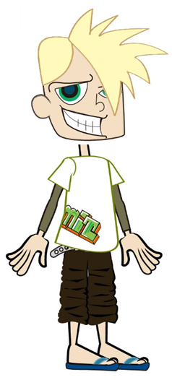
The heat travels in rays directly to Earth and does not spread out
Heat from the Sun
I think it is not hot in outer space because the heat spreads out
Maybe the heat travels to Earth in another form of energy

Slide 2
There is only energy in a slingshot if it is moving
Energy in a slingshot
A slingshot needs energy to make it work
I don’t think a slingshot has energy at all, it only helps move energy around

Slide 3
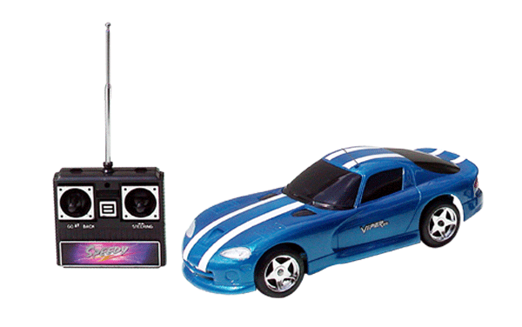
The ‘flat’ toy car
The toy car has ‘used up’ all the energy from the batteries
I think recharging the batteries fills them back up with energy again
The car needs energy to move, and this is a different sort of energy than is in the batteries

Slide 4
The toys only have energy if they fall off the shelf
I think the toys have energy but not the type that makes them move
They only have energy when we push them or make them move
Toys on a shelf

Slide 5
Campfire
Air particles contain the heat and they spread away from the fire
The heat comes from the wood and changes it into ashes
The heat is disappearing straight upwards

Slide 6
Water can’t get any hotter once it has started to boil
Boiling water
Steam can burn more than boiling water as it is hotter
Once the water stops boiling it starts to lose all of its energy anyway

Slide 7
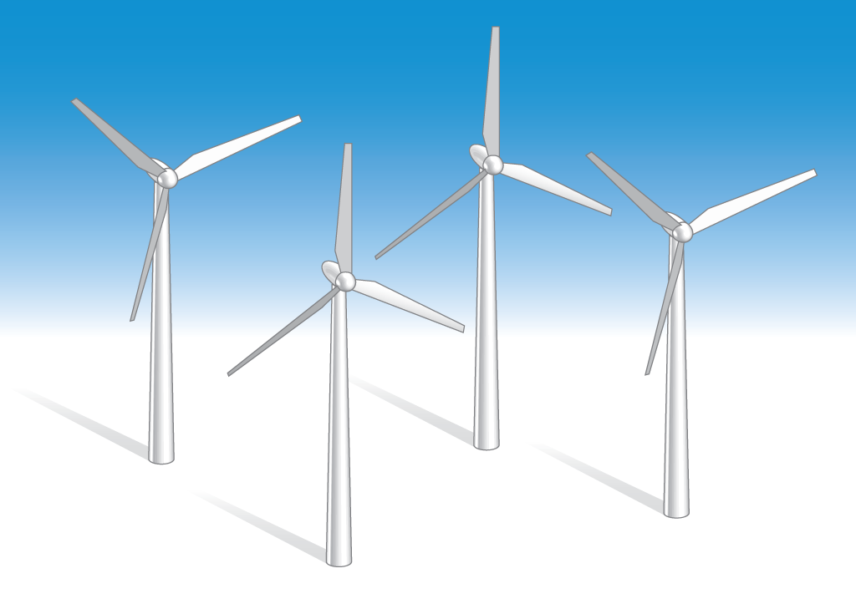
Wind Turbines
The turbines are used to generate electricity from wind
The wind turbines take the energy out of the wind
Air particles make the turbines move not energy

Slide 8
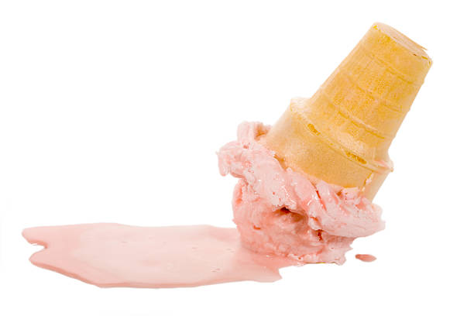
Melting ice cream
The ice cream is absorbing heat energy from the air
The molten ice cream contains more heat energy than the frozen ice cream
The ice cream is losing its coldness as it melts

Slide 9
Swings
If we stop swinging then the swings run out of energy
The more energy you put into swinging the higher the swing goes
The swing transfers kinetic energy to us, that makes us ‘fly’ when we jump off as it is moving

Slide 10
Hot Roads
The black road is made of material that gets hotter than grass
The black road feels hotter on a sunny day because it releases heat
The black road feels hotter on a sunny day because it more absorbs heat than the grass

