Slide 1
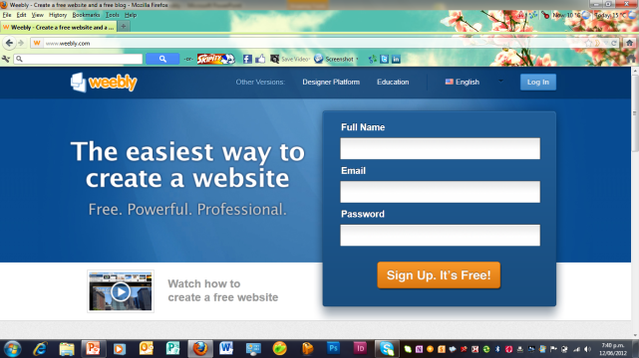
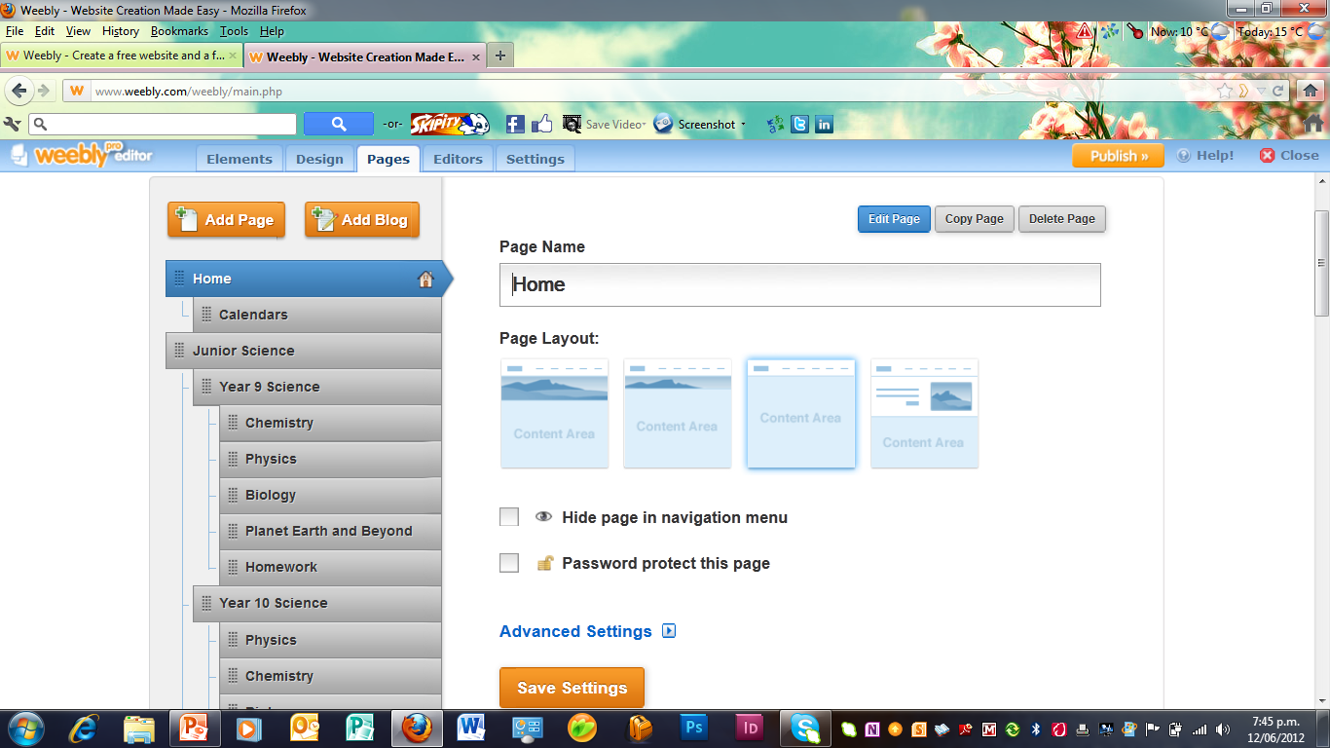
Creating a website on Weebly
Log onto www.weebly.com > select education on the top button
Create a site > Use a memorable user name and password
Select a name for your webpage i.e gz@scienceclassonline
4. Decide what main pages you want > under headings of classes and what subpages you would like under each class (either worlds for junior or AS for senior classes)
5. Decide on a design for your page > this can be changed whenever you choose
6. Decide what you want to add to each page to be available for your students
The front page for each class can be used as a summary of the course
Each individual topic/ AS page can include:
Class notes
SLO sheets
Resources for the students to print at home
Worksheets
Links to websites that may be useful

Slide 2
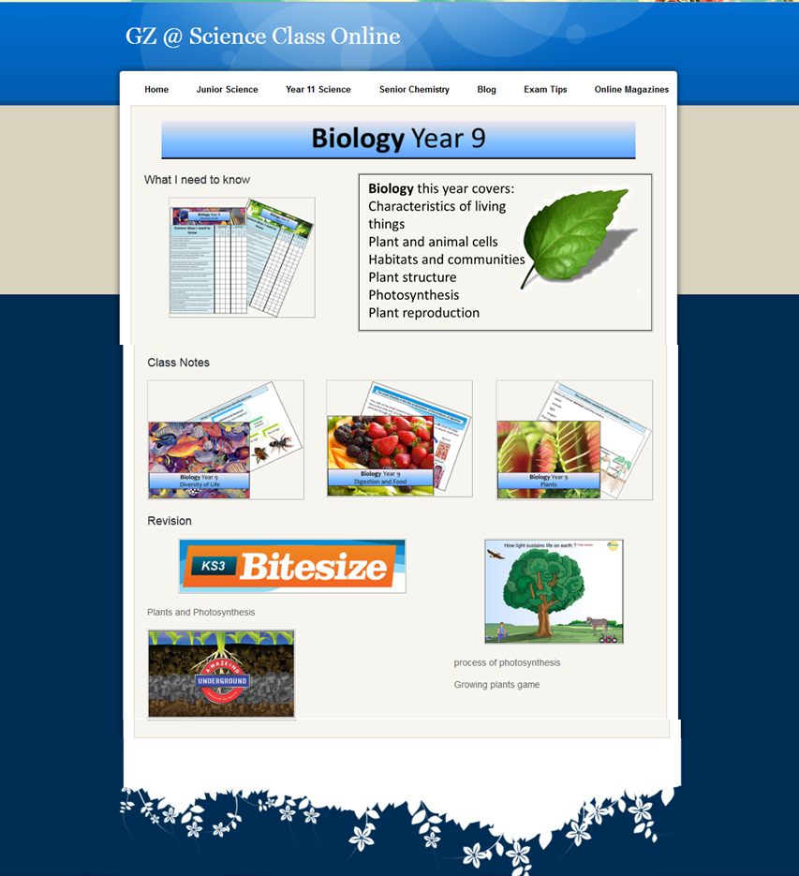
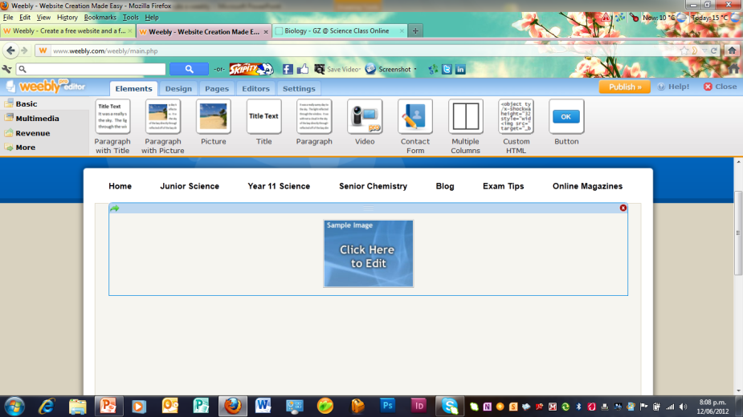
7. Creating picture logo’s and titles – Make a new powerpoint > save as webpage scrapbook
For powerpoints or word copy a page and paste on a powerpoint scrapbook. Crop picture to size (right click) and save as picture > have a folder in your photos as webpage photos.
Drag a picture icon down onto page and browse for the picture on your computer or drag a picture across to the page

Slide 3
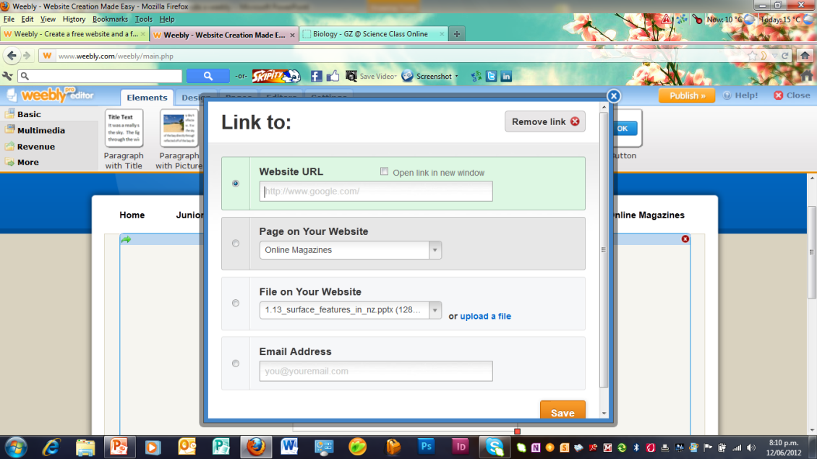
8. Link the picture to a file on your computer by pushing upload file
Or link to another website by cut and pasting the URL (click open in new window)
9. Once you are happy with how the site looks push publish before you exit and after each time you are updating.
Your new website is ready to use!
Keep adding to your site every time you create useful electronic resources or find a website that is relevant to the topic.
Email the parents so they are aware of the website and inform them if their child is away then they can download material to catch up from there.
Once a number of websites are prepared a main CHS Science Faculty page will be ready to place links to all of them.

Slide 4
Main page:
Page organisation for website
Subject 1 | Subject 5
Subject 2 | Subject 6
Subject 3 | Subject 7
Subject 4 | Subject 8
Class 1:
Subject 1 | Subject 5
Subject 2 | Subject 6
Subject 3 | Subject 7
Subject 4 | Subject 8
Class 2:
Subject 1 | Subject 5
Subject 2 | Subject 6
Subject 3 | Subject 7
Subject 4 | Subject 8
Class 3:
Subject 1 | Subject 5
Subject 2 | Subject 6
Subject 3 | Subject 7
Subject 4 | Subject 8
Class 4:
Subject 1 | Subject 5
Subject 2 | Subject 6
Subject 3 | Subject 7
Subject 4 | Subject 8
Class 5:

