Slide 1
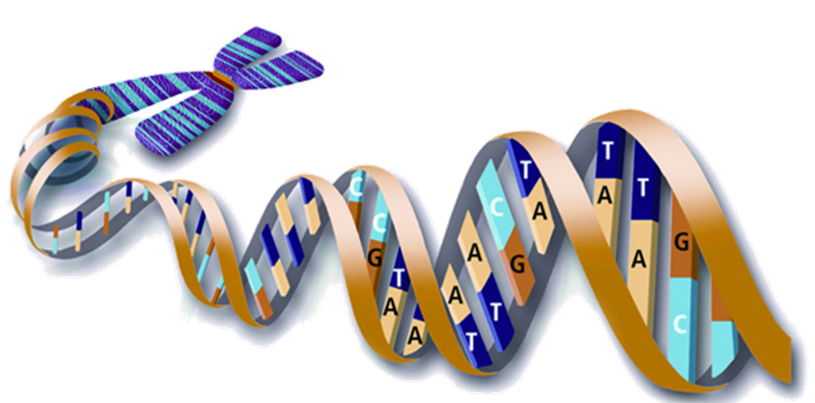
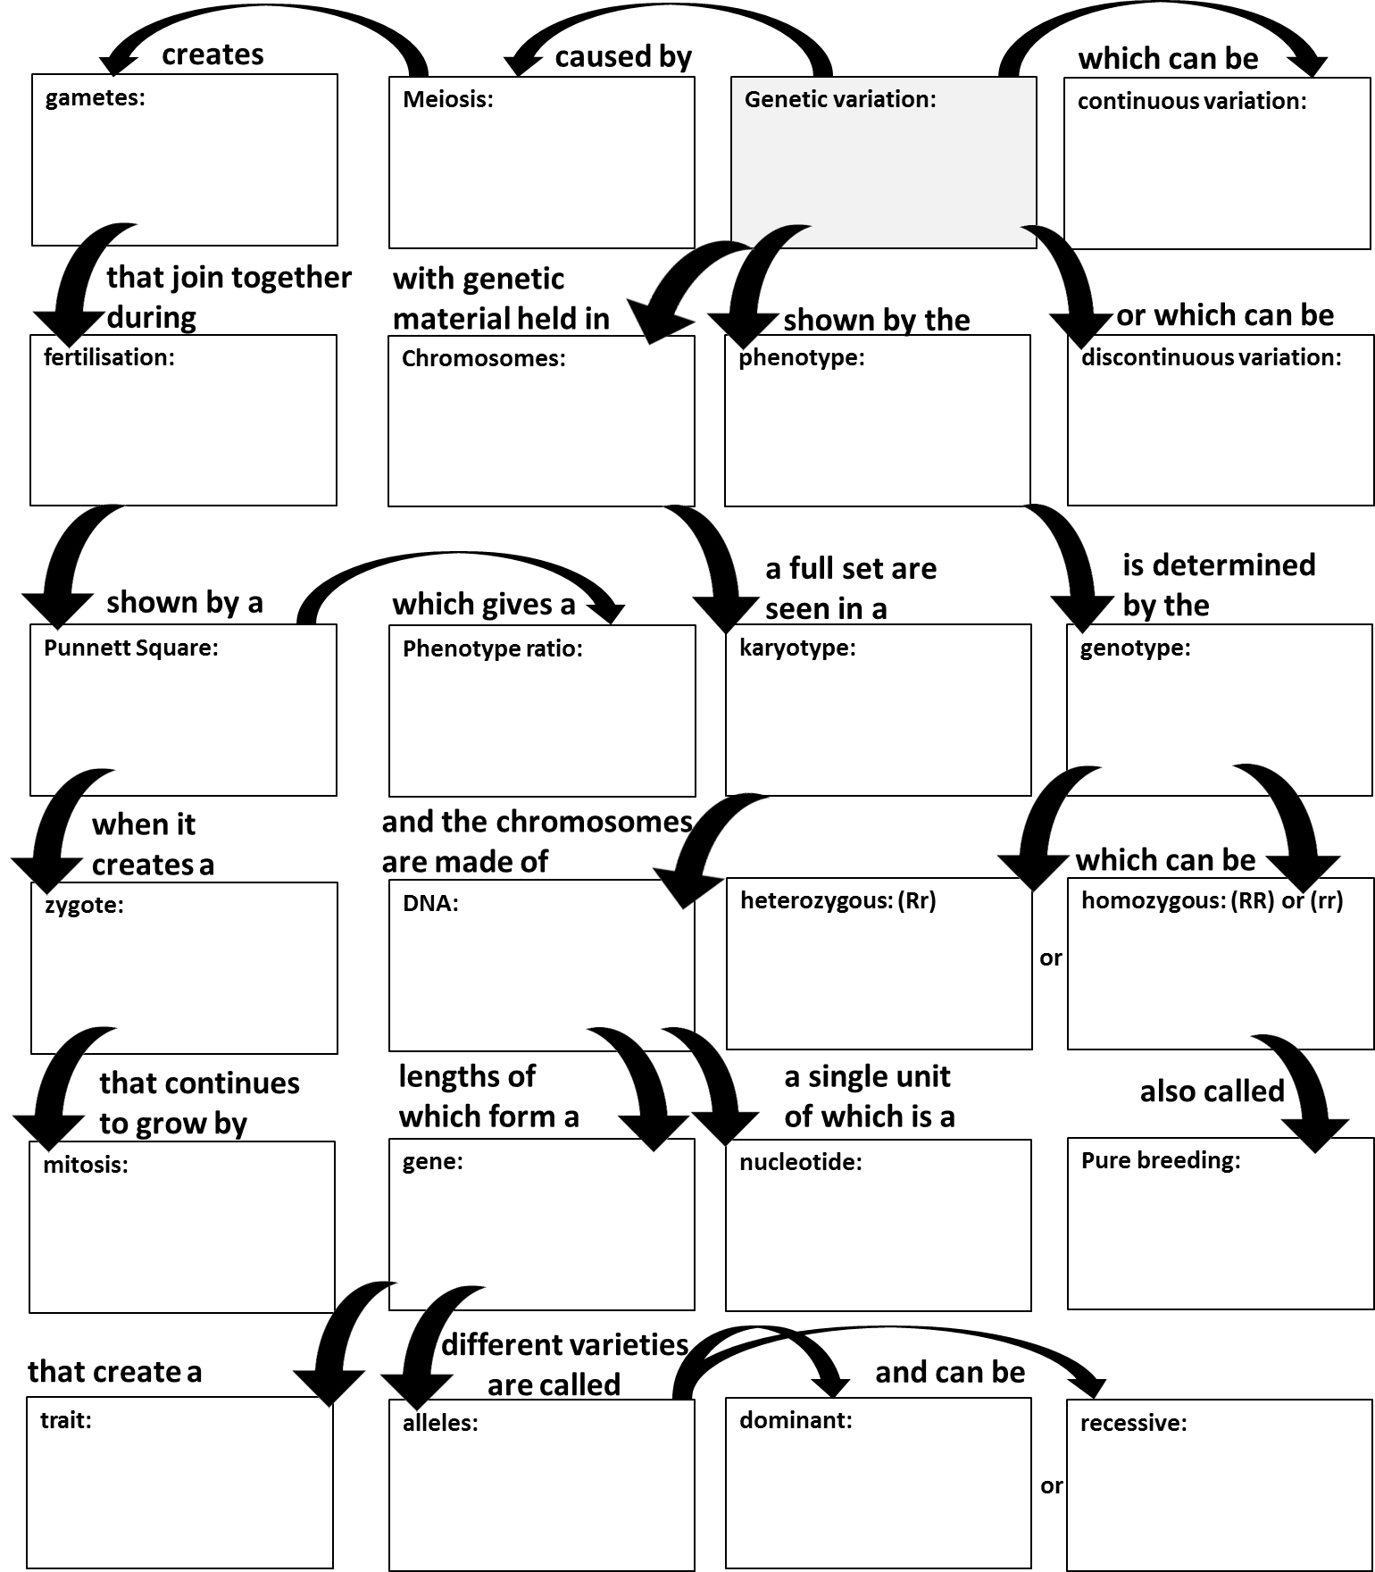
Genetic Definitions
Karyotype:

Slide 2
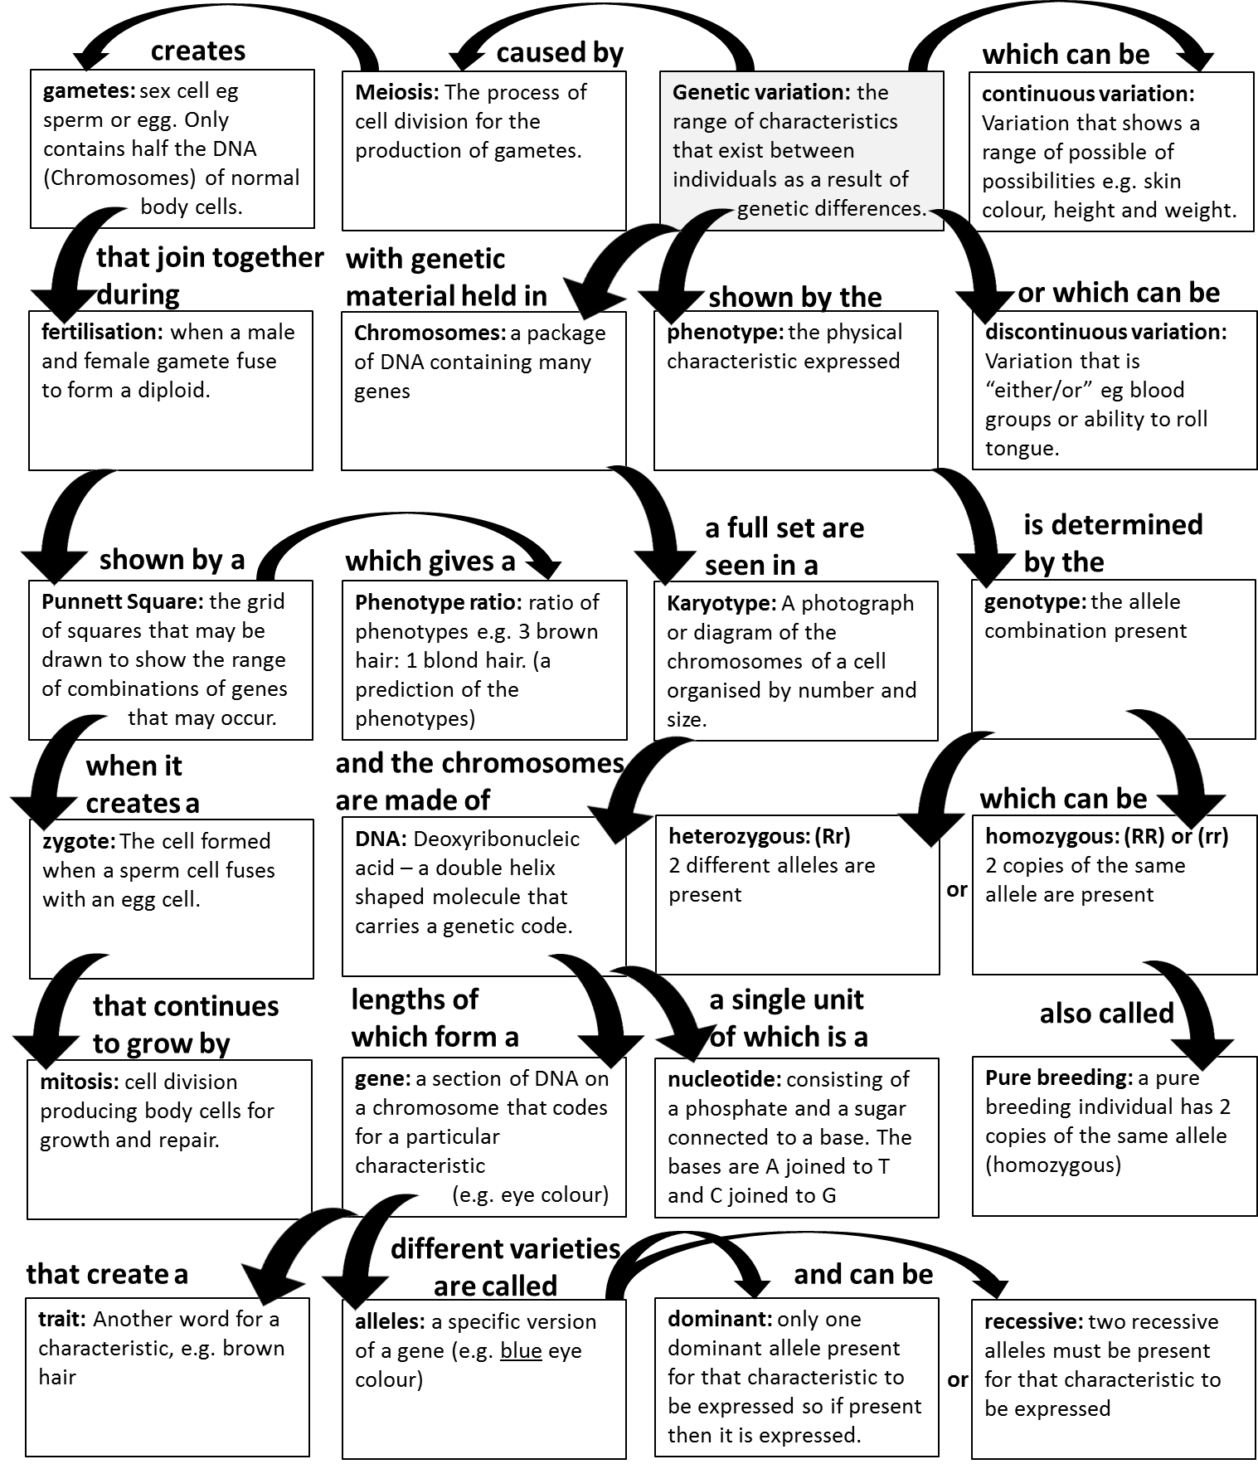
Genetic Definitions

Slide 3
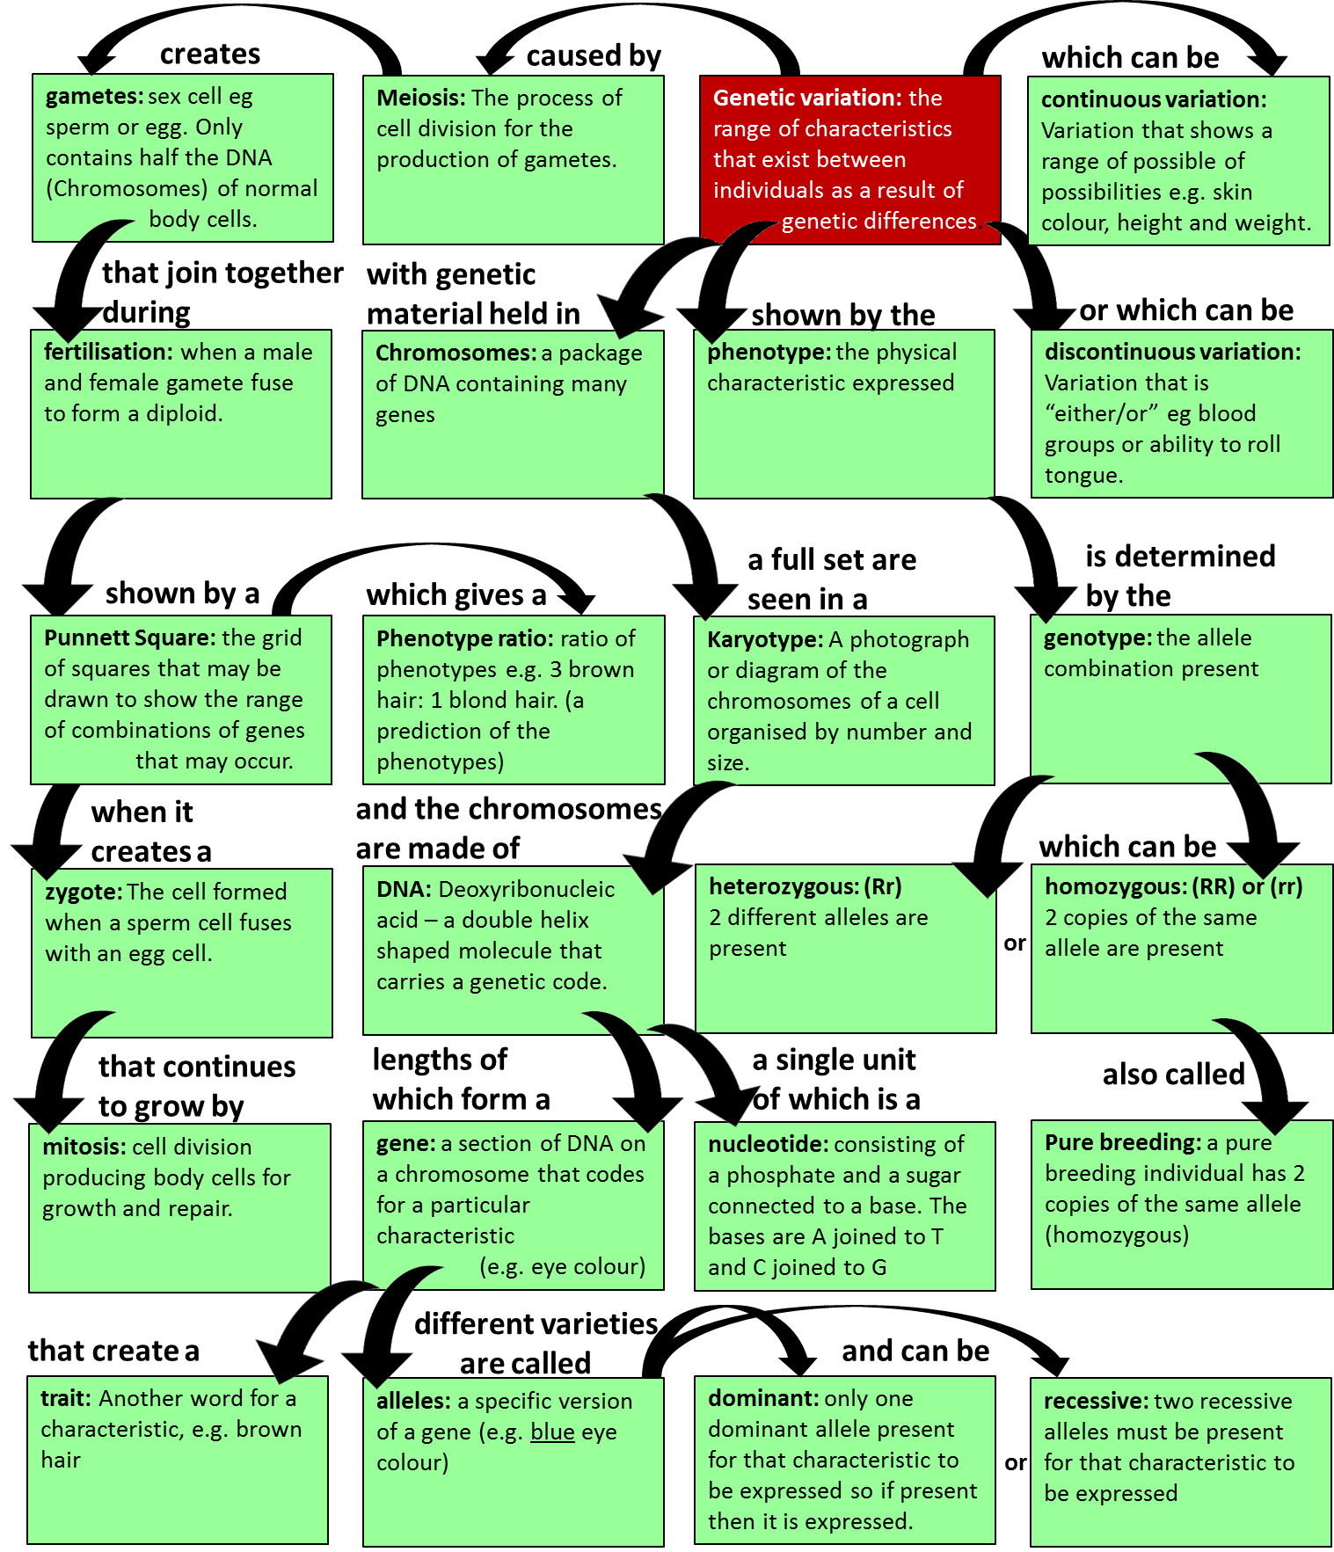
Genetic Definitions

Slide 4
Genetic Definitions
a specific version of a gene (e.g. blue eye colour)
a package of DNA containing many genes.
Variation that shows a range of possible of possibilities e.g. skin colour, height and weight.
Variation that is “either/or” eg blood groups or ability to roll tongue.
Deoxyribonucleic acid – a double helix shaped molecule that carries a genetic code.
only one dominant allele must be present for that characteristic to be expressed OR if this allele is present then it is expressed.
when a male and female gamete fuse to form a diploid.
sex cell eg sperm or egg. Only contains half the DNA (Chromosomes) of normal body cells.
a section of DNA on a chromosome that codes for a particular characteristic (e.g. Eye colour)
the range of characteristics that exist between individuals as a result of genetic differences.
the allele combination present
2 different alleles are present (e.g. Bb)
2 copies of the same allele are present (e.g. BB or bb)
A photograph or diagram of the chromosomes of a cell organised by number and size.
The process of cell division for the production of gametes.
cell division producing body cells for growth and repair
ratio of phenotypes e.g. 3 brown hair: 1 blond hair. (This is a prediction of the phenotypes and their occurrence from a punnet square)
the physical characteristic expressed
A name given to the grid of squares that may be drawn to show the range of combinations of genes that may occur.
a pure breeding individual has 2 copies of the same allele (homozygous)
two recessive alleles must be present for that characteristic to be expressed.
Another word for a characteristic, e.g. brown hair
The cell formed when a sperm cell fuses with an egg cell.

Slide 5
Allele: a specific version of a gene (e.g. blue eye colour)
Chromosome: a package of DNA containing many genes.
Continuous Variation: Variation that shows a range of possible of possibilities e.g. skin colour, height and weight.
Discontinuous Variation: Variation that is “either/or” eg blood groups or ability to roll tongue.
DNA: Deoxyribonucleic acid – a double helix shaped molecule that carries a genetic code.
Dominant: only one dominant allele must be present for that characteristic to be expressed OR if this allele is present then it is expressed.
Fertilisation: when a male and female gamete fuse to form a diploid.
Gametes: sex cell eg sperm or egg. Only contains half the DNA (Chromosomes) of normal body cells.
Gene: a section of DNA on a chromosome that codes for a particular characteristic (e.g. Eye colour)
Genetic Variation: the range of characteristics that exist between individuals as a result of genetic differences.
Genotype: the allele combination present
Heterozygous: 2 different alleles are present (e.g. Bb)
Homozygous: 2 copies of the same allele are present (e.g. BB or bb)
Karotype: A photograph or diagram of the chromosomes of a cell organised by number and size.
Meiosis: The process of cell division for the production of gametes.
Mitosis: cell division producing body cells for growth and repair
Phenotype Ratio: ratio of phenotypes e.g. 3 brown hair: 1 blond hair. (This is a prediction of the phenotypes and their occurrence from a punnet square)
Phenotype: the physical characteristic expressed
Punnet square: A name given to the grid of squares that may be drawn to show the range of combinations of genes that may occur.
Pure Breeding: a pure breeding individual has 2 copies of the same allele (homozygous)
Recessive: two recessive alleles must be present for that characteristic to be expressed
Trait: Another word for a characteristic, e.g. brown hair
Zygote: The cell formed when a sperm cell fuses with an egg cell.
*Extension – Haploid: contains half the DNA (Chromosomes) of an organism compared to a normal cell.
*Extension - Diploid: a normal cell containing a full complement of the organisms DNA (chromosomes)

