Slide 1
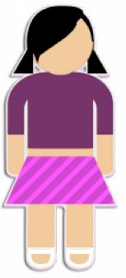
46
Variation Summary
mutation
stage
adult
23
process
Independent assortment
sperm
fertilisation
Source of variation
gametes
meiosis
egg
Random gamete pairing
Crossing over
zygote
Environmental influences
23
mitosis
46
46
46
baby
Asexual reproduction
46
mitosis
46
mitosis
Number of chromosomes
embryo

Slide 2
Variation Summary
stage
process
Source of variation
gametes
46
Asexual reproduction
Number of chromosomes

