Slide 1
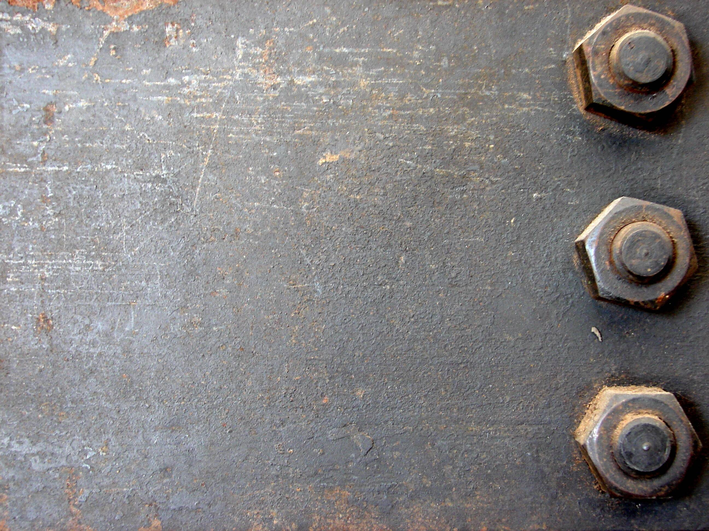
Metals
Junior Science

Slide 2
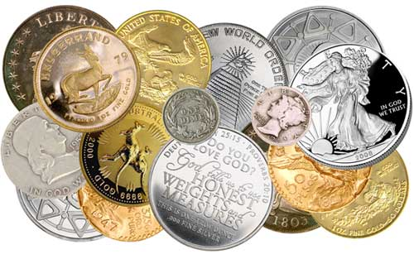
8a
Metals
Metals can be distinguished from non-metals by their physical properties; they are strong, dense, shiny solids that can be worked into different shapes. They are good conductors of heat and electricity.

Slide 3
8a
The Physical Properties of Metals
Physical properties of Metals
Electrical conductivity allow electricity to pass through
State solid liquid or gas
Colour of the substance
Lustre shininess of an object
Ductility drawn into a wire
Density mass of a standard volume
Melting point temp solid turns to liquid
Malleability beaten flat without breaking
Thermal conductivity allowing heat to pass through
Mass amount of matter in an object (kg)
Substances can be distinguished by their different physical properties.
Some groups of substances, such as metals, can show similar physical properties.

Slide 4
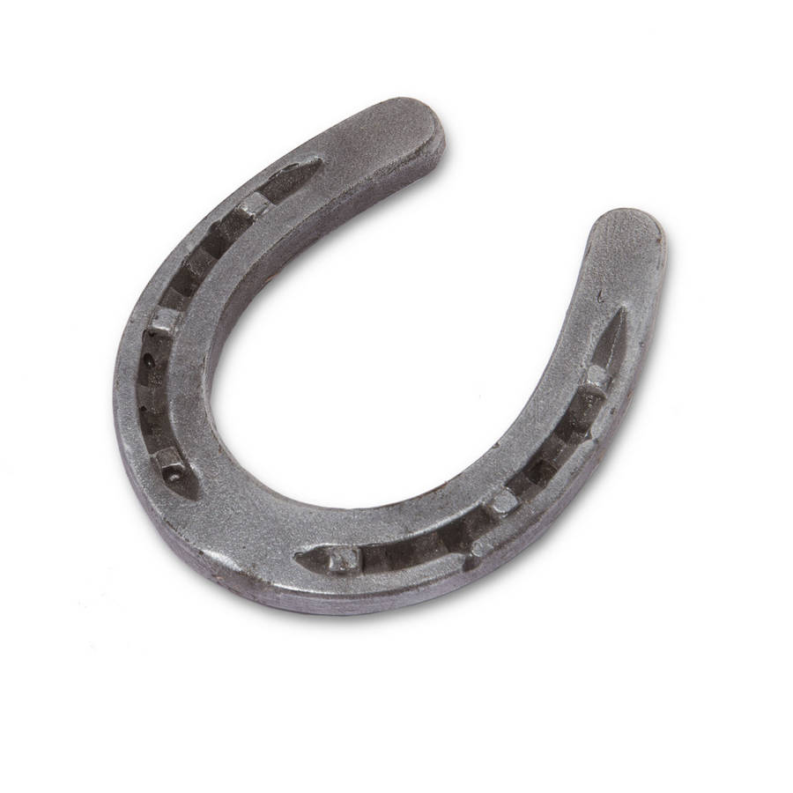
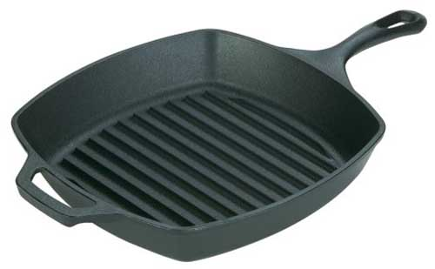
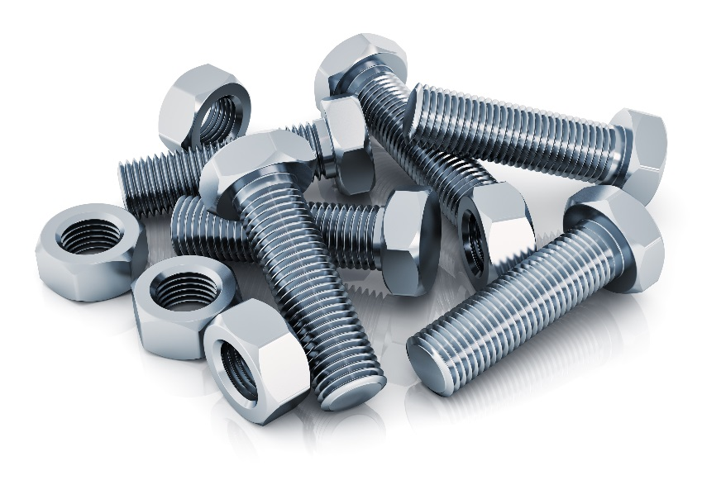
8c
Metal physical properties – Iron (once processed)
•Ductile, malleable & tough. •Shrinks on cooling •Making water pipes, gas pipes and sewers •Making ornamental castings such as brackets, gates, lamp posts, spiral staircases etc. •Making parts of machinery •Becomes soft at white heat & can be easily welded. •Can be used to form temporary magnets. •used where a tough material is required. •Used for rivets, chains, ornamental iron work, railway lines, water and steam pipes, bolts, nails and nuts, horse shoes, handrails, roofing sheets, electro-magnets

Slide 5
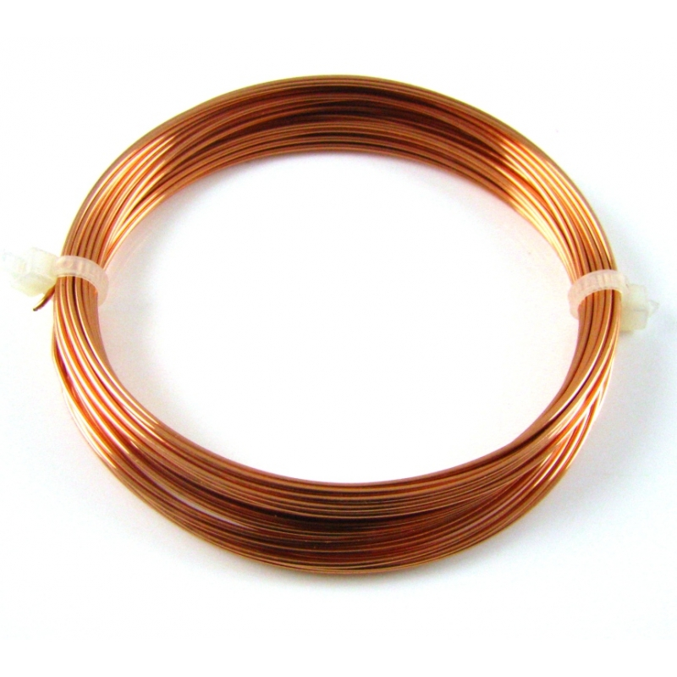
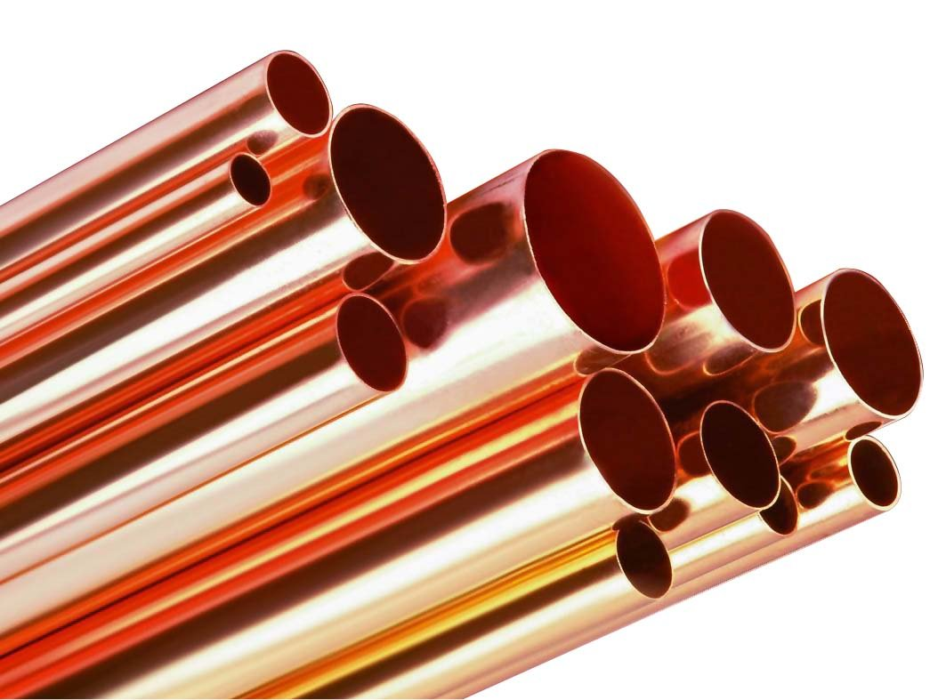
8c
Metal physical properties – Copper
• Reddish-brown in colour • Malleable • ductile • good heat and electrical conductivity •Electrical wires •Heating pipes •Roofing

Slide 6
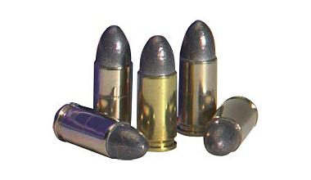
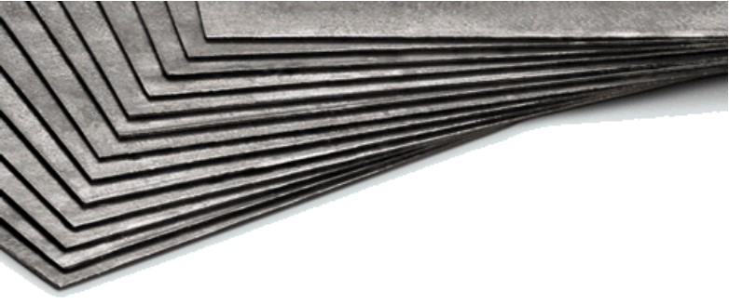
8c
Metal physical properties – Lead
•can be cut with a knife. •Lustrous (shiny) & heavy metal •bluish-grey colour •very soft & plastic (can be easily moulded) at room temperature •Making shots, bullets, alloys, storage cells •toilet fittings, water-proof and acid proof chambers •gas pipes, roof gutters •damp-proof courses of buildings, cable coverings •plates for storage batteries, covering for electrical cables

Slide 7
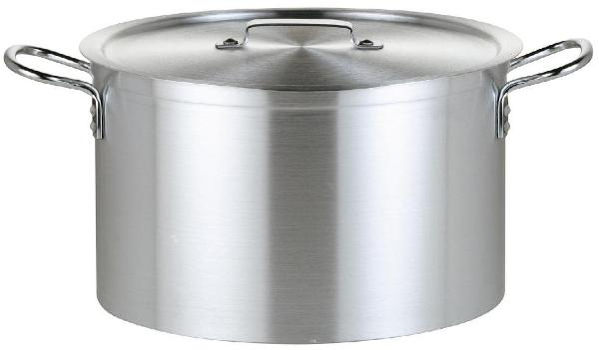
8c
Metal physical properties – Aluminium
•Silver in colour •Very strong but light in weight •very good conductor of heat and electricity •non-magnetic substance •Soft & malleable •Ductile •making automobile bodies, engine parts •casting of steel •manufacture of electrical conductors •Making drink cans, high tension wires

Slide 8
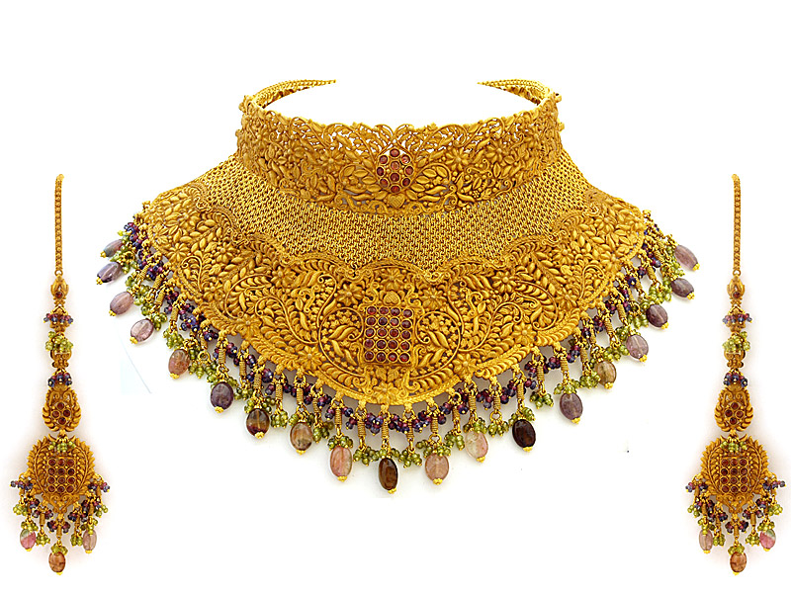
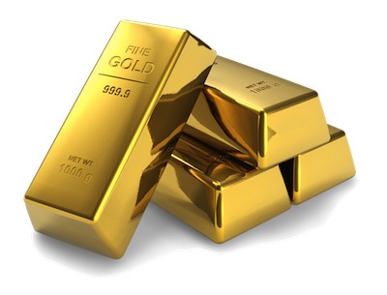
8c
Metal physical properties – Gold
•yellow gold in colour •Very soft and malleable and heavy in weight •very good conductor of heat and electricity •Ductile •Jewellery and decorative objects •manufacture of audio wires and fittings •gold bullion (bars) and coins

Slide 9
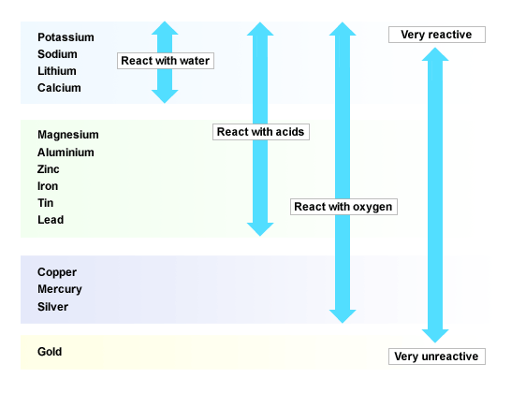
9a
Metal reactivity
Metals react with other chemicals with varying speed or not at all. Differences in reactivity are shown in the reactivity series of metals. Metals will react faster if they are more reactive – more reactive metals give up their electrons more readily to react with other chemicals

Slide 10
9c
Metal Chemical Properties
The reactivity of metals also determines the uses we have for metals.
Aluminium is very unreactive (once an oxide coat forms) and can be used outside for windows, boats, airplanes, pipes without needing to be painted.
Copper is also unreactive and can be used outside for decorative roofing and water pipes
Gold is another unreactive metal and can be worn as jewellery with out reacting to the persons skin or water.
Zinc is reactive but can be used to cover iron (which rusts) in a process called galvanising. The zinc becomes the “sacrificial metal” and will react first and prevent the iron rusting. Galvanised iron is used for roofing material.
Lead is not very reactive but it is no longer used for water pipes as it poisons people who drink from them.

Slide 11
Some metals are more suitable for certain uses than others because of their Physical and Chemical properties - Summary
9c
We select appropriate metals which are the most useful for the task or technology they assist with because of their particular characteristics.
Metal | Uses | Property involved
copper | Pipes. Wires. cooking pots | Unreactive with air and water Excellent electrical conductor good thermal conductor
aluminium | Aircraft frames wires | Strong light and unreactive Good conductor and ductile
mercury | thermometers | Expands regularly with heat
lead | Roof flashing | Very malleable
zinc | galvanising | Forms a protective coat
tin | Tin coating | Unreactive with air and water
silver | jewellery | Malleable, ductile, unreactive
iron | Car bodies Structural steel | Forms strong alloys, malleable Forms strong alloys, flexible

Slide 12
Metals and non-metals
Group | Physical properties | Chemical properties
Metals | >Lustre >good conductor >High density >High melting point >Malleable and Ductile | >Easily lose electrons >Corrode easily
Semi-Metals | >Solids >Can be shiny or dull >Ductile and malleable >Conduct heat and energy better than Non Metals but not as good as metals
Non-Metals | >No lustre >Poor conductor >Brittle >Not ductile >Low density >Low melting point | >Tend to gain electrons

Slide 13
10
Metals form oxides by reaction with oxygen
Metals react with oxygen in the air to produce metal oxides, like magnesium oxide.
Electrons are lost from the metal to form a cation (positive ion) and gained by the oxygen to form an anion – oxide (negative ion). The cation and anion then join together to form a neutral metal oxide.

Slide 14
10
Metals form oxides by reaction with oxygen
2Mg + O₂ → 2MgO
Magnesium + Oxygen Magnesium Oxide
12p
+ve
-ve
12p

Slide 15
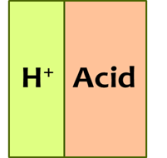
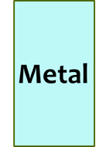
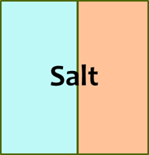
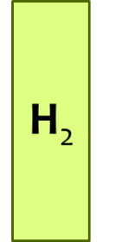
10
Metals form salts and hydrogen gas when reacting with acid
Acids react with metals to give a salt and hydrogen. Most metals will react with acid – especially if the acid is heated and concentrated
O
O
H
Mg
S
H
O
O

Slide 16
10
Metals form salts and hydrogen gas when reacting with acid
Mg + H₂SO₄ → MgSO₄ + H₂
Magnesium + Sulfuric Magnesium + hydrogen
Acid sulfate gas
O
O
+ve
H
Mg
S
H
O
O
-ve

Slide 17
10
Metal reactions summary
1. Metal and water
General equation metal + water → hydrogen + metal hydroxide
Word equation calcium + water → hydrogen + calcium hydroxide
Formula equation Ca + 2H₂O → H₂ + Ca(OH)₂
2. Metal and Acid
General equation acid + metal → salt + hydrogen gas
Word equation sulfuric acid + calcium → calcium sulfate + hydrogen gas
Formula equation H₂SO₄ + Ca → CaSO₄ + H₂
3. Metal and Oxygen
General equation metal + oxygen → metal oxide
Word equation magnesium + oxygen → magnesium oxide
Formula equation 2Mg + O₂ → 2MgO

