Slide 1
NCEA REVISION NCEA Science 1.5
Acids and Bases AS 90944

Slide 2
Achievement Criteria
Aspects of acids and bases will be selected from:
Atomic structure
electron arrangement of atoms and monatomic ions of the first 20 elements (a periodic table will be provided)
ionic bonding
names and formulae of ionic compounds using a given table of ions.
Properties
acids release hydrogen ions in water (HCl ; hydrochloric acid, H₂SO_{4 :} sulphuric acid, HNO_{3 :} nitric acid)
reactions (of acids with bases) to form salts
pH and effects on indicators.
Uses
neutralisation
carbon dioxide formation
salt formation.
Rates of reaction and particle theory.
AS 90944
S1.5

Slide 3
NCEA 2012 Electron Configuration - (Part ONE)
Question 1a: Complete the table below for ions formed by Ca, F, and Cl.
 | Atomic Number | Electron arrangement of atom | Electron arrangement of ion | Ion symbol
Ca
F
Cl
Cl
2
8
7
Cl⁻
2
8
8
One electron is gained by the atom
Number of protons = 17
Number of electrons = 17
Charge = 0 (neutral)
Number of protons = 17
Number of electrons = 18
Charge = -1
e-

Slide 4
Achieved
Question
NCEA 2012 Electron Configuration - (Part ONE)
Question 1a: Complete the table below for ions formed by Ca, F, and Cl.
 | Atomic Number | Electron arrangement of atom | Electron arrangement of ion | Ion symbol
Ca | 20 | 2,8,8,2 | 2,8,8 | Ca²⁺
F | 9 | 2,7 | 2,8 | F⁻
Cl | 17 | 2,8,7 | 2,8,8 | Cl⁻
Cl
2
8
7
Cl⁻
2
8
8
One electron is gained by the atom
Number of protons = 17
Number of electrons = 17
Charge = 0 (neutral)
Number of protons = 17
Number of electrons = 18
Charge = -1
e-

Slide 5
NCEA 2012 Electron Configuration - (Part TWO)
Question 1b: Explain the charges on ALL three ions, in terms of electron
arrangement and number of protons. Use their positions on the periodic table to explain why two of the atoms form ions with the same charge, AND two of the atoms form ions with the same electron arrangement.

Slide 6
Excellence
Question
NCEA 2012 Electron Configuration - (Part TWO)
Question 1b: Explain the charges on ALL three ions, in terms of electron
arrangement and number of protons. Use their positions on the periodic table to explain why two of the atoms form ions with the same charge, AND two of the atoms form ions with the same electron arrangement.
F has 9 protons and electron arrangement of 2,7. Cl has 17 protons and an electron arrangement of 2,8,7. Both atoms are in group 17 of the periodic table as they both have 7 electrons in the valence shell. Both atoms gain one electron to have a full outer shell. For F ion the electron arrangement is 2,8, and for Cl ion it is 2,8,8.
F has a charge of –1 as it now has 10 electrons (–) and 9 protons (+). Cl has a charge of –1 as it now has 18 electrons (–) and 17 protons (+).
Ca has 20 protons and electron arrangement of 2,8,8,2. Ca has two electrons in its outer shell, which it loses, so its new outer shell is full (2,8,8) and it has a charge of +2, as it still has 20 protons (+) and now has only 18 electrons (–). Therefore Ca and Cl ions now both have the same electron configuration of 2,8,8.

Slide 7
NCEA 2013 Electron Configuration - (Part ONE)
Question 1a: F–, Ne, and Mg²⁺ have the same electron arrangement.
(a) Complete the table below.
 | Atomic Number | Number of protons | Number of electrons | Electron arrangement
F⁻
Ne
Mg²⁺
F
2
7
F⁻
2
8
One electron is gained by the atom
Number of proton = 9
Number of electrons = 9
Charge = 0 (neutral)
Number of proton = 9
Number of electrons = 10
Charge = -1
e-

Slide 8
Achieved
Question
NCEA 2013 Electron Configuration - (Part ONE)
Question 1a: F–, Ne, and Mg²⁺ have the same electron arrangement.
(a) Complete the table below.
 | Atomic Number | Number of protons | Number of electrons | Electron arrangement
F⁻ | 9 | 9 | 10 | 2,8
Ne | 10 | 10 | 10 | 2,8
Mg²⁺ | 12 | 12 | 10 | 2,8
F
2
7
F⁻
2
8
One electron is gained by the atom
Number of proton = 9
Number of electrons = 9
Charge = 0 (neutral)
Number of proton = 9
Number of electrons = 10
Charge = -1
e-

Slide 9
NCEA 2013 Electron Configuration - (Part TWO)
Question 1b: Compare the atomic structure of F–, Ne, and Mg²⁺.
In your answer you should:
• describe the difference between an atom and an ion
• explain the charges on F–, Ne, and Mg²⁺ in terms of electron arrangement and number of protons
• relate the position of F–, Ne, and Mg²⁺ on the periodic table to the charges and electron arrangement
• explain why all three have the same electron arrangement.

Slide 10
Excellence
Question
NCEA 2013 Electron Configuration - (Part TWO)
Question 1b: Compare the atomic structure of F–, Ne, and Mg²⁺.
In your answer you should:
• describe the difference between an atom and an ion
• explain the charges on F–, Ne, and Mg²⁺ in terms of electron arrangement and number of protons
• relate the position of F–, Ne, and Mg²⁺ on the periodic table to the charges and electron arrangement
• explain why all three have the same electron arrangement.
The difference between an ion and an atom is that an atom has a neutral charge as it has not gained or lost electrons and therefore has the same number of protons (+) and electrons (–) whereas an ion has a charge as the atom it was formed from has either gained or lost electrons to form a full outer shell and therefore has a different number of protons (+) from the number of electrons (–).

Slide 11
NCEA 2013 Electron Configuration - (Part TWO)

Slide 12
Excellence
Question
NCEA 2013 Electron Configuration - (Part TWO)
Explanation of charges
Fluorine has 9 protons and electron arrangement of 2,7. Neon has 10 protons and an electron arrangement of 2,8. Magnesium has 12 protons and an electron arrangement of 2,8,2.
Fluorine gains one electron to have a full outer shell. This is because it is in group 17 and has 7 valence electrons. For fluorine ion, the electron arrangement is 2,8.
Fluorine has a charge of –1 as it now has 10 electrons (negative charges) and nine protons (positive charges).
Neon has no charge as it has the same number of protons and electrons, as it has not gained or lost electrons, as it has an electron arrangement of 2,8 because it is in group 18 of the periodic table and its valence shell is complete.
Magnesium has 12 protons and electron arrangement of 2,8,2.
Magnesium has two electrons in its outer shell as it is in group 2 of the periodic table, which it loses, so its outer shell is full (2,8) and it has a charge of +2, as it still has 12 protons (positive charges) and now has only 10 electrons (negative charges).
All three have the same electron arrangement as they have gained one electron, lost two electrons or have neither gained or lost electrons. The electron arrangement is 2,8 as this is the nearest possible stable electron arrangement for all three.

Slide 13
NCEA 2014 Electron Configuration - (Part ONE)
Question 1b: Complete the table below for the ions formed by magnesium, aluminium, and oxygen.
 | Atomic Number | Electron arrangement of atom | Electron arrangement of ion | Charge on ion
Mg
Al
O
Al
Al³⁺
2
8
2
8
3
Three electrons are lost by the atom
Number of proton = 13
Number of electrons = 13
Charge = 0 (neutral)
Number of proton = 13
Number of electrons = 10
Charge = +3
e-
e-
e-

Slide 14
Achieved
Question
NCEA 2014 Electron Configuration - (Part ONE)
Question 1b: Complete the table below for the ions formed by magnesium, aluminium, and oxygen.
 | Atomic Number | Electron arrangement of atom | Electron arrangement of ion | Charge on ion
Mg | 12 | 2,8,2 | 2,8 | +2
Al | 13 | 2,8,3 | 2,8 | +3
O | 8 | 2,6 | 2,8 | -2
Al
Al³⁺
2
8
2
8
3
Three electrons are lost by the atom
Number of proton = 13
Number of electrons = 13
Charge = 0 (neutral)
Number of proton = 13
Number of electrons = 10
Charge = +3
e-
e-
e-

Slide 15
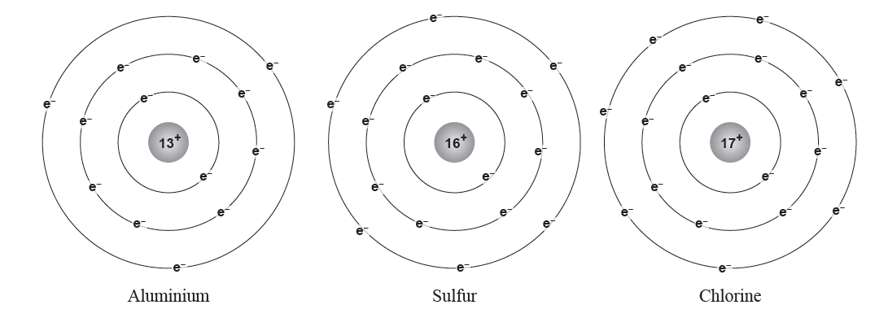
NCEA 2015 Electron Configuration
The diagrams below show models of three different atoms
Question 2a: Each of these atoms can form ions, as listed below.
• Explain why each of the ions has the charge it does, in terms of electron arrangement and number of protons.
• Ions are charged atoms. Explain how each of the ions below reached the charge shown.
You should discuss particles gained or lost by the atoms involved, and the reasons for this.
Aluminium ion, Al³⁺: Sulfide ion, S^{2–} : Chloride ion, Cl– :

Slide 16
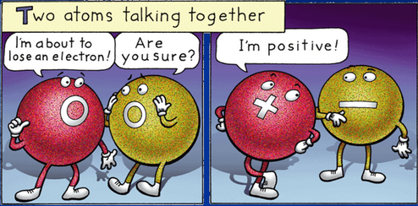
NCEA 2015 Electron Configuration
Excellence
Question
Answer 2a: Al³⁺ because it has 13 protons (+ charges) and only 10 electrons (– charges). It has only 10 electrons, as its electron arrangement as an atom was 2,8,3, and when it forms an ion, it loses three electrons to form an arrangement of 2,8 to have a full outer shell, which is more stable.
S^{2–} because it has 16 protons (+ charges) and 18 electrons (– charges). It has 18 electrons, as its electron arrangement as an atom was 2,8,6, and when it forms an ion, it gains two electrons to form an arrangement of 2,8,8 to have a full outer shell, which is more stable.
Cl– because it has 17 protons (+ charges) and 18 electrons (– charges). It has 18 electrons, as its electron arrangement as an atom was 2,8,7, and when it forms an ion it gains one electron to form an arrangement of 2,8,8 to have a full outer shell, which is more stable.

Slide 17
NCEA 2016 Electron Configuration
Question 1a: Complete the table below.
Element | Atomic Number | Electron arrangement of atom | Electron arrangement of ion
F
S
Ca
F
2
7
F⁻
2
8
One electron is gained by the atom
Number of proton = 9
Number of electrons = 9
Charge = 0 (neutral)
Number of proton = 9
Number of electrons = 10
Charge = -1
e-

Slide 18
Achieved
Question
NCEA 2016 Electron Configuration
Question 1a: Complete the table below.
Element | Atomic Number | Electron arrangement of atom | Electron arrangement of ion
F | 9 | 2,7 | 2,8
S | 16 | 2,8,6 | 2,8,8
Ca | 20 | 2,8,8,2 | 2,8,8
F
2
7
F⁻
2
8
One electron is gained by the atom
Number of proton = 9
Number of electrons = 9
Charge = 0 (neutral)
Number of proton = 9
Number of electrons = 10
Charge = -1
e-

Slide 19
NCEA 2016 Electron Configuration
Question 1c (i) : Sodium burns in oxygen gas, O₂, to form sodium oxide, Na₂O.
(i) Explain how the Na and O atoms form Na⁺ and O^{2–} ions, in terms of their groups in the periodic table, electron arrangement, AND number of protons.

Slide 20
Excellence
Question
NCEA 2016 Electron Configuration
Question 1c (i) : Sodium burns in oxygen gas, O₂, to form sodium oxide, Na₂O.
(i) Explain how the Na and O atoms form Na⁺ and O^{2–} ions, in terms of their groups in the periodic table, electron arrangement, AND number of protons.
Answer 1c (i) : Na is a group one element, so the Na atom has one valence electron and an electron configuration of 2, 8, 1. The Na atom loses its one valence electron to gain a full outer shell – it now has 1 more proton (11) than electrons; the Na⁺ ion is formed.
O is a group sixteen element, so the O atom has six valence electrons and an electron configuration of 2, 6. The O atom gains two electrons to gain a full outer shell – it now has 2 less protons (8) than electrons; the O^{2–} ion is formed.

Slide 21
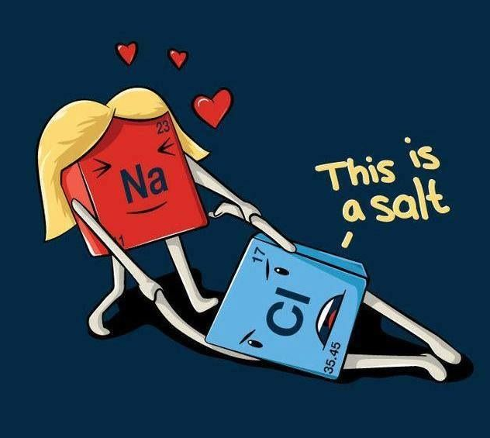
NCEA 2015 Ionic Bonding
Question 2b: Explain why an ionic bond would not form between a sulfide ion and a chloride ion.
In your answer you should:
• describe an ionic bond
• refer to charges and electron arrangements of the ions involved.

Slide 22
NCEA 2015 Ionic Bonding
Question 2b: Explain why an ionic bond would not form between a sulfide ion and a chloride ion.
In your answer you should:
• describe an ionic bond
• refer to charges and electron arrangements of the ions involved.
Excellence
Question
Answer 2b: An ionic bond is the attraction between a positive ion and a negative ion. It is formed because opposite charges will attract one another.
An ionic bond would not form between chloride ions and sulphide ions, as they both have negative charges because they have both gained negative electrons in order to form a full valence shell, and the ions with the same charge will repel each other.

Slide 23
NCEA 2014 Ionic Compounds - (part one)
Q: The formula for magnesium oxide is MgO. The formula for aluminium oxide is Al₂O₃.Explain why the two formulae are different.
In your answer:
• consider the ratio of ions in each formula and explain how the ratio is related to the charge on the ions
• relate the ratio of ions in the formula to the number of electrons lost or gained by each atom..

Slide 24
Excellence
Question
NCEA 2014 Ionic Compounds - (part one)
Q: The formula for magnesium oxide is MgO. The formula for aluminium oxide is Al₂O₃.Explain why the two formulae are different.
In your answer:
• consider the ratio of ions in each formula and explain how the ratio is related to the charge on the ions
• relate the ratio of ions in the formula to the number of electrons lost or gained by each atom..
Fully explains the ratio of ions in magnesium oxide
Step one: charge of ions - Magnesium ion has a charge of +2 and oxide ion has a charge of –2.
Step two: neutral compounds - A compound overall has to have no charge. Therefore the +2 charge of magnesium ion cancels out the –2 charge of oxide ion and so therefore the ratio of ions is one to one.
Step three: movement of electrons - The charge on the ions arises as magnesium
has to lose two electrons in order to have a full outer shell and gets a charge of +2, and oxygen has to gain two electrons in order to have a full outer shell and gets a charge of –2.

Slide 25
NCEA 2014 Ionic Compounds - (part two)
Q: The formula for magnesium oxide is MgO. The formula for aluminium oxide is Al₂O₃.Explain why the two formulae are different.
In your answer:
• consider the ratio of ions in each formula and explain how the ratio is related to the charge on the ions
• relate the ratio of ions in the formula to the number of electrons lost or gained by each atom..

Slide 26
Excellence
Question
NCEA 2014 Ionic Compounds - (part two)
Q: The formula for magnesium oxide is MgO. The formula for aluminium oxide is Al₂O₃.Explain why the two formulae are different.
In your answer:
• consider the ratio of ions in each formula and explain how the ratio is related to the charge on the ions
• relate the ratio of ions in the formula to the number of electrons lost or gained by each atom..
Fully explains the ratio of ions in aluminium oxide
Step one: charge of ions - Aluminium ion has a charge of +3, and oxide ion has a charge of -2.
Step two: neutral compounds - A compound overall has to have no charge. two aluminium ions with a combined charge of +6 are required to cancel out the charge on three oxide ions with a combined charge of –6.
Step three: movement of electrons - The charge on the ions arises as aluminium has to lose three electrons in order to have a full outer shell and gets a charge of +3, and oxygen has to gain two
electrons in order to have a full outer shell and gets a charge of –2.

Slide 27
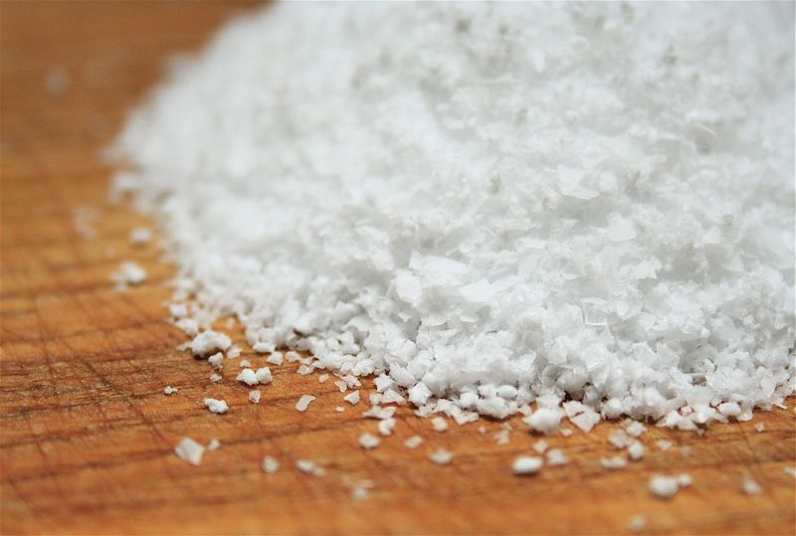
NCEA 2014 Ionic Compounds
Question 1a: Write the formulae for the following ionic compounds.
(i) Calcium chloride
(ii) Sodium nitrate
(iii) Zinc nitrate

Slide 28
Achieved
Question
NCEA 2014 Ionic Compounds
Question 1a: Write the formulae for the following ionic compounds.
(i) Calcium chloride
(ii) Sodium nitrate
(iii) Zinc nitrate
Answer 1a:
Calcium chloride- CaCl₂
Sodium nitrate - NaNO₃
Zinc nitrate - Zn(NO₃)₂

Slide 29
NCEA 2015 Ionic Compounds - (Part ONE)
Question 2c: Determine the ionic formulae of the compound that forms when aluminium combines with chlorine, AND when aluminium combines with sulfur.
In your answer you should:
• consider the ratio of ions in each formula, and explain how the ratio is related to the charge on the ions
• relate the ratio of ions in each formula to the number of electrons lost or gained by each atom when forming ions.
Aluminium and chlorine: Aluminium and sulfur:

Slide 30
Excellence
Question
NCEA 2015 Ionic Compounds - (Part ONE)
Question 2c: Determine the ionic formulae of the compound that forms when aluminium combines with chlorine, AND when aluminium combines with sulfur.
In your answer you should:
• consider the ratio of ions in each formula, and explain how the ratio is related to the charge on the ions
• relate the ratio of ions in each formula to the number of electrons lost or gained by each atom when forming ions.
Aluminium and chlorine: Aluminium and sulfur:
Answer 2c: Elements 1 and 3: AlCl₃
Aluminium has a charge of +3. In order to have a neutral compound overall, one aluminium ion is required to cancel out the charge on three chloride ions with a combined charge of –3. The charge on the aluminium ion arises as it gives away three electrons in order to have a full outer shell. Because it has to give 3 electrons away and each chlorine has to accept one electron, in order to have a full shell, the ratio of ions required is one to three.

Slide 31
NCEA 2015 Ionic Compounds - (Part TWO)
Question 2c: Determine the ionic formulae of the compound that forms when aluminium combines with chlorine, AND when aluminium combines with sulfur.
In your answer you should:
• consider the ratio of ions in each formula, and explain how the ratio is related to the charge on the ions
• relate the ratio of ions in each formula to the number of electrons lost or gained by each atom when forming ions.
Aluminium and chlorine: Aluminium and sulfur:

Slide 32
Excellence
Question
NCEA 2015 Ionic Compounds - (Part TWO)
Question 2c: Determine the ionic formulae of the compound that forms when aluminium combines with chlorine, AND when aluminium combines with sulfur.
In your answer you should:
• consider the ratio of ions in each formula, and explain how the ratio is related to the charge on the ions
• relate the ratio of ions in each formula to the number of electrons lost or gained by each atom when forming ions.
Aluminium and chlorine: Aluminium and sulfur:
Answer 2c: Element 1 and 2: Al₂S₃
The aluminium ion has a charge of +3. In order to have a neutral compound overall, two aluminium ions with a combined charge of +6 are required to cancel out the charge on three 2⁻ sulfide ions with a combined charge of –6. The charge on the aluminium ion arises as aluminium gives away three electrons in order to have a full outer shell. Because it has to give 3 electrons away and sulfur has to accept two electrons in order to have a full shell, the ratio of ions required is two to three.

Slide 33
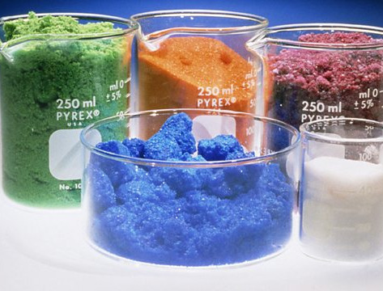
NCEA 2016 Ionic Compounds
Question 1b: Write the formulae for the following ionic compounds.
(i) Silver fluoride
(ii) Potassium sulfate
(iii) Calcium nitrate

Slide 34
Achieved
Question
NCEA 2016 Ionic Compounds
Question 1b: Write the formulae for the following ionic compounds.
(i) Silver fluoride
(ii) Potassium sulfate
(iii) Calcium nitrate
Answer 1b:
Silver fluoride - AgF
Potassium sulfate - K₂SO₄
Calcium nitrate - Ca(NO₃)₂

Slide 35
NCEA 2016 Ionic Compounds
Question 1c (ii): Justify the ratio of Na⁺ and O^{2–} ions in the formula Na₂O, in terms of the electrons lost or gained, and the charge on each ion.
Include an explanation of the type of bonding between the Na⁺ and O^{2–} ions.
Na⁺
O²⁻
Ionic bonding
Na⁺

Slide 36
Excellence
Question
NCEA 2016 Ionic Compounds
Question 1c (ii): Justify the ratio of Na⁺ and O^{2–} ions in the formula Na₂O, in terms of the electrons lost or gained, and the charge on each ion.
Include an explanation of the type of bonding between the Na⁺ and O^{2–} ions.
Answer 1c (ii):
The Na atom loses one electron to form the Na⁺ ion; however, the O atom requires two electrons to fill its outer shell. Therefore, two Na atoms react for every one O atom.
The two Na⁺ ions have a total charge of +2 to balance the –2 charge of the O^{2–} ion, i.e. an ionic compound has no overall charge.
The bonding / attraction between the Na⁺ ions and the O^{2–} ions is an ionic bond, formed when the electrons lost by the Na are gained by the O.
Na⁺
O²⁻
Ionic bonding
Na⁺

Slide 37
NCEA 2014 Acids and ions
Question 3c: A student was given two beakers (Beaker 4 and Beaker 5) each containing different liquids. The liquid in Beaker 4 had a pH of 1. The liquid in Beaker 5 had a pH of 6.
Discuss which liquid is more acidic and how you know this.
In your answer you should:
• use the pH to determine which liquid is more acidic
• compare the amount of hydrogen ions AND hydroxide ions in Beaker 4 (pH 1) with the
amount of hydrogen ions AND hydroxide ions in Beaker 5 (pH 6).

Slide 38
Excellence
Question
NCEA 2014 Acids and ions
Question 3c: A student was given two beakers (Beaker 4 and Beaker 5) each containing different liquids. The liquid in Beaker 4 had a pH of 1. The liquid in Beaker 5 had a pH of 6.
Discuss which liquid is more acidic and how you know this.
In your answer you should:
• use the pH to determine which liquid is more acidic
• compare the amount of hydrogen ions AND hydroxide ions in Beaker 4 (pH 1) with the
amount of hydrogen ions AND hydroxide ions in Beaker 5 (pH 6).
Answer 3c:
Beaker with a pH of one is more acidic. In both solutions there are an excess of hydrogen ions compared to hydroxide ions, but in the solution with a lower pH the number of hydrogen ions is much more in excess compared to hydroxide ions; whereas when the pH is 6 the hydrogen ions are still in excess but not by as much.

Slide 39
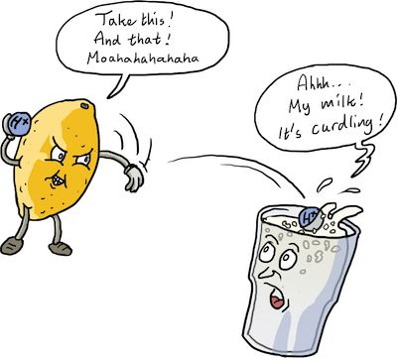
NCEA 2015 Acids and ions
Question 3b: Water is formed in the reaction below.
Explain what ions form water in this reaction, and where they come from.
HCl + NaOH → NaCl + H₂O

Slide 40
NCEA 2015 Acids and ions
Merit
Question
Question 3b: Water is formed in the reaction below.
Explain what ions form water in this reaction, and where they come from.
HCl + NaOH → NaCl + H₂O
Answer 3b:
When HCl reacts it donates an H⁺ and when NaOH reacts it provides OH–, and these two ions combine to form (neutral) H₂O.

Slide 41
NCEA 2012 pH and Indicators - (Part ONE)
Question 3:. Beaker one contains sulfuric acid
solution and 5 drops of universal indicator.
Beaker two contains pure water and 5 drops of universal indicator.
Sodium hydroxide solution was added to both beakers until no more changes were observed.
(b) What is the colour of universal indicator in each solution at the start?
(c) Describe the colour changes as sodium hydroxide solution is added to each beaker, AND explain what this tells you about the changing pH of each solution.
(d) Explain the relationship between the pH of the solutions and the ions in the solutions, as the sodium hydroxide is added to each of the beakers.

Slide 42
Excellence
Question
NCEA 2012 pH and Indicators - (Part ONE)
Question 3:. Beaker one contains sulfuric acid
solution and 5 drops of universal indicator.
Beaker two contains pure water and 5 drops of universal indicator.
Sodium hydroxide solution was added to both beakers until no more changes were observed.
(b) What is the colour of universal indicator in each solution at the start?
(c) Describe the colour changes as sodium hydroxide solution is added to each beaker, AND explain what this tells you about the changing pH of each solution.
(d) Explain the relationship between the pH of the solutions and the ions in the solutions, as the sodium hydroxide is added to each of the beakers.
Beaker one (acid)
The solution would be red to start with as the pH would be 1–2. The ions present in solution would be H⁺. The pH would be low as there is a high number of H⁺ ions present.
As NaOH is added the solution would go orange, then yellow, then green. When the solution is orange and yellow the pH is still less than 7 as there are still more H⁺ than OH– ions. When the solution becomes green the amount of OH– ions added (from the NaOH) cancel out the H⁺ ions from the sulfuric acid and form water in a neutralisation reaction. At this stage the pH would be 7.
As more NaOH is added the solution then becomes blue and then purple. When the solution is blue the pH is 8 -11 as there are now more OH– ions present than H⁺ ions. When it becomes purple the pH is 13 – 14 as there are now many more OH– ions present than H⁺ ions.

Slide 43
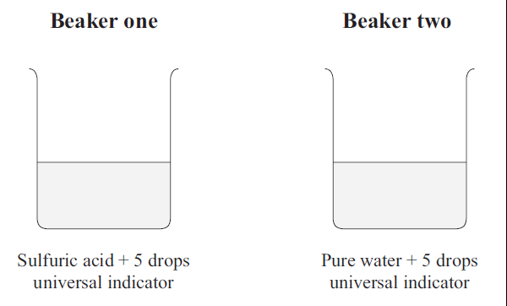
NCEA 2012 pH and Indicators - (Part TWO)
Question 3: Two beakers are shown below. Beaker one contains sulfuric acid
solution and 5 drops of universal indicator.
Beaker two contains pure water and 5 drops of universal indicator.
Sodium hydroxide solution was added to both beakers until no more changes were observed.
(b) What is the colour of universal indicator in each solution at the start?
(c) Describe the colour changes as sodium hydroxide solution is added to each beaker, AND explain what this tells you about the changing pH of each solution.

Slide 44
Excellence
Question
NCEA 2012 pH and Indicators - (Part TWO)
Question 3: Two beakers are shown below. Beaker one contains sulfuric acid
solution and 5 drops of universal indicator.
Beaker two contains pure water and 5 drops of universal indicator.
Sodium hydroxide solution was added to both beakers until no more changes were observed.
(b) What is the colour of universal indicator in each solution at the start?
(c) Describe the colour changes as sodium hydroxide solution is added to each beaker, AND explain what this tells you about the changing pH of each solution.
Beaker two (water)
The solution is green initially as water contains equal numbers of H⁺ and OH– ions and is pH 7. As NaOH is added, the solution would become blue (pH 8 - 11) and then purple (pH 13 – 14). Because the water was neutral to start with, as more OH– ions are added, the solution becomes more basic as the OH– ions are immediately in excess.

Slide 45
NCEA 2013 pH and Indicators - (Part ONE)
Question 2a: Potassium hydroxide (KOH) was added to a solution of sulfuric acid containing universal indicator until no further change was observed.
The experiment was repeated, but a piece of red litmus paper and a piece of blue litmus paper were each dipped into the solution after each 5 mL of potassium hydroxide was added.
The results of the experiments are shown in the table below.
Volume of KOH added (mL) | Colour of solution with universal indicator | Colour of red litmus paper | Colour of blue litmus paper
0 | red | Stays red | Turns red
5 | Orange-yellow | Stays red | Turns red
10 | green | Stays red | Stays blue
15 | blue | Turns blue | Stays blue
20 | purple | Turns blue | Stays blue
Write a word equation AND a balanced symbol equation for the reaction between sulfuric acid and potassium hydroxide.
Sulfuric acid + potassium hydroxide → potassium sulfate + water
H₂SO₄ + 2KOH → K₂SO₄ + 2H₂O

Slide 46
Achieved
Question
NCEA 2013 pH and Indicators - (Part ONE)
Question 2b: Discuss what happened in this reaction as the potassium hydroxide was added to the sulfuric acid.
• relate the colours of the solution observed to the acidity and pH of the solution
• explain why the different colours of the solution were produced AND link these colours to the ions present during the reaction.
• explain the advantages of using universal indicator compared to litmus paper.
As the KOH is added, the H₂SO₄ is being neutralised until water is formed, then after that the solution becomes more basic. When no KOH (0mL) has been added, the solution is red and has a pH of 1–2 and there is an excess of H⁺ ions. As 5mL is added the solution becomes orange-yellow, the pH becomes 4–6. There is still an excess of H⁺ ions but not as big an excess as when the pH was lower.
When 10 ml has been added and the solution is green, the pH is 7, which is neutral. At this point, the number of H⁺ and OH– ions is equal and they cancel each other out to form water.
After 15 mL has been added and the solution is blue, the pH is 9–12 and there is now an excess of OH– ions. When 20 mL have been added and the solution is purple, the pH is 13–14 and there is now a greater excess of OH– ions than when the solution was blue.
Litmus paper is useful to tell us if a solution is acidic, basic or neutral. (When blue litmus turns red and red litmus stays red, this tells us the solution is acidic. When both blue and red litmus papers stay the same, this tells us the solution is neutral. When red turns blue, this tells the solution is basic.) UI however tells us more information and tells us how acidic, basic a solution is or if it is neutral. Litmus is limited as it only tells us if it is acid, basic, or neutral whereas UI tells us how acidic or basic it is.

Slide 47
NCEA 2014 pH and Indicators
Question 3a: A student has three unlabelled beakers each containing a colourless liquid. One contains water, one contains a solution of baking soda (sodium hydrogen carbonate), and one contains white vinegar (a solution of ethanoic acid).
To work out which liquid is which, the student put a drop from each beaker onto a piece of blue litmus paper and a piece of red litmus paper. She then added universal indicator to each beaker. The following results were obtained below.
Complete the last column of the table above to identify the three liquids.

Slide 48
Achieved
Question
NCEA 2014 pH and Indicators
Question 3a: A student has three unlabelled beakers each containing a colourless liquid. One contains water, one contains a solution of baking soda (sodium hydrogen carbonate), and one contains white vinegar (a solution of ethanoic acid).
To work out which liquid is which, the student put a drop from each beaker onto a piece of blue litmus paper and a piece of red litmus paper. She then added universal indicator to each beaker. The following results were obtained below.
Complete the last column of the table above to identify the three liquids.
Beaker 1 = water
Beaker 2 = vinegar
Beaker 3 = baking soda

Slide 49
NCEA 2014 pH and Indicators
Question 3b: Use the information in the table to show how each of the liquids can be identified.
In your answer you should:
• use all of the observations for each beaker
• state the approximate pH from the colour of the universal indicator.

Slide 50
Excellence
Question
NCEA 2014 pH and Indicators
Question 3b: Use the information in the table to show how each of the liquids can be identified.
In your answer you should:
• use all of the observations for each beaker
• state the approximate pH from the colour of the universal indicator.
Beaker 1 = water
The green colour of the universal indicator indicates that this solution has a pH of 7 and therefore is neutral. The fact that both litmus papers stay the same colour also indicates that the liquid is neutral and has a pH of seven, and therefore Beaker 1 must be water.
Beaker 2 = vinegar
The orange colour of the universal indicator indicates that the solution is acidic and has a pH of 4–5. Because the blue litmus turns red, this also indicates that the solution is acidic, and therefore Beaker 2 must be vinegar (ethanoic acid)
Beaker 3 = baking soda
The blue colour of the universal indicator indicates that the liquid is basic and has a pH of 9–10. Because the red litmus turns blue, this also indicates that the liquid is basic, and therefore Beaker 3 must be basic, as baking soda (sodium hydrogen carbonate) is basic.

Slide 51
NCEA 2014 pH and Indicators
Question 4: A beaker contains sodium hydroxide solution and 5 drops of universal indicator. Sulfuric acid was added to the beaker until no more changes were observed.
(b) Describe how the indicator colour changes as the sulfuric acid is added to the beaker, AND explain what this tells you about the changing pH of this solution.
(c) Explain the relationship between the changing pH of the solution and the ions in the solution as the sulfuric acid is added to the beaker.

Slide 52
Excellence
Question
NCEA 2014 pH and Indicators
Question 4: A beaker contains sodium hydroxide solution and 5 drops of universal indicator. Sulfuric acid was added to the beaker until no more changes were observed.
(b) Describe how the indicator colour changes as the sulfuric acid is added to the beaker, AND explain what this tells you about the changing pH of this solution.
(c) Explain the relationship between the changing pH of the solution and the ions in the solution as the sulfuric acid is added to the beaker.
The solution would be purple to start with, as the pH would be 13–14. The pH would be high, as there is a high number of OH– ions present. At this stage OH– ions are in excess when compared to H⁺ ions.
As H₂SO₄ is added, the solution would go blue. At this stage the pH would be 8–12 and OH– ions are still in excess of H⁺ ions, but not by as much as when the solution was purple.
When the solution becomes green, the amount of H⁺ ions added (from the H₂SO₄ ) cancel out the OH– ions from the sodium hydroxide and form water in a neutralisation reaction. At this stage the pH would be 7.
As more H₂SO₄ is added, the solution then turns yellow, then orange, and then red. When the solution is yellow or orange, the pH is 3–6 as there are now more H⁺ ions present than OH– ions.
When it becomes red, the pH is 1–2, as there are now many more H⁺ ions present than OH– ions.

Slide 53
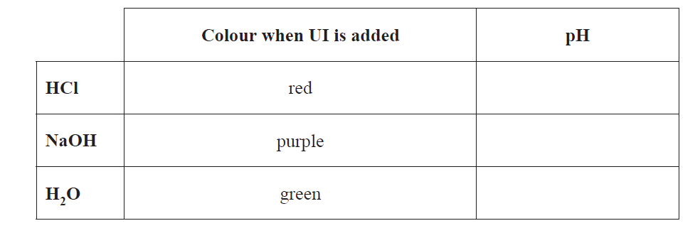
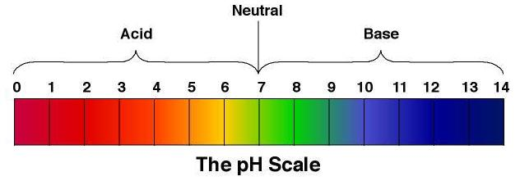
NCEA 2015 pH and Indicators
Question 3a: The chemical equation below represents the reaction between hydrochloric acid and sodium hydroxide:
HCl + NaOH → NaCl + H₂O
Complete the table below to show the approximate pH for each of the three solutions.
Answer 3a:

Slide 54
NCEA 2015 pH and Indicators
Question 3a: The chemical equation below represents the reaction between hydrochloric acid and sodium hydroxide:
HCl + NaOH → NaCl + H₂O
Complete the table below to show the approximate pH for each of the three solutions.
Answer 3a:
Achieved
Question
1 - 3
12 - 14
7

Slide 55
NCEA 2015 pH and Indicators - NCEA Case Study
Question 3c: NaOH is gradually added to a solution of HCl with universal indicator present, until no further colour change occurs.
Discuss what is occurring in the beaker at each of the pH’s shown, as the NaOH is added.
In your answer you should refer to:
• the colours that would occur at each pH
• the relative amounts of hydrogen and hydroxide present at each of the pH’s shown.
pH = 1 (before any NaOH is added): pH = 4, pH = 7, pH = 10, pH = 13

Slide 56
Excellence
Question
NCEA 2015 pH and Indicators
Question 3c: NaOH is gradually added to a solution of HCl with universal indicator present, until no further colour change occurs.
Discuss what is occurring in the beaker at each of the pH’s shown, as the NaOH is added.
In your answer you should refer to:
• the colours that would occur at each pH
• the relative amounts of hydrogen and hydroxide present at each of the pH’s shown.
pH = 1 (before any NaOH is added): pH = 4, pH = 7, pH = 10, pH = 13
Answer 3c:
As the NaOH is added, the HCl is being neutralised until water is formed, then after that the solution becomes more basic.
When no NaOH has been added, the solution is red and has a pH of 1–2 and there is an excess of H⁺ ions. The concentration of hydroxide ions is very low. At pH 4, the solution is orange–yellow and there is still an excess of H⁺ ions but not as big an excess as when the pH was lower. At pH 7 the solution is green, which is neutral. At this point, the number of H⁺ and OH– ions is equal and they cancel each other out to form neutral water.
At pH 10 the solution is blue, and there is now an excess of OH– ions. At pH 13 the solution is purple, and there is now a greater excess of OH– ions than when the solution was blue.

Slide 57
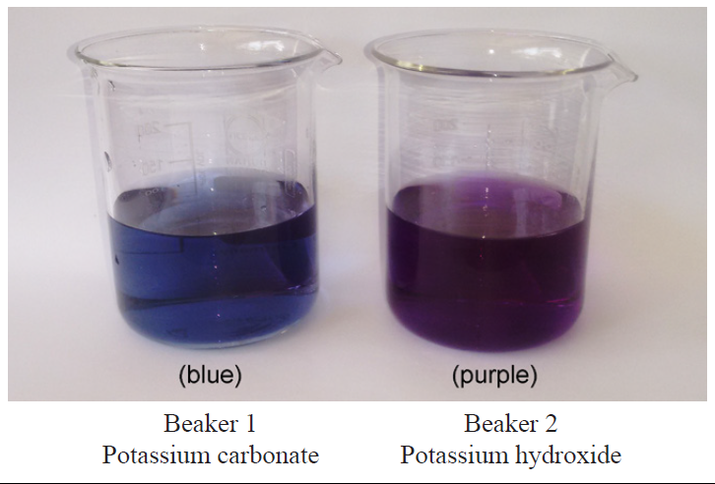
NCEA 2016 pH and Indicators
Question 3a: A student added universal indicator to the solutions in two beakers as shown below.
Explain why the solutions are different colours.

Slide 58
NCEA 2016 pH and Indicators
Merit
Question
Question 3a: A student added universal indicator to the solutions in two beakers as shown below.
Explain why the solutions are different colours.
Answer 3a:
Potassium hydroxide (KOH) has a higher hydroxide ion concentration [OH–] than potassium carbonate (K₂CO₃) and therefore has a higher pH / is more basic than K₂CO₃. Universal Indicator is purple at a pH of 12–14, whereas Universal Indicator is blue for a base with a lower pH of 8–11.

Slide 59
NCEA 2016 pH and Indicators
Question 3c: Explain what will happen to the indicator colour in Beaker 2 (potassium hydroxide) as the hydrochloric acid is added.
Relate this to the changing pH, the ions present in the beaker, and the type of reaction occurring.

Slide 60
Excellence
Question
NCEA 2016 pH and Indicators
Question 3c: Explain what will happen to the indicator colour in Beaker 2 (potassium hydroxide) as the hydrochloric acid is added.
Relate this to the changing pH, the ions present in the beaker, and the type of reaction occurring.
Answer 3c:
Beaker 2 is initially purple since [OH–] is much greater than [H+]; the pH is 12–14.
As HCl is added, the H⁺ start to neutralise some of the OH–.
As the pH decreases to 8–11, the solution turns blue and [OH–] > [H⁺].
Once enough HCl has been added such that [OH–] = [H⁺], the UI turns green since all the OH– have been neutralised by H⁺ ions to form water, and the pH equals 7.
As more HCl is added, the pH decreases to pH 3–6 since [H⁺] > [OH–], so the UI turns yellow / orange.
As more HCl is added, the pH decreases to 1–2 since [H⁺] becomes much greater than [OH–], so UI turns red.

Slide 61
NCEA 2012 Neutralisation
Question 2a: A student wanted to make the neutral salt, sodium nitrate.
Explain how to make sodium nitrate by mixing sodium carbonate and nitric acid solutions using school laboratory equipment. Explain how litmus paper could be used during the process described to show the salt being produced is neutral.

Slide 62
Excellence
Question
NCEA 2012 Neutralisation
Question 2a: A student wanted to make the neutral salt, sodium nitrate.
Explain how to make sodium nitrate by mixing sodium carbonate and nitric acid solutions using school laboratory equipment. Explain how litmus paper could be used during the process described to show the salt being produced is neutral.
How to make it
Mix the two solutions together, then take the resulting solution and put it in an evaporating dish. It could be heated using a Bunsen burner or left somewhere warm for a few days. The water would evaporate off leaving behind the neutral salt sodium nitrate.
Add universal indicator to acid and add base. UI will turn green when neutralised
Heat to remove water. The sodium nitrate will remain
Litmus paper: The solution will be neutral when red and blue litmus papers both stay the same colour. When blue paper changes to red the solution is acidic. When red paper changes to blue the solution is basic.

Slide 63
NCEA 2012 Acid Reactions
Question 2c: Write a word equation AND a balanced symbol equation for the reaction between sodium carbonate and nitric acid.

Slide 64
NCEA 2012 Acid Reactions
Question 2c: Write a word equation AND a balanced symbol equation for the reaction between sodium carbonate and nitric acid.
Achieved
Question
nitric acid + sodium carbonate → sodium nitrate + water + carbon dioxide.
Excellence
Question
2HNO₃ + Na₂CO₃ → 2NaNO₃ + H₂O + CO₂

Slide 65
NCEA 2012 Acid Reactions
Question 3a: Write a word equation AND a balanced symbol equation for the reaction between sulfuric acid and sodium hydroxide.

Slide 66
NCEA 2012 Acid Reactions
Question 3a: Write a word equation AND a balanced symbol equation for the reaction between sulfuric acid and sodium hydroxide.
Achieved
Question
Sulfuric acid + sodium hydroxide → sodium sulfate + water
Excellence
Question
H₂SO₄ + 2NaOH → Na₂SO₄ + 2H₂O

Slide 67
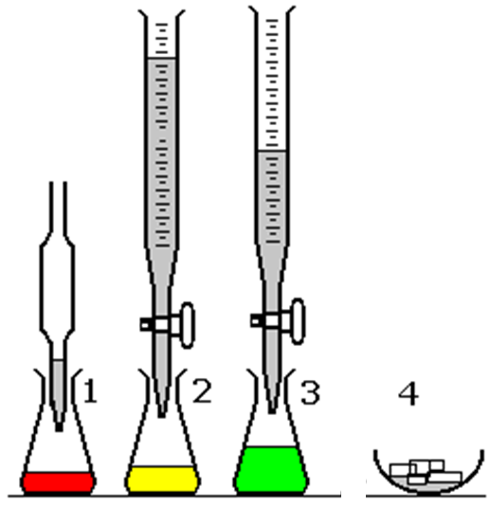
NCEA 2013 Neutralisation- (Part ONE)
Question 4b: Experiment One
A student carried out an experiment in the lab using the following method:
Step one: Universal indicator was added to a solution of hydrochloric acid in a beaker.
Step two/three: Calcium hydroxide was added slowly until the solution turned yellow then green.
Step four: The contents of the beaker were then poured into an evaporating dish and left in a sunny place for several days.
Explain the purpose of each step in the method and how the equipment and chemicals used achieve that purpose.

Slide 68
Excellence
Question
NCEA 2013 Neutralisation- (Part ONE)
Question 4b: Experiment One
A student carried out an experiment in the lab using the following method:
Step one: Universal indicator was added to a solution of hydrochloric acid in a beaker.
Step two/three: Calcium hydroxide was added slowly until the solution turned yellow then green.
Step four: The contents of the beaker were then poured into an evaporating dish and left in a sunny place for several days.
Explain the purpose of each step in the method and how the equipment and chemicals used achieve that purpose.
UI is used to check the pH of the solution. Calcium hydroxide is added so that it reacts with HCl to form calcium chloride. It is added until the solution is green so that the solution formed is neutral. The contents are put into an evaporating dish so that the water can evaporate to leave the salt calcium chloride. It is left for a few days to ensure that all the water has evaporated as this process takes time.

Slide 69
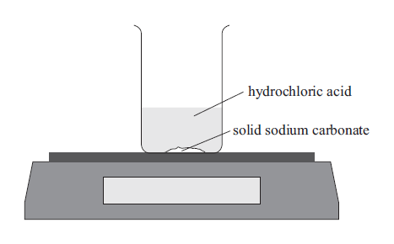
NCEA 2013 Neutralisation - (Part TWO)
Experiment Two
In another experiment the following method was used:
Step one: A beaker was placed on a balance as shown in the diagram below.
Step two: Hydrochloric acid was added to solid sodium carbonate in the beaker.
Step three: The mass was recorded over time.
Write a word equation AND a balanced symbol equation for the reaction between hydrochloric acid and sodium carbonate.

Slide 70
Excellence
Question
NCEA 2013 Neutralisation - (Part TWO)
Experiment Two
In another experiment the following method was used:
Step one: A beaker was placed on a balance as shown in the diagram below.
Step two: Hydrochloric acid was added to solid sodium carbonate in the beaker.
Step three: The mass was recorded over time.
Write a word equation AND a balanced symbol equation for the reaction between hydrochloric acid and sodium carbonate.
hydrochloric acid + sodium carbonate → sodium chloride + water + carbon dioxide
2HCl + Na₂CO₃ → 2NaCl + H₂O + CO₂

Slide 71
NCEA 2013 Neutralisation- (Part TWO)
Experiment Two
(d) Explain why the mass of the beaker and contents would decrease over time.
In your answer you should:
• state any other observations that would be made as hydrochloric acid reacts with the sodium carbonate
• explain how the products formed by the reaction lead to the decrease in mass of the beaker and contents.

Slide 72
Excellence
Question
NCEA 2013 Neutralisation- (Part TWO)
Experiment Two
(d) Explain why the mass of the beaker and contents would decrease over time.
In your answer you should:
• state any other observations that would be made as hydrochloric acid reacts with the sodium carbonate
• explain how the products formed by the reaction lead to the decrease in mass of the beaker and contents.
Observations: Fizzing would be observed.
The fizzing observed is due to carbon dioxide gas being released, and therefore because the carbon dioxide gas is leaving the beaker, there is less mass remaining in the beaker and therefore the balance measures less weight.

Slide 73
NCEA 2013 Acid Reactions
Question 2a: Write a word equation AND a balanced symbol equation for the reaction between sulfuric acid and potassium hydroxide.

Slide 74
NCEA 2013 Acid Reactions
Question 2a: Write a word equation AND a balanced symbol equation for the reaction between sulfuric acid and potassium hydroxide.
Achieved
Question
Sulfuric acid + potassium hydroxide → potassium sulfate + water
Excellence
Question
H₂SO₄ + 2KOH → K₂SO₄ + 2H₂O

Slide 75
NCEA 2014 Acid Reactions
Question 2c: Write a word equation AND a balanced symbol equation for the reaction between calcium carbonate and hydrochloric acid.

Slide 76
NCEA 2014 Acid Reactions
Question 2c: Write a word equation AND a balanced symbol equation for the reaction between calcium carbonate and hydrochloric acid.
Achieved
Question
Hydrochloric acid + calcium carbonate → calcium chloride + carbon dioxide + water.
Excellence
Question
2HCl + CaCO₃ → CaCl₂ + CO₂ + H₂O

Slide 77
NCEA 2014 Acid Reactions
Question 4a: A beaker contains sodium hydroxide solution and 5 drops of universal indicator.
Sulfuric acid was added to the beaker until no more changes were observed.
(a) Write a word equation AND a balanced symbol equation for the reaction between sulphuric acid and sodium hydroxide.

Slide 78
NCEA 2014 Acid Reactions
Question 4a: A beaker contains sodium hydroxide solution and 5 drops of universal indicator.
Sulfuric acid was added to the beaker until no more changes were observed.
(a) Write a word equation AND a balanced symbol equation for the reaction between sulphuric acid and sodium hydroxide.
Sulfuric acid + sodium hydroxide → sodium sulfate + water
Excellence
Question
H₂SO₄ + 2NaOH → Na₂SO₄ + 2H₂O

Slide 79
NCEA 2015 Acid Reactions
Question 1c: Write a word equation AND a balanced symbol equation for the reaction between nitric acid and calcium carbonate.

Slide 80
NCEA 2015 Acid Reactions
Question 1c: Write a word equation AND a balanced symbol equation for the reaction between nitric acid and calcium carbonate.
Achieved
Question
nitric acid + calcium carbonate → calcium nitrate + carbon dioxide + water
Excellence
Question
2HNO₃ + CaCO₃ → Ca(NO₃)₂ + H₂O + CO₂

Slide 81
NCEA 2015 Acid Reactions
Question 3d: In a different chemical reaction, hydrochloric acid reacts with magnesium hydroxide.
Write a word equation and a balanced chemical equation for this reaction in the boxes below.

Slide 82
NCEA 2015 Acid Reactions
Question 3d: In a different chemical reaction, hydrochloric acid reacts with magnesium hydroxide.
Write a word equation and a balanced chemical equation for this reaction in the boxes below.
Achieved
Question
Hydrochloric acid + magnesium hydroxide → magnesium chloride + water
Excellence
Question
2HCl + Mg(OH)₂ → MgCl₂ + 2H₂O

Slide 83
NCEA 2016 Acid Reactions
Question 1d: Write a word equation AND a balanced symbol equation for the reaction between sodium hydroxide and sulfuric acid.

Slide 84
NCEA 2016 Acid Reactions
Question 1d: Write a word equation AND a balanced symbol equation for the reaction between sodium hydroxide and sulfuric acid.
Achieved
Question
sodium hydroxide + sulfuric acid → sodium sulfate + water
Excellence
Question
2NaOH + H₂SO₄ → Na₂SO₄ + 2H₂O

Slide 85
NCEA 2016 Acid Reactions
Question 3b: Write a word equation AND a balanced symbol equation for the reaction between hydrochloric acid and potassium carbonate in Beaker 1.

Slide 86
NCEA 2016 Acid Reactions
Question 3b: Write a word equation AND a balanced symbol equation for the reaction between hydrochloric acid and potassium carbonate in Beaker 1.
Achieved
Question
hydrochloric acid + potassium carbonate→ potassium chloride + water + carbon dioxide
Excellence
Question
2HCl + K₂CO₃ → 2KCl + H₂O + CO₂

Slide 87
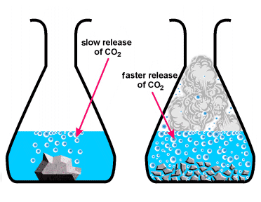
NCEA Reaction rate
Hydrochloric acid was reacted with calcium carbonate in the form of marble chips (lumps) and powder (crushed marble chips) in an experiment to investigate factors affecting the rate of a chemical reaction..
Explain why the hydrochloric acid would react faster with the powder.

Slide 88
NCEA Reaction rate
Hydrochloric acid was reacted with calcium carbonate in the form of marble chips (lumps) and powder (crushed marble chips) in an experiment to investigate factors affecting the rate of a chemical reaction..
Explain why the hydrochloric acid would react faster with the powder.
When the marble chips are crushed there is a greater surface area. This means there are now more particles for collisions to occur between the acid and the calcium carbonate. Because more collisions can now occur more frequently the reaction rate is faster.

Slide 89
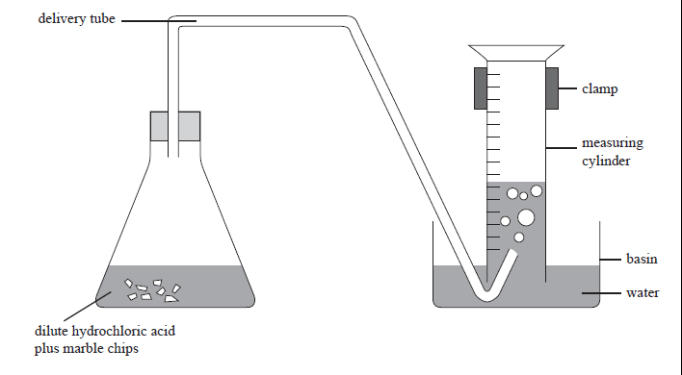
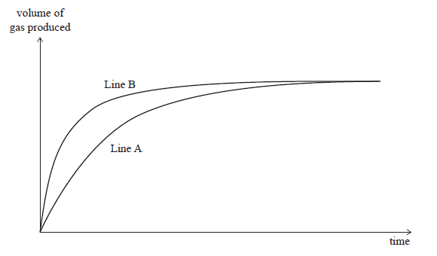
NCEA 2012 Reaction Rates – (Part One)
Question 4a : The following experiment was carried out at 20°C and then repeated at 40°C.
Marble chips (calcium carbonate) were added to hydrochloric acid in a conical flask. The mass and size of marble chips, and the concentration and volume of hydrochloric acid used, were the same for both experiments. The flask was connected to an inverted measuring cylinder in a basin of water, as shown in the diagram below.
The volume of gas produced at the two different temperatures was measured for a few minutes and the results were used to sketch the graph shown below.

Slide 90
NCEA 2012 Reaction Rates – (Part One)
Question 4a : State which line on the graph represents the reaction at 40ºC and explain how you worked this out.
In your answer you should:
• identify which line represents the reaction at 40°C
• explain why the line you have identified is the reaction at 40°C
• give reasons for the different rates of reaction in terms of particles
• explain why both lines end up horizontal.

Slide 91
Excellence
Question
NCEA 2012 Reaction Rates – (Part One)
Question 4a : State which line on the graph represents the reaction at 40ºC and explain how you worked this out.
In your answer you should:
• identify which line represents the reaction at 40°C
• explain why the line you have identified is the reaction at 40°C
• give reasons for the different rates of reaction in terms of particles
• explain why both lines end up horizontal.
The reaction is faster at the higher temperature, because the H⁺ ions have more kinetic energy, and therefore are moving faster. When they are moving faster, there will be more collisions, and more of these collisions will be effective, as the particles will collide with more energy.
Line B represents the faster reaction, as it is steeper at the start. This represents the reaction carried out at 40°C.
Both lines become horizontal at the same point on the Y-axis, as this is when both reactions have finished, ie one of the reactants has been completely used up and therefore no more gas is produced. Both finished with same amount of gas produced, as both reactions had the same amount of reactants to start with.

Slide 92
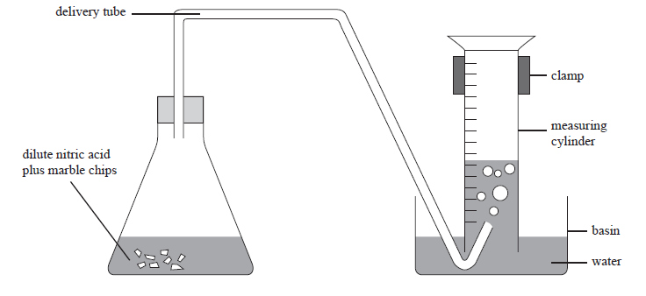
NCEA 2013 Reaction Rates – (Part One)
Question 3a : The table below shows the size of marble chips (calcium carbonate) used in a chemical investigation into factors affecting rate of reaction.
Experiment 1: 10 mL of hydrochloric acid was added to a boiling tube containing small marble chips.
Experiment 2: 10 mL of hydrochloric acid of the same concentration as in Experiment 1 was added to another boiling tube containing large marble chips.
In both experiments the total mass of the marble chips was the same.
The boiling tubes were connected to an inverted measuring cylinder in a basin of water, as shown in the diagram below.

Slide 93
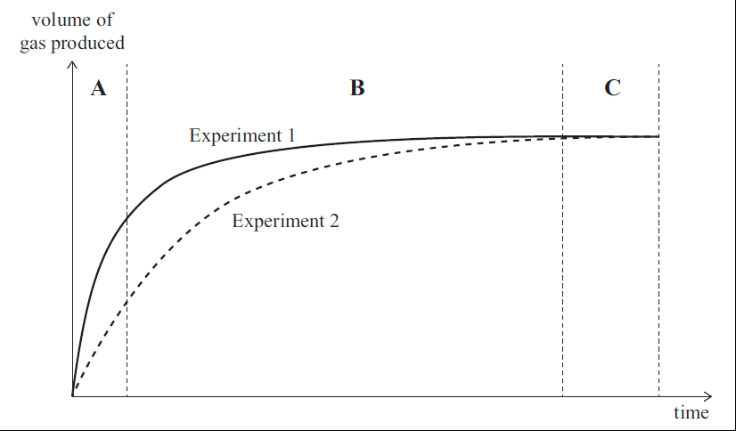
NCEA 2013 Reaction Rates – (Part One)
Question 3a : The graph below shows the results for the volume of gas produced over a period of time.
State what factor affecting the rate of reaction is being investigated in this experiment.

Slide 94
Achieved
Question
NCEA 2013 Reaction Rates – (Part One)
Question 3a : The graph below shows the results for the volume of gas produced over a period of time.
State what factor affecting the rate of reaction is being investigated in this experiment.
The factor being investigated is surface area of the calcium carbonate / marble chips.

Slide 95
NCEA 2013 Reaction Rates – (Part Two)
Question 3b : Explain what is happening in Experiment 1 in sections A, B, and C of the graph in terms of reaction rate.
In your answer you should refer to particle collisions.

Slide 96
Excellence
Question
NCEA 2013 Reaction Rates – (Part Two)
Question 3b : Explain what is happening in Experiment 1 in sections A, B, and C of the graph in terms of reaction rate.
In your answer you should refer to particle collisions.
Answer 3b : In section A of the graph the rate is fastest as there are more collisions between the HCl and CaCO₃. This is because at the start of the reaction there are more particles available for collision. In section B the rate of reaction is slowing down as the number of particles available for collision is becoming fewer as some of the HCl and CaCO₃ have already collided and have been used up, therefore fewer particles and therefore fewer collisions.
In part C the reaction has stopped, as all of the reactants (or one of them) have reacted, and therefore there are no particles present that can collide and react.

Slide 97
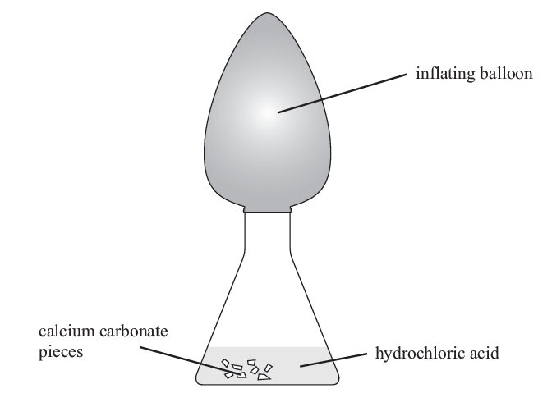
NCEA 2014 Reaction Rates - (Part One)
Question 2a (i) : Calcium carbonate pieces are placed in a flask and hydrochloric acid is added. Immediately a balloon is placed over the top of the flask. The balloon then starts to inflate.
Explain why the balloon inflates.

Slide 98
Achieved
Question
NCEA 2014 Reaction Rates - (Part One)
Question 2a (i) : Calcium carbonate pieces are placed in a flask and hydrochloric acid is added. Immediately a balloon is placed over the top of the flask. The balloon then starts to inflate.
Explain why the balloon inflates.
Answer 2a (i) : When a metal carbonate reacts with an acid, carbon dioxide gas is released. This gas causes the balloon to inflate.

Slide 99
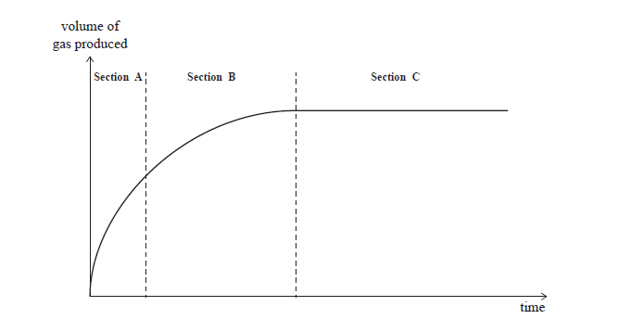
NCEA 2015 Reaction Rates
Question 1a: Marble chips (calcium carbonate) were added to nitric acid in a conical flask. The temperature of the acid was 50°C. The flask was connected to an inverted measuring cylinder in a basin of water to measure the volume of gas produced, as shown in the diagram beside. The graph beside shows the volume of gas produced against time.
Explain what is happening in terms of particle collisions and rate of reaction in each section of the graph.

Slide 100
Excellence
Question
NCEA 2015 Reaction Rates
Answer 1a: As the reactant particles collide, they form product particles.
As the reaction proceeds, there are fewer and fewer reactant particles left to collide, and so the rate of reaction becomes slower.
At the start (section A) of the reaction, more product particles are being formed. This is because at the start of the reaction there are many particles present; therefore there will be many collisions, and the more collisions (per unit time), the faster the rate of reaction, and the more gas produced.
In section B, there are now fewer (less) reactants, and so there are fewer collisions per second (unit time); therefore a slower rate of reaction and so less product is formed.
In section C, the reaction has stopped, as one of the reactants (marble chips or nitric acid) has run out, so there are no particles left to react.
Link in each section
Relative amount of reactants:products
Collisions per unit of time
Rate of reaction
Amount of gas produced

Slide 101
NCEA 2013 Reaction Rates – (Part Three)
Question 3c : Explain why Experiment 1 was faster than Experiment 2.
In your answer you should:
• explain how the graph shows that Experiment 1 is faster
• explain how the size of the marble chips affects the number of particle collisions.
Experiment 1: small marble chips.
Experiment 2: large marble chips.

Slide 102
Excellence
Question
NCEA 2013 Reaction Rates – (Part Three)
Question 3c : Explain why Experiment 1 was faster than Experiment 2.
In your answer you should:
• explain how the graph shows that Experiment 1 is faster
• explain how the size of the marble chips affects the number of particle collisions.
Experiment 1: small marble chips.
Experiment 2: large marble chips.
The rate of Experiment 1 is faster as the slope in section A of the graph is steeper than in Experiment 2. It is faster because when smaller chips are used, the surface area of the chips is greater. Because there is more surface area, there is more surface for the HCl particles to collide. Because there are more collisions occurring more frequently, the rate is faster.

Slide 103
NCEA 2014 Reaction Rate Factors - (Part Two)
Question 2a (ii): In a second experiment, the same mass of calcium carbonate in a powdered form is used.
Explain why the balloon inflates faster when powdered calcium carbonate is used.

Slide 104
Excellence
Question
NCEA 2014 Reaction Rate Factors - (Part Two)
Question 2a (ii): In a second experiment, the same mass of calcium carbonate in a powdered form is used.
Explain why the balloon inflates faster when powdered calcium carbonate is used.
Answer 2a (ii): It is faster when powder is used, because the surface area of the powder is greater. Because there is more surface area, there is more surface with which the HCl particles can collide. Because more collisions occur more frequently, the rate is faster, and CO₂ will be generated more quickly.
Explains that when the concentration is increased, there are more particles present in the same volume and so therefore there is a greater chance of collisions occurring per unit time.

Slide 105
NCEA 2014 Reaction Rate Factors - (Part Three)
Question 2b : Using the same chemical substances (calcium carbonate and hydrochloric acid), discuss a different way to make the balloon inflate faster.
In your answer you should refer to rates of reaction and particle collisions.

Slide 106
Excellence
Question
NCEA 2014 Reaction Rate Factors - (Part Three)
Question 2b : Using the same chemical substances (calcium carbonate and hydrochloric acid), discuss a different way to make the balloon inflate faster.
In your answer you should refer to rates of reaction and particle collisions.
Answer 2b : One way of making the reaction occur faster is to increase the concentration of the acid used. When this happens there are more HCl particles in the same volume of acid, and therefore there is a greater chance of collisions occurring more frequently, and so the rate of reaction is faster. Because the rate is faster, CO₂ is produced more rapidly, and the balloon inflates faster.
OR
The other way is to increase the temperature of the acid. When this happens, the HCl particles move faster; because they are moving faster, there is a greater chance of collisions occurring more frequently, and so the rate of reaction is faster. Because the rate is faster, CO₂ is produced more rapidly, and the balloon inflates faster.

Slide 107
NCEA 2015 Reaction Rate Factors
Question 1b: The reaction was carried out again but this time at 20ºC. The mass and size of the marble chips, and the concentration and volume of nitric acid used were kept the same.
(i) Draw a line on the graph that represents the reaction at 20ºC.
(ii) Explain why you drew this line where you did, and explain if this means that the rate of reaction is slower, the same, or faster.
In your answer you should
• discuss why you drew your line with the slope that you did, and why you stopped the line at the point that you did
• explain the effect of temperature on reaction rate, in terms of particle collisions.

Slide 108
Excellence
Question
NCEA 2015 Reaction Rate Factors
Answer 1b: The reaction is slower at the lower temperature, because the particles have less kinetic energy, and therefore are moving slower. When they are moving slower, there will be less frequent collisions, and less of these collisions will be effective, as the particles will collide with less energy. The line drawn represents this slower reaction, as it is less steep at the start.
Both lines become horizontal at the same point on the Y-axis, as this is when both reactions have finished, i.e. one of the reactants has been completely used up and therefore no more gas is produced. Both finished with same amount of gas produced, as both reactions had the same amount of reactants to start with.

Slide 109
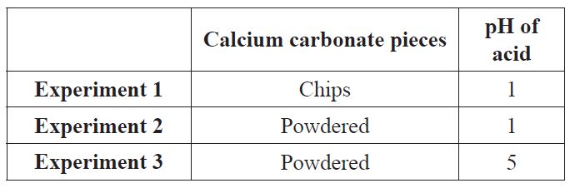
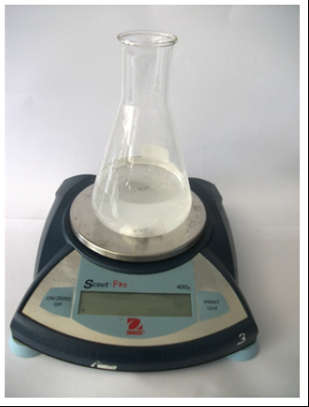
NCEA 2016 Reaction Rates – (Part One)
Question 2a: A sample of calcium carbonate is added to dilute hydrochloric acid in an open conical flask. The total mass of the flask and contents is measured over time.
Three experiments are carried out at 25°C using the same mass of calcium carbonate, and the same volume of acid:
For each of the experiments reacting calcium carbonate and dilute acid together, the mass of the flask and its contents decreases over time.
Describe why this happens.

Slide 110
Achieved
Question
NCEA 2016 Reaction Rates – (Part One)
Question 2a: A sample of calcium carbonate is added to dilute hydrochloric acid in an open conical flask. The total mass of the flask and contents is measured over time.
Three experiments are carried out at 25°C using the same mass of calcium carbonate, and the same volume of acid:
For each of the experiments reacting calcium carbonate and dilute acid together, the mass of the flask and its contents decreases over time.
Describe why this happens.
The mass of the flask and its contents decreases over time because one of the products is carbon dioxide gas. Since the reaction takes place in an open conical flask, the mass of the CO₂ gas is lost to the surroundings.

Slide 111
NCEA 2016 Reaction Rate Factors – (Part Two)
Question 2b (i) : Identify the factor affecting the reaction rate being investigated in Experiments 1 and 2.
Question 2b (ii) : Explain how this factor affects the rate of reaction in the two flasks, with reference to particle collisions.
Explain any observations, including changes in mass, over the course of Experiments 1 and 2 until the reactions are finished.

Slide 112
NCEA 2016 Reaction Rate Factors – (Part Two)
Question 2b (i) : Identify the factor affecting the reaction rate being investigated in Experiments 1 and 2.
Achieved
Question
Surface area.
The mass of the flask and its contents will decrease faster with the powder (experiment 2) compared to the chunks (experiment 1), and the gas production will be faster. This is because the powder has a larger surface area than the large chips, so more particles of calcium carbonate are exposed for the acid to react with / collide with, and therefore experiment 2 has a higher frequency of successful collisions, and subsequently a faster rate of reaction.
Both reactions will get to the same mass, as both have
the same amount of reactants and therefore
release the same amount of CO₂, but at different
rates.
Question 2b (ii) : Explain how this factor affects the rate of reaction in the two flasks, with reference to particle collisions.
Explain any observations, including changes in mass, over the course of Experiments 1 and 2 until the reactions are finished.
Excellence
Question

Slide 113
NCEA 2016 Reaction Rate Factors – (Part Three)
Question 2c: Compare and contrast the rate of reaction of Experiments 2 and 3, with reference to particle collisions and the concentration of hydrogen ions in the solution.
Strong Acid pH 1
Weak Acid pH 5
H⁺
H⁺
H⁺
H⁺
H⁺
H⁺
H⁺
H⁺
H⁺
H⁺
H⁺
H⁺
H⁺
H⁺
H⁺
H⁺
H⁺

Slide 114
NCEA 2016 Reaction Rate Factors – (Part Three)
Excellence
Question
Question 2c: Compare and contrast the rate of reaction of Experiments 2 and 3, with reference to particle collisions and the concentration of hydrogen ions in the solution.
An acid with a pH of 1 has a higher [H⁺] than an acid with a pH of 5. Since experiment 2 has more H⁺ ions per unit volume / a higher concentration of H⁺ ions, it will have a higher frequency of successful collisions (more successful collisions per second) and subsequently a higher / faster rate of reaction.
Strong Acid pH 1
Weak Acid pH 5
H⁺
H⁺
H⁺
H⁺
H⁺
H⁺
H⁺
H⁺
H⁺
H⁺
H⁺
H⁺
H⁺
H⁺
H⁺
H⁺
H⁺

