Slide 1
Creating structure to give freedom and choice
Making self-management work for GATE students in Secondary School
Sarah Gaze
Creating structure to give freedom and choice
Illustration: EFF / Flickr via Creative Commons

Slide 2
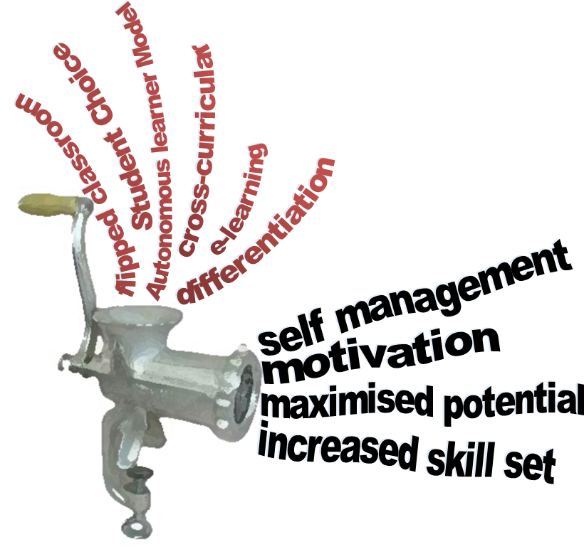
Creating structure to give freedom and choice

Slide 3
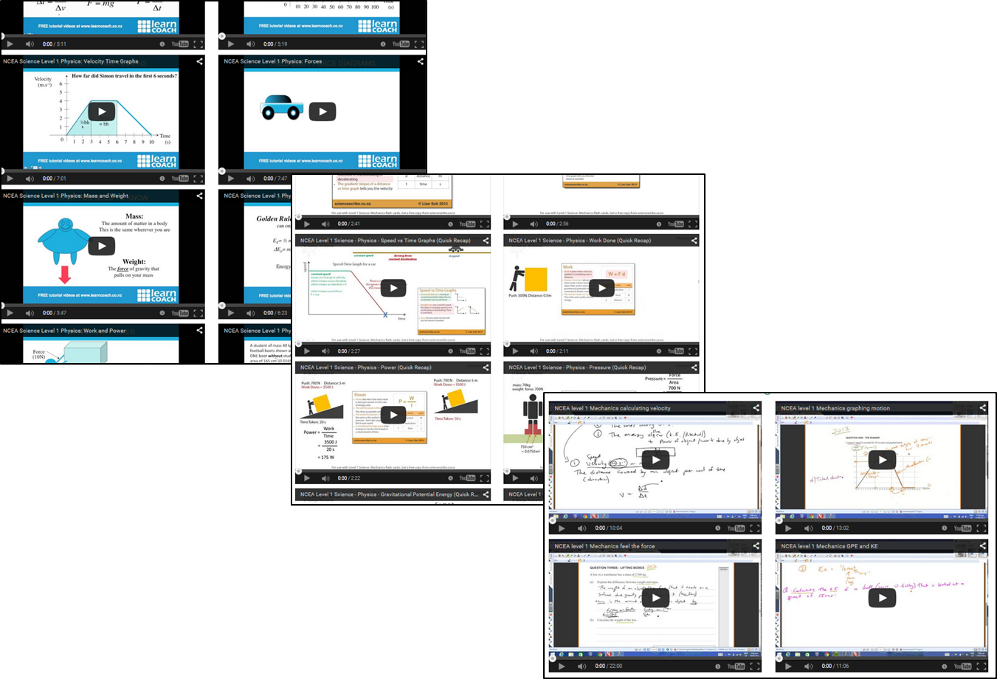
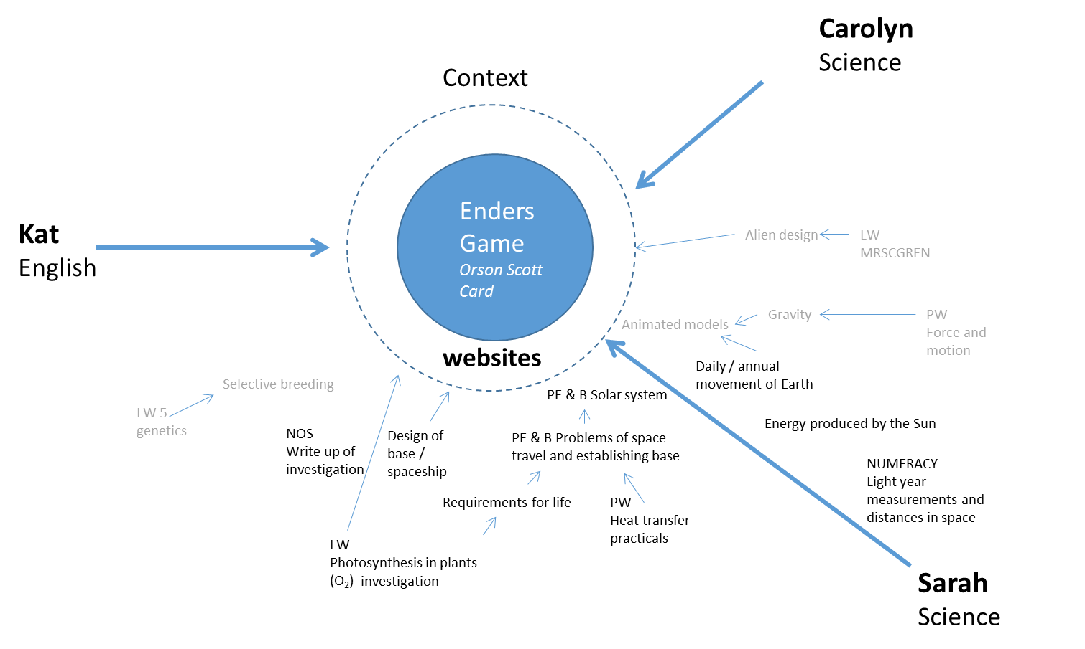
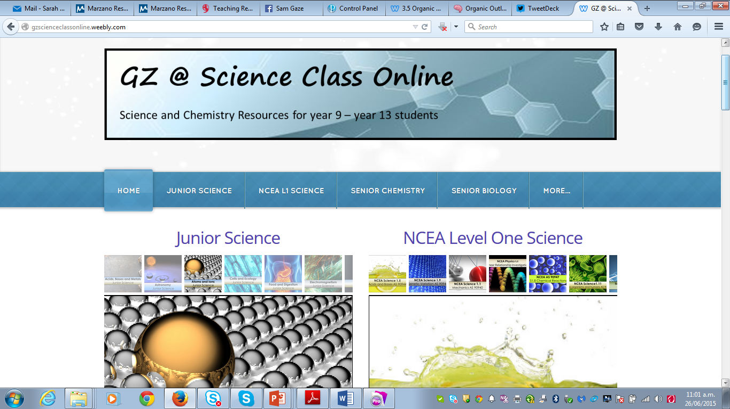
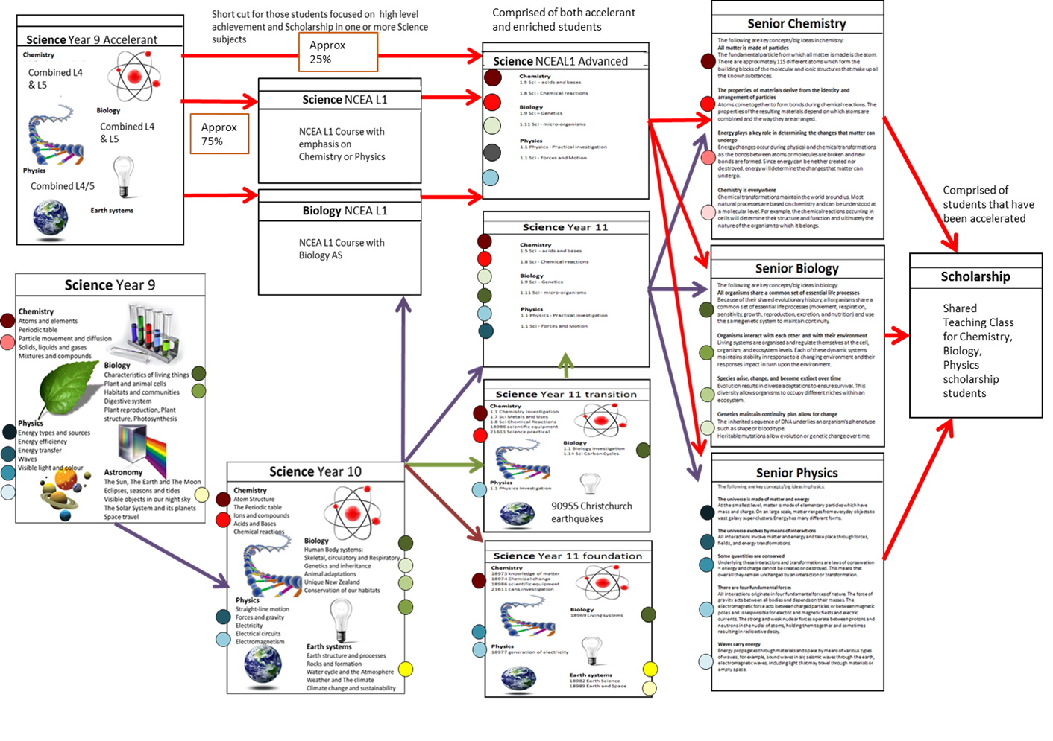
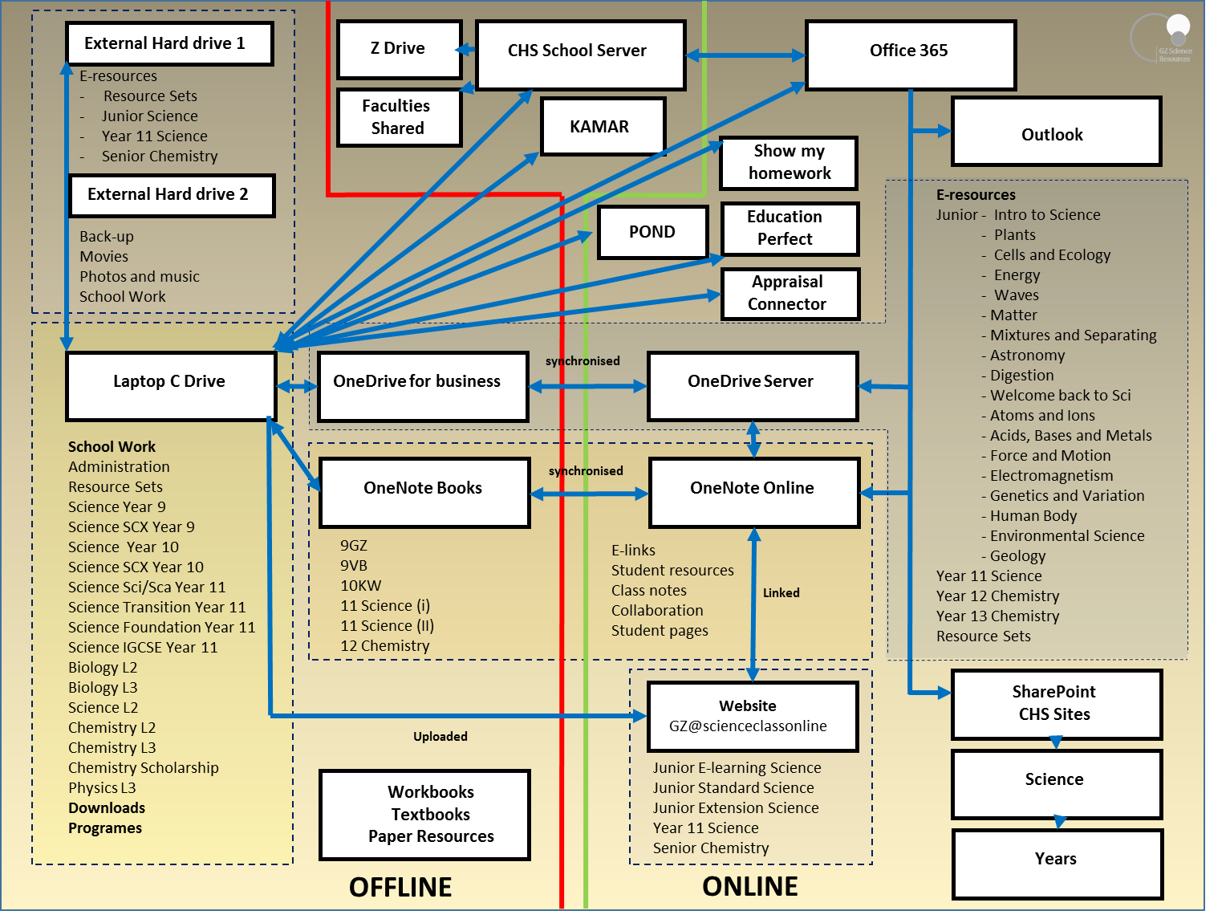
Autonomous Learner Model and other GATE systems
Website development for students
Flipped classrooms
Cross-curricular planning
Evolution of practice….
Creating structure to give freedom and choice
Resource collecting and organising
Scheme planning with differentiation
Developing structure for students
GATE future pathway planning

Slide 4
Cross - curricular units…. Helping students to make links
Carolyn
Science
Context
Enders Game
Orson Scott Card
Kat
English
Alien design
LW MRSCGREN
Creating structure to give freedom and choice
Animated models
Gravity
PW Force and motion
websites
Daily / annual movement of Earth
Selective breeding
PE & B Solar system
LW 5
genetics
Energy produced by the Sun
NOS Write up of investigation
Design of base / spaceship
PE & B Problems of space travel and establishing base
NUMERACY
Light year measurements and distances in space
Requirements for life
PW Heat transfer
practicals
LW Photosynthesis in plants (O₂)
investigation
Sarah
Science

Slide 5
Cross - curricular units…. Any context will do
Creating structure to give freedom and choice
From: www.korero.maori.nz
From: retronaut.co
From:www.tours-istanbul.info/250,tour-from-istanbul-to-gallipoli.html
From: thunder106.com/everyday-heroes/

Slide 6
The Autonomous Learner Model…. How can I use it?
What is an autonomous learner?
“..one who solves problems or develops new ideas through a combination of divergent and convergent thinking and functions with minimal external guidance in selected areas of endeavour.” (Betts and Knapp, 1981)
Creating structure to give freedom and choice

Slide 7
Cherry picking the ALM….
Individual Development
*Study skills that are more individualised, academic skills that are content specific
*Gather information through use of computers, internet
*Learn different methods of organisation and develop approach for themselves
Orientation
*Group process, group roles, group strategies to foster ability to work together
*Comprehend difference between student and learner, teacher and facilitator
Enrichment
*Find new and unique knowledge using a variety of methods
*Steps and skills for independent inquiry are directly taught
Creating structure to give freedom and choice
In-depth study
*Autonomous: able to plan a project, participate in the project, complete the project and assess the project
Seminars
*Selection of topic of importance to learner
*Choice of presentation

Slide 8
And what else can I use….
When given choice by teachers, students perceive classroom activities as more important: choice of tasks, choice of reporting formats, choice of learning goals, and choice of behaviours
Providing students academic choices increases engagement.
Robert J Marzano: The Highly engaged Classroom, 2010
“They need classrooms that are respectful to them, provide both structure and choice, and help them achieve more than they thought they could. These are needs shared by all learners, not just those who are gifted. But good instruction for gifted learners must begin there.”
Carol Ann Tomlinson: What it Means to Teach Gifted Learners Well, May 1997 issue of Instructional Leader
Creating structure to give freedom and choice
“And it envisions schooling as an escalator on which students continually progress, rather than a series of stairs, with landings on which advanced learners consistently wait”
Carol Ann Tomlinson: What it Means to Teach Gifted Learners Well, May 1997 issue of Instructional Leader

Slide 9
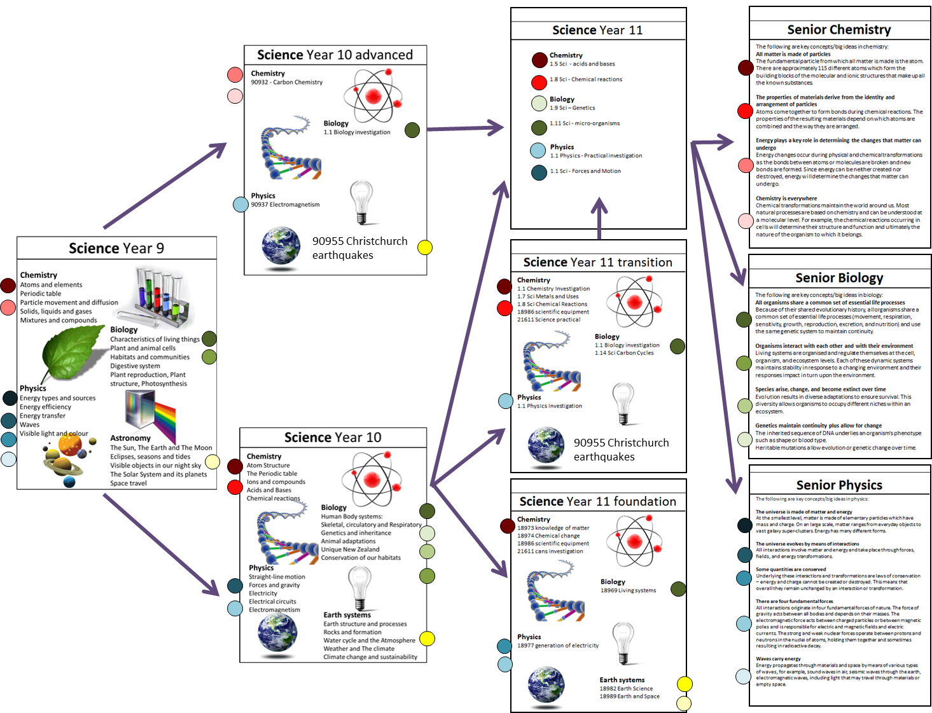
The previous pathway for GATE students
Creating structure to give freedom and choice

Slide 10
Adapting the pathway to cater for GATE students
Creating structure to give freedom and choice

Slide 11
Adding differentiation to the schemes….
Creating structure to give freedom and choice
Options for extension
Choice of activities

Slide 12
Adding differentiation to the Success Criteria….
Catering for GATE students in mixed ability classes
Creating structure to give freedom and choice

Slide 13
Where can I find it….. Putting resources in their place
Creating structure to give freedom and choice

Slide 14
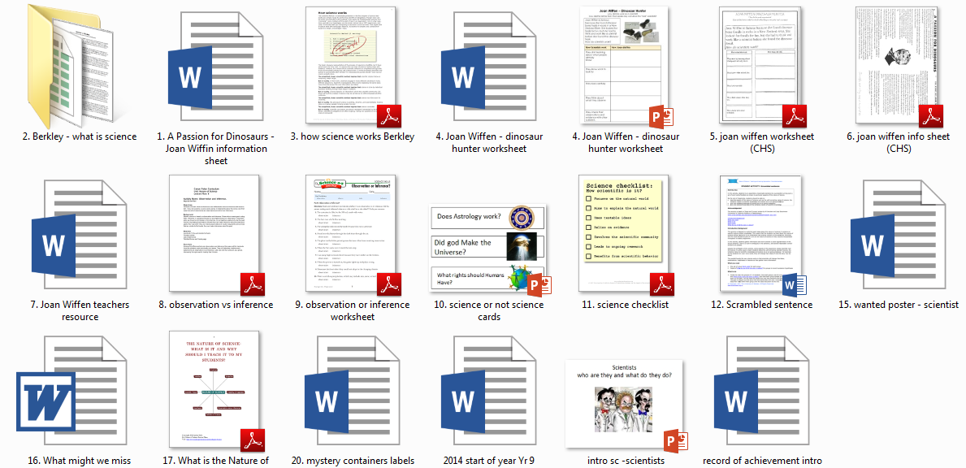
Where can I find it….. Putting resources in their place
Creating structure to give freedom and choice

Slide 15
Linking the unit plan, class notes and what is happening….
Creating structure to give freedom and choice
Specific Learning Intention
1. Investigate what it means to be a Scientist
Success Criteria
c. Understand Scientists must adapt Science ideas when new evidence is found

Slide 16
Class website…..first port of call
Creating structure to give freedom and choice
NCEA documents
tutorial videos
class notes
worksheets
web links

Slide 17
Class notes….. Have the lot
Stream on any device
Download
Print
Re-write
Summarise
Add pages/notes
Scribble on top
Highlight
Dyslexic font option
Evolving
White board to notes
Creating structure to give freedom and choice

Slide 18
Flipped classrooms….. Why not
Creating structure to give freedom and choice

Slide 19
Flipped classrooms….. Why not
No need to reinvent the wheel….
So many good resources available and shared…
Creating structure to give freedom and choice
Differentiated tutorial videos
Learn coach
Science Scribe
Mr HughesNZ

Slide 20
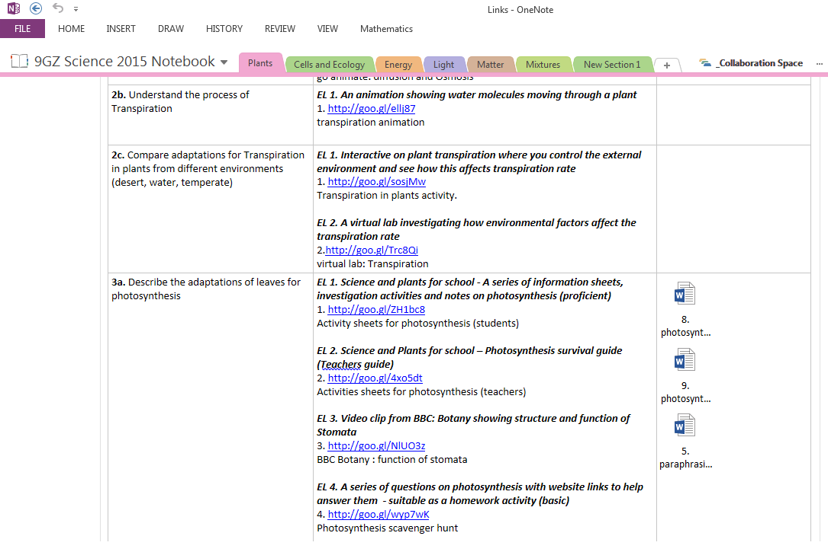
Making use of OneNote….
Let them choose
Work in groups or by themselves
Creating structure to give freedom and choice

Slide 21
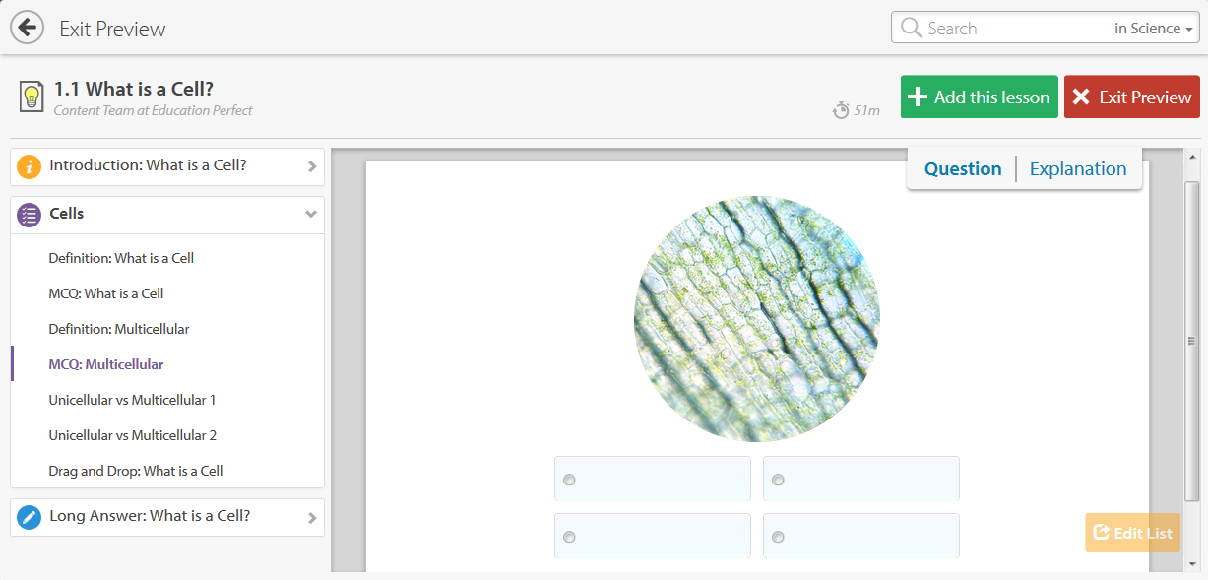
Making use of online learning programmes….
Creating structure to give freedom and choice
“I found this very useful as it helped me understand better and helped me make sure that I knew it and if I didn’t then I know what to work on and/or study for next time”

Slide 22
What do the GATE students say about all this….
Let us show you how we would like to work
Give us more choice in what we do
Let us work in groups to understand stuff together
Creating structure to give freedom and choice
Let me work at my own speed
It’s important for us to understand what is needed to succeed
Let me move around to see what ideas other groups have
Show me where to find stuff that will help me learn

Slide 23
And what about the academic results…. Junior
Differentiated e-learning
Access to all Class notes
Class website
Online learning programme
Choice of presentation
Creating structure to give freedom and choice

Slide 24
And what about the academic results…. Senior
Flipped classroom
Access to all Class notes
Differentiated worksheets
Online tutorials
Class website
Creating structure to give freedom and choice

Slide 25
Where does inquiry learning and teaching fit in to all this….
Listening
Relationships
Including
Waikato GATE network
ALM
GATE PD
What are our own learning needs?
Design of tasks and experiences
Teaching actions
What has been the impact of our changed actions?
What are our students learning needs?
Reading
Thinking
Reflection
sharing
Choice
Student voice
Future thinking
Cross-curricular Differentiation
e-learning
Planning
Creating structure to give freedom and choice
Trialling
Developing
Experimenting
Reflecting
Data
Analysis
Reflecting
Increased skill set
Realised potential
Self management
Motivation
Choice
Facilitating
Flipped classroom
An inquiry and knowledge-building cycle for improving provision for gifted and talented students (adapted from the teacher Professional Learning and Development BES [Timperley, Wilson, Barrar, and Fung, 2007]
Notes:
MOE Page 18 – Gifted and Talented students – meeting their needs in New Zealand School
Tikanga a Iwi: Best evidence synthesis Iteration [BES]

Slide 26
Autonomous Learner Model and other GATE systems
Website development for students
Flipped classrooms
Cross-curricular planning
Evolution of practice….
Creating structure to give freedom and choice
Resource collecting and organising
Scheme planning with differentiation
Developing structure for students
GATE future pathway planning

