Slide 1
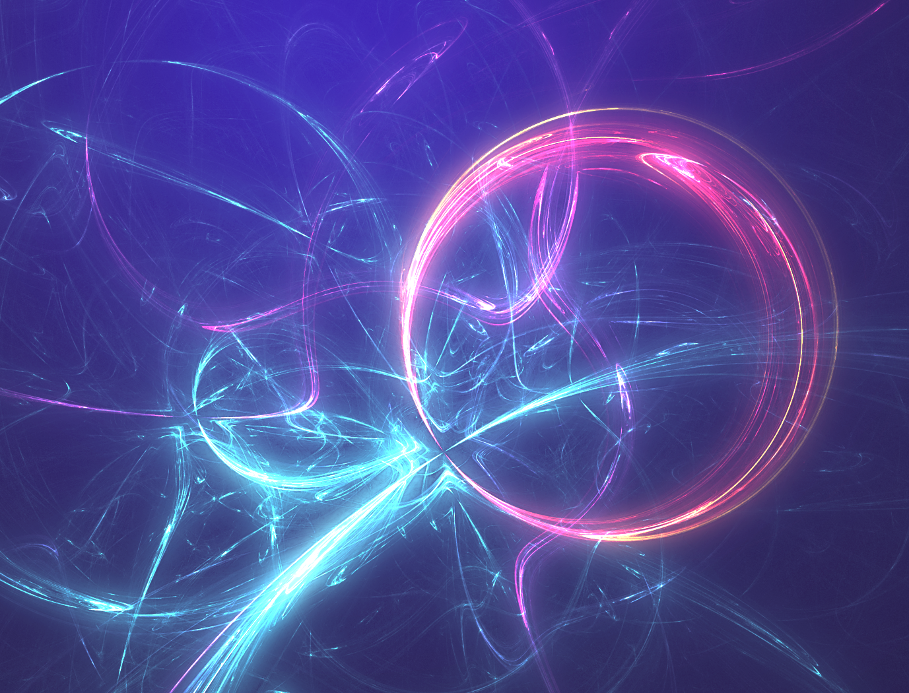
Physics 1.3
Electromagnetism

Slide 2
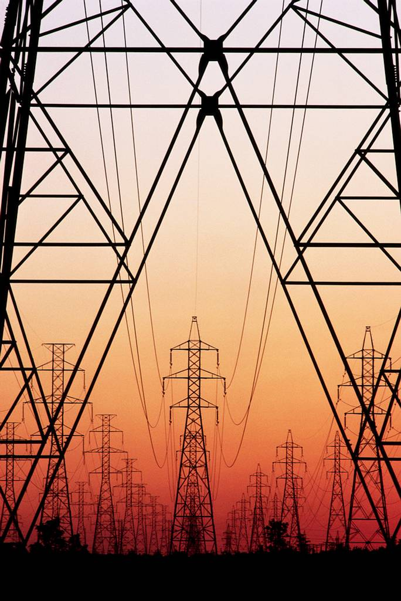
Electricity is a form of Energy
Electricity is a type of energy. It can be transformed from many other types of energy; kinetic, chemical, nuclear etc.
We make use of electricity by transforming it into other types of energy; light, heat, sound, kinetic etc., to run many appliances and machines.

Slide 3
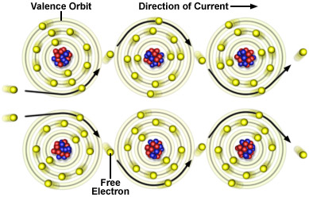
Electricity is a form of Energy
Electricity is all about electrons and their movement. Electrical energy is carried by electrons, and isn’t the electrons themselves. Electrons can carry varying amounts of energy. The more energy, the faster they move about.
All matter is made up of atoms. Atoms consist of protons, neutrons and electrons. Protons have a positive charge, neutrons have no charge and electrons have a negative charge. The charges of protons and electrons are equal and opposite.

Slide 4
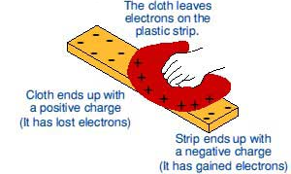
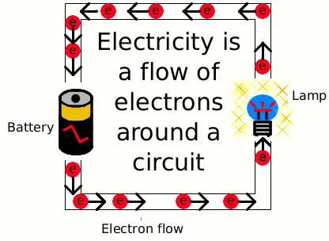
Electric charge produced by friction is the same charge which, moving around a circuit, produces an electric current
There are two types of electricity. Static electricity involves electrons that are moved from one place to another, usually by friction and it is stationary. Current electricity involves the movement of electrons through a conductor and it flows.
Static electricity
Current electricity

Slide 5
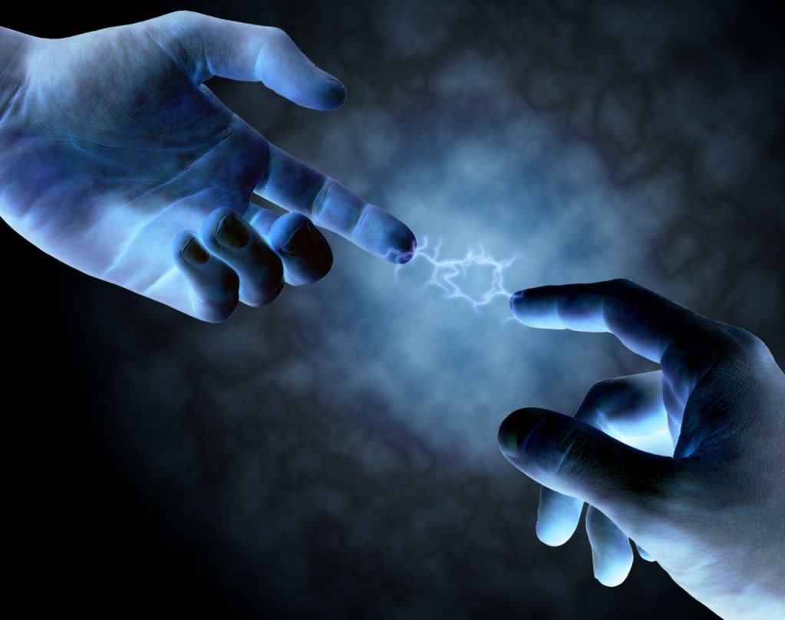
Static Electricity
Static electricity is the build up of electrical charges on the surface of a material, usually an insulator (non-conductor of electricity). It is called "static" because there is no current flowing, as there is in alternating current (AC) or direct current (DC) electricity.
Usually, two materials are involved in static electricity, with one having an excess of electrons or negative (−) charges on its surface and the other material having an excess of positive (+) electrical charges. Atoms near the surface of a material that have lost one or more electrons will have a positive (+) electrical charge.

Slide 6
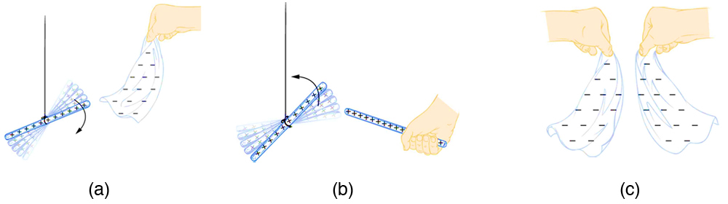
Attraction or repulsion
There are only two types of charge, which we call positive and negative. Like charges repel, unlike charges attract, and the force between charges decreases with the square of the distance. Both positive and negative charges exist in neutral objects and can be separated by rubbing one object with another. For objects (large enough to be visible),negatively charged means an excess of electrons and positively charged means a depletion of electrons.

Slide 7
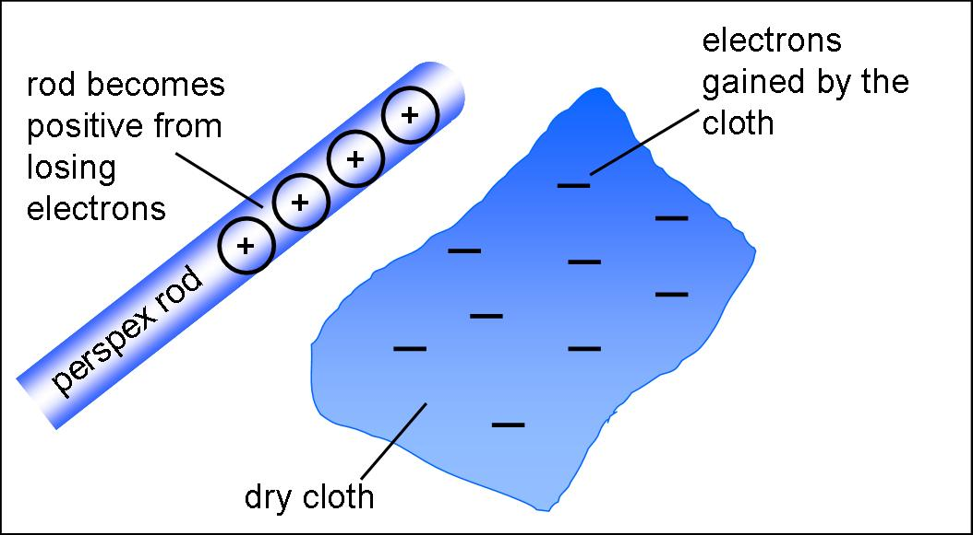
Law of Conservation of charge
No charge is actually created or destroyed when charges are separated. Instead, existing charges are moved about. In all situations the total amount of charge is always constant. This universally obeyed law of nature is called the law of conservation of charge.

Slide 8
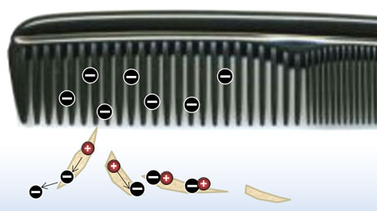
Charging by contact
Static electricity involves a build up of charge when two different objects are rubbed together and electrons from one jump across to another. This is called charging by contact. Some materials, such as plastic, hold onto electrons better than others and they will become negatively charged. The other object, due to electrons being lost, will become positively charged. The two objects will be attracted to each other due to their positive and negative charges.
Materials that hold electrons well include plastic, silk and glass – these become negative. Objects that lose electrons include metals which become positive.

Slide 9
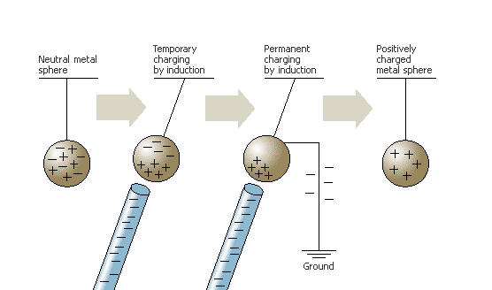
Charging by induction
Objects can also be charged by induction. When a negatively charged object is held close to another object but not touching then the negative electrons are repelled and move away (if a path is created which “earths” the object) and the non moving protons cause the object to be positively charged.
If the object being charged is not earthed then as soon as the negatively charged object is moved away then then electrons will just shift back again and neutralise it once more.

Slide 10
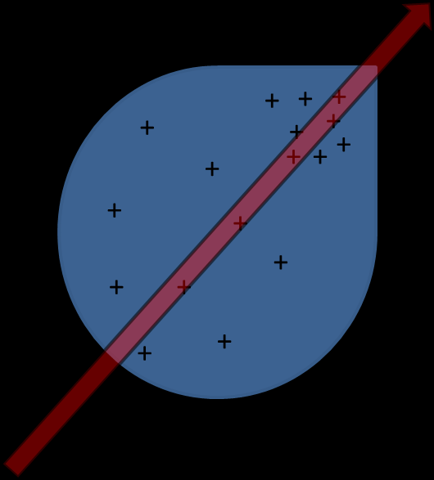
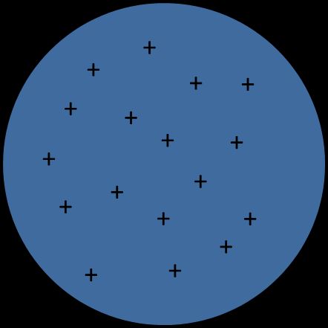
Uniform and non-uniform charge distributions
Uniform charge distribution
It has been found that a charged metal sphere has a uniform charge density all over its surface
Non-uniform charge distributions
A pear shaped conductor, however, has a high density at the pointed part.

Slide 11
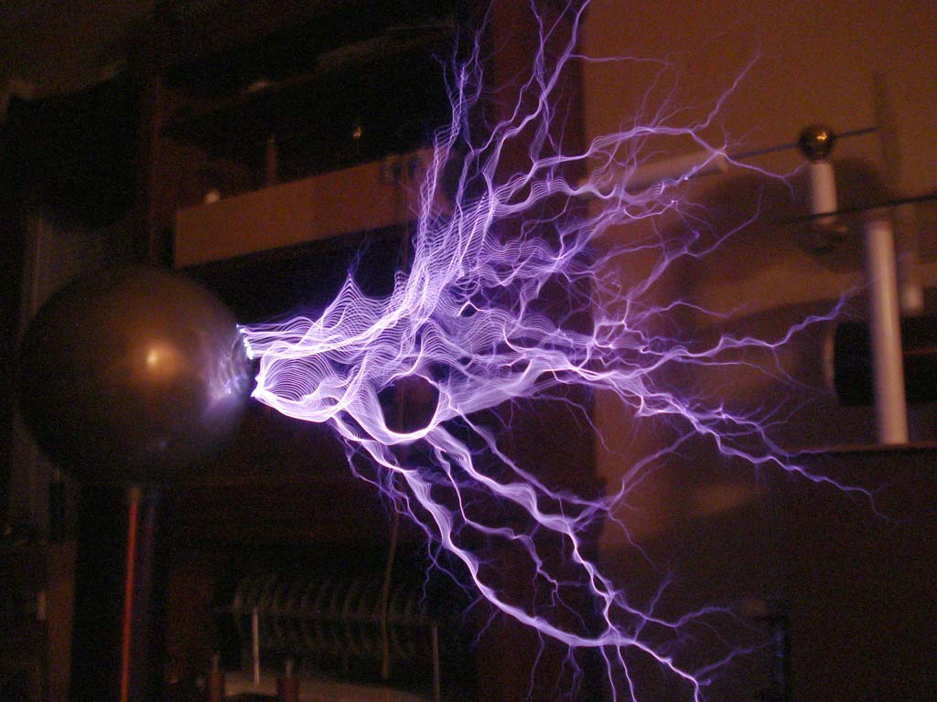
Electrical discharge in air
Electric discharge describes any flow of electric charge through a gas, liquid or solid. If there are enough positive (+) electrical charges on one object or material and enough negative (−) charges on the surface of the other object the attraction between the charges may be great enough to cause electrons to jump the air gap between the objects.
Once a few electrons start to move across the gap, they heat up the air, encouraging more electrons to jump across the gap. This heats the air even more. It happens rapidly , and the air gets so hot that it glows for a short time. That is a spark.
The same thing happens with lightning, except on a much larger scale, with higher voltages and current.

Slide 12
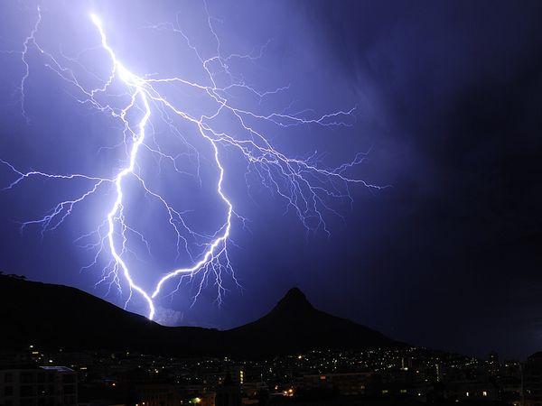
Lightning is a form of Static Electricity discharge
The build up of charge can be released when the electrons move through the air and make contact with an earthed object. This discharge can be seen as a bright spark. On a larger scale during a storm when particles in clouds rub together the discharge is seen as lightning. The lightning will usually make contact with the closest object (the tallest) that is conductive.
Some tall buildings have lightning rods on them. These give a path for the lightning to travel down to the ground and prevent the energy of the lightning from damaging and burning the building. Animals and people can be harmed if they are struck by lightning because of the huge amounts of energy being released.

Slide 13
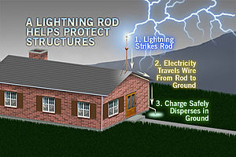
Earthing: how earthing removes excess charges
Electrical earthing (or grounding) diverts potentially dangerous electrical curernt by providing a conductive path between the area where static charge has built up and the earth where the charge can spread out. Lightning can be a source of dangerous or damaging charges that can be dissipated through a earthing system. Many tall buildings that attract lightning strikes have earthing electrodes (also called lightning rods) connected to the building that are sunk into the ground and disperse the excess charge.

Slide 14
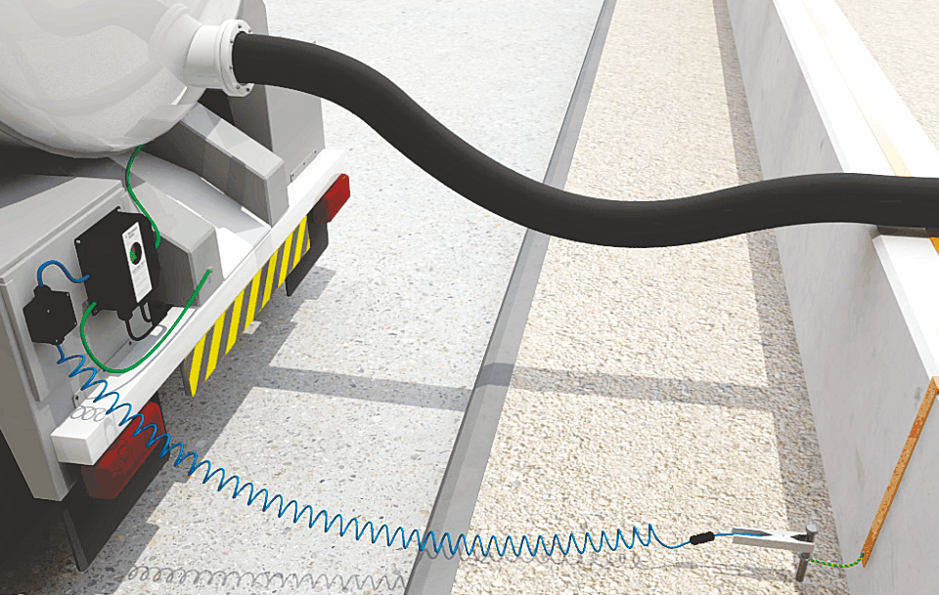
The dangers and uses of static charges
A build up of electrostatic charge can result in sparks or flashes of light. If this spark occurs near any combustible material then it may cause it to ignite. Fuel trucks often use earthing cables when refuelling tanks to discharge any build up of static electricity that the truck may have gained when travelling.
Air rushing past a moving vehicle drags electrons off the car and leaves it positive causing a build up of charge. This can cause travel sickness for some people. Conducting tails allow the car to pick up electrons from the road surface and lose its charge.
Electrostatic charges are important and useful in photocopying machines and in removing (extracting) dust

Slide 15
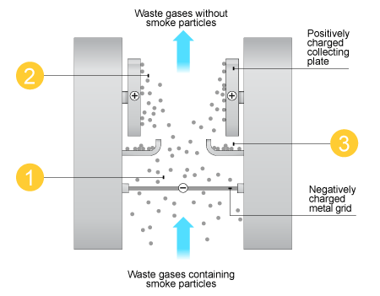
Electrostatic precipitators
Factories use static electricity to reduce pollution coming from their smoke stacks. They give smoke particles an electric charge
Smoke particles pick up negative charge
negative smoke particles attracted to positive collecting plates
collecting plates knocked to remove smoke particles
This keeps the pollution from going out into the atmosphere

Slide 16
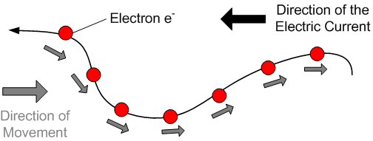
An electric current is a flow of charge
Electric current is the rate of flow of electric charge. Particles called electrons carry the electric charge. While some substances called conductors conduct very well, e.g. metals, other substances are not able to conduct or nearly conduct no electric current, e.g. glass. Electric current is nearly as fast as the speed of light.
+
NOTE:
The charge of an electron is negative. Previously people thought that positive particles serve as charge carriers. Due to this error the current flow is moving in the opposite direction of the electrons by convention from the positive terminal to the negative terminal.
-
Direction of “current flow”

Slide 17
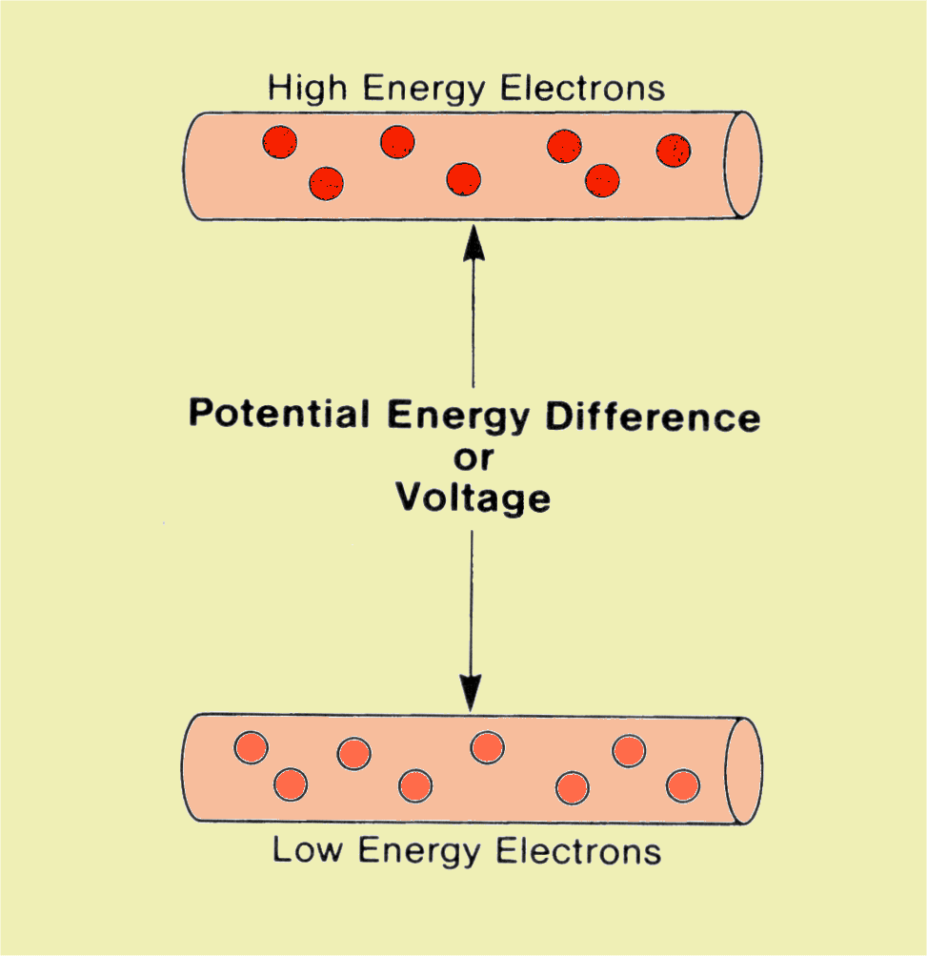
The ‘voltage’ of an electrical supply is a measure of the energy it can transfer from an electrical supply elsewhere
An electric current won't flow through a circuit unless there's a source of energy like a battery or mains electricity to push the electric charges along through the wire.
'Voltage' is a measure of how much energy the electric charges have between two points in a circuit.
Voltage is also known as potential difference. The more potential difference the more energy is available to be transferred into components attached to a circuit.

Slide 18
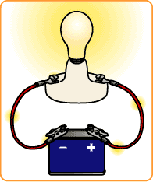
The properties of simple electric circuits
Electrical current occurs when electrons flow through a conductor from an area which is negatively charged to an area which is positively charged.
A circuit is a continuous pathway around which electrons can flow. The movement of electric current can be compared with a pipe full of water: If water is put in the pipe on the one end, water will drip out on the other side immediately.

Slide 19
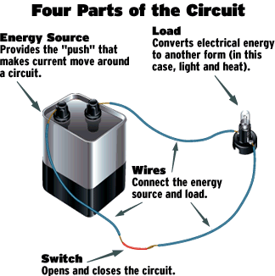
There is a need for a complete circuit when making use of electricity
A circuit is made up of electrical components connected together so electrons move through the components.

Slide 20
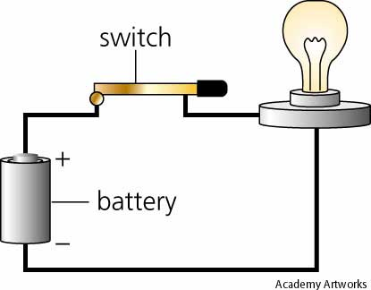
There is a need for a complete circuit when making use of electricity
A circuit must be closed for the electrons to flow and produce a current.
A switch breaks the circuit when it is opened and the flow of electrons stops, resulting in no current.

Slide 21
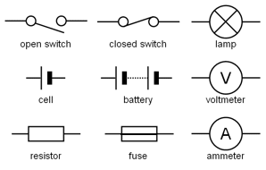
Circuit diagrams use symbols to represent components in a circuit
These symbols can be used universally by electricians and scientists regardless of their different languages to show how different circuits are arranged.

Slide 22
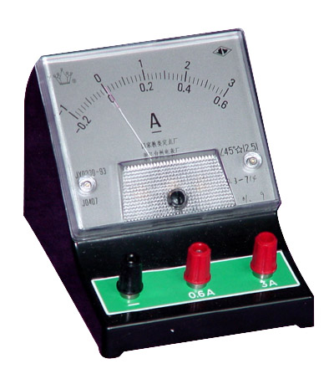
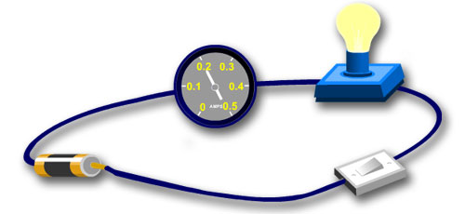
Ammeters are used in circuits to measure Amps
We can measure the amount of electric current flowing in a circuit with a device called an ammeter. The unit of electric current is the Amp - which is often abbreviated to the letter A, especially if it comes after a number. So, for example, 3 Amps can also be written 3A.
To measure the current flowing in a circuit you must connect the ammeter in series with the other components

Slide 23
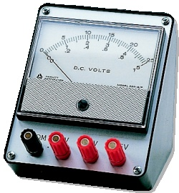
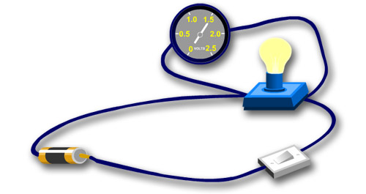
Voltage can be measured with a voltmeter
A voltmeter is used to measure voltage or potential difference and is placed in parallel to an appliance. We can measure the energy of electric charges in a circuit before they enter a bulb and after they leave it by putting a voltmeter in parallel across the bulb like this:

Slide 24
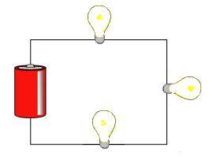
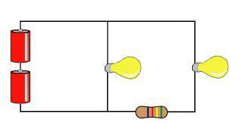
There are two types of circuits; Series and Parallel
In a Series circuit there is only one pathway for the electricity to flow, and in a Parallel circuit there is more than one pathway for the electricity to flow.
Series Circuit
Parallel Circuit
One pathway
More than one pathway

Slide 25
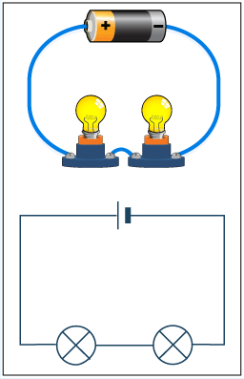
In a series circuit, the electrons move along one path
The electrical current flows through one component then the next – more lamps added in series cause their brightness to decrease.
Series Circuit
Circuit drawing

Slide 26
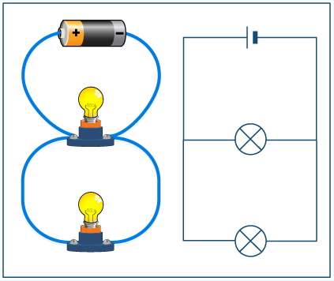
In a parallel circuit, electrons have a choice of two or more pathways.
More lights added in parallel do not effect the brightness.
Parallel Circuit
Circuit drawing

Slide 27
In Series circuits, the current is the same at any point on the circuit
Current = 1 truck (amps)
A
Current
In series circuits, components are connected on after the other. All of the current must travel through each of the components in turn.
A
Current = 1 truck (amp)
A

Slide 28
In Series circuits, the voltage is shared out around the circuit
Voltage
Current = 1 truck (amps)
Current
A
A
The current is the same at all points around a series circuit.
The total voltage = sum of voltage across all components i.e. voltage is shared out
V
V
Voltage = 1/2 load (volts)
Current = 1 truck (amp)
V
A

Slide 29
In parallel circuits, the current is shared out between branches
Total Current = 2 trucks (amps)
A
Current
A
Branch Current = 1 truck (amp)
A

Slide 30
In parallel circuits, the voltage is the same across all branches
Voltage
Current = 2 trucks (amps)
Current
The total current in the circuit = sum of the currents i.e. current is shared.
The voltage is the same across all branches around a parallel circuit.
A
V
A
Voltage = whole load (volts)
Current = 1 truck (amp)
V
A

Slide 31
Current and Voltage in Parallel and Series circuits
 | Current | Voltage
Series | >Same everywhere in the circuit >Doesn’t increase as more bulbs added | >total voltage coming out of battery is all used up by components (i.e. bulb) >total voltage loss is shared between components
Parallel | >total current coming out of battery is shared amongst branches >increases as more bulbs added | >total voltage loss is the same across all components

Slide 32
Advantages and Disadvantages of Parallel and Series circuits
 | Advantage | Disadvantage
Wiring done in parallel | Other bulbs remain working if one bulb is blown or removes All bulbs glow brightly | More current is needed when extra bulbs added The battery runs out quicker
Wiring done in series | You can turn off all of the appliances / lights with one switch The wiring is simpler | If one bulb is disconnected the circuit is not complete and all the bulbs will go out Resistance of the circuit is greater if more than one bulb – the other bulbs don’t glow as brightly Hard to find the blown bulb

Slide 33
The effects and uses of conductors and insulators
Electrons can travel freely in conductors such as metal.
Electrons can’t travel through insulators such as plastic.
Conductors
insulators
e-
e-
No flow
e-
electrons
electrons
e-
e-
Direction of flow
e-
good conductors have very low resistance
Insulators have high resistance.

Slide 34
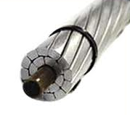
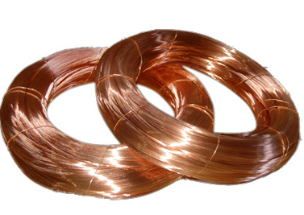
Conductors allow the flow of current through them and insulators prevent the flow of current through them
Conductors
Copper is considered to be a conductor because it “conducts” the electron current or flow of electrons fairly easily. Most metals are considered to be good conductors of electrical current. Copper is just one of the more popular materials that is used for conductors.
Other materials that are sometimes used as conductors are silver, gold, and aluminium.

Slide 35
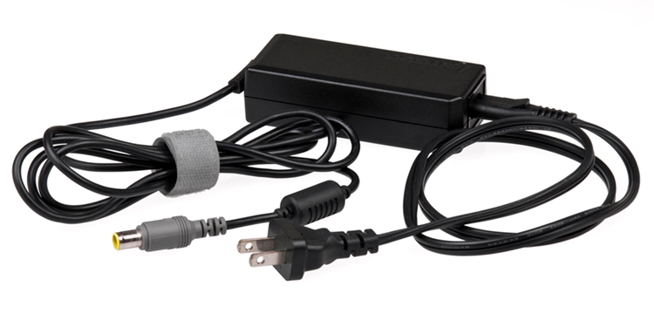
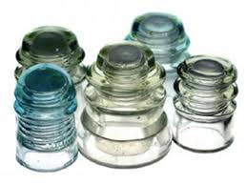
Conductors allow the flow of current through them and insulators prevent the flow of current through them
Insulators
Insulators are materials that have just the opposite effect on the flow of electrons. They do not let electrons flow very easily from one atom to another. Insulators are materials whose atoms have tightly bound electrons. These electrons are not free to roam around and be shared by neighbouring atoms.
Some common insulator materials are glass, plastic, rubber, air, and wood

Slide 36
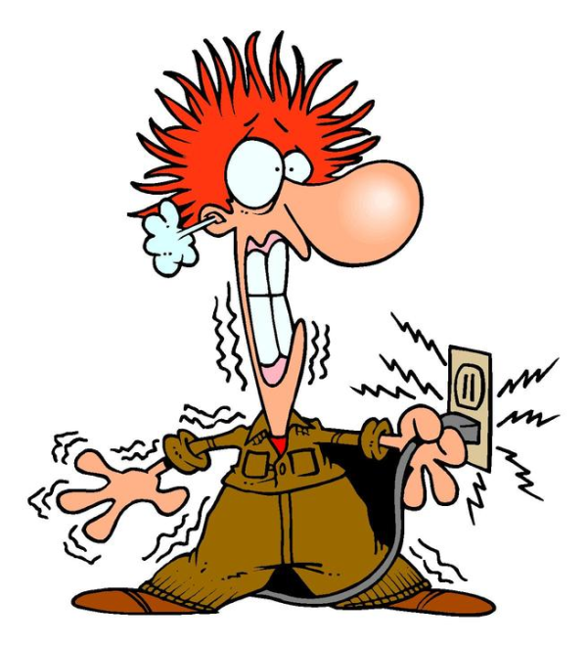
The dangers of electricity and the hazards of poor insulation, overloading and damp conditions
If electricity flows through your body with enough voltage or current it could kill you or cause damage. If your body is earthed, that is touching the ground or another conductive object that is touching the ground, and then you come in contact with an electrical source you will form a circuit for a current to flow. The electrical current will follow a path of least resistance which may be across your skin but it also may enter the body at one point and exit through another. The electrical current may cause bad burns as it converts some of its electrical energy to heat energy. It may also stop your heart as the electricity interferes with the pacemaker of your heart that sends out small pulses of electricity
to keep the heart muscles all contracting
and relaxing in rhythm.

Slide 37
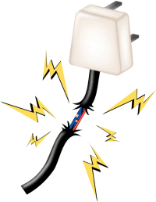
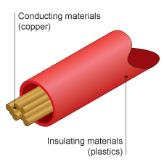
The hazards of poor insulation
Machines, wires and appliances that use electricity or have electricity flowing through them must have a insulating material such as plastic surrounding parts that we may come in contact with.
Power lines are usually held off the ground by wooden or concrete posts and suspended by glass or ceramic (material that coffee cups are made of) insulators.
Appliances including the cords and plugs usually have plastic or rubber coverings.
If the coverings become cracked or worn and expose the metal that conducts the electricity then we are in danger of an electric shock if we touch that part.

Slide 38
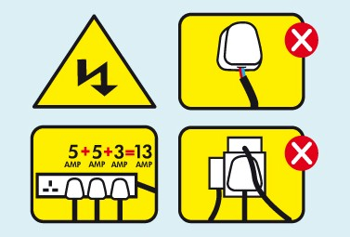
The dangers of overloading
Household circuits are wired in parallel so the same voltage is available no matter how many appliances are being used. The danger of overloading, or using to many appliances at once, is that the current drawn increases with each one used. If the current travelling through the circuit is to high the resistance of the wiring maybe to much and excess electrical energy maybe released as heat and cause a fire.
Circuits usually have fuses built into them which have a set resistance wire that breaks before the current in the circuit gets to high. Modern fuses have a switch that can be flicked back on rather than replacing the wire.

Slide 39
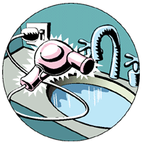
The dangers of electricity and damp conditions
Water conducts electricity because it usually has ions dissolved within in that can carry charge. When appliances come in contact with water accidentally the electric current moving inside it may travel through the water and come in contact with the person touching it. The current will then travel through the person and Earth into the ground.
Electricians working safely with electricity use insulating tools and if they are working on power lines they suspend them selves above the ground so they do not make a path for electricity to Earth or use ladders that have an insulated portion.

Slide 40
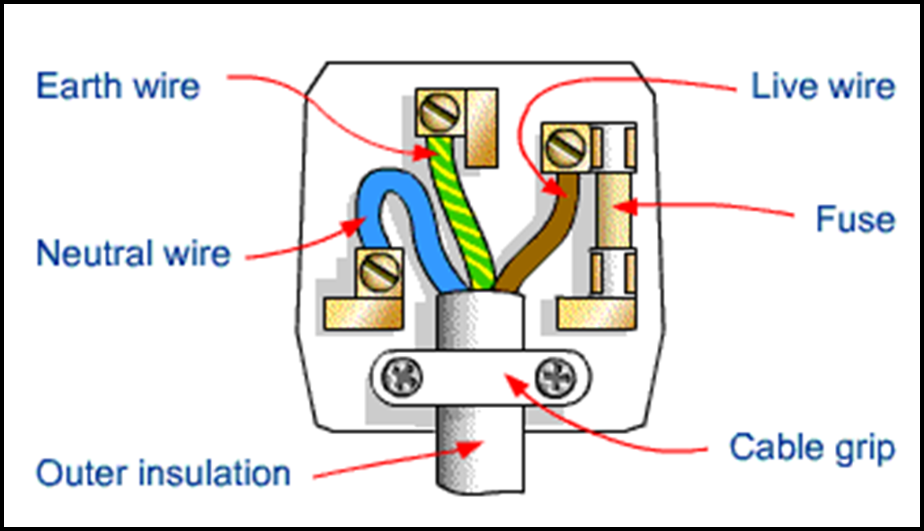
The safety features of the 3-pin plug
The case is made from tough plastic or rubber because these materials are good electrical insulators.
The three pins are made from brass, which is a good conductor of electricity.
There is a fuse between the live terminal and the live pin.
The fuse breaks the circuit if too much current flows.
The cable is secured in the plug by a cable grip. This should grip the cable itself and not the individual wires inside it.

Slide 41
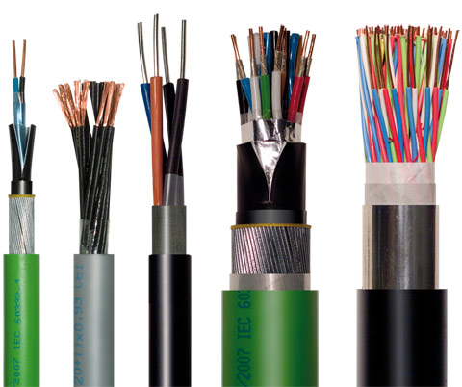
We make use of the conducting and insulating properties of materials in technological applications
Every day we use materials because of their ability to conduct electricity. The most common product around the home is cables and wiring. Our houses are wired with metals such as copper which carry charge around. The wires are coated in plastic which acts as an insulator to prevent electricity flowing away from the wire.
Wires are also used to transport electricity around from where it is generated such as at a hydropower station to towns where it is used. The insulating material around the wire needs to be much thicker and the wires are suspended from pylons by other insulators made from glass or ceramic materials.

Slide 42
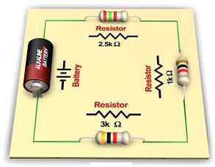
Electrical resistance
Resistance (symbol R) measures how difficult it is for current to move through a component. Resistance is measured in ohms (symbol Ω)
Resisters will reduce the current that flows through a circuit. Components that add resistance to a circuit can often transform electrical energy in light, sound or heat energy.

Slide 43
The resistance of a component (in ohms) = voltage across component / current through component
Resistance is calculated using R = V/I
The resistance of an object determines the amount of current through the object for a given voltage across the object.
where
  R is the resistance of the object, usually measured in ohms
  V is the voltage across the object, usually measured in volts
  I is the current through the object, usually measured in amperes
The higher the resistance the less the current.

Slide 44
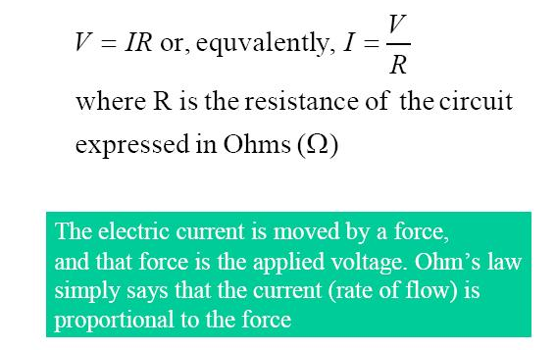
Ohm’s Law

Slide 45
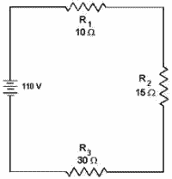
R_{T} = Total resistance
Resistors in series
The total resistance in a series circuit is calculated by this formula:
R_{T} + R₁ + R₂ + ….
Total resistance (R_{T}) in the circuit to the right = 10 + 15 + 30
R_{T} = 55Ω
Resistors in parallel
The total resistance in a parallel circuit is calculated differently (not required at L1). When resistors are added in parallel the total resistance decreases

Slide 46
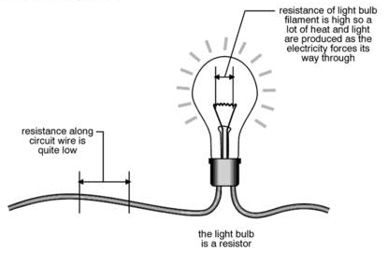
Electrical resistance
Parts of a circuit which offer high resistance transform a greater amount of electrical energy into light and heat energy. This is why the high resistance, very thin wire of a filament light bulb glows hot and bright while the lower resistance thicker wire providing the current to the bulb stays cooler.

Slide 47
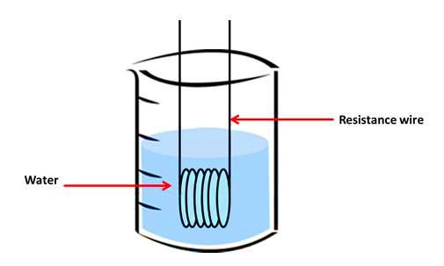
Ohmic Conductors
Resistors which obey Ohm's Law have a straight line of voltage against current. An ohmic conductor has a constant resistance - wire in a circuit can act as an ohmic conductor if it is kept at a constant temperature. The resistance wire is acting as an ohmic conductor.

Slide 48
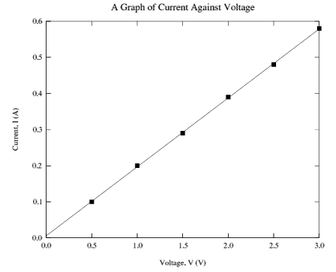
The resistance of an ohmic component (in ohms) = voltage across component / current through component

Slide 49
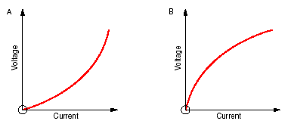
Non-ohmic conductors
Resistors which do not obey Ohm's Law have a curved line of voltage against current.
In filament lamps, the temperature of the wire (resistor) rises sharply as the current increases. This causes the resistance to increase and the gradient of the
voltage-current graph rises (diagram A below). The resistance of the wire increases as the temperature increases, because the particles in the wire move quickly, preventing the electrons from flowing past them easily.
Thermistors and light-dependent resistors are made from semiconductors in which the resistance falls as the temperature increases. This means that the gradient of the voltage-current graph falls as the current increases and the temperature increases (diagram B below).
GZ Science resources physics 1.3 2013
49

Slide 50
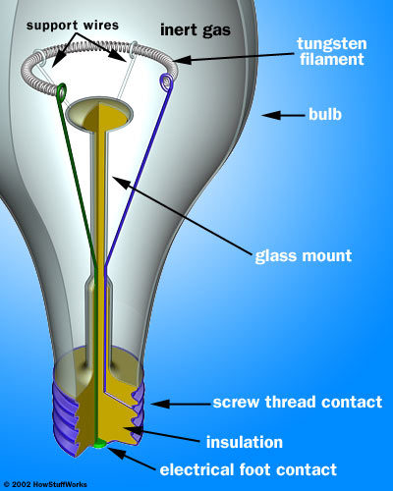
power = voltage x current
Power (symbol P) is the rate at which electrical energy is used by a component or supplied by an energy source. Power is measured in watts, W.
The watt (symbol: W) is equal to one joule per second.
A person climbing a flight of stairs is doing work at the rate of about 200 watts; a highly trained athlete can work at up to approximately 2,000 watts for brief periods. An car engine produces 25,000 watts while cruising. A typical household lightbulb uses 40 to 100 watts.

Slide 51
power = voltage x current
Electric power, like mechanical power, is represented by the letter P in electrical equations.
where
  P is the power (watt or W)
  I is the current (ampere or A)
  V is the potential difference (volt or V)
Power increases if either the current or the voltage increases.

Slide 52

Wasted power and overheating
Normally electric power is useful, making a lamp light or a motor turn for example. However, electrical energy is converted to heat whenever a current flows through a resistance and this can be a problem if it makes a device or wire overheat. If the resistance is low (a wire or low value resistor for example) the current can be sufficiently large to cause a problem.
From the equation P = I² × R for a given resistance the power depends on the current squared, so doubling the current will give 4 times the power.
Resistors are rated by the maximum power they can have developed in them without damage.

Slide 53
Energy
Energy measures power supplied over a time period (t).
Energy is measured in joules, J.
Energy is calculated using E = P x t.
where
  P is the power (watt or W)
  t is the time (seconds or s)
  E is the energy (joules or J)

Slide 54

Energy
The amount of energy used (or supplied) depends on the power and the time for which it is used:
Energy = Power × Time
A low power device operating for a long time can
use more energy than a high power device operating
for a short time. For example:
A 60W lamp switched on for 8 hours uses
60W × 8 × 3600s = 1728kJ.
A 3kW kettle switched on for 5 minutes uses
3000W × 5 × 60s = 900kJ.

Slide 55

Measuring electrical energy use
The standard unit for energy is the joule (J), but 1J is a very small amount of energy for mains electricity so kilojoule (kJ) [1000 joules]or megajoule (MJ) [1000000 (million) joules] is sometimes used in scientific work. In the home we measure electrical energy in kilowatt-hours (kWh). 1kWh is the energy used by a 1kW power appliance when it is switched on for 1 hour:
1kWh = 1kW × 1 hour = 1000W × 3600s = 3.6MJ
For example:
A 60W lamp switched on for 8 hours uses
0.06kW × 8 = 0.48kWh.
A 3kW kettle switched on for 5 minutes uses
3kW × 5/60 = 0.25kWh

Slide 56

Formula wheel

Slide 57

The links between forces and energy
Power is a measure of work done over time.
Power is measured in units called watts.
Power = work/time
P = w/t
Force = 20N
Time = 25seconds
Distance = 5 metres
A car is pushed with a force of 20N and travels 5 metres.
The work done is w = f x d w = 20 x 5 = 100 joules
The power used to push the car is p = w/t p = 100/25 = 4 watts

Slide 58

Magnetic materials have the ability to attract some materials but to attract and repel each other
Some objects attract iron and steel. They are called magnets.
A magnet has a magnetic force field around it. When another magnet or an iron object enters the field it experiences a force as either a push or a pull.
The force field of a magnet can be reveled by sprinkling iron fillings around it, or by moving a small compass around the magnet and marking the needle direction.
Magnets have a variety of uses. Examples of uses of permanent magnets in the home include: fridge magnets, cupboard door latch, magnetic knife holder, magnetic
screwdriver etc.

Slide 59
Magnetic materials have the ability to attract some materials but to attract and repel each other
A magnet will have a positive and negative end, sometimes called North and South.
Like charges will repel each other. e.g. positive and positive.
Unlike charges will attract each other. e.g. positive and negative
Repulsion
Attraction
+ve
+ve
+ve
-ve

Slide 60

Magnets attract some metals but not others
Only iron, cobalt and nickel and some iron alloys like steel are able to act as magnets. The particles that they consist of are able to align themselves so that all their negative ends are facing the same direction.
Aluminium cans are not magnetic whereas ‘tins’ are largely made of iron and are magnetic.
It is sometimes difficult to distinguish between a magnet and a magnetic material. When two magnets are put together there is either attraction or repulsion, but when a magnet and a magnetic material are put together there is just attraction.

Slide 61


Magnetic fields are arranged in fixed patterns
Field patterns produced by bar magnets can be visualized using iron filings. This is the magnetic field. The field lines move out from the N end of a magnet and into the S end.
Compasses, which contain a movable magnet, can also be used to show magnetic fields. The needles will align in the direction of the field.

Slide 62

Magnetic field interactions
A strong field is produced between unlike poles.
Between the middle of like poles the net magnetic force is zero due to the fields cancelling out. This is shown by a blank space between.
The field lines move out from a North pole (and into a South pole).

Slide 63

Magnetic fields are arranged in fixed patterns
If a circuit with a wire and battery is set up and a compass placed near the wire, the needle will change direction when the current is on.
When current flows through a conductor it creates a magnetic force field around it – this is called the electromagnetic effect. The force field is a circular one running around the wire
The strength of the magnetic field around a current-carrying wire can be boosted by increasing the current, by looping wire into a coil and by placing an iron bar inside the coil.
SJ
Gaze

Slide 64

Electric currents and magnetic fields interact
Electromagnetism describes the relationship between magnetism and electricity. The electric field not only describes the region surrounding an electrically charged body but in addition the force experienced by any further charges placed within this region. Michael Faraday was the scientist who first discovered the effects of electromagnetism.

Slide 65

Magnetic field around a solenoid
Magnetic field lines
Coming out of wire
Going into wire
current

Slide 66

Electric currents and magnetic fields interact
Magnetic fields are the result of electric charges in motion; this can be currents flowing through wires or simply electrons in their atomic orbits.
The direction of the magnetic field around a current can be visualised using a hand. The direction of the thumb shows the direction of the electric current. The fingers wrapped around show the direction of the magnetic field lines.

Slide 67

Magnetic field strength
B – magnetic field strength (T)
K – constant (in TmA⁻¹)
l – current (A)
d – distance from wire (m)
Kl
B
d

Slide 68

An electric current itself has a magnetic field
When electrical charges are moving they create or induce magnetic fields.
A changing magnetic field will create an electric current and an electric current will induce a magnetic field.
This is called electromagnetic induction, it is the principle used to drive generators, motors, transformers, amplifiers and many more electrical devices.

Slide 69

Electrical currents moving around a magnet can produce an electromagnet
A magnetic field can be made stronger with a coil of conductive wire wrapped around it and an electric current flowing through the wire. This is called an electromagnet. An electromagnet can be made stronger by: increasing the number of turns (how many times the wire is wound) and by increasing the current. A coil of wire is called a solenoid.
Electromagnets are used when a stronger magnet is required such as for picking up cars at a wreckers and has the advantage of being “switched off” when the current is stopped.

Slide 70




Forces can act on an electric current when in a magnetic field
If a current carrying conductor is in a magnetic field, the conductor will experience a force and will move if it is free to do so. This is the principal behind the electric motor. The motor transforms electrical energy into kinetic or movement energy and can be used to operate a small toy or machine.
The movement, magnetic field and the current are all at right angles to each other.

Slide 71

Forces can act on an electric current when in a magnetic field
If the current goes in the other direction, the wire moves the other way. If the current is kept in the same direction but the direction of the magnetic field is reversed, then the wire moves the other way.

Slide 72

Relays
A relay is an electrically operated switch. It works on the principle of a magnet attracting iron when a current is flowing, closing the switch and creating a complete circuit (a) and releasing it when the current is no longer flowing therefore opening the switch (b).

Slide 73


Using a relay to switch on a light bulb
The relay has a coil containing a sliding iron core to turn on the light bulb
When the current flows, the coil becomes magnetised and pulls soft iron core to the left. The head of the core touches the two metal contacts thereby completing the light bulb circuit

Slide 74

Workings of a chime door bell
When the solenoid (wire coil) is “switched on” it becomes magnetised and the piston is pulled to the right to hit the right tone bar. When the solenoid is turned off, it becomes non-magnetised and the piston is pulled to the left by the spring to hit the left tone bar
As long as you hold the doorbell button, current will flow through the electromagnet and the piston will remain in this position. But when you release the button, the current will stop flowing through the electromagnet and the magnetic field will collapse. The spring snaps the piston back to the left, where it hits the tone bar on the other side. The second tone bar produces the "dong" sound

Slide 75

The Earth is surrounded by a magnetic field
The Earth has a magnetic field. The outer core of the Earth is liquid iron and as heat from the very hot solid iron inner core moves through it then electrical currents are produced. Current Scientific theory suggests that this in turn produces an electric field that stretches far beyond Earth.
This magnetic field produces a North and South Pole, although they are not exactly in the same place as the geographical North and South Pole.
The North of a needle compass is attracted to the South, so the North pole is actually the South Pole!

Slide 76

The Earth is surrounded by a magnetic field
Harmful radiation (which would kill living organisms) emitted from the Sun is deflected by our magnetic field. Small amounts of radiation which enter through the small gaps in the magnetic field lines over the poles interact with the ionosphere layer around Earth and cause beautiful coloured lights in the sky called the Aurora borealis (Northern lights) and Aurora Australis (Southern lights)
The moving inner solid core maybe the cause of the shifting magnetic field. Evidence in ancient rocks shows us that in the past the magnetic field around Earth has switched direction reasonably quickly many times. During these switch overs the Earth may have been left defenceless from dangerous radiation.

