Slide 1
Oxidised state
MnO₄⁻
Purple (aq)
Permanganate
Oxidised state
MnO₄⁻
Purple (aq)
Permanganate
Oxidised state
Cr₂O₇²⁻
Orange (aq)
Dichromate
Reduced state
Cr³⁺
Green (aq)
Chromium ion

Slide 2
Oxidised state
Fe³⁺
Orange (aq)
Iron (lll) ion
Reduced state
Fe²⁺
Green (aq)
Iron (ll) ion
Oxidised state
Cu²⁺
Blue (aq)
Copper (ll) ion
Reduced state
NO₂
Brown (g)
Nitrogen dioxide

Slide 3
Oxidised state
I₂
Blue-Black (s)
Iodine
Reduced state
(Neutral conditions)
MnO₂
Brown (s)
Manganese dioxide
Oxidised state
MnO₄⁻
Purple (aq)
Permanganate
Reduced state
(Alkaline conditions)
MnO₄²⁻
Green (aq)
Manganate

Slide 4
Oxidised state
S
yellow (s)
Sulfur
Oxidised state
Br₂
Brown (s)
Bromine
Oxidised state
Cl₂
Pale green (g)
Chlorine
Reduced state
Cu
Red/brown (s)
Copper

Slide 5
Oxidised state
ClO₃⁻
colourless (aq)
Chlorate
Reduced state
Cl⁻
Colourless (aq)
Chloride ion
Oxidised state
O₂
colourless (g)
Oxygen
Reduced state
O²⁻
colourless (aq)
Oxide ion

Slide 6
Oxidised state
H⁺
colourless (aq)
Hydrogen ion
Reduced state
H₂
Colourless (g)
Hydrogen gas
Reduced state
H₂S
colourless (g)
Hydrogen sulfide
Reduced state
Br⁻
colourless (aq)
Bromide

Slide 7
Oxidised state
CO
colourless (g)
Carbon monoxide
Reduced state
C
Black (s)
Carbon
Oxidised state
O₂
colourless (g)
oxygen
Reduced state
H₂O₂
colourless (l)
Hydrogen peroxide

Slide 8
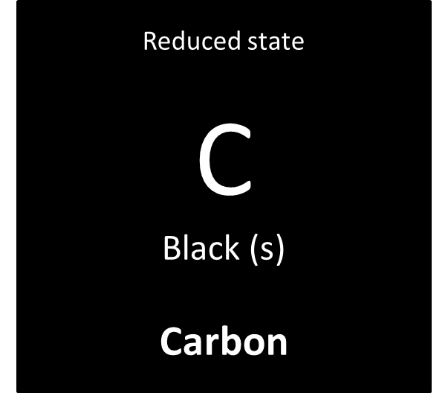
Reduced state
C
Black (s)
Carbon

Slide 9
Oxidised state
SO₄²⁻
colourless (aq)
Sulfate ion
Reduced state
SO₂
colourless (g)
Sulfur dioxide
Oxidised state
H₂O₂
colourless (l)
Hydrogen peroxide
Reduced state
H₂O
colourless (l)
Water

Slide 10
Oxidised state
CO₂
colourless (g)
Carbon dioxide
Reduced state
H₂C₂O₄
colourless (l)
Oxalic acid
Oxidised state
O₂
colourless (g)
oxygen
Reduced state
H₂O₂
colourless (l)
Hydrogen peroxide

Slide 11
Reduced state
I⁻
colourless (aq)
Iodide
Reduced state
Mn²⁺
Colourless (aq)
Manganese ion
Oxidised state
NO₃⁻
colourless (aq)
Nitrate ion
Reduced state
Cu⁺
White (aq)
Copper (l) ion

Slide 12
Reduced state
Zn²⁺
colourless (aq)
Zinc ion
Reduced state
Cu⁺
White (aq)
Copper (l) ion
Oxidised state
BrO₃⁻
colourless (aq)
Bromate
Reduced state
Zn
silver (s)
Zinc

Slide 13
Oxidised state
Zn²⁺
colourless (aq)
Zinc ion
Oxidised state
Cu⁺
White (aq)
Copper (l) ion
Reduced state
Cl⁻
Colourless (aq)
Chloride ion
Reduced state
Br⁻
colourless (aq)
Bromide

