Slide 1
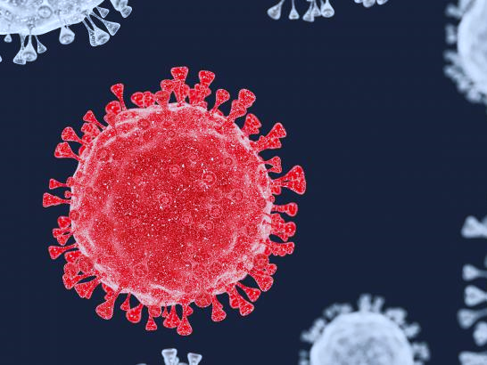
The Science of
Viruses and COVID-19

Slide 2
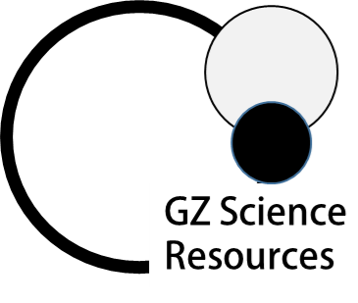
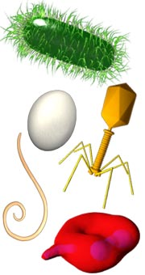
Micro-organisms
Micro-organisms (or microbes) are very small organisms, which are usually only visible with the aid of a microscope. Sometimes a colony of micro-organisms can be seen with the naked eye.
Micro-organisms which have single cells are unicellular. Those made of many cells are multicellular. Some have no cells at all – viruses.

Slide 3
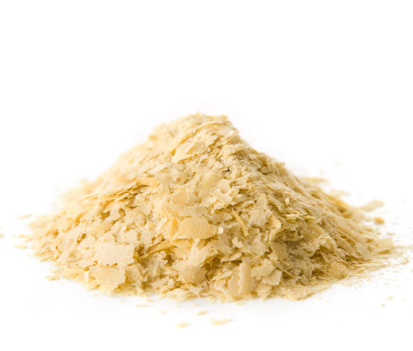
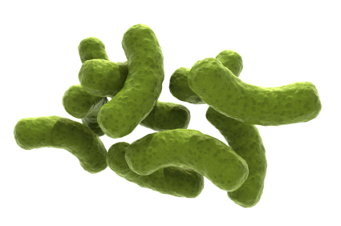
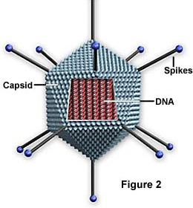
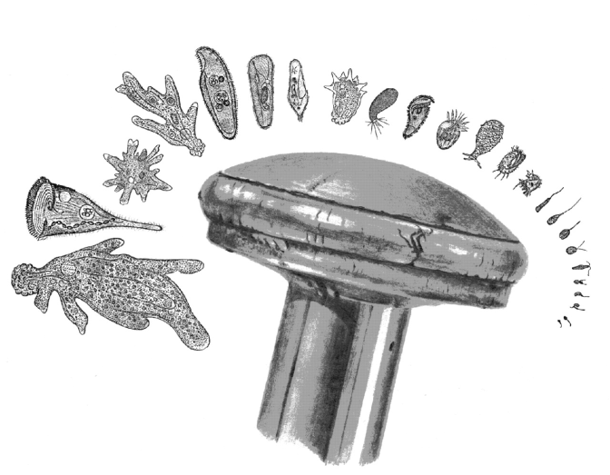
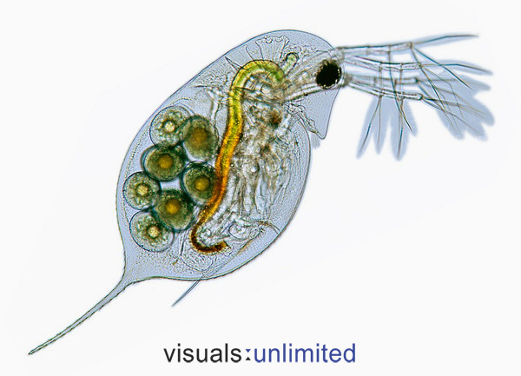
Types of Micro-organisms
Living
Non-living
Yeast (fungi)
Bacteria
Protista
Viruses
Daphnia (animal)

Slide 4
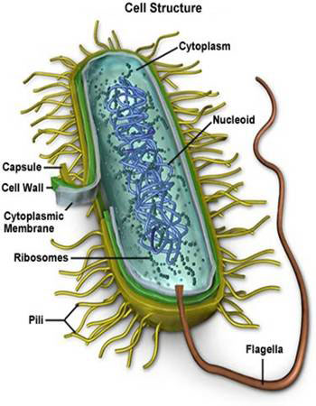
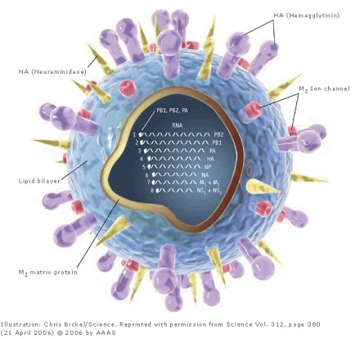
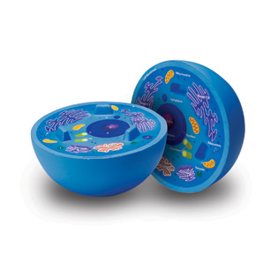
All living organisms are made of cells
Fungi | Bacteria | Virus
Similar to the animal cell, but has a cell wall made of chitin (the same material insect exoskeletons are made of). Does not have chloroplasts as it can not photosynthesis. Eukaryote cell. | Does not have nucleus or organelles (except ribosomes). Prokaryote cell | Not considered living or consisting of cells but contains genetic material (RNA/DNA) similar to all other living things.
4

Slide 5
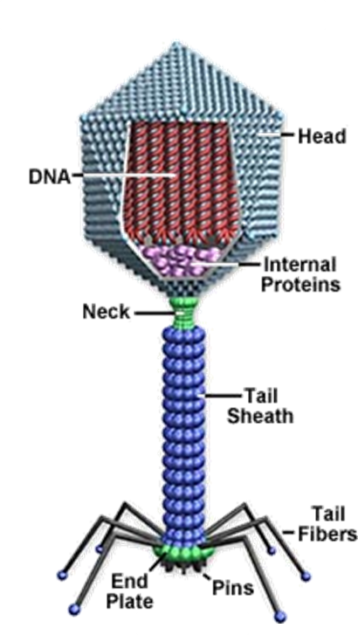
Viruses
Viruses are not living organisms because they are unable to carry out all of the life functions of living organisms without invading a living cell and ‘hijacking’ it’s processes. Viruses do not possess cells or cell components of their own.
They cannot synthesise proteins, because they lack ribosomes. Viruses cannot generate or store energy.
Viruses are the smallest of all of the micro-organisms and are usually between 20 – 400nm. (in one metre is 10⁹ nanometers)
Interesting fact: Because viruses can not survive without cells, scientists predict that they originated from rogue pieces of DNA/RNA strand.

Slide 6
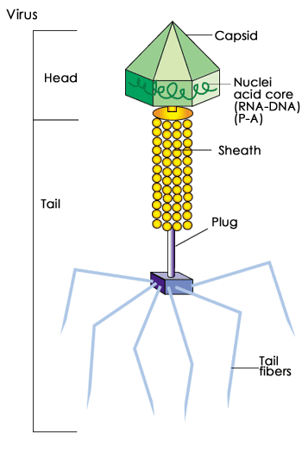
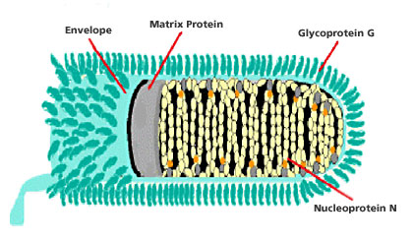
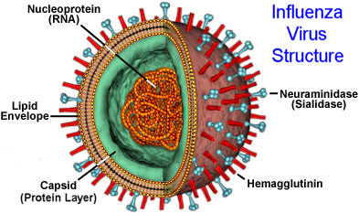
Examples of Viruses
Rabies virus
Influenza virus
Bacteriophage virus
Viruses can take numerous forms

Slide 7
Covid-19 Viruses
https://www.columbia.edu/content/coronavirus
The virus known as COVID-19 belongs to a family of coronaviruses, mostly found in animals. Some coronaviruses have passed across to humans, by close contact with the host animals, such as SARS (severe acute respiratory syndrome), and MERS (Middle East respiratory syndrome). The disease caused by COVID-19 is called SARS-CoV-2.
Currently it is estimated that 1 person on average can infect 2.2 other people. This is known as the R0 (or R-nought). Symptoms for the disease include fever, coughing, and difficulty breathing. In some people, currently around 20%, and mostly older people, or those with underlying health problems, the disease leads to hospitalisation

Slide 8
The structure of Viruses
All viruses contain:
Nucleic acid, either DNA or RNA (but not both),
A protein coat (capsid), which encases the nucleic acid.
Some viruses are also enclosed by an envelope of fat and protein molecules.
Spikes
Protein Coat
Lipid layer
RNA/DNA strands
Example – HIV Virus

Slide 9
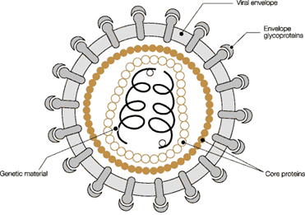
Function of the Viral components
Nucleic Acid - Just as in cells, the genetic material (DNA or RNA) of each virus encodes the genetic information for the synthesis (creation) of all proteins. While the double-stranded DNA is responsible for this in prokaryotic and eukaryotic cells, only a few groups of viruses use DNA. Most viruses have single-stranded RNA. The genetic material can only make protein when it is slotted into the DNA of a host cell as it has no ribosomes

Slide 10
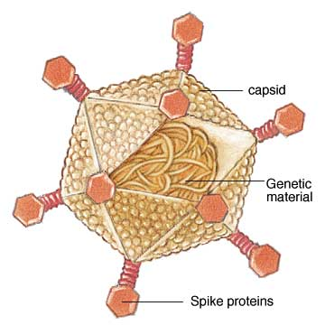
Function of the Viral components
Capsid - The capsid is the protein shell that encloses the nucleic acid; The capsid has three functions:
it protects the genetic material from digestion by enzymes.
2) contains special sites on its surface that allow the virus to attach to a host cell.
3) It may contain spike proteins that enable the virus to penetrate the host cell membrane and, in some cases, to inject the viral nucleic acid into the cell's cytoplasm.

Slide 11
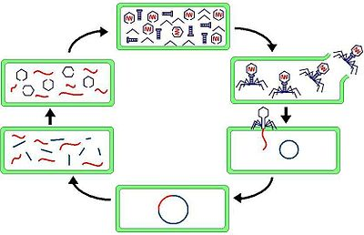
Replication of viruses
Absorption Viruses can enter an organism through any cavity or broken surface of an organism. Once inside, they find a host cell to infect.
Entry The Virus attaches to a specific cell type and ‘injects’ its genetic material.
Replication The viruses genetic material joins into the cell DNA and viral protein is made.
Assembly Various pieces of viral protein are constructed into individual viral particles (or virions).
Release The newly created virions break through the cell wall (killing it) and proceed to infect other cells.
Assembly
Release
Absorption
Replication
Entry

Slide 12
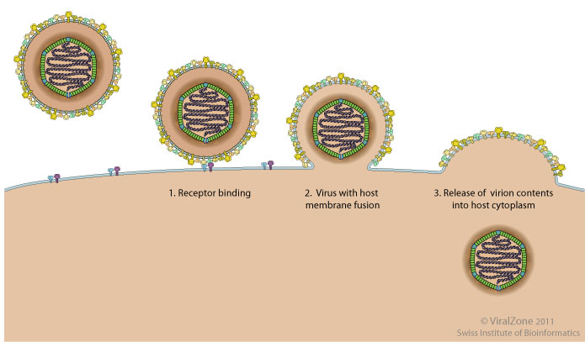
Targeted cells
The virus attaches to the target cell, usually through specific protein-protein interactions between capsid and cell surface receptors.
Only then can the genetic material be taken into the host cell.
There are three requirements that must be met to ensure successful infection of a virus:
sufficient virus must be present
the cells must be susceptible and permissive (matching) to the virus,
and local defences (immune system) must be absent.

Slide 13
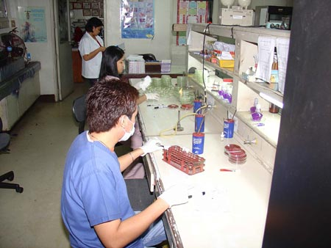
Growth - Culturing Viruses
Viruses will not grow on agar (jelly made from seaweed with nutrients) because they cannot feed.
They need living cells to reproduce in and are often grown in fertile hen’s eggs.
The introduction of micro-organisms onto agar or into living cells is known as inoculation.
It is to dangerous to grow viruses in the school laboratory as all viruses are Pathogens (harmful to living organisms).
Viruses do not require nutrition as they are not alive – and have no cells or metabolism that require energy

Slide 14
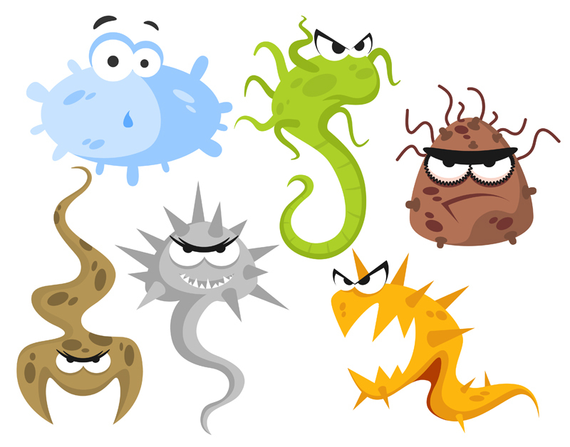
Disease
A disease is a pathological condition of body parts or tissues characterized by an identifiable group of signs and symptoms.
Infectious disease are diseases caused by an infectious agent such as a bacterium, virus, protozoan, or fungus that can be passed on to others.
An infection occurs when an infectious agent enters the body and begins to reproduce; may or may not lead to disease.
A pathogen is an infectious agent that causes disease and they affect a Host, which is an organism infected by another organism.
Diseases are classified by their virulence, which is the relative ability of an agent to cause rapid and severe disease in a host

Slide 15
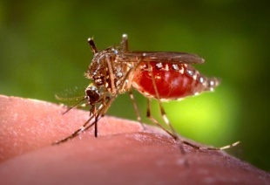
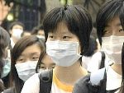
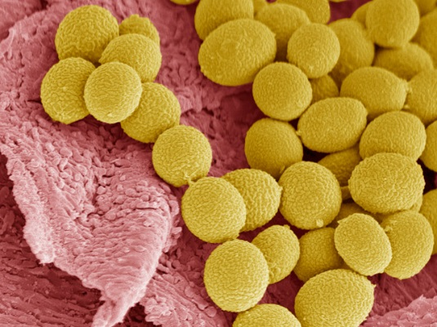
Transmission of infectious diseases
Agents that cause infectious diseases can be transmitted in many ways.
Through the air
Through contaminated food or water
Through body fluids such as blood or saliva
By direct contact with contaminated objects
By animal vectors such as insects, birds, bats, etc
Explain what the pathogen does/needs that means it can get from person to person like this
Describe the transmission of the pathogen
“Transmission happens like this because…”
Courtesy of CDC
Mosquito
Known to transmit Zika virus
Courtesy of VOA
Chinese students wearing masks during a SARS outbreak
Courtesy of BPoA
Athletes foot (Tinea) is spread by fungal spores

Slide 16
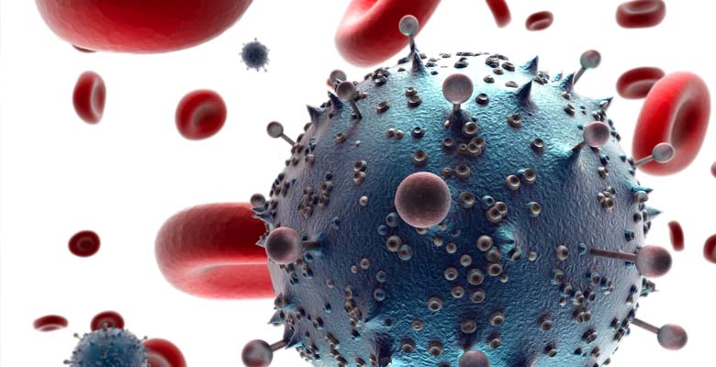
How Pathogens cause diseases
Many pathogens (disease causing micro-organisms) that infect humans produce of poisons, such as toxins and enzymes, that destroy cells and tissues. These poisons are created during the micro-organisms life processes during feeding, excretion or respiration. Micro-organisms such as viruses also have direct invasion and destruction of host cells.
Pathogens can cause triggering responses from the host’s immune system leading to disease signs and symptoms.

Slide 17
Classification of infectious diseases
By duration
Acute – develops and runs its course quickly.
Chronic – develops more slowly and is usually less severe, but may persist for a long, indefinite period of time.
Latent – characterized by periods of no symptoms between outbreaks of illness.
By location
Local – confined to a specific area of the body.
Systemic – a generalized illness that infects most of the body with pathogens distributed widely in tissues.
By timing
Primary – initial infection in a previously healthy person.
Secondary – infection that occurs in a person weakened by a primary infection.

Slide 18
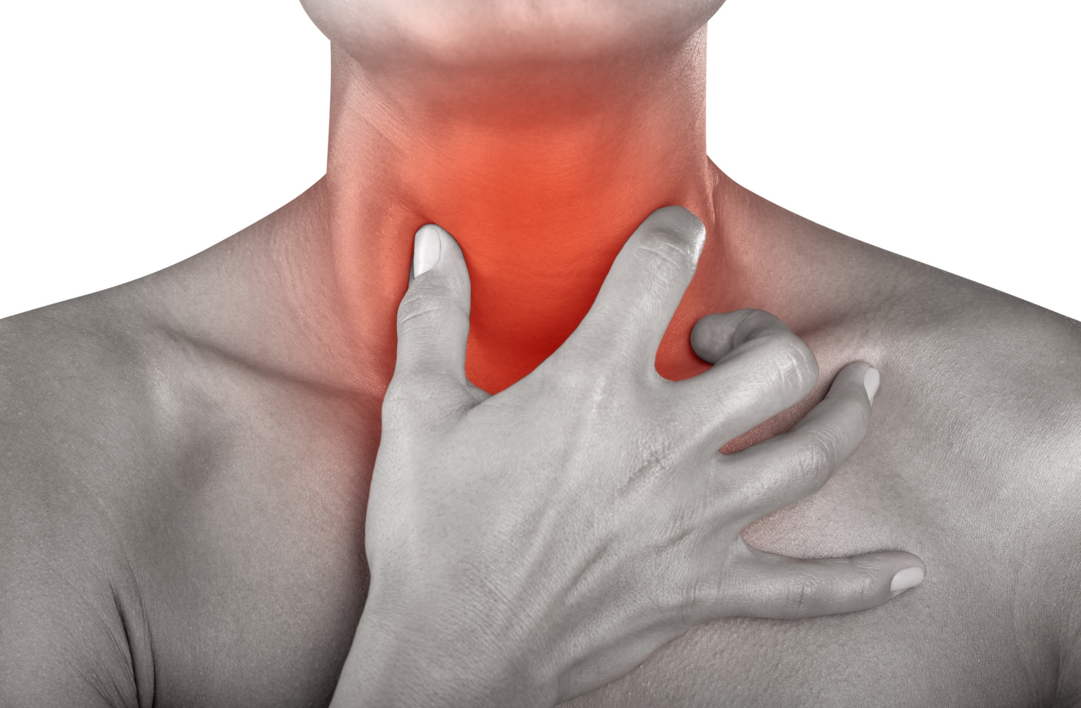
Symptom of an infectious disease
When micro-organisms infect the body many of the symptoms associated with particular infections are caused due to the bacteria or fungi carrying out various life functions or the virus replicating.
Nutrition using extra-cellular digestion in fungi and bacteria will cause death of cells as they are destroyed. Replication of Virus also destroys cells as they replication. Death of cells causes redness, swelling and pain – a common symptom of disease.
Some micro-organisms release toxins which cause damage and death in humans.

Slide 19
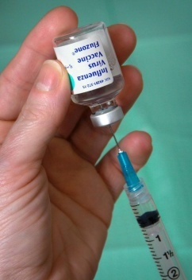
Treatment of infectious diseases
For the prevention of many viruses humans have developed vaccines which trigger the immune system to produce antibodies that are stored. Specific antibodies will target and destroy invading viruses quickly before they can multiply.
We also have developed antimicrobial drugs such as antibiotics (and penicillin from fungi) that can kill bacterial, and antiviral drugs that can fight some viruses like HIV (although not kill them altogether)
Treatment will slow or prevent a life process
“this reduces the symptoms by…”
Describe the treatment of the pathogen
Explain how the pathogens life processes are effected

Slide 20
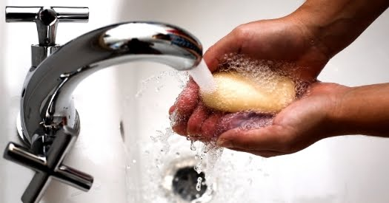
Preventing the spread of infectious diseases
Good personal hygiene and sanitation
Washing your hands with soap to remove viral spores when you have a cold or the flu
Quarantine can stop diseases spreading while they are infectious.
Describe the prevention of the pathogen
“this prevents illness from the pathogen by…”
Explain how life is made more difficult for the pathogen by what may be done

Slide 21
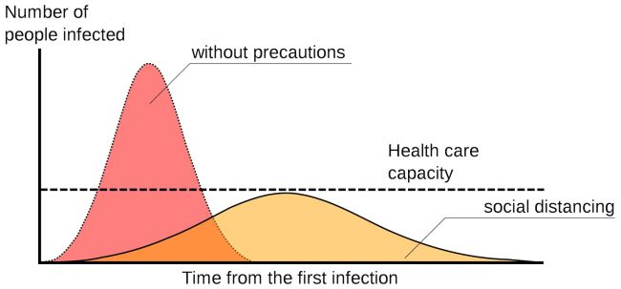
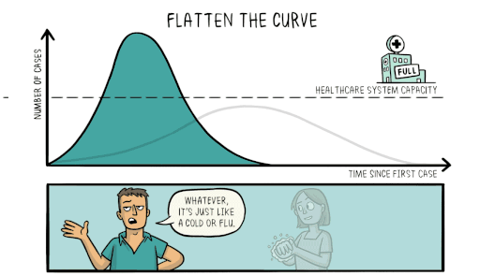
The 2020 COVID-19 Pandemic – Flattening the Curve
Many Governments, and the World Health Organisation (WHO) put out recommendations to reduce transmission of COVID-19 between people.
A sample epidemic curve, with and without social distancing. (Image credit: Johannes Kalliauer/ CC BY-SA 4.0)
They included:
Washing hands with soap for 20seconds (and then drying) several times a day
and
Social distancing to avoid being in close physical contact with others.
Flattening the curve refers to using methods to reduce the number infected at any one time, to relieve healthcare pressure.
https://commons.wikimedia.org/wiki/File:Covid-19-curves-graphic-social-v3.gif

Slide 22
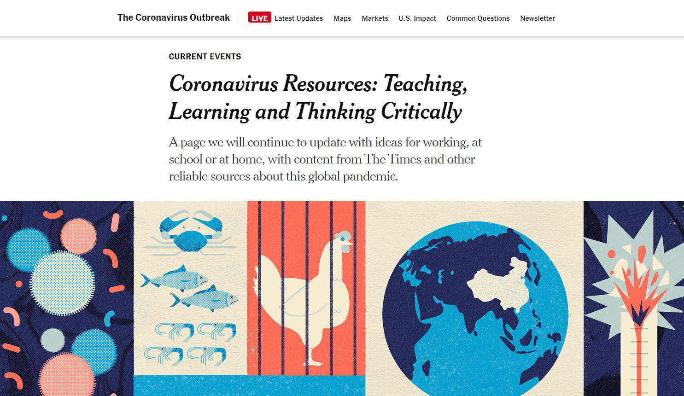
The 2020 COVID-19 Pandemic

